Slide 1
Seminar on the threat of Huanglongbing Disease to the Near East and Mediterranean citrus production
Mekki Chouibani
Agadir, Morocco, 1 November, 2013

Slide 3
Huanglongbing Disease: Candidatus Liberibacter sp
One of the most devastating diseases of citrus
3 species of bacteria:
C.L. asiaticus (/D.c.)
C.L. africanus (/T.e.)
C.L. americanus
2 Vectors
Diaphorina citri (Asian Citrus Psyllid)
Trioza erytreae (African Citrus Psyllid)
Little resistance or tolerance in any species

Slide 4
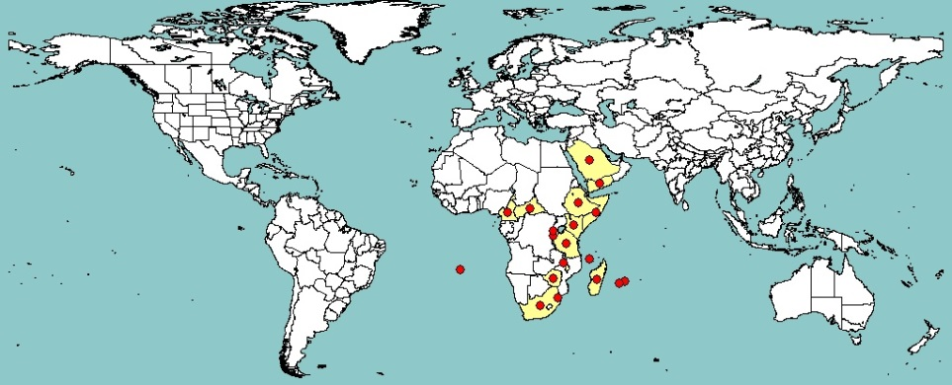
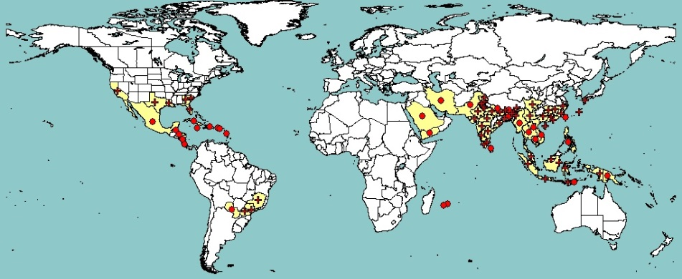
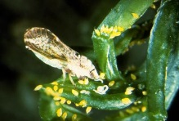
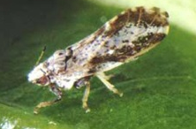
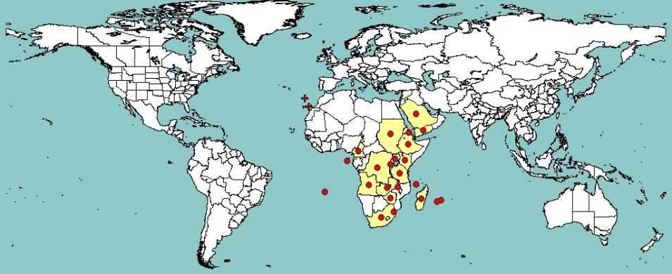
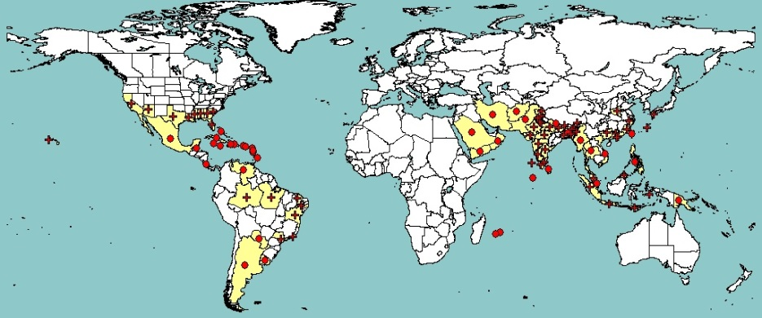
Candidatus Liberibacter africanus
Candidatus Liberibacter asiaticus
Trioza erytrea
Diaphorina citri

Slide 5
Program
Time |  | Faciltator
9 :00 – 9 :05 | Opening
9 :05 – 9 : 50 | Situation of HLB in COSAVE region | Pablo Cortese SENASA. Argentina, COSAVE
9:50 – 10:10 | Situation of HLB in OIRSA region | OIRSA (NEPPO on Behalf of)
10:10- 10: 30 | Coffee break
10:30- 10:45 | Situation of Trioza erytreae in Canaries Islands | Dr. Estrella Hernandez Suárez Dpto. Protección Vegetal Instituto Canario de Investigaciones Agrarias. Iles Canaries. Espagne
10:45- 11: 10 | Threat of HLB in the Mediterranean region | Dr. María M. López Instituto Valenciano de Investigaciones Agrarias, Espagne
11:10 -12:30 | Discussion
12:00 | Closure

Slide 6
Thank you
This is your seminar.
Do not hesitate to interact and to ask all deemed relevant question or clarification

