Slide 1
The European and Mediterranean Plant Protection Organisation update on activities
Event 2014 Technical Consultation of RPPOs
Date 10-14th November 2014
Martin Ward (Director General) - mw@eppo.int

Slide 2
1951 EPPO Convention – 15 countries Now 50 member countries

Slide 3
Aims (Convention Article 1)
a. to support the Member Governments in their aim of assuring plant health, while preserving human and animal health and the environment
b. to pursue and develop, by cooperation between the Member Governments, the protection of plants and plant products against pests and the prevention of their international spread and especially their introduction into endangered areas
c. to develop internationally harmonized phytosanitary and other official plant protection measures and, as appropriate, to elaborate standards to that effect
d. to present the collective views of the Member Governments, as appropriate, to FAO, WTO, other regional plant protection organizations and any other bodies with related responsibilities.

Slide 4
Remit
Plant quarantine
Plant certification schemes
Efficacy of plant protection products
Invasive alien plants
Biological control agents
by:
Development of regional technical standards
Sharing intelligence and expertise through networks

Slide 5
Organisation
National Plant Protection Organisations
EPPO Secretariat
National Experts

Slide 6
Council
Representatives of all member countries
Meets annually in September
Alternately in Paris and elsewhere
Sets strategy
Agrees budget and contribution level
Invites new countries to become members
Elects DG and Executive Committee

Slide 7
Executive Committee
Seven member countries, each serving for three years
Meets twice a year
Oversees preparation of budget
Oversees implementation of strategy
Appoints members of expert panels

Slide 8
Working Parties
Representatives of all member countries
Oversee work of panels
Approve draft standards for submission to Council
Each meets once a year in a member country
WP on Plant Protection – 2014 Hungary
WP on Phytosanitary Regulations – 2014 Moldova

Slide 9
Expert Panels
Nominated by member countries
Appointed by Executive Committee
Serve as experts, not representatives
Costs paid by member countries
Responsible for developing standards
Frequency varies between panels from 4 -18 months

Slide 10
Phytosanitary Regulations Panels
IPPC Affairs
Risks and Measures
Forestry
Potatoes
Inspections
Diagnostics
Entomology
Nematodes
Bacteria
Fungi
Virology
Invasive Alien Plants
Biocontrol Agents
Plant Protection Products Panels
General Standards
Herbicides
Insecticides and Fungicides
Resistance
Harmonisation of Data Requirements

Slide 11
Expert Working Groups
Mainly for Pest Risk Analyses (five per year)
Nominated by countries, selected by secretariat
Experts in specific aspects of risk
Expenses paid from EPPO budget

Slide 12
Secretariat
Martin Ward Director General
Françoise Petter Assistant DG
Vlasta Zlof Scientific Officer (Plant Protection)
Andrei Orlinski Scientific Officer (Forestry and Biocontrol)
Anne‐Sophie Roy Information Officer
Muriel Suffert Scientific Officer (Potatoes and PRA)
Sarah Brunel Scientific Officer (Invasive Alien Plants)
Valerio Lucchesi Scientific Officer (Plant Protection)
Baldissera Giovani Euphresco Co-ordinator
Damien Griessinger Information Technology Officer
Madeleine McMullen Managing Editor
Eliane Madène Administrator
Marie‐Christine Ozanon Secretary
Jocelyne Cesari Secretary
Jean Perchet 3 year secondment from French Government

Slide 13
2013 Report

Slide 14
Membership of EPPO: Stable currently 50 members. Contacts continued with CIS countries and Mediterranean countries.
EPPO staff: 12,8 positions(7,8 Scientific positions)
Robert Sunley left EPPO in December 2012
Valerio Lucchesi recruited in June 2013

Slide 15
EPPO work programme in 2013
20 Panel meetings
5 Expert Working Groups (EWGs)
9 Workshops/training:
1 meeting on the Colorado beetle campaign
20 new or revised Standards approved
Plant protection products:
4 specific Standards, 2 extrapolation tables and 2 zonal examples
Phytosanitary Regulations
16 Standards were approved and 9 withdrawn.
8 pests added to the A1 or A2 Lists of pests recommended for regulation.
Russian translation programme 6 EPPO Standards translated series PM 3, PM 6, PM 9 and PM 10.

Slide 16
Implementation of the EPPO strategy
1- Comparative assessment & Integrated Pest Management issues.
Standard PP 1/271 Guidance on comparative assessment published in 2011. EPPO continues to monitor activities on IPM to avoid duplication of work.
WPPPP 2013, decided to convene an Ad hoc Expert Working Group to study and update one of the existing GPP Standards to evaluate the feasibility of this activity the group will meet in 2014
2- Risk-based approach in justifying phytosanitary management and regulation.
4 expert working groups to perform PRAs
Tomato study to lists of pests associated with the pathway of fruit of Solanum lycopersicum (tomato) was launched
Adoption of PM 5/7 Screening process to identify priorities for commodity PRA for plants for planting.

Slide 17
Implementation of the EPPO strategy
3- support to plant pest diagnostic laboratories
7 Diagnostic Standards finalized
On-line survey in 2013 to collect data on the use of tests included in EPPO Diagnostic Protocols in laboratories in the EPPO region
Revision of PM 7/98 Specific requirements for laboratories preparing accreditation for a plant pest diagnostic activity
New Standard Guidelines for the organization of interlaboratory comparisons by plant pest diagnostic laboratories finalized (proposed for adoption this year)
4- eradication and containment
PM 9 on management of aquatic invasive alien plants and Epitrix species damaging potato tubers in preparation
4 PM 9 Standards adopted (Agrilus planipennis (EAB), Anoplophora glabripennis (ALB) and Anoplophora chinensis (CLB), Meloidogyne chitwoodi and M. fallax)
Standard Decision-support scheme for prioritizing action during outbreaks finalized (proposed for adoption this year)

Slide 18
Implementation of the EPPO strategy
5- Minor uses- risk of resistance
Minor uses
2 new Extrapolation tables for herbicides adopted to be used in conjunction with EPPO Standard PP 1/257 Efficacy and crop safety extrapolations for minor uses. A total of 46 extrapolation tables have now been completed.
EPPO was an active participant at the EU Technical Group on Minor Uses and OECD Expert Group on Minor Uses (EGMU).
PP 1/224 Principles of efficacy evaluation for minor uses and PP 1/257 Efficacy and crop safety extrapolations for minor uses, are being reviewed by OECD the result could be joint EPPO/OECD publications.
Risk of resistance
The Resistance Panel operates as a central point for sharing information on resistance activities amongst member countries.
Review of the Standard PP 1/213 Resistance Risk Analysis initiated on the basis of results of a scientific project on fungicide resistance risk assessment and management.

Slide 19
Implementation of the EPPO strategy
6- Establishing collective views on issues discussed at a global level in relation to the IPPC and SPS agreement
EPPO member countries were well represented at the CPM-8
Three experts from the FAO European region attended the IPPC Technical Panel on the Glossary as experts
The EPPO Secretariat hosted a meeting of the IPPC Technical Panel on Diagnostic Protocols (TPDP) in 2013.
CPM-8 adopted the members and replacement members proposed by EPPO to join the Standards Committee and Dispute Settlement Body.
7- Invasive Alien Plants
A computerized version of the EPPO Prioritization process of invasive alien plants has been developed.

Slide 20
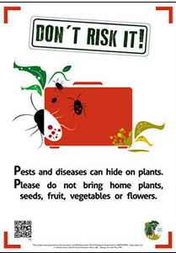
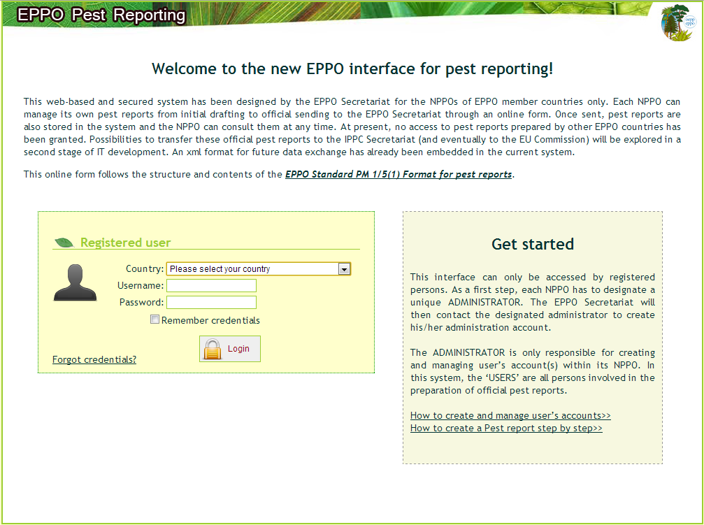
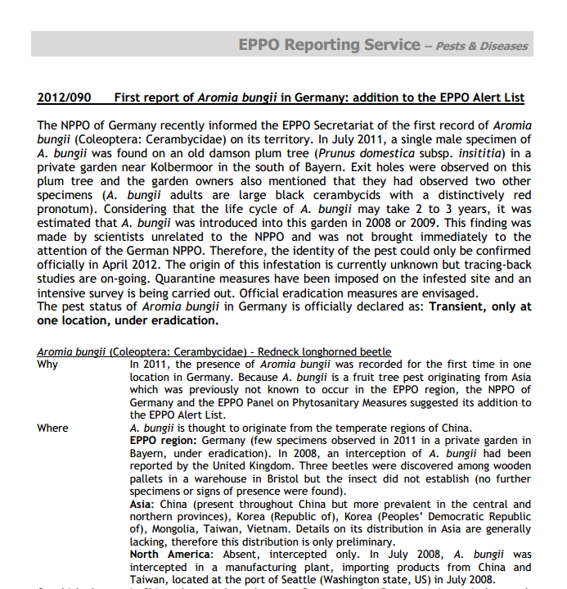
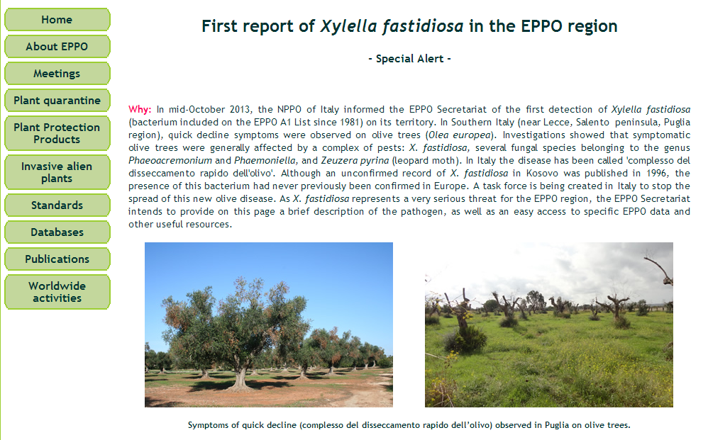
Implementation of the EPPO strategy
8- provide selected, reviewed or validated documentation on pests
Poster and leaflet (communication material)
EPPO computerized system for pest reports
EPPO Reporting Service
250 articles
EPPO website and
e-magazines

Slide 21
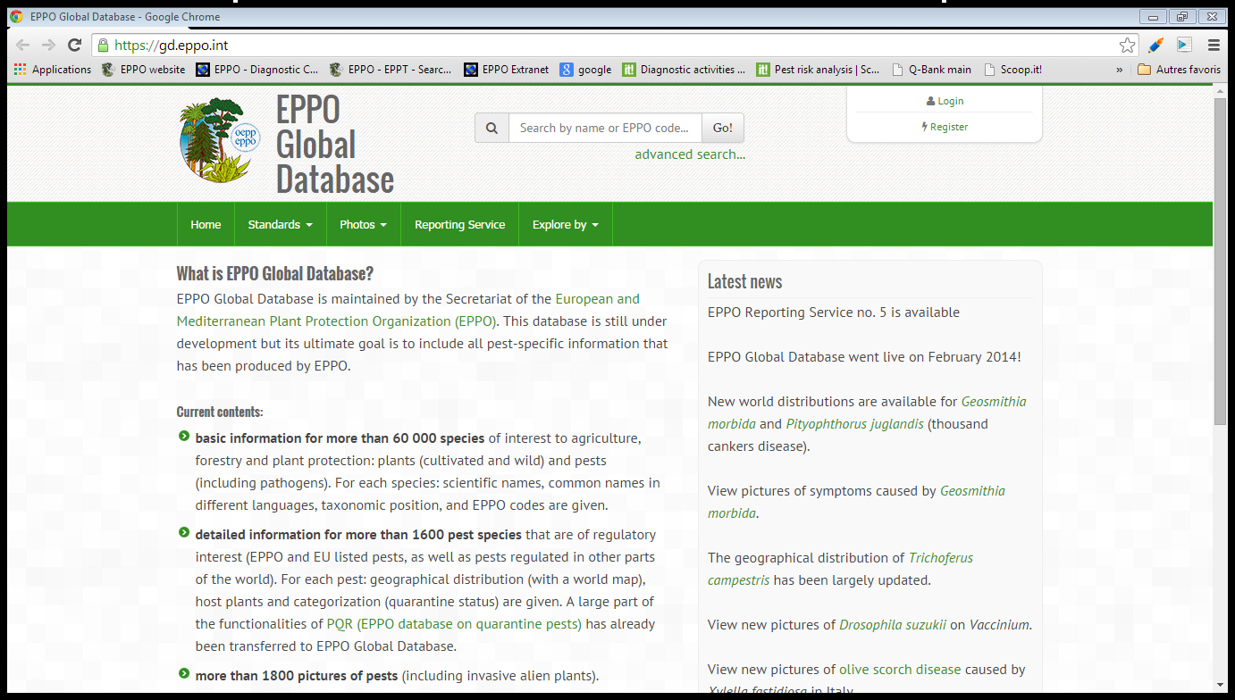
Implementation of the EPPO strategy
8- provide selected, reviewed or validated documentation on pests
PQR more than 30 400 downloads have been registered.
EPPO databases
The EPPO Secretariat continues to develop a true web-based interface which will be called the ‘EPPO Global database’

Slide 22
Implementation of the EPPO strategy
8- provide selected, reviewed or validated documentation on pests
Rank | Article Title | Vol | Iss | Accesses
1 | PM 7/42 (2) Clavibacter michiganensis subsp. michiganensis (EPPO Diagnostic Standard) | 43 | 1 | 1 538
2 | PM 7/20 (2) Erwinia amylovora (EPPO Diagnostic Standard) | 43 | 1 | 1 437
3 | PM 7/110 (1) Xanthomonas spp. (Xanthomonas euvesicatoria, Xanthomonas gardneri, Xanthomonas perforans, Xanthomonas vesicatoria) causing bacterial spot of tomato and sweet pepper (EPPO Diagnostic Standard) | 43 | 1 | 1 307
4 | PM 7/98 (1): Specific requirements for laboratories preparing accreditation for a plant pest diagnostic activity (EPPO Diagnostic Standard) | 40 | 1 | 1 294
5 | Heracleum mantegazzianum, Heracleum sosnowskyi and Heracleum Persicum (EPPO Datasheet on Invasive Alien Plants) | 39 | 3 | 1 280
6 | PM 7/83 (1) Rhynchophorus ferrugineus and Rhynchophorus palmarum (EPPO Diagnostic Standard) | 37 | 3 | 1 102
7 | PM 7/87 (1) Ditylenchus destructor and Ditylenchus dipsaci (EPPO Diagnostic Standard) | 38 | 3 | 1 101
8 | PM 7/40 (2) Globodera rostochiensis and Globodera pallida (EPPO Diagnostic Standard) | 39 | 3 | 1 100
9 | PM 7/102 (1) Curtobacterium flaccumfaciens pv. flaccumfaciens (EPPO Diagnostic Standard) | 41 | 3 | 1 096
10 | PM 7/4 (3) Bursaphelenchus xylophilus (EPPO Diagnostic Standard) | 43 | 1 | 1 077
EPPO bulletin:
3 issues
published

Slide 23
Implementation of the EPPO strategy
9. Standards for efficacy evaluations of Plant Protection Products.
2 new and 2 revised specific Standards in 2013
A number of general Standards on efficacy evaluation are in preparation or under revision.
10. EPPO will develop harmonized phytosanitary procedures.
Panel reactivated and work programme established [including inspection of palms for RPW]
11. Implementation of International Standards for Phytosanitary Measures (ISPMs).
Three Workshops on training in 2013:
EPPO/FAO Workshop on ‘Pest reporting and exchange of phytosanitary information’ (Riga 2013-05-14/17),
EPPO/IPPC Regional Workshop on ‘Review of Draft ISPMs’ (Moscow, 2013-07-17/20).
Andrei Orlinski provided training in Russian under USAID programme to the NPPO of Armenia on Pest Risk Analysis

Slide 24
Implementation of the EPPO strategy
12- collaboration with international organizations
Discussion with the European Commission and with the Eurasian Economic Commission on possible joint projects.
EPPO has observer status in EFSA’s Plant Health Plenary meetings and members of EFSA’s Plant Health Unit participated in EPPO Panels. EFSA and EPPO prepared a Joint Colloquium on “Data collection and information sharing in plant health” for April 2014.
EUPHRESCO
Q-bank steering committee
EPPO is following the activities of different OECD’s Working Group.
In 2013, CABI and EPPO signed A Memorandum of Understanding

Slide 25
Activities in 2014

Slide 26
Plant Protection Products
Harmonisation of data packages for efficacy to enable mutual recognition of approvals between countries
Facilitation of EU zonal authorisation
Work to ensure continued availability for “minor uses”
Possibility of hosting EU Minor Uses Co-ordination
Pilot study in developing Standards for IPM

Slide 27
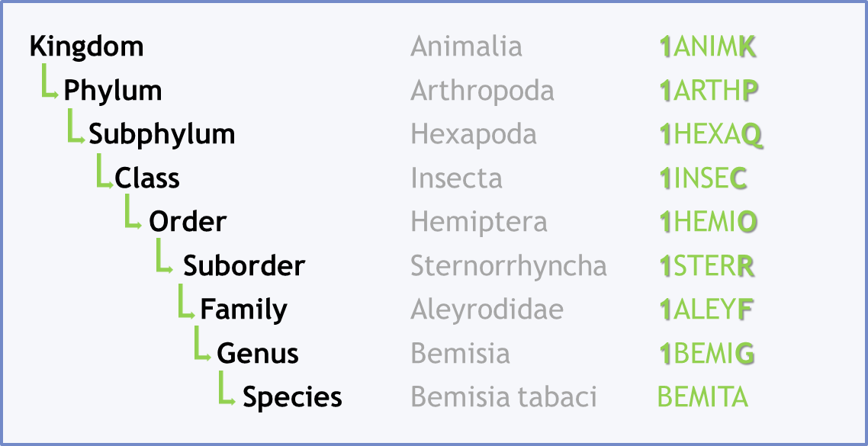
EPPO Codes
Codes for over 30,000 pests and 30,000 host plants
Taxonomic structure
120,000 common names in > 20 languages
Used (and originally developed) by pesticide industry
Key to EPPO, EU, IPPC and national databases
Now free to users

Slide 28
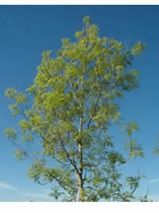
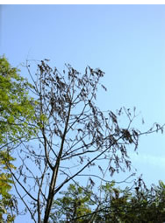
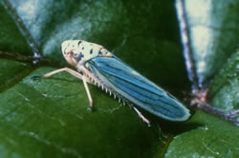
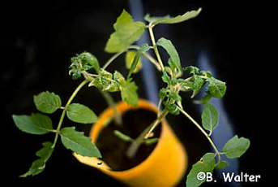
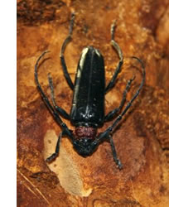
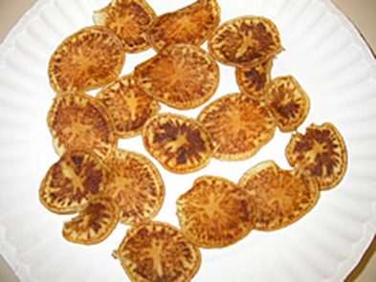
Horizon Scanning and Risk Assessment
Reporting Service - monthly news of pests on the move
Alert List of pests not yet regulated
Rapid risk assessment and prioritisation tools
International Sentinel Plants Network (EPPO advising)
Risk assessments on pathways
Plants for planting (contributing to EU regime review)
Tomato fruit
Wood chips and wood waste (major issue of definitions!)

Slide 29
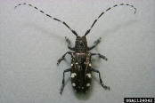
EPPO Reporting Service: example of a first record
EPPO Reporting Service – Pests & Diseases
2010/200 First record of Anoplophora glabripennis in the Netherlands
The NPPO of the Netherlands recently informed the EPPO Secretariat of the first record of Anoplophora glabripennis (Coleoptera: Cerambycidae – EPPO A1 List) on its territory. On 2010-11-16, the identity of the pest was confirmed on the basis of analysis of wing covers and DNA analysis of larval remains which had been found in 1 tree in a lane of Acer pseudoplatanus in the municipality of Almere. In total 16 exit holes and 3 larvae were detected in one tree. Observations indicated that some exit holes had been formed recently, whereas others were estimated to be at least three years old. The exact age of exit holes is still to be determined. Signs of the presence of A. glabripennis have also been detected on 6 adjacent trees in a lane of A. pseudoplatanus trees. These trees are located in an industrial area of Almere and were planted approximately ten years ago. In this area there are no tree nurseries and only a limited number of public or private gardens, but a nature conservation area is situated within the surveillance area of 1 kilometre radius around the infested site. It is considered that the most likely source of the outbreak is wood packaging material from Asia because there are several companies importing goods from Asia in the vicinity. Investigations are being carried out to identify the possible source of this infestation. The following phytosanitary measures aiming at a prompt eradication of A. glabripennis are being taken and include the following:
1) Destruction of all symptomatic trees, as well as all deciduous trees and shrubs (with a diameter of 2.5 cm or more) located within a range of 100 m from the infested trees. Each individual plant will be dissected and analysed by the national reference laboratory for any signs of the pest. It is envisaged to finalize tree destruction by January 2011.
2) Restrictions on the movement of host plant material (with a diameter of more than 2.5 cm) within a range of 500 m around the infested trees. This material should be officially reported and destroyed according to official procedures.
3) Specific surveillance (also involving specialized tree climbers) will be carried out on an annual basis within a radius of 1 000 m around the affected trees for at least the next four years.
The pest status of Anoplophora glabripennis in the Netherlands is officially declared as: Transient – Isolated outbreak, actionable, under eradication.
Source: | NPPO of the Netherlands (2010-11).
Additional key words: new record |  | Computer codes: ANOLGL, NL
Notes:
Encourage prompt reporting of new finds … always some nervousness because of potential impact on trade, but countries generally getting better, and Europe generally better than the rest of the world.

Slide 30
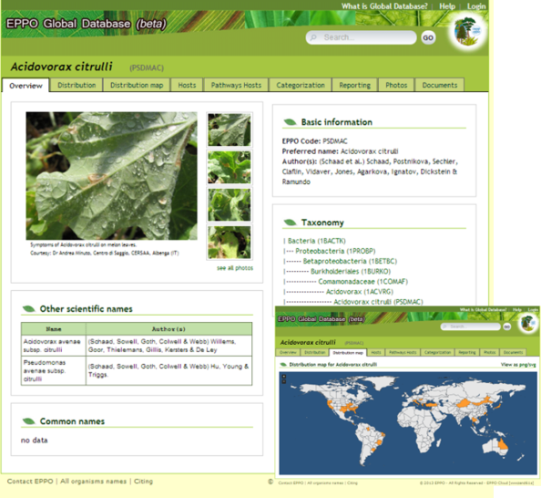
Information Services
EPPO Bulletin
New “EPPO Global Database” combining
Data sheets
Risk assessments
Maps
Pictures

Slide 31
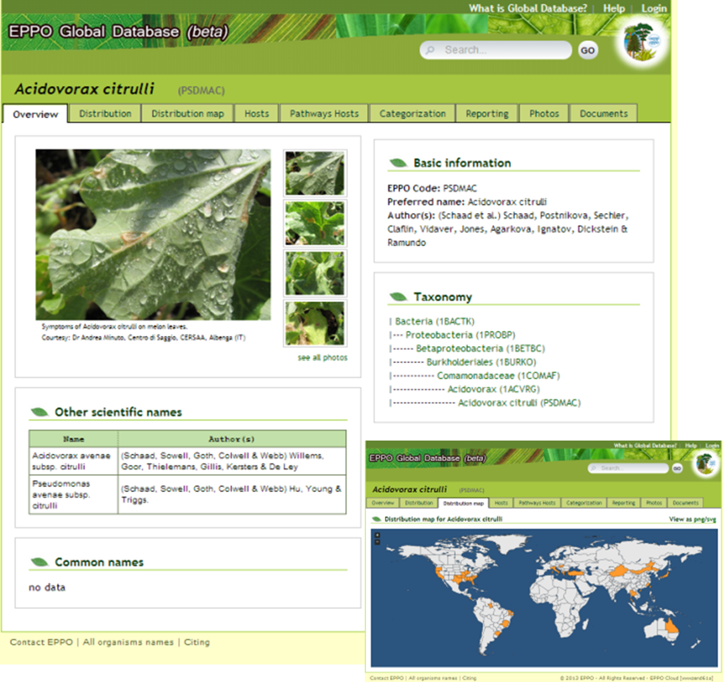
Notes:
Integration of all of EPPO’s information on pests into a single online database

Slide 32
Development and Implementation of ISPMs
Workshop on e-Phyto, Baku, April
Regional workshop on Implementation, Bishkek, June
Regional workshop on draft ISPMs, Bykovo, July
CPM Panel collating comments for OCS, Tallin, Sept

Slide 33
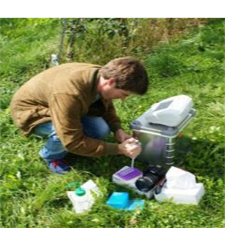
Diagnostics
Getting accreditation right for plant health labs
Including molecular methods in diagnostic protocols
Linking EPPO with global work on diagnostic standards
Database of diagnostic experts in the EPPO region

Slide 34
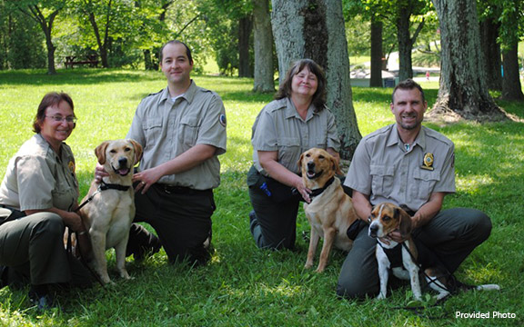
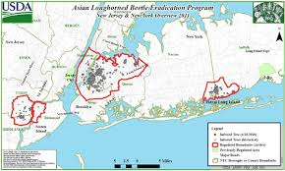
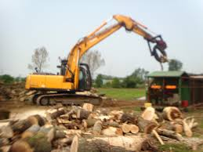
Contingency Planning
Standard on “Generic Elements for Contingency Plans”
Council Colloquium – Moscow, 2013
EPPO Inspectors Workshop – Kew, November 2014
Encourage learning from others’ experience
Potential database of eradication expertise?

Slide 35
EPPO Strategy 2015 - 2020

Slide 36
Convention
Strategy (5 years)
Annual Work Programme
Annual Objectives for staff and Panels

Slide 37
Starting from success - 2010
A stable organization with a clear scope and well established procedures
Creates its output based on a wide participation of national experts
Output has a high status and is considered reliable and authoritative
A highly motivated staff with a good scientifically and practically oriented background.
Minimum of bureaucracy: flexible and able to respond quickly to new needs
(Strategy 2010 – 2014)

Slide 38
Starting from success - 2015
Committed members
Dedicated and knowledgeable staff
Enthusiastic networks of experts
Sound finances
Authoritative reputation
(Strategy 2015 – 2020)

Slide 39
So why change?
Members ask EPPO to explore other sources of funds
EPPO is asked to take on projects
If EPPO does not, others will, risking duplication and weakening EPPO’s co-ordinating role
To do more projects we need robust and flexible procedures for costing and managing projects
Practice is evolving outside EPPO
Reviewing does not mean changing, but making evolution possible where we see benefits

Slide 40
Main Sections
Scope of EPPO work
1. Improving Protection of Plant Health
2. Maintaining and Strengthening Relationships
3. Building Capability to Manage Projects
4. Improving Processes
5. Securing the Future of EPPO
Appendix – schedule of reviews envisaged

Slide 41
Scope of EPPO work
Scope mostly clear, with no change but:
Plant Protection Products – focus now on efficacy rather than safety (WPPPP)
Biological Control Agents – continue to focus on safety rather than efficacy (WPPPR)
Are these compatible, or do they reflect the different approach of the two Working Parties?

Slide 42
Improving Protection of Plant Health
Main technical work of EPPO
Overseen by the Working Parties, with regular adjustment of priorities
Therefore no need for major change
Further discussion on EPPO role in relation to biological control agents and IPM

Slide 43
Maintaining and Strengthening Relationships
Members
RPPOs and IPPC
EU
EEC
CABI, Council of Europe, OECD
Industry sectors
discussion of how industry expertise is best engaged in Panels

Slide 44
Improving Processes
Review, but not looking for radical change of:
Governance
Development of Standards
Work of Panels
Expert Working Groups
IT Strategy
Information and Communications

Slide 45
Securing the Future of EPPO
Contributions up by < rate of inflation
Project funding to fill the gap
EPPO Project Fund for lean years of external funding?
Succession planning for staff (our main resource)
Possibility of interchanges and secondments

