Slide 1
27th Technical Consultation among Regional Plant Protection Organizations
Memphis (Tennessee, USA) 2-6 November 2015
Mekki Chouibani
www.neppo.org

Slide 2
NEPPO
Entered into force in 2009, recognized in March 2002 by 7 ^{th} session of CPM
12 countries members:
Algeria, Egypt, Jordan, Iraq, Libya, Malta, Morocco, Oman, Pakistan, Syria, Sudan, Tunisia
Adhesion of Oman (December 29, 2014)
Staff: 2
Executive Director,
Assistant director

Slide 3
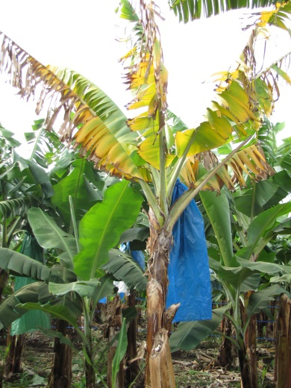
Activities
Participated in technical workshop on Fusarium Wilt Disease of Banana, Rome, 9-10 December 2014,
35 experts (Asia, Africa, Near east, Europe, Latin America and Caribbean,
29 presentations
Recommendations:
Awareness raising at farmer, producer and political level,
Surveillance, early detection and rapid response,
Legislation, quarantine measures and role of IPPC and plant protection organizations
Risk assessment and contingency planning,
Use of clean planting materials,
Development and use of resistant varieties,
Inoculum reduction through appropriate management practices,
Capacity building and training of technical officers and farm workers,
Regional and global collaboration,
Altus, SA

Slide 4
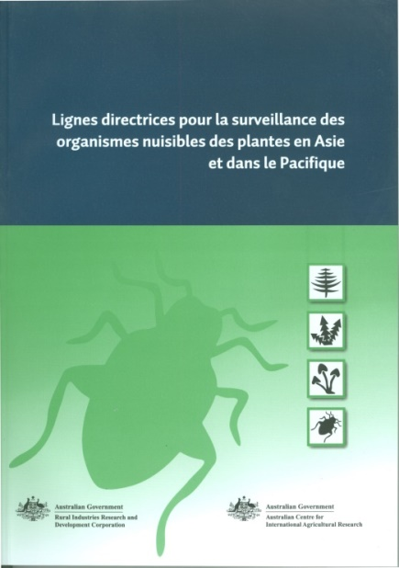
Activities
Participated in the Regional workshop on Plant Health and Plant Protection Products, Rabat, Morocco, 8-12/12/2015 (BTSF-EU).
Presentation on NEPPO
Translation and edition in French of :
Arabic version: on going process
McMaugh, T. 2012. Guidelines for surveillance for plant pests in Asia and the Pacific. ACIAR Monograph No. 119d. Australian Centre for International Agricultural Research: Canberra. 192 pp.

Slide 5
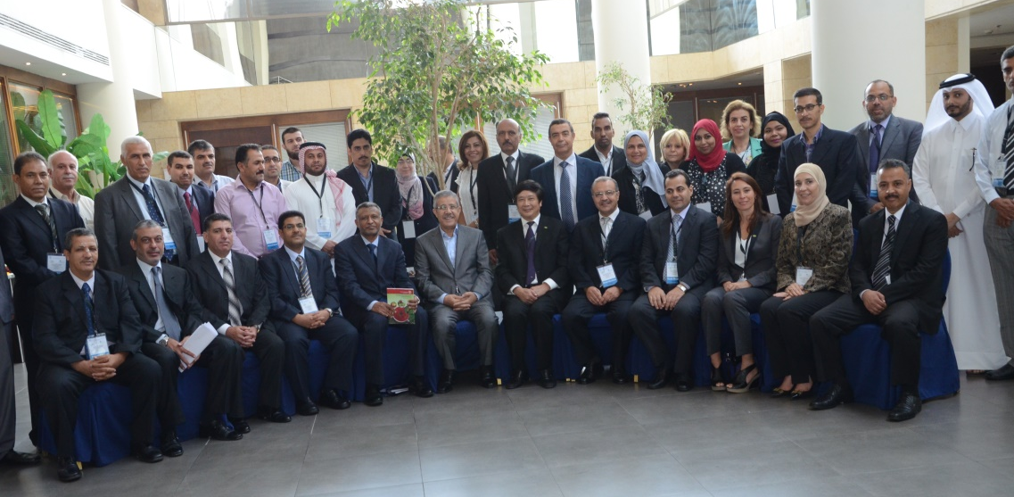
Activities
Participated in the ^{10th} session of CPM, March 16-20, 2015,
Implementation of Arabic Language review Group for standards,
Participated in the Standard meeting, Rome, May 4-8, 2015
Contribution to the organization of the IPPC Regional workshop for the Near East and North Africa held in Amman, Jordan 16-18 September 2015

Slide 6
Review of implementation of ISPM 6 in the NENA region
Based on Questionnaire 6, elaborated by IPPC Secretariat under IRSS in 2012,
Used by NEPPO to identify the current situation and so the real needs of NEPPO countries
Administered to 24 countries (Near East and Corn Africa)
Feedback from 9 countries

Slide 7
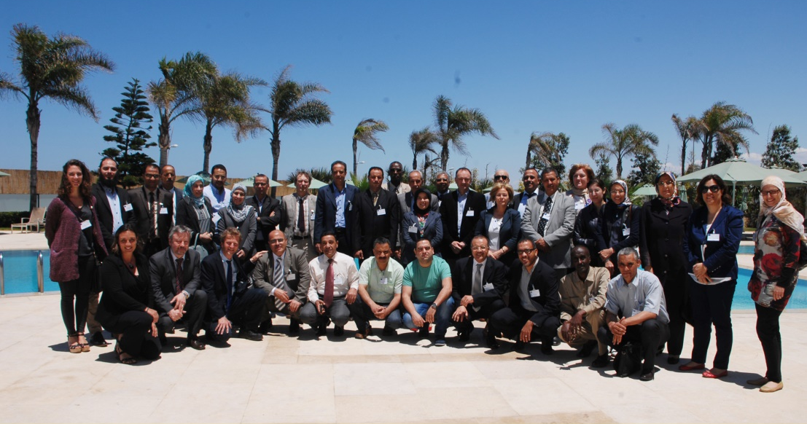
BTSF- Workshop on effective participation in IPPC activities (EU programme)
Casablanca (Morocco), May 25-27,
Contribution in the organization of the workshop
Participation by a presentation on
« Regional plant Protection Organisations »

Slide 8
IPM
Organization of a workshop on “Evaluation of the Role of Farmer field School (FFS) for Anchoring Sustainable Integrated Pest Management (IPM) by Small Farm Holders in NENA Region”, Tunisia, October 26-28, 2015
Participants: 33: Algeria, Egypt, Jordan, Iraq, Iran, Lebanon, Mauritania, Morocco, Palestine, Syria, Tunisia; Yemen, FAO (RNE)
Objectives
To promote the positive attitudes and the importance of the IPM;
To review the past experience/success stories of the NENA countries in FFS-IPM through FAO and other projects to support small scale farmers;
To discuss the lessons learnt from the past experience and identify and address any failure aspects/obstacles challenging the success of the FFS;
To come up with feasible recommendations/action plan to improve/sustain the IPM-FFS in the region

Slide 9
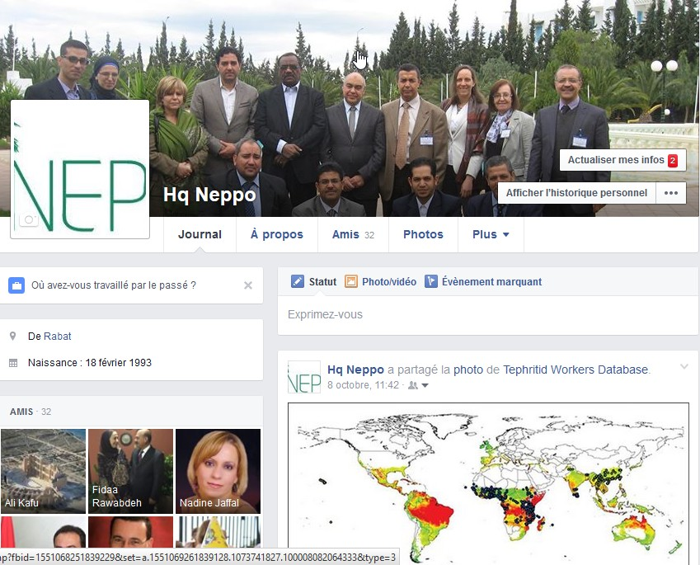
Exchange information
Development of NEPPO page in Facebook for large dissemination of information)

Slide 10
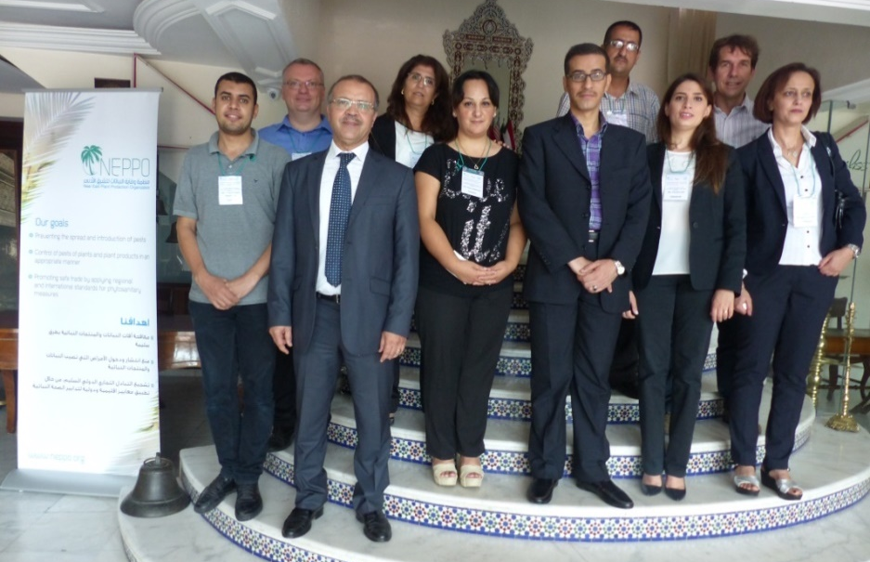
Training course for trainers on PRA
Rabat (Morocco), September 28-October 2, 2015
Collaboration with Fera
Enhance skills of NPPOs
Initiation of PRA on Xylella fastidiosa

Slide 11
NEPPO PRA working group
Establishment of NEPPO core group on PRA, October 2, 2015
Egypt, Jordan, Lebanon, Morocco, Palestine, Tunisia
First programme: Finalize PRA on Xylella fastidiosa
Jordan
Lebanon
Palestine
Tunisia
Morocco
Egypt
Morocco

Slide 12
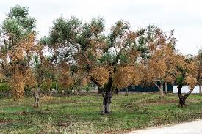
Emerging pests of concern for the NEPPO region
Xylellla fastidiosa on olive tree. Currently detected in Italy and France (Corsica)
Red Palm Weevil : Rhynchophorus ferrugineus : High threaten and highly negative environment and socioeconomically impact.

Slide 13
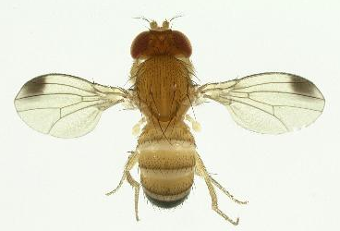
Emerging pests of concern for the NEPPO region (Continued)
Fruit flies: Bactrocera zonata and B, dorsalis.
Huanglonging Citrus Disease (HLB). The Mediterranean and most Near East (Except Saudia Arabia and Yemen) area are free from HLB and its vectors (Except Iran, and currently Spain North). Important threat to Citrus Industry.
Tuta absoluta in some extent in the Middle East countries
Drosophila suzuki
EPPO

Slide 14
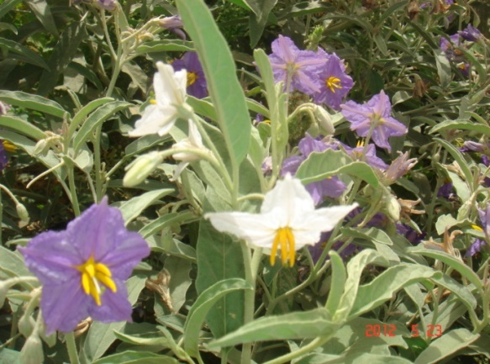
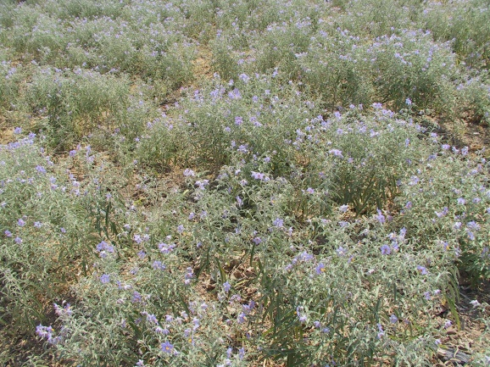
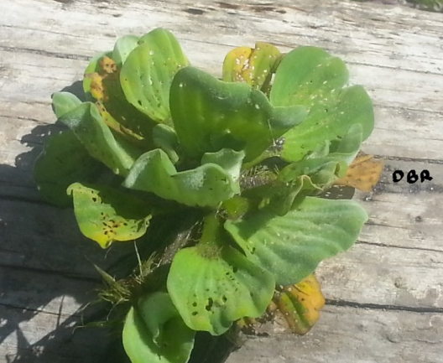
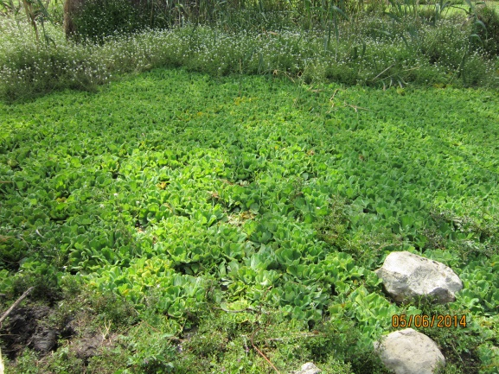
Invasive Alien Species as Emerging pests of concern for the NEPPO region
Solanum elaeagnifolium
Pr. Bouhache
Pr. Bouhache
Pistia stratiotes
R. Bouzaidi
R. Bouzaidi

