Slide 1
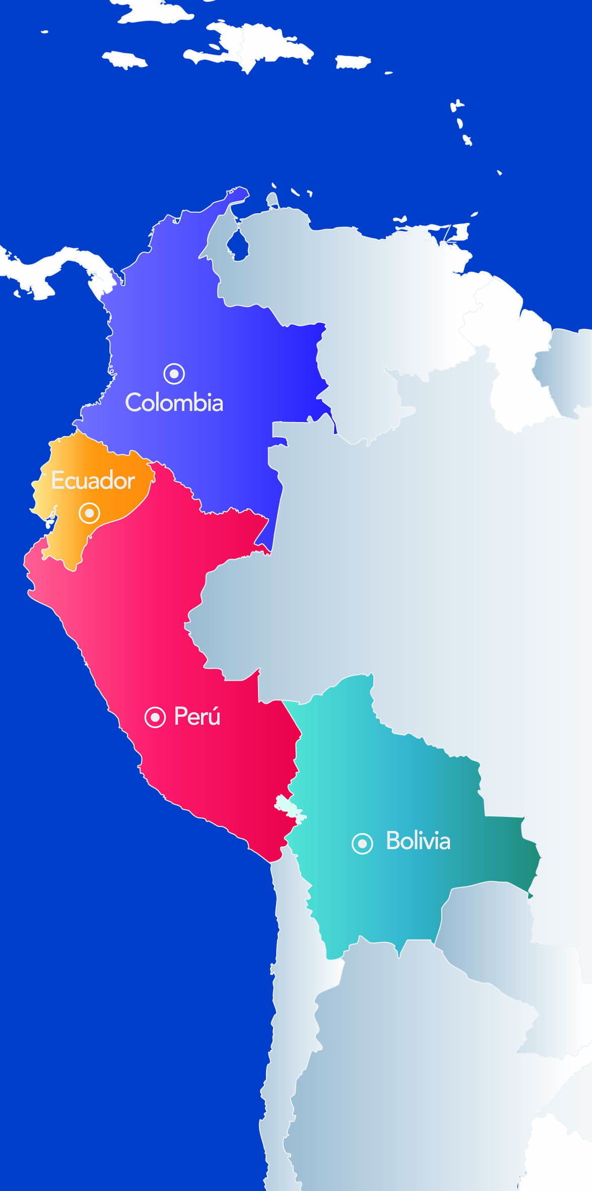
27TH TECHNICAL CONSULTATION AMONG RPPO´s
REVIEW OF COMUNIDAD ANDINA (CAN) ACTIVITIES
2-6 November, 2015 Memphis, Tennessee, USA

Slide 2
Content
1. General information
2.Bodies and institutions of the Andean Integration System (AIS)
3. Structure of the general secretariat
Institutional framework
Objectives
Subregional register
Pesticides
Andean Phytosanitary requirement and transboundary pests
Andean phytosanitary web site
What is Comunidad Andina?
Animal and Plant Health Andean System
2015 Report activities

Slide 3
What is Andean Community ?
Integration and economic and social cooperation
Agreed policies and joint projects in the political, social , cultural, environmental, commercial, among others
Binding laws and regional strategies , to address common challenges
Is the Andean Subregional Integration Agreement, the Cartagena Agreement (1969)
General information
20%
planet's biodiversity
10%
world's freshwater
35%
forests in Latin America and the Caribbean
To the Andean community belong Bolivia , Colombia , Ecuador and Peru, and the bodies and institutions of the Andean Integration System (AIS)

Slide 4
What is Andean Community ?
Bodies and institutions of the Andean Integration System (AIS)
The principal organs and institutions of the (AIS) are:
Andean Presidential Council. (It consists of the presidents of Bolivia , Colombia , Ecuador and Peru , is in charge of the political leadership of the CAN)
Council of Ministers of Foreign Affairs. (formulates foreign policy of the Andean countries on issues related to integration)
Commission (composed of plenipotentiaries or delegates with full powers , they are responsible for formulating , implementing and evaluating integration policy on trade and investment and generate rules that are binding for the 4 countries).
Andean Court of Justice (It is the entity that controls the legality of the actions of all the organs and institutions and existing settles disputes between countries , between countries and citizens or between citizens when the agreements reached within the framework of the Andean Community are not met.)
General Secretariat (Executive body, that manages and coordinates the integration process )
Also belong the Business Advisory Council, Labour Advisory Council, Andean Development Corporation ( CAF), Latin American Reserve Fund , Simon Bolivar University (for more information see http://www.comunidadandina.org/Seccion.aspx?id=189&tipo=QU&title=somos-comunidad-andina)
The Andean free trade area began to develop in 1969 and was completed in 1993. Was used as the main instrument Liberation Program , which aims to remove all customs duties and other charges having an impact on imports .

Slide 5
What is Andean Community ?
Structure of the general secretariat

Slide 6
Animal and Plant Health Andean System
Institutions
The Andean Community Commission
The General Secretary of the Andean Community
The Animal and Plant Health Committee
The state member’s Agricultural Sanitary Measures Official Services

Slide 7
Animal and Plant Health Andean System
Objectives
Protection Agricultural Health of the subregion and prevent that sanitary and phytosanitary measures be unjustified restrictions in the trade
Harmonize plant and animal health legislation
Prevent and control pests or diseases that representing risk for agricultural health
Promote cooperation and development programs of joint action
Promote the adoption of common positions in scientific, technical or trade issues, in international forums or international bodies

Slide 8
Report 2015 activities
Sanitary and Phytosanitary Rules Subregional Register
The principal objective is provide transparency, legal certainty and security in the application of the phytosanitary standards adopted by our member countries. (Sub regional application)
Based on technical and scientific principles and be compatible with existing sub-regional or international standards
Not constitute an unnecessary , unjustified or covert restriction on intra-subregional trade
Not discriminate arbitrarily and unjustifiably against imports originating products to other countries , when in the territory of which adopted the measure prevail identical or similar conditions
Comply with Community law
(Taked from “Decisión 515)
In 2015, the General Secretariat of the Andean Community attended 13 requests , and a one reconsideration resource.

Slide 9
Report 2015 activities
Chemical pesticides for agriculture use
The Andean Community has rules for the registration and control of pesticides .
Updating the subregional rules for registration and control of the chemical pesticides for agricultural use, through Decision 804, adopted in 30th April 2015 by the trade and agriculture ministers, in commission session.
Decision 804 is to establish the guidelines and harmonized procedures for the registration and control of chemical pesticides for use Agricultural ( PQUA ) ; orient their proper use and management in the framework of good practices agricultural ; prevent and minimize risks to health and the environment; ensure effectiveness biological product ; and facilitate trade in the subregion

Slide 10
Report 2015 activities
The Animal and Plant Health Andean Committee(COTASA)
Transboundary pest
Regional contingency plan to prevention of introduction of citrus disease “huanglongbing” (still in development)
Plan to prevent the entry of Fusarium oxysporum f. sp. cubense race 4 tropical and subtropical, according to continental plan (still in development)
Andean phytosanitary requirements
Update/derogate the Andean phytosanitary requirements for trade of 31 plant products, according to criteria of the ISPM (still in development)

Slide 11
Report 2015 activities
Andean phytosanitary web site (under construction)
The Andean Community has a web site that provides general information on all topics (http://www.comunidadandina.org). However, we are developing a micro site for the phytosanitary exchange information.
This microsite is being developed in "google sites" and his tools
https://sites.google.com/a/comunidadandina.org/sanidad-vegetal-comunidad-andina/

Slide 12
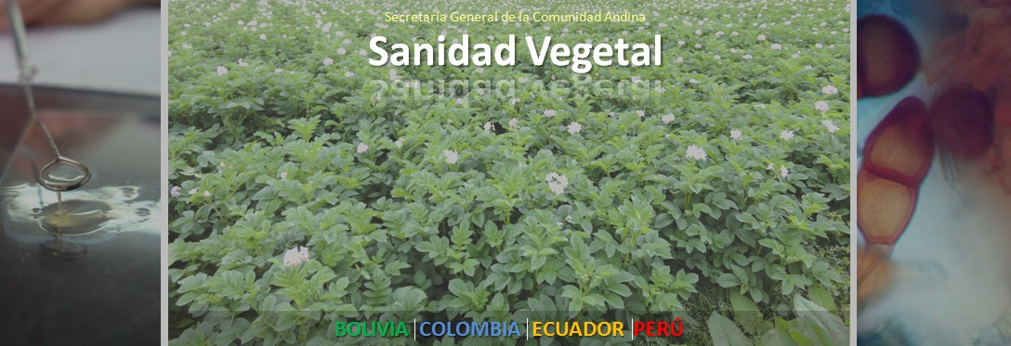
!
THANK YOU FOR YOUR KIND ATTENTION

