Slide 1

The European and Mediterranean Plant Protection Organization
Organisation Européenne et Mediterranéenne pour la Protection des Plantes
2015 Update
Technical Consultation between RPPOs
Memphis, USA
2nd- 6th November 2015
Martin Ward (Director General) - hq@eppo.int

Slide 2
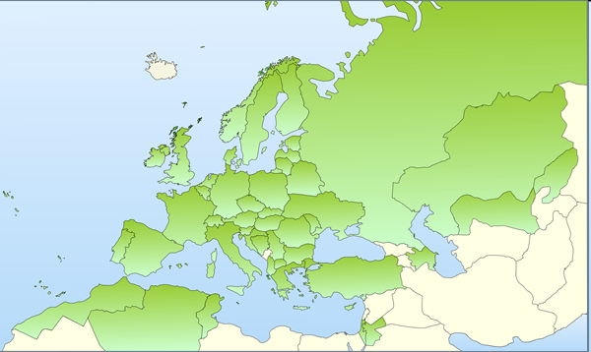
1951 EPPO Convention – 15 countries
Now 50 member countries

Slide 3
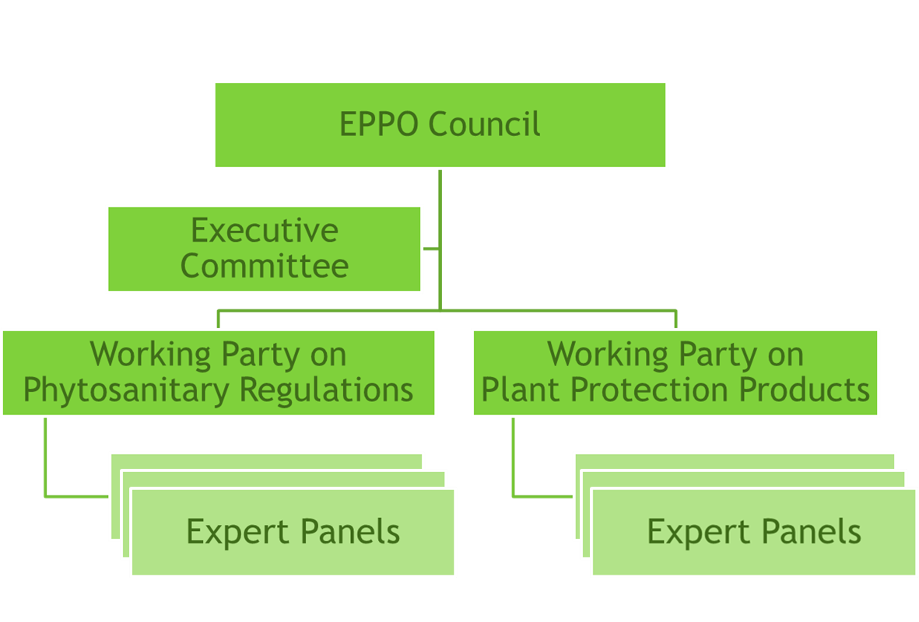
Organisation
National Plant Protection Organisations
EPPO Secretariat
National Experts

Slide 4
Plus ad hoc Expert Working Groups
Mainly for Pest Risk Analyses (five per year)
Nominated by countries, selected by secretariat
Experts in specific aspects of risk
Include experts from continents where pest is present
Expenses paid from EPPO budget

Slide 5
Active Panels
Phytosanitary Regulations
  Global Affairs
  Risks and Measures
  Forestry
  Potatoes
  Inspection Procedures
  Information
  Diagnostics (General) +
    Entomology
    Nematodes
    Bacteria
    Fungi
    Virology
  Invasive Alien Plants
  Biological Control Agents
Plant Protection Products
  General Standards
  Herbicides
  Insecticides and Fungicides
  Resistance
  Harmonisation of Data Requirements

Slide 6
Secretariat
Martin Ward Director General
Françoise Petter Assistant Director
Vlasta Zlof Scientific Officer (Plant Protection)
Andrei Orlinski Scientific Officer (Forestry and Biocontrol)
Anne‐Sophie Roy Information Officer
Muriel Suffert Scientific Officer (Potatoes and PRA)
Rob Tanner Scientific Officer (Invasive Alien Plants)
Valerio Lucchesi Scientific Officer (Plant Protection)
Damien Griessinger Information Technology Officer
Madeleine McMullen Managing Editor
Eliane Madène Administrator
Marie‐Christine Ozanon Secretary
Jocelyne Cesari Secretary
Cintia Mauchien Administrative Assistant
Baldissera Giovani Euphresco Co-ordinator
Jeroen Meeussen EU Minor Uses Co-ordinator

Slide 7
Some current activities …

Slide 8
Plant Protection Products

Slide 9
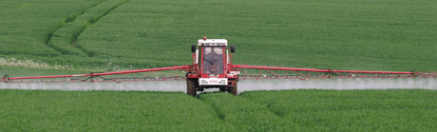
Working Party on Plant Protection Products
Now hosting “EU Minor Uses Co-ordination Facility”
Funded by EU, France, Germany and the Netherlands with a focus on practical solutions to growers’ problems
Links with EPPO’s existing work programme of
  Standards for efficacy testing
  Extrapolation tables
  Codes for uses of PPP
WP assessed costs of updating Good Plant Protection Practice Standards to help with implementation of IPM

Slide 10
Phytosanitary Regulations

Slide 11
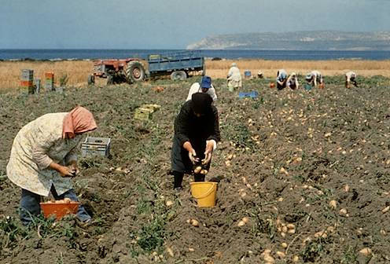
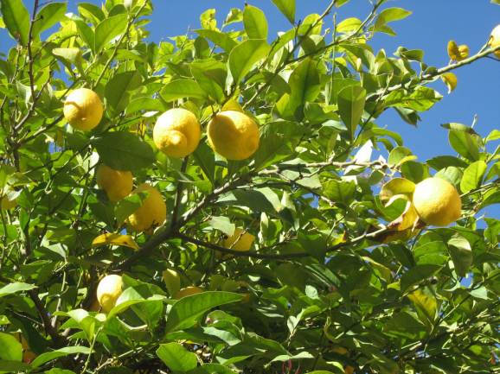

Working Party on Phytosanitary Regulations
Larnaca 2015-06-16/19

Slide 12
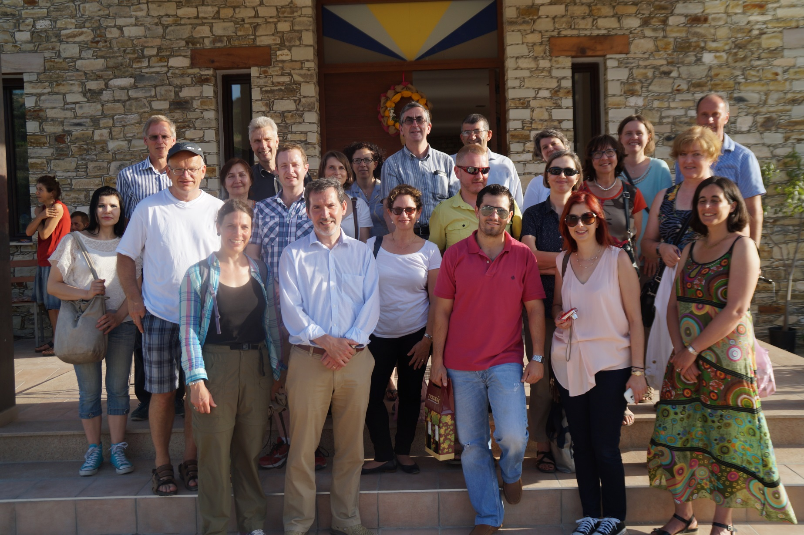
16 participants from 16 EPPO countries and 3 observers from the European Commission, the North American Plant Protection Organization and APHIS/United States Department of Agriculture.

Slide 13
Submitted for approval to the Council:
Pests recommended for regulation

Slide 14
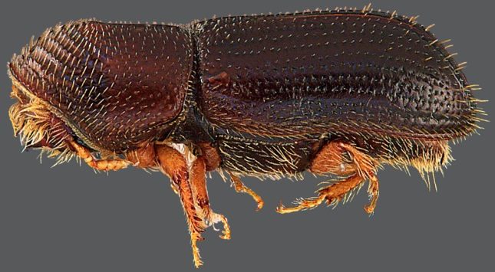
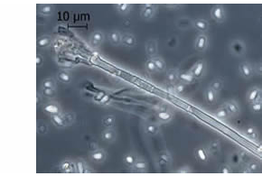
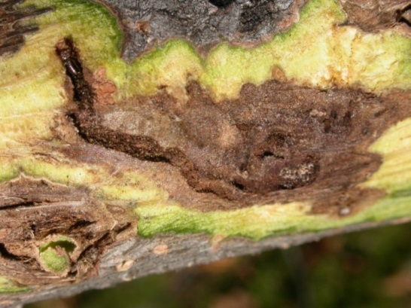
Thousand cankers disease of walnut
Pityophthorous juglandis
  bark beetle
  2-3 generations/year
  Can attack healthy trees
  May attack same tree many times
Geosmithia morbida
  Fungi (Ascomycota)
  Spores transported and introduced into
  wounds made by P. juglandis
  Disease from the combined effects
  of the two species

Slide 15
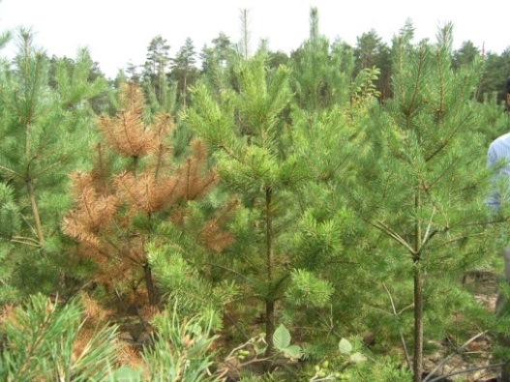
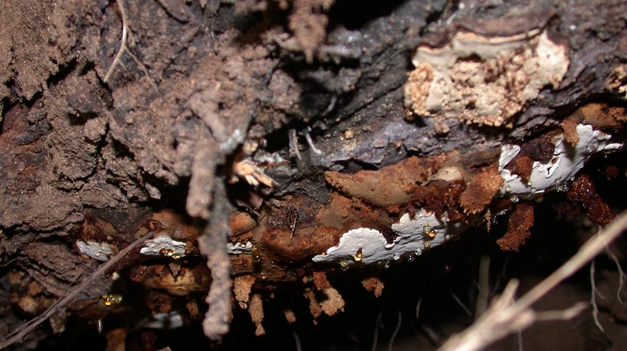
Heterobasidion irregulare
Part of H. annosum complex
Infection through spores or mycelial spread
Host plants: family Pinaceae and Cupressaceae, in particular Pinus and Juniperus
Also non-coniferous hosts (but not pathogenic)
Symptoms: Root and butt rots. Mortality within a few years in species whose roots are extensively attacked.

Slide 16
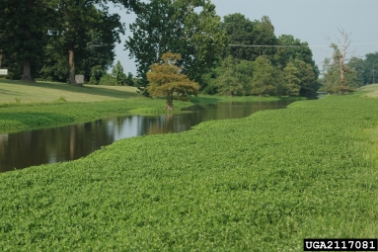
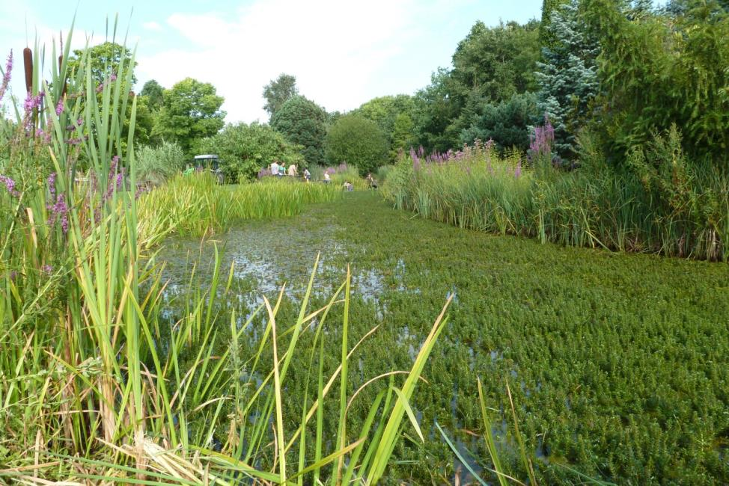
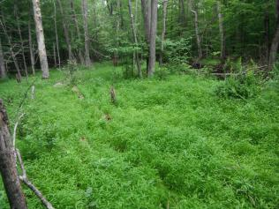
Invasive Alien Plants
Alternanthera philoxeroides
Myriophyllum heterphyllum
Microstegium vimineum

Slide 17
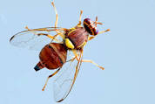

Transfer of pests from the A1 to the A2 List
Bactrocera zonata
Dacus ciliatus
Both present in Israel:
containment considered feasible but no longer eradication

Slide 18
Submitted for approval to the Council
Standards

Slide 19
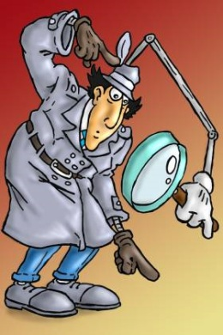

Phytosanitary Procedures (series PM3):
  Trees of Malus, Pyrus, Cydonia, and Prunus spp. –
  Inspection of places of production
  Consignment inspection of seed of Solanum lycopersicum
  Consignment inspection for Anoplophora chinensis and A. glabripennis
  Vegetable plants for planting under protected conditions - Inspection of places of production
  Consignment inspection of seed and grain of cereals
  Some drafts under discussion for several years. The Working Party agreed they should now be issued and used, so that experience can be gained and comments fed back into the further work of the Panel.
  Two inspection Standards on Xylella fastidiosa (consignment inspection and place of production inspection) in preparation and will have high priority for adoption in 2016.

Slide 20
Safe use of biological control (series PM6)
Standard adopted following a specific procedure: PM 6/3 List of biological control agents widely used in the EPPO region (version 2015)
Preparation (with other organisations) for a Workshop on Evaluation and Regulation of Biological Control Agents in the EPPO Region, Budapest from 23rd-24th November
Will address variation in the way in which regulation of biological control agents is applied across the region

Slide 21

Diagnostics (series PM7):
  ELISA tests for viruses
  Electron microscopy in diagnosis of plant viruses
  Spodoptera littoralis, Spodoptera litura, Spodoptera frugiperda, and Spodoptera eridania
  Phytophthora lateralis
  Amendments to:
  PM 7/46 (3) PM 7/46 (3) Lecanosticta acicola (formerly Mycosphaerella dearnessii), Dothistroma septosporum (formerly Mycosphaerella pini) and Dothistroma pini;
  PM 7/48(2) Plenodomus tracheiphilus.

Slide 22
National Regulatory Control System (series PM9)
Parthenium hysterophorus
Methyl bromide fumigation: withdrawal of PM 3 and PM 10 Standards dealing with
PM 3/1, PM 3/24, PM 3/3, PM 3/5, PM 3/6, PM 3/8, PM 3/9, PM 3/11, PM 3/12, PM 3/13, PM 3/14, PM 3/15, PM 3/16, PM 3/19, PM 3/20, PM 10/3, PM 10/5, PM 10/7, PM 10/11, PM 10/12

Slide 23
Other issues considered by
Working Party and Council

Slide 24
EPPO Alert List and PRA activities
The Working Party discussed the maintenance and purpose of the Alert List, and procedure for deleting a pest
A survey on use of the different PRA schemes is being organised
Dynamic databases on imports are needed to identify emerging trades - in the EU this will be achieved through the TRACES system. EPPO encourages other member countries to develop an equivalent system.
We had difficulties determining the size of the buffer zones in the framework of the establishment of pest free areas and pest free place of production for the two newly recommended pests
This will need further consideration, e.g. at the EPPO / EFSA Colloquium on modelling in December 2016

Slide 25
Revisions of Taxonomy
Regular problem for risk analysts and managers
Principle is clear that taxonomists do not change the meaning of regulations or recommendations!
EPPO Lists adjusted this year in response to changes of taxonomy in the genera Leucinodes and Xanthomonas

Slide 26
Study on Wood Commodities
(other than round wood, sawn wood and manufactured wood items)
Focus on categorisation and terminology
Risk matrix based on expert judgement
Information gaps remain on volumes actually being moved and degree of risk mitigation from industry processes
Study being published for use by risk assessors / managers
Comments and information to fill gaps would be welcome

Slide 27
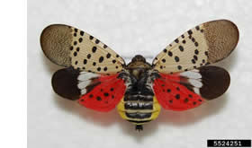
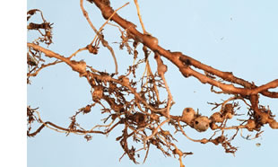
Priorities for PRA in 2015-2016
Pospiviroids,
Selected pests identified during the EPPO Study on pest risks associated with the import of tomato fruit
Lycorma delicatula
Meloidogyne mali
Review the EFSA Opinion on soil and growing media to make recommendations for horizontal measures against Phytophthora and other soil borne species.

Slide 28
Other developments

Slide 29
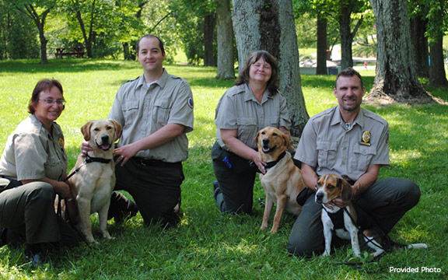
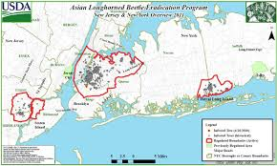
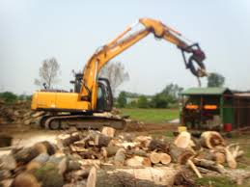
Contingency Planning
Standard on “Generic Elements for Contingency Plans”
Council Colloquium – Moscow, 2013
EPPO Inspectors Workshop – Kew, November 2014 on developing and exercising contingency plans
Encourage learning from others’ experience
Potential database of eradication expertise?
Development of PM9 Standards (Popillia japonica next)

Slide 30
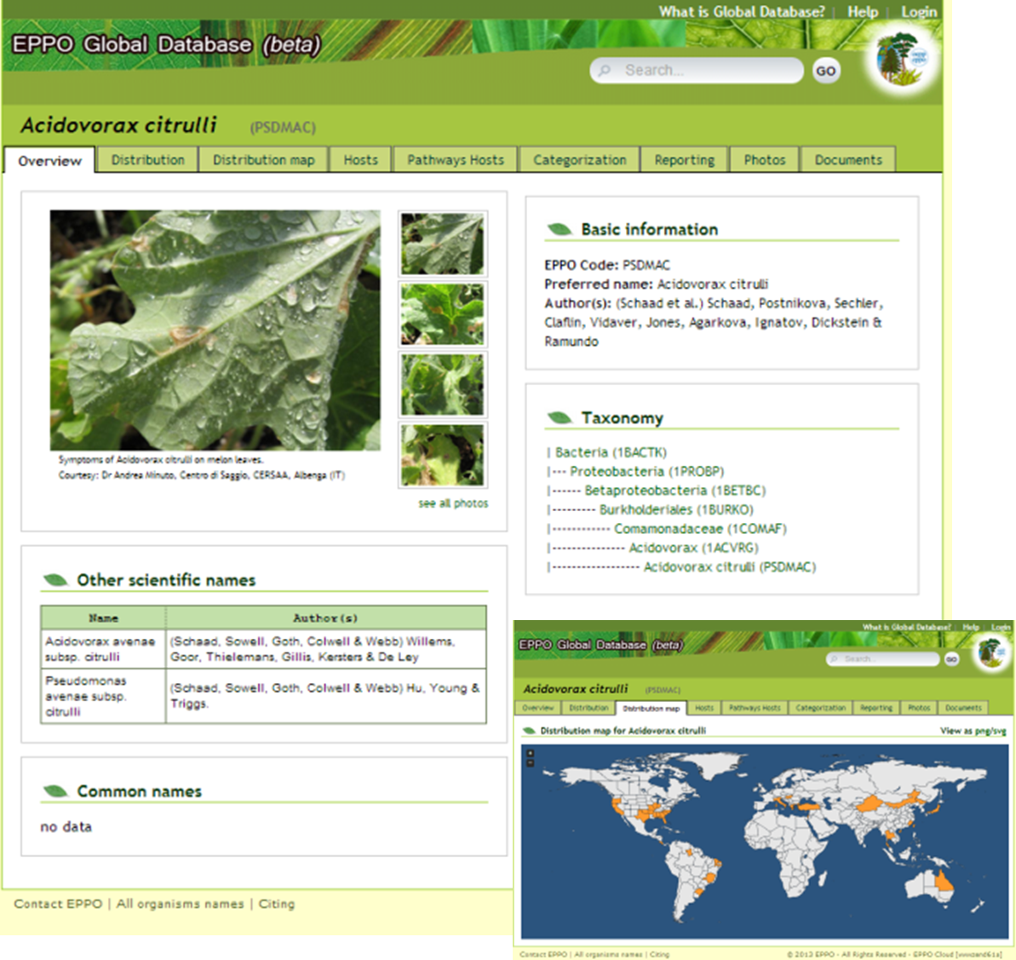
Notes:
Integration of all of EPPO’s information on pests into a single online database

Slide 31
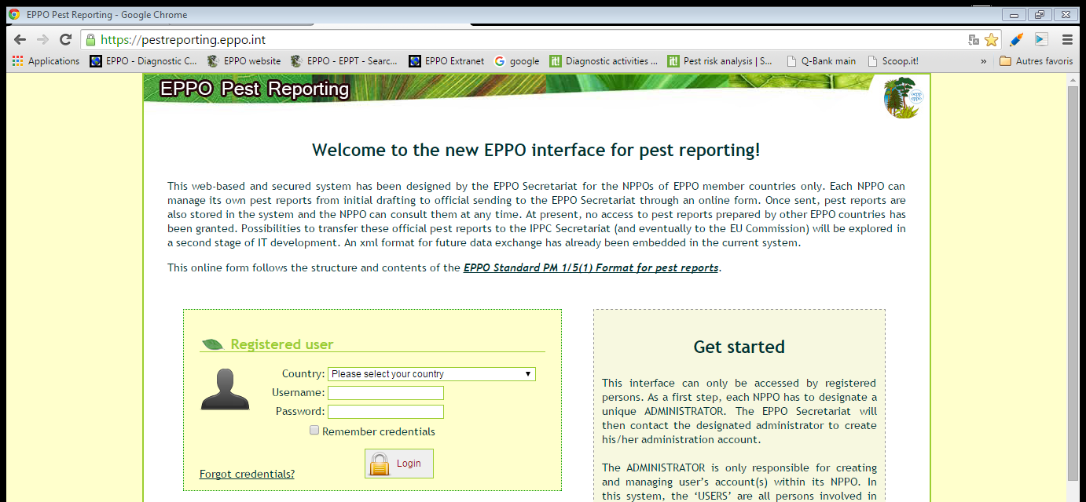
Pest reporting
EPPO worked with IPPC IT for 4 months to help develop a single pest reporting system with the IPPC. Further steps are needed for exchanges with EU countries

Slide 32
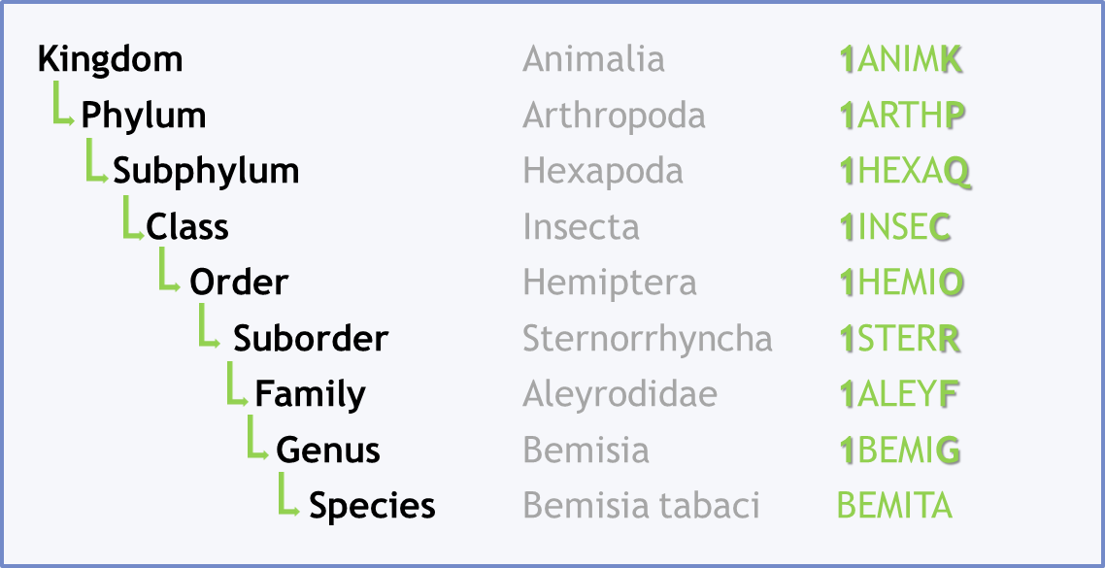
EPPO Codes
Codes for over 30,000 pests and 30,000 host plants
c. 2,000 new codes added each year
120,000 common names in > 20 languages
Free to users, but recovery of costs for new codes
Clear distinction now made between
  Codes in the taxonomic hierarchy (Secretariat responsibility)
  Non-taxonomic codes (EPPO Panel responsibility)

Slide 33
International Work
3 meetings of “CPM Affairs Panel”
Hosting of EWG on commodity standards
2 topic proposals – apples and tomatoes
Agreement on European nominations for IPPC bodies
Proposals for International Year on Plant Health welcomed by EPPO Council

Slide 34
Euphresco (Plant Health Research Co-ordination)
Started as an EU supported ERA-net in 2006
Now a self sustaining network funded by partners
Hosted by EPPO
31 partners from 24 countries
Including CFIA and USDA - WELCOME!
c. 1.2M€ available for small projects in 2015
18 topics likely to be funded in 2015
Also mapping of activity and research agendas

Slide 35



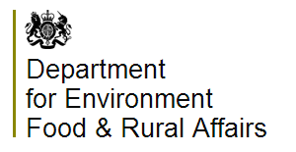
























Euphresco Network at end of 2014

Slide 36
The European and Mediterranean Plant Protection Organization
Thank you!

