Slide 1
Protecting North American plant resources while facilitating trade UPDATES for 2015 for your RPPO ?
Dr. Stephanie Bloem
NAPPO Executive Director
27th Technical Consultation of RPPOs
Memphis, TN, Nov.2-6, 2015

Slide 2
my job this morning ..
NAPPO mission and workflow
NAPPO new team members
NAPPO new location
New Website
NAPPO strategic plan 2016-2020
2015 workplan updates

Slide 3
1. Our mission
Provide a forum for public and private sectors in Canada, the United States and Mexico to collaborate in the regional protection of agricultural, forest, other plant resources, and the environment while facilitating trade.

Slide 4
1. How do we accomplish our mission ?
Development of regional standards
Promoting harmonized approaches
Cooperating with key partners
Communicating and educating stakeholders
Gathering and disseminating relevant scientific and official information
Promoting transparency

Slide 5
1. NAPPO Work-flow
Executive Committee
Osama El-Lissy (USA)
Javier Trujillo (Mexico)
Greg Wolff (Canada)
Stephanie Bloem
Executive Director
Rebecca Lee
Technical
Director
Alba Campos
Executive
Assistant
Nedelka Marin-Martinez
Translator
Interpreter
Secretariat
Industry Advisory Group - IAG
Working Group
Stephanie Bloem & Rebecca Lee (NAPPO)
Marie-Claude Forest & Steve Cote (Canada)
John Greifer, Patricia Abad & Stephanie Dubon
(USA)
Ana Lilia Montealegre, Guillermo Santiago, Isabel Diaz-Nieves (Mexico)

Slide 6
2. New Team Members
Osama El-Lissy - USDA-APHIS-PPQ Deputy Administrator – NAPPO EC - Jan, 2015; outgoing EC Chair
Stephanie Bloem – Executive Director, July, 2015
Patricia Abad – USDA-APHIS-PPQ-IPS, NAPPO Technical Director; new NAPPO WG member for the USA, Oct. 2015
Marie-Claude Forest – new NAPPO EC member for Canada; incoming EC Chair, Oct. 2015

Slide 7
3. New Location for NAPPO Secretariat
After 39 years from Ottawa, Ontario, Canada to Raleigh, NC, USA
At NCSU Centennial Campus
Transition while maintaining continuity/productivity/service
Staff relocation
“Becoming” independent

Slide 8
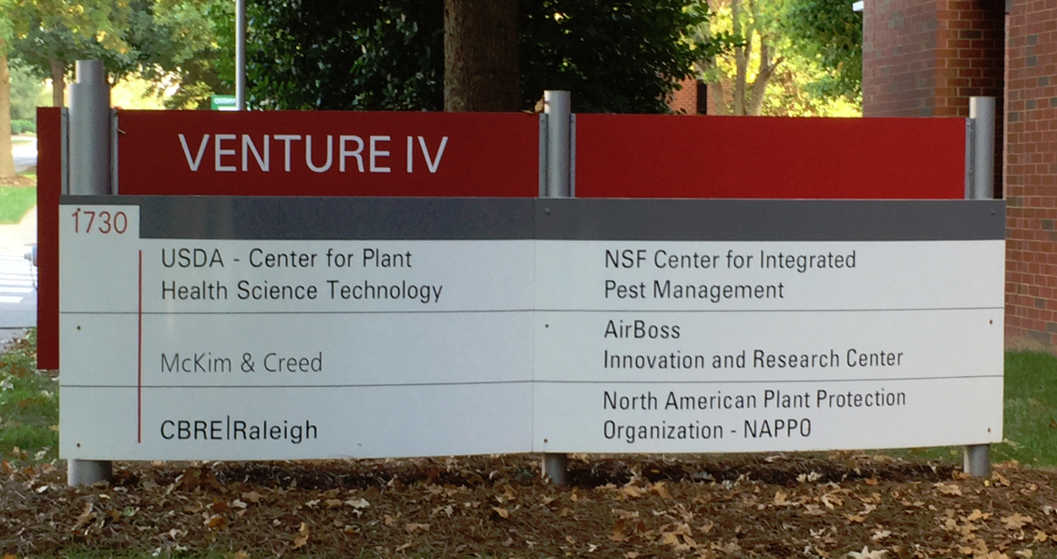
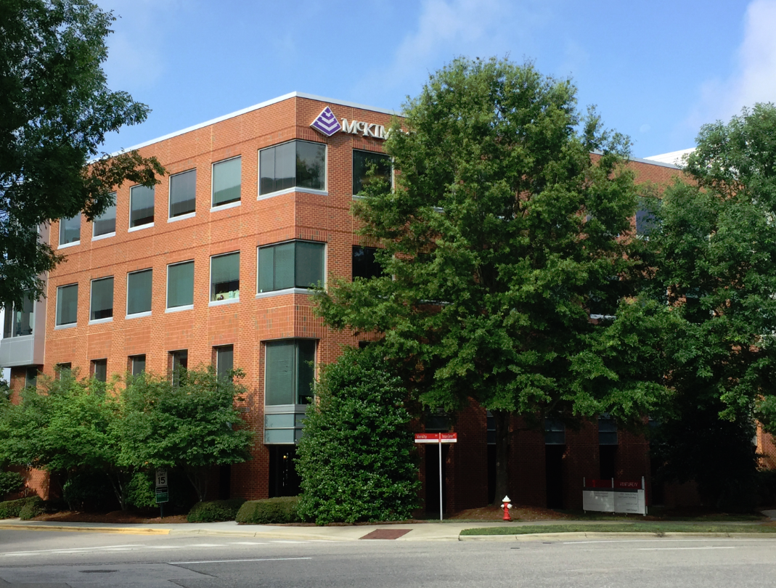

Slide 9
4. New Website!

Slide 10
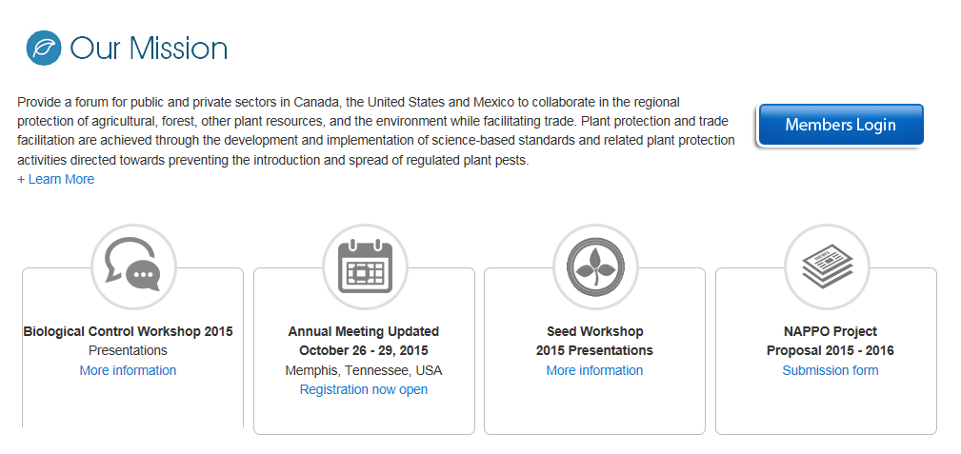

Slide 14
5. New 5-year Strategic Plan
Current plan ends in 2015
Strategic thinking and ideas with EC, WG and IAG at the Annual Meeting
Build on current objectives
Priority driven approach
Science-based
Harmonization
Continual improvement in our business practices, service and communication

Slide 15
6. 2015 Project and Expert Group Updates
3 workshops – 2 in July, 1 upcoming
Biological Control EG - Implementation of RSPM 12
Seed EG – Needs Assessment for regulatory support of the North American seed industry
AGM EG - Implementation of RSPM 33

Slide 16
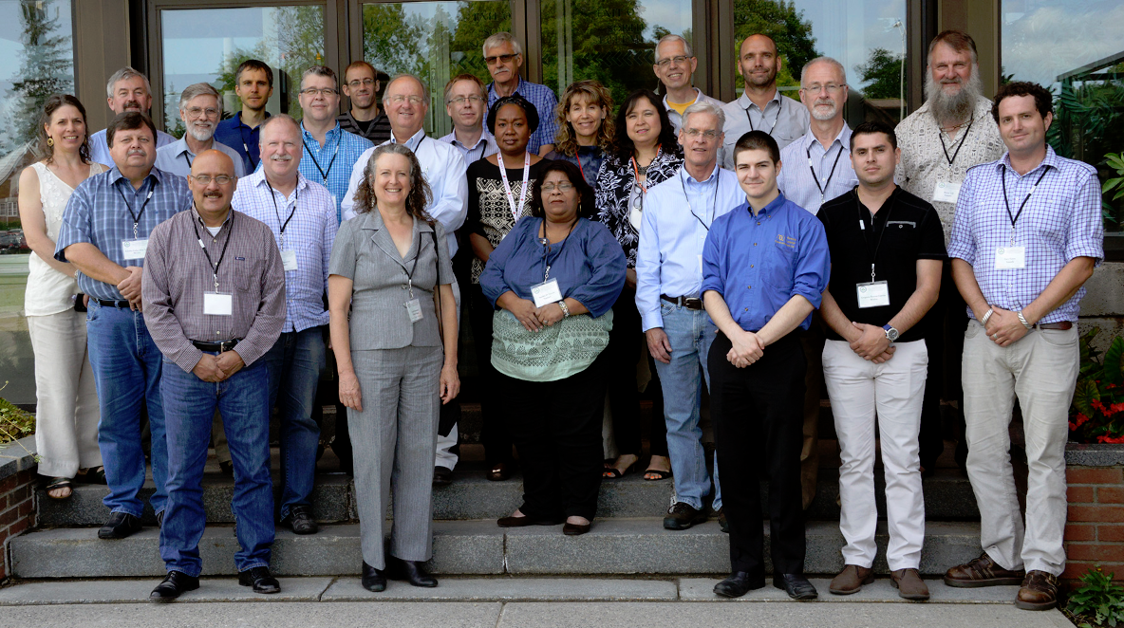
Biocontrol Workshop – NA + Panama & UK

Slide 17
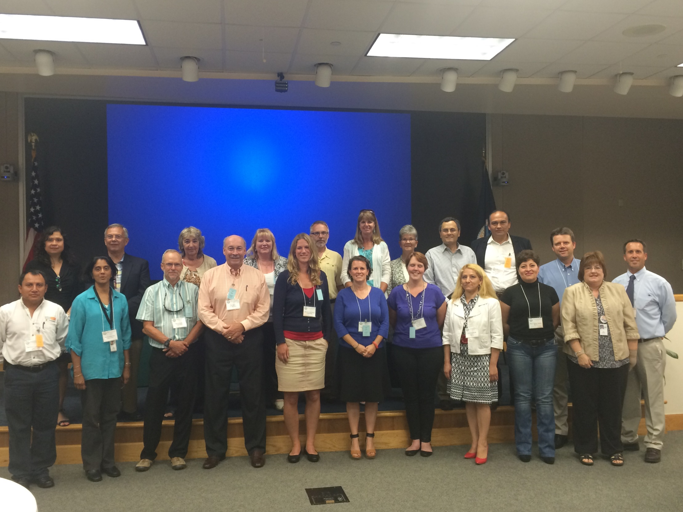
2015 NAPPO Workshop on Needs Assessment for regulatory support of the North American seed industry – NA + EPPO
Bring together stakeholders to define and prioritize the phytosanitary needs of the industry

Slide 18
6. 2015 Project and Expert Group Updates
Revision & update of several RSPMs by several different EGs
Citrus EG – emerging pest template format ; Citrus Leprosis; HLB AWMP; protocols for shoot-tip micro-grafting & thermotherapy
ISPM 15 EG
Foresty EG - Draft specification for Systems Approaches in Forestry; Lymantriid risks

Slide 19
6. 2015 Project and Expert Group Updates
Communication – spotlight-on video
Updated project proposal format
Documents – new regional standard, diagnostic protocol, discussion document, position/decision paper, science/technology document
Event or activity – training/implementation workshop, conference, educational activity
Project duration – 1 or more years

Slide 20
Call for New Project Proposals – 2016 NAPPO Work Program
Advertised in August; closed in late September
Sixteen new projects were received for consideration to the 2016 NAPPO work program
Stakeholders at the annual meeting participated in initial prioritization – through voting!
EC, WG and IAG met on Oct. 30 to review and begin project prioritization

Slide 21
Other NAPPO business
40th NAPPO Annual Meeting – Montreal, Quebec, Canada
October 31 – Nov. 4, 2016
Strengthening (re-invigorating) and updating our working relationships and (in some cases) the appropriate foundational documents with IICA, OIRSA and GICSV

