Slide 1
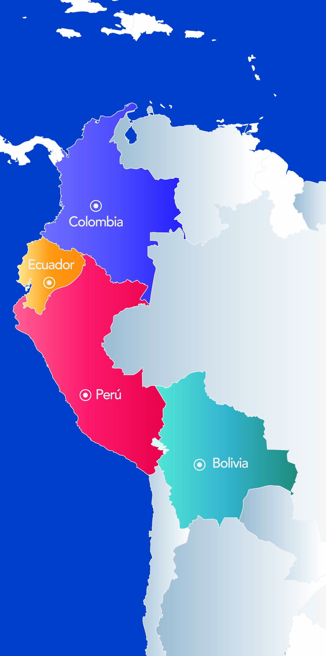
28TH TECHNICAL CONSULTATION AMONG RPPO´s
REPORT: COMUNIDAD ANDINA (CAN)
14 - 18 November, 2016
Rabat, Marocco

Slide 2
REPORT: COMUNIDAD ANDINA (CAN)
On this presentation you will find:
1. RPPO specificities
2. Technical and capacity development achievements
3. Emerging pest and issues
4. Surveillance and projects activities
5. Proposal for further colaboration

Slide 3
1
RPPO specificities
Andean System of Animal and Plant Health
Objectives
Protect the agricultural health of the subregion and prevent that phytosanitary measures be unjustified restrictions in the trade
Harmonize plant and animal health legislations
Prevent and control pests or diseases that representing risk for agricultural health
Promote cooperation and development programs of joint action
Promote the adoption of common positions in scientific, technical or trade issues
Institutions:
(i) Andean Community Commission: formed by trade ministers. For the agricultural topics is extended to agriculture ministers.
(ii) General Secretariat of the Andean Community (SGCAN), Is the executive body of the Andean community.
(iii) Andean Committee of Animal and Plant Health (COTASA): It is a committee responsible for issuing non-binding technical opinion in the field of animal and plant health, and to advise the Commission or the General Secretariat to better perform its activities
(iv) Animal and Plant Official Services
For more information you can see Decision 515 avalaible on: http://www.comunidadandina.org/Documentos.aspx?GruDoc=07

Slide 4
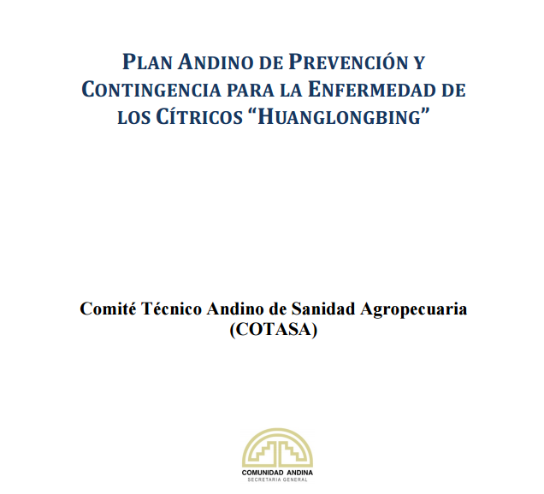
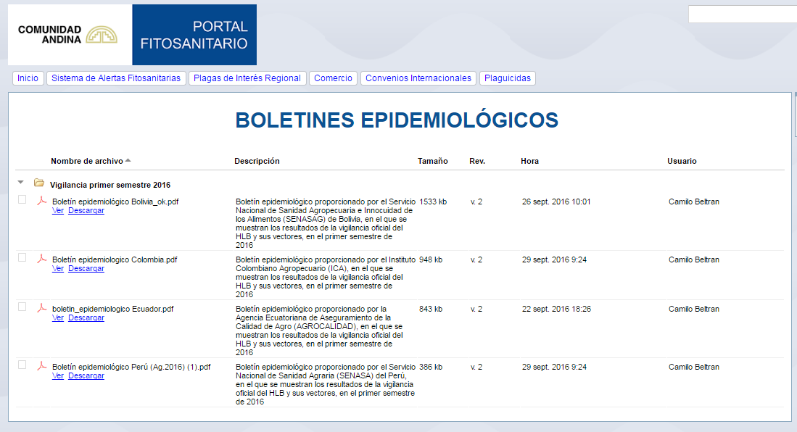
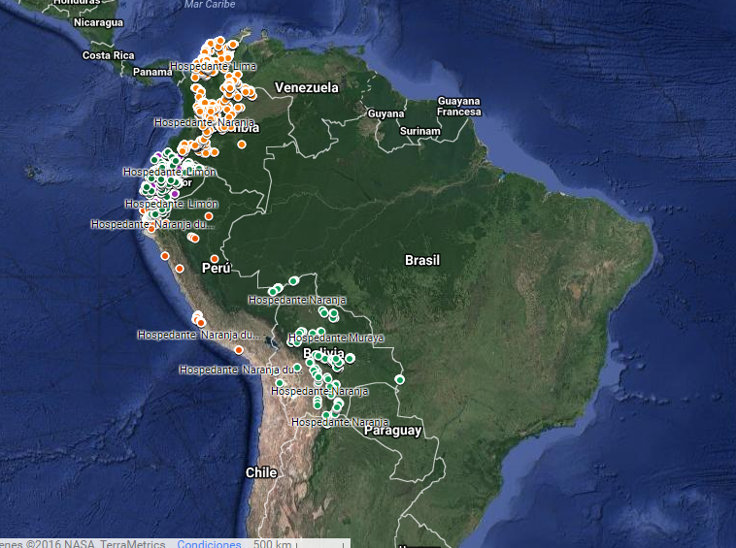
Technical and capacity development achievements
2
1. Huanglongbing Prevention and Contingency plan
The prevention and contingency Andean plan was adopted by the SGCAN through the Resolution 1850. The plan was worked and recomended by the Andean Commitee of Animal and Plant Helth.
Main topics: (i) promotes colective action; (ii) exchanges information; (iii) NPPOs obligations to surveillance; and, (iv) promotes borders work.
Avalaible: https://sites.google.com/a/comunidadandina.org/portal-fitosanitario/plagasregional/huanglongbing

Slide 5
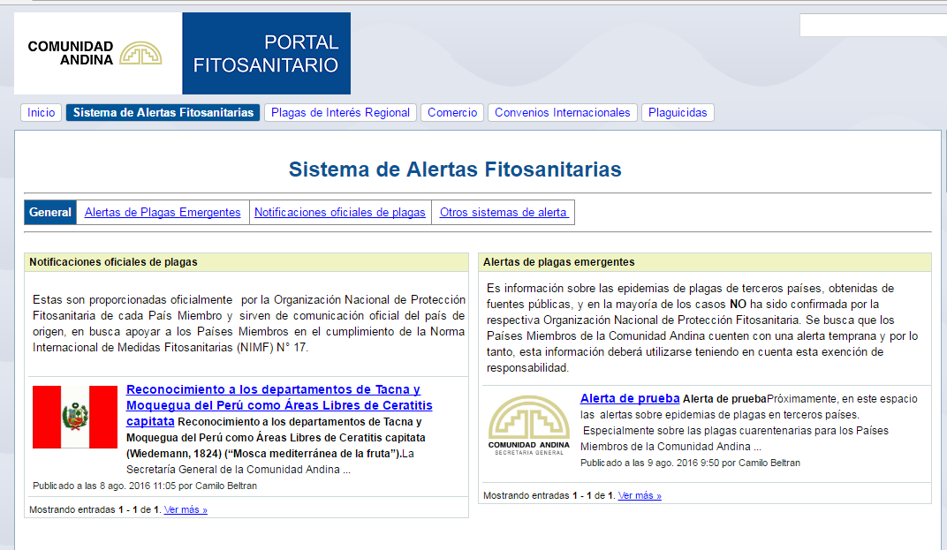
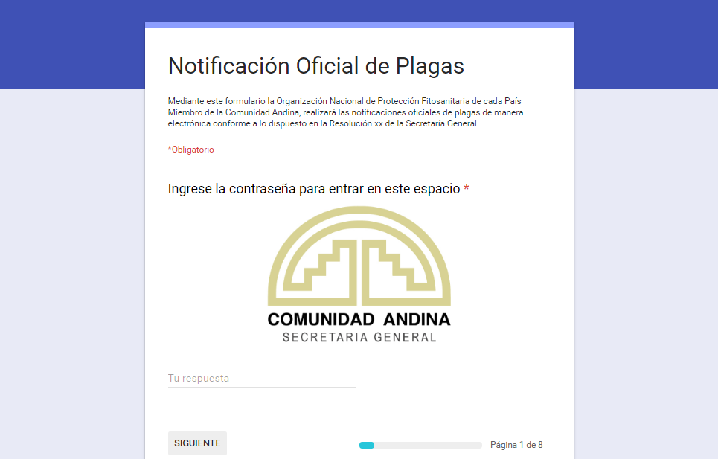
Technical and capacity development achievements
2
2. Pest Alert System Pilot
A Pest Alert System Pilot was developed with the purpose to support to Andean NPPOs to pest notification, allowing notification through Andean Phythosanitary Portal. The pilot was developed inspired on the NAPPO system.
To regulate the system use, a normative project was developed that currently is being analyzed by the Andean Committee of Animal and Plant Health to eventually recommend to SGCAN the adoption by Resolution. it should be noted that the Andean countries already have to the legal obligation to pest notifications to SGCAN.
Avalaible: https://sites.google.com/a/comunidadandina.org/portal-fitosanitario/alertas-fitosanitarias

Slide 6
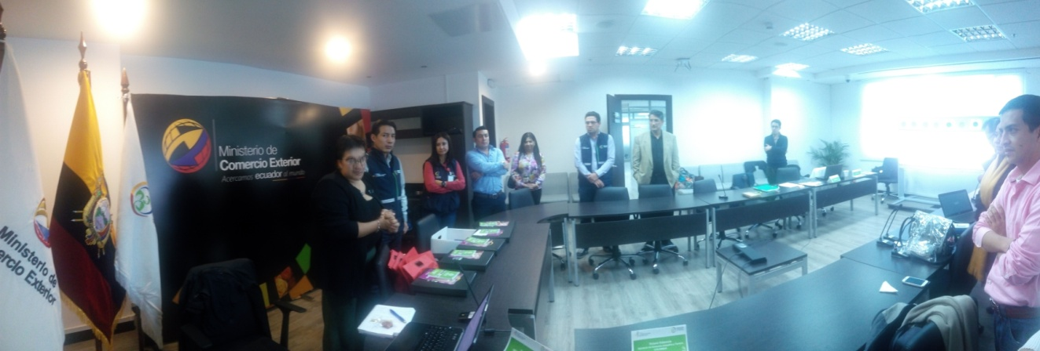
Technical and capacity development achievements
2
3. Still updating regulations to agricultural pesticides registration
The last year the general framework to pesticides registration was updated (Decision 804) and now the Technical Manual is being update. Several meetings were held and a webinar to about alternatives methodologies to registration (avalible on: https://www.youtube.com/watch?v=4FljSfG5OdQ.)

Slide 7
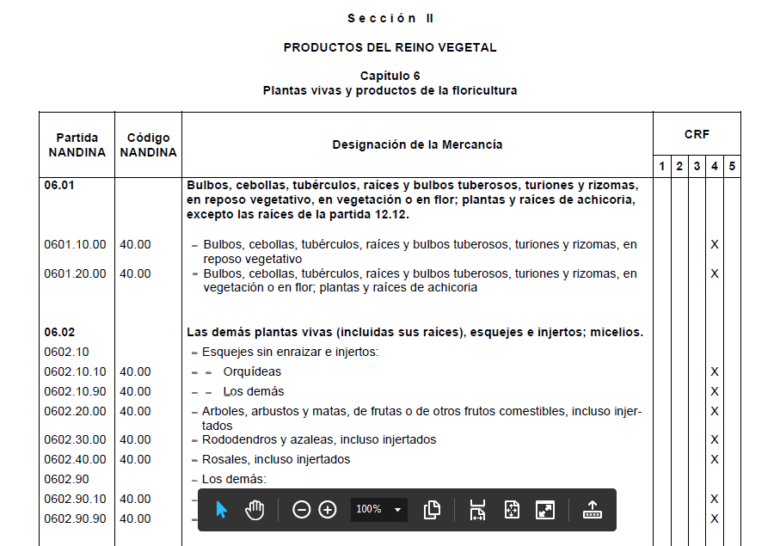
Technical and capacity development achievements
2
4. Start of update the Andean norm that implement the ISPM 32
Joint with the Andean Committee of Animal and Plant Health (COTASA) was started the update to SGCAN Resolution 1475. These norm implements the ISPM N°32 assigning a pest risk categorization to commodities according to the Andean customs nomenclature.
Several codes require review the categorization according with the method and degree of processing.

Slide 8
Emerging and pest issues
3
(i) Fusarium oxysporum f. sp. cubense race 4 tropical (TR4)
(ii) Fruit flies
(iii) Huanglongbing
(iv) Drosophila suzukii
(v) African giant snail
Main emerging pest and issues
(i) According with the LA risk assessment, TR4 has high risk to entry, establishment, dispersal, and economic impact. Is not known a resistant genotype commercially accepted (ii) The main fruit flies threats for CAN region are: Anastrepha suspensa; Bactrocera and Dacus species, particularly B. carambolae (avoid entry of absents quarantine fruit flies); (iii) CAN region there are countries where the HLB not yet arrived. Even there are countries where Diaphorina citri is not present. Therefore exists a regional responsibility to avoid entry of the HLB associated agent´s and his vectors to new areas; (iv) Invasive pest. Not present in CAN region. Cause damage especially in Vaccinium, Rubus, Prunus, Fragaria, Vitis, Ficus. (v) The African giant snail has become a problem for most of the countries in which its presence is reported. The main problem is that the snail is polyphagous, it is considered one of the most destructive pest species in tropical and subtropical areas, causing damage to commercial crops and domestic gardens (Alburqueque et al., 2008), and its main means of dispersion has been man (Linares et al., 2013), diverse practices, and even the ignorance have contributed to spread them

Slide 9
4
Surveillance and projects activities
Exchange information about Huanglongbing surveillance
Through the Resolution 1850 the members countries acquired the obligation of provide the information obtained from of the surveillance, this show geographic coordinates located in different points (commercial crops, urban, garden, nurseries,…), where they identificated the host (orange, tangerine, lemon, between others) and the presence or absense of agents associated with HLB and its vectors .
This way, we follow up on the region´s phytosanitary situation and we publish the information in the Andean Phythosanitary Portal.
Avalaible: https://sites.google.com/a/comunidadandina.org/portal-fitosanitario/plagasregional/huanglongbing

Slide 10
5
Surveillance and projects activities
Proposal for further collaboration
(i) FOCR4T
(ii) Fruit flies
(iii) Phythosanitary education
(iv) Surveillance
(v) Diagnostic laboratories network
(i) Promotes colective action to avoid or delay the entry to LA; (ii) Better implementation and understanding of the quarantine treatments (irradiation); (iii) Could be considered develop an annual virtual course with interactive materials, increasing amount of people trained, mainly on: Pest Risk Assesment; updating of quarantine treatments (i.e irradiation) (iv) Incresing human and physical capacitys to specific survillance (v) To devolpment diagnostic capacities.

Slide 11
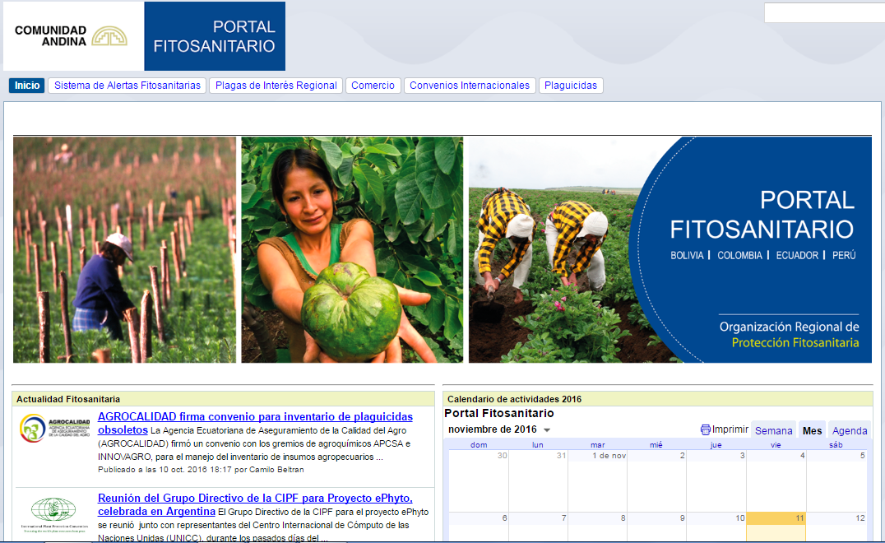
Thank you by your kind attention!
Andean phythosanitary portal avalaible: https://sites.google.com/a/comunidadandina.org/portal-fitosanitario/

