Slide 1
The European and Mediterranean Plant Protection Organization Presentation to 28th Technical Consultation among RPPOs 2016-11-14/18 Rabat

Slide 2
Specificities of EPPO
founded 1951 by 15 countries
now 51 member countries
Europe (almost all countries), N Africa, Mediterranean, Central Asia
15 panels on plant quarantine, 5 on plant protection products
c. 15 staff working on core programme
5 Expert Working Groups per year on PRA
Core work funded by member country contributions (c.65%)
Plus projects with other funders (c.35%) - 5 main ones currently
Euphresco (35 members in 2016)
EU Minor Uses Co-ordination Facility (EU, DE, FR, NL)
RNQPs for the EU (EU - DG Sante)
LIFE Invasive Plants (EU - DG Environment)
DROPSA (EU - DG Research)

Slide 3
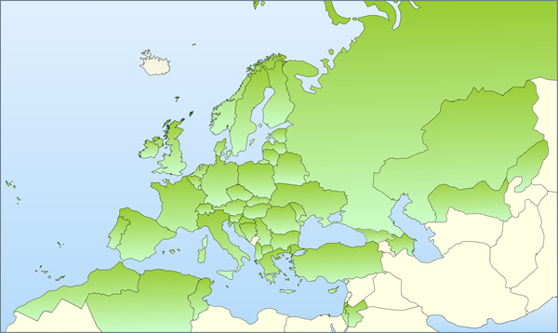
Notes:
Two announcements – Georgia

Slide 4
EPPO’s Organisation
National Plant Protection Organisations
EPPO Secretariat
National Experts

Slide 5
Active Panels
Phytosanitary Regulations
Global Affairs
Risks and Measures
Forestry
Potatoes
Inspection Procedures
Information
Diagnostics (General) +
Entomology
Nematodes
Bacteria
Fungi
Virology
Invasive Alien Plants
Biological Control Agents
Colorado beetle campaign
Plant Protection Products
General Standards
Herbicides
Insecticides and Fungicides
Resistance
Harmonisation of Data Requirements

Slide 6
Secretariat
Martin Ward Director General
Françoise Petter Assistant Director
Vlasta Zlof Scientific Officer (Plant Protection)
Andrei Orlinski Scientific Officer (Forestry and Biocontrol)
Anne‐Sophie Roy Information Officer
Muriel Suffert Scientific Officer (Potatoes and PRA)
Fabienne Grousset Scientific Officer (PRA, translations)
Rob Tanner Scientific Officer (Invasive Alien Plants)
Valerio Lucchesi Scientific Officer (Plant Protection)
Damien Griessinger IT and Systems Manager
Madeleine McMullen Managing Editor
Eliane Madène Administrator
Jocelyne Cesari Secretary
Cintia Mauchien Administrative Assistant
Baldissera Giovani Euphresco Co-ordinator
Jeroen Meeussen EU Minor Uses Co-ordinator
Nathalie Butron EU MUCF IT Officer
Flora Limache EU MUCF Technical Expert
Camille Picard Secondee from NPPO of France

Slide 7
Technical and Capacity Development Achievements
New and amended EPPO Standards
PM3 - Phytosanitary Procedures
place of production inspection for Xylella fastidiosa
consignment inspection for Xylella fastidiosa
guidelines on "plants grown under complete physical isolation"
PM7 - Diagnostics
DNA barcoding as an identification tool for selected regulated pests
Guideline on the authorization of laboratories to perform diagnostic activities
Xanthomonas axonopodis pv. allii
Acidovorax citrulli
plus 6 amended and updated diagnostic protocols, including Xylella fastidiosa
PM9 - National Regulatory Control Systems
Baccharis halimifolia
Popillia japonica
Epitrix species damaging potato tubers (subject to early review)
Workshops
Regulation of Biological Control Agents, jointly with others (Budapest, 2015-11)
EPPO Codes Users Webinar (Paris, 2016-03)
Efficacy of low risk active substances, jointly with NL, IBMA (Ede, 2016-04)
Research Collaboration, jointly with EEC (Moscow, 2016-07)
Modelling to support PRA, jointly with EFSA (Parma, 2016-12)

Slide 8
Changes in EPPO Pest Lists and other pest priorities
2016 Additions to the EPPO A1 and A2 lists
Lycorma delicatula (A1), Euwallacea fornicatus sensu lato and Fusarium euwallaceae (A2)
Some recent additions to the EPPO Alert List
Aleurotrachelus trachoides, Bactrocera latifrons. Ceratothripoides brunneus, C. claratris Prodiplosis longifila, Contarinia pseudotsugae, Sirococcus tsugae (shoot blight), Citrus bark cracking viroid ,Tomato leaf curl New Delhi virus
Priorities for PRA in 2017 Work Programme
Massicus raddei,
Thekopsora minima (blueberry leaf rust)
Candidatus Phytoplasma phoenicium (almond witches broom)
Grapevine red blotch associated virus
Priorities for revised or new PM9 Standards (on regulatory control)
Epitrix papa, Bursaphelenchus xylophilus, zebra chip disease, Globodera rostochiensis and G. pallida, Microstegium vimineum
Priority for publicity material - Popillia japonica
Priorities for research (from proposed Euphresco topics)
Xylella fastidiosa and its vectors, Candidatus Phytoplasma vitis, Phytoplasmas in forests, Candidatus Liberibacter solanacearum, Candidatus Liberibacter asiaticus, Ralstonia solanacearum, Synchitrium endobioticum, Little Cherry Virus, Pospiviroids on Solanaceae, Begomoviruses, Epitrix spp., Thrips setosus, Meloidogyne spp. Lecanosticta acicola, Hymenoscyphus pseudoalbidus,

Slide 9
Surveillance Projects and Activities
Many EPPO Standards (diagnostic, inspection, and national regulatory control systems) include elements of surveillance
EPPO is working with EFSA on ways of collaborating to produce more guidance; surveillance in the EU is becoming mandatory for priority pests, and more co-ordinated, with EU co-funding
EPPO is joint steward in surveillance pilot for Xylella fastidiosa
EPPO is developing a Standard on raising public awareness to encourage pest reporting (specification has been agreed)

Slide 10
Proposals for Further Collaboration
Globally
Co-ordinate planning and funding of phytosanitary research by extending or copying the Euphresco network
Continue collaboration on diagnostic protocols
Improve horizon scanning, e.g. through use of sentinel plants
Develop commodity standards, creating "toolboxes" of measures to simplify implementation and facilitate trade
Continue to facilitate work on e-Phyto (e.g. through development of Codes)

Slide 11
Proposals for Further Collaboration
Within EPPO region, initially
develop platforms for exchange of information on
planned and completed PRAs
applications to release biological control agents
emerging cases of resistance to plant protection products
gene sequence data (including Q-bank)
biological collections and specimens
develop guidance on use of pheromones in surveillance
strengthen links between plant quarantine and ppp regulation
continue to develop inspection Standards
continue to develop prioritisation systems

Slide 12
Emerging issues in plant health
Making efficient use of resources
Resources for plant health are unlikely to increase substantially - we have to collaborate effectively between IPPC, RPPOs, NPPOs, academia and industry
Simplifying measures to facilitate safe trade
Measures must be justified by PRA but 200 importing countries x 200 exporting x 300 trades x 300 pests = 3600000000 measures!
Need Commodity Standards with agreed "toolbox" of measures.
Increasing collaboration on research
See Australia SPG and Euphresco TC papers
Improving horizon scanning for new threats
Sentinel plants (requires international trust and co-operation)
Other ways of seeing what is coming before it comes?
Earlier detection of outbreaks and pest presence
Technology is changing fast - can we adapt and use it quickly for improving early detection of pests new to an area?

Slide 13
Euphresco
An international network of plant health research funders and managers:
Mapping existing research programmes
Developing a common strategic research agenda
Making annual calls for topics for transnational funding:
2015 round funded 15 projects, with 3.6 m€, from 29 countries
2016 round has so far short-listed 24 research topics

Slide 14
History
Euphresco started in 2006 through EU funding for European Research Area Networks (“ERA-nets”)
Facilitation of co-operation in research was one of the functions set out in the 1951 EPPO Convention
2014 it was agreed EPPO was the right organisation to host a self-sustaining long term network
Running costs are covered by annual payments of at least 3000 Euros from each network member
Currently 35 members of Euphresco across 26 countries, 24 of which are EPPO member countries.

Slide 15
Euphresco network, as of July 21, 2016

Slide 16
Membership and Governance
Annual Governing Board meeting makes decisions
Network Management Group (6-8 representatives, elected by Governing Board) implements them
Some members are EPPO NPPOs (or close)
From 2017 all EPPO members will also be members of Euphresco, paying through the annual contribution an amount covering about half the costs

Slide 17
Membership and Governance
Other members are funders and managers of plant health research from:
different departments or levels of government
research institutes
countries outside the EPPO region.
These other members are fully involved in the activities and governance of Euphresco and contribute towards costs of running the network through payment of at least 3000€ per year

Slide 18
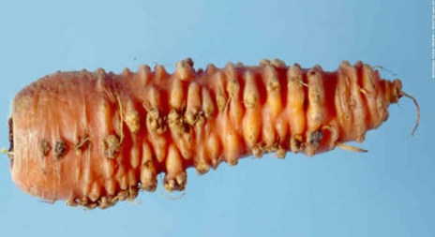
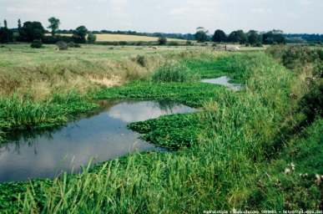
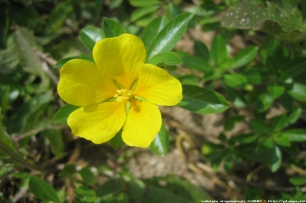
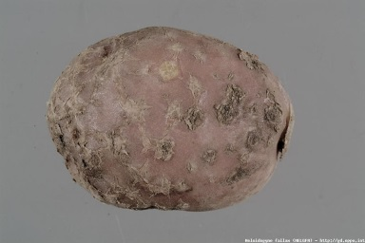
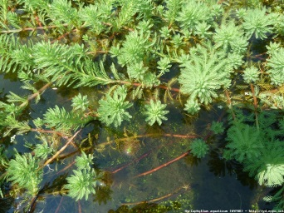
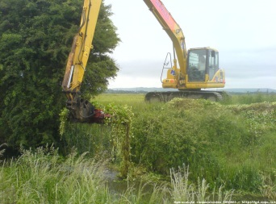
Some projects funded under EUPHRESCO I
Strategies for Ambrosia artemisiifolia control
Development and validation of innovative diagnostic tools for the detection of fire blight (Erwinia amylovora)
Evaluating the risk of spread of Scaphoideus titanus with propagation material
Decision support systems for control of alien invasive macrophytes
Development of validated procedures for whole genome amplification of DNA/RNA for quarantine plant pathogens and pests
Ring test on diagnostic methods for Pantoea stewartii spp. stewartii, maize bacterial blight
Detection and management of the quarantine nematodes Meloidogyne chitwoodi and Meloidogyne fallax

Slide 19
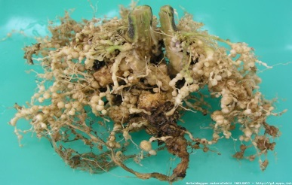
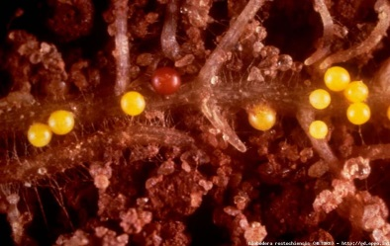
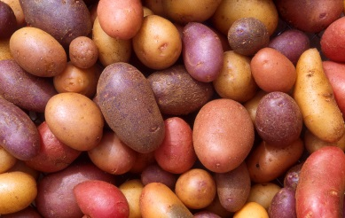
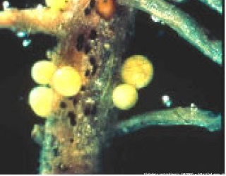
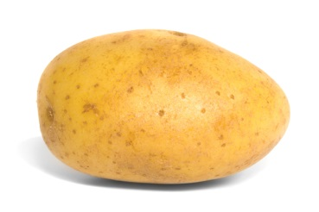
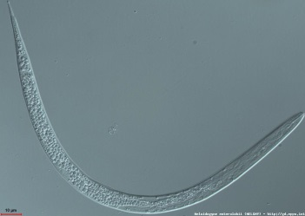
Some projects funded under EUPHRESCO II
Use of novel molecular methods to understand population diversity and its implications on disease management through the use of resistant potato varieties (Potato Cyst Nematode)
Development and validation of innovative diagnostic tools for detection and identification of Meloidogyne enterolobii in support of integrated plant protection strategies
Epidemiological studies on reservoir hosts and potential vectors of Grapevine flavescence dorée (GFD) and validation of different diagnostic procedures for GFD
Bursaphelenchus xylophilus methods for early detection
Plant Health Fellowship
IPM strategies against Drosophilidae

Slide 20
Funding projects - "real pot, competitive"
Funder A
Funder B
Funder C
Funder D
Funder E
Topic ideas
Topic description
Funding Commitment
Competitive Call
Award of Project
or
Consortium 1
Consortium 2
Team A
Team B
Team C
Team D
Team F
Team E

Slide 21
"non-competitive virtual pot"
Funder A
Funder B
Funder C
Funder D
Funder E
Topic ideas
Topic description
Funding Commitment
Team A
Team B
Team C
Team D
Team E

Slide 22
A Global Future?
Benefits of phytosanitary research collaboration not limited to Europe!...
Efficiencies of scale
Avoidance of duplication
Drawing on the best expertise
Studying pests where they occur
Euphresco could grow to become a global network
Euphresco could be a model for other regions
Should present options at CPM in 2018
Could link to "Plant Health and Environment Theme" through choice of examples of successful collaboration

