Slide 1
Express Delivery Industry
Notes:
Greetings.
Thank you for the opportunity to address the .....
My name is ...

Slide 2




Global Express Association
Notes:
Before we delve into the subject of IPR, let me briefly introduce ourselves.
The Global Express Association represents the four major express delivery companies (read names).
The names, colour schemes and logos are trademarks and protected.

Slide 3
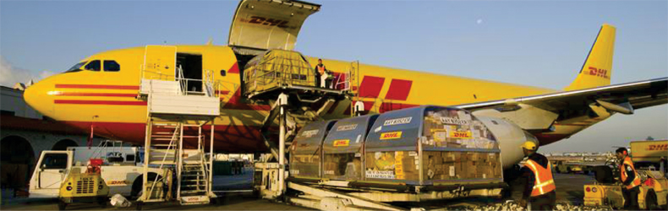
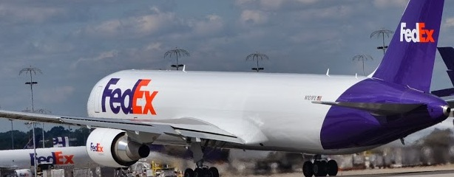


The Express Delivery Services Industry
Over 30 million shipments daily
220 countries and territories
1,700 aircraft
200,000 ground vehicles
3 million jobs world-wide (direct, indirect, induced)

Slide 4
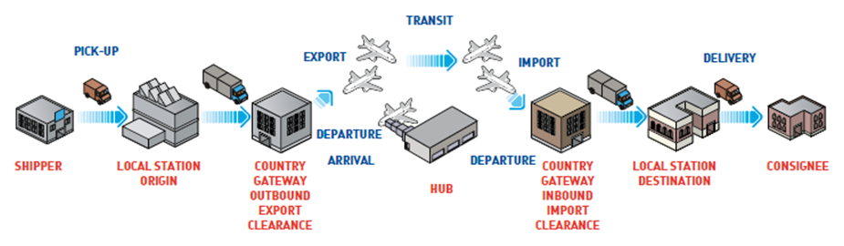
Express Delivery Chain
Control from pick-up to delivery.
Shipments from anywhere, to anywhere can be delivered within 24-72 hrs
Source: Global Express Association
Notes:
Because this is what express does.
Express delivery carriers provide sophisticated world-wide logistic services.
We are also known as integrators. What you see on the screen is a graphic description of the various steps involved in air cargo. One of the particular features of our business model is that all of these steps are either carried out by the same company or controlled by it.
In particular, we transport high value added, time sensitive cargo.
The delivery is time-guaranteed, and can range from overnight (or same day) to 48 hours after pick-up, again depending on distance and the level of service required by the customer.

Slide 5
High Value-added, Time-guaranteed
Source: Frontier Economics, Express Delivery and Trade Facilitation: Impacts on the Global Economy, January 2015
Notes:
We do not fill our trucks and planes. Who does?
Refer to Graph....
Individuals do.
Small and medium sized exporters do, in developed as in developing nations.
And major multinational corporations do, particularly those with global, just-in-time manufacturing chains.
High tech, for instance, represents about 29% of our business. Banking (your replacement credit card), automotive industries (your replacement clutch that you need so urgently), or pharmaceuticals are amongst those who have come to rely on the time-guaranteed transport system that we provide.
Express delivery carriers transport around 30 million shipments daily.

Slide 6
The Essentials of Every One of our Consignments
Data
Paperwork
Consignment
Package
Must be accurate and move together
through the supply chain to ensure on-time delivery

Slide 7
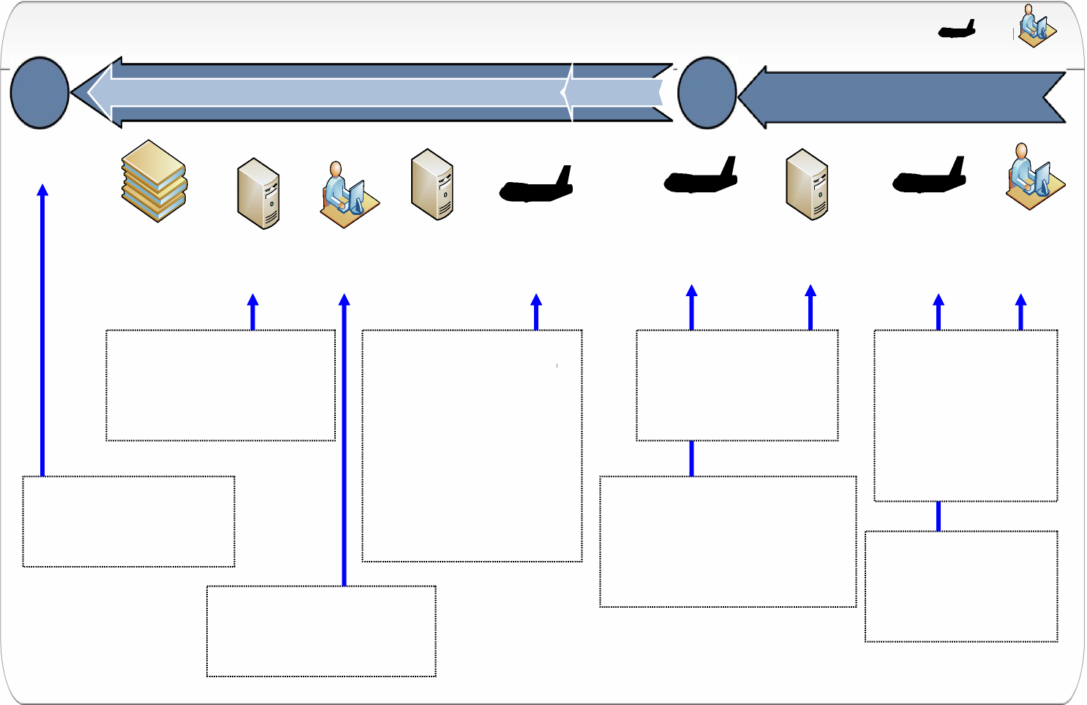
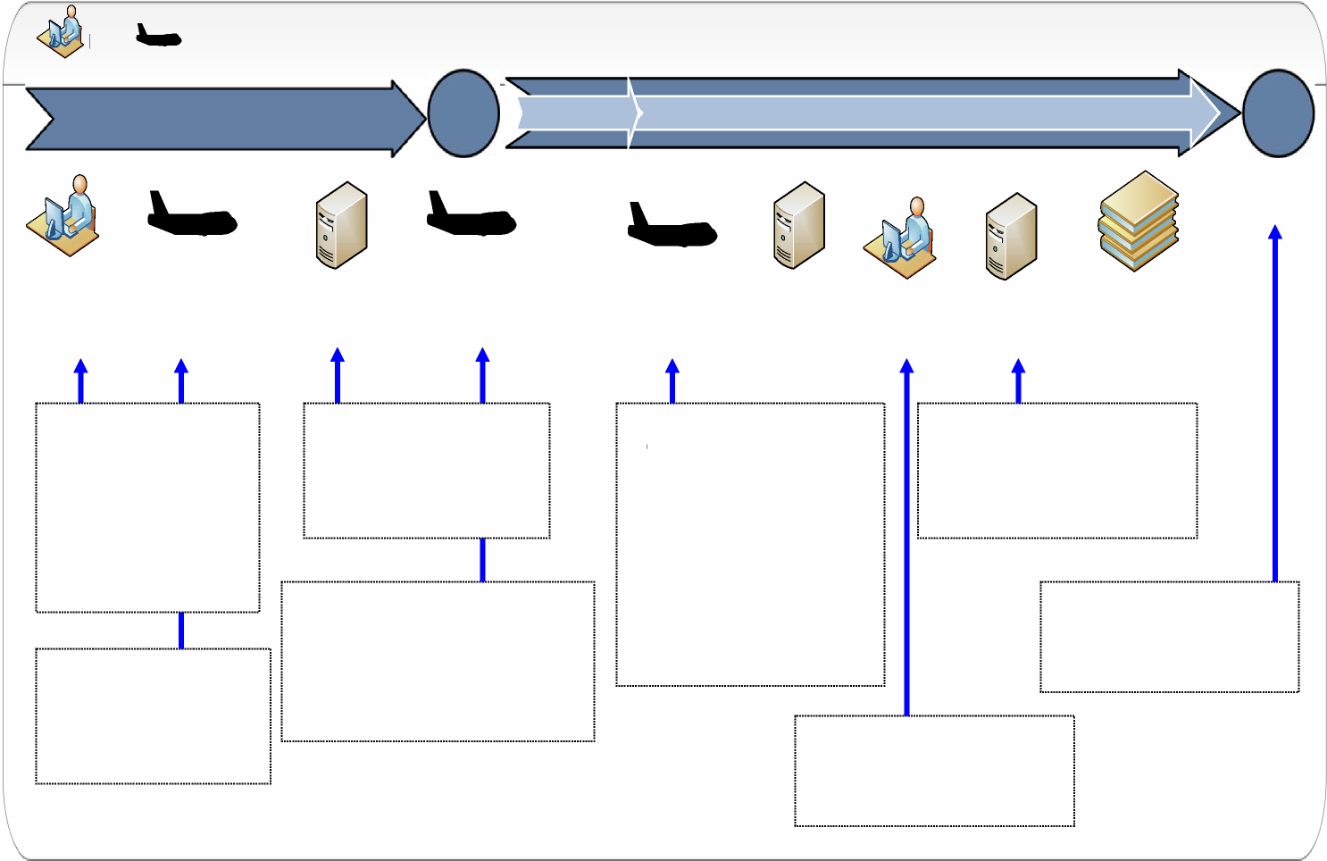

Pre-Arrival for different purposes
Secure Supply Chain
Pick-up
Input Shipment Data
Targeting Systems
Flight Departure
Brokerage Process
Customs/
OGA
Flight Arrival/Release
Delivery
Clearance
Security
Safety Revenue
 | 1 | 2 | 3 | 4
Current Model 4 Steps | Security filing, e.g. ACAS | Pre-arrival manifest (obl.) Pre-Arrival Entry (optional) (Transactional) | Other Government Agencies (OGA) Releases | Release and Clearance Payment 10 days
Single Window 3 Steps | Security filing, e.g. ACAS | Pre-Arrival Single Window processing - OGAs - Transactional Process |  | Release and Clearance Payment 10 days
“ABC” - 2 Steps Advance Processing and Account Based Controls | Security filing, e.g. ACAS Local clearance Authorized Trader Certification & commodity pre-certification |  |  | Self-Assessment Period Entry / Deferred payment

Slide 8
Holds Impact our Supply Chains; Higher Holds Correlate with Lower Volumes
Volume, million
Global Border Holds and Global Volume 2015
Border Holds, %
40,000,000
10,000,000
9,000,000
8,000,000
7,000,000
6,000,000
5,000,000
4,000,000
3,000,000
2,000,000
11.01% Global Average
1,000,000
0
Source: Global Express Association
219 Countries and Territories
% Holds
8
Volume

Slide 9
Border Holds at Global and Regional Level at a Glance
Overview of Border Clearance Performance 2013 - 2015, in %
%
11%, 11%
Global Average 2015, 2014
Global
G7
OECD
G20
NAFTA
EU
APEC
ASEAN
SAFTA
CAREC
MENA
GCC
COMESA
ECOWAS
SADC
SACU
South America
Mercosur
CARICOM
Central America
Source: Global Express Association
2013
2014
2015

Slide 10
WTO Trade Facilitation Agreement (TFA)
Art. 7.1 Pre-arrival Processing
1.1 Each Member shall adopt or maintain procedures allowing for the submission of import documentation and other required information, including manifests, in order to begin processing prior to the arrival of goods with a view to expediting the release of goods upon arrival.
1.2 Each Member shall, as appropriate, provide for advance lodging of documents in electronic format for pre-arrival processing of such documents.

Slide 11
Conclusions
Pre-Arrival processing and risk-based selectivity are important TF measures critical to our industry
All border agencies should apply them
100% inspection is ineffective and inefficient
Customs performance has improved; inspections by other authorities more visible and have become a barrier
E-phyto project very important and timely
Partnership with industry (legitimate trade) crucial

Slide 12
Thank you
Global Express Association
info@global-express.org
www.global-express.org

