Slide 1
28th Technical Consultation among Regional Plant Protection Organizations
Rabat (Morocco) 14-18 November 2016
Mekki Chouibani
www.neppo.org

Slide 2
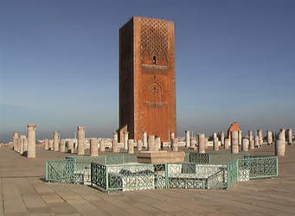
Entered into force in 2009, recognized in March 2002 by 7th session of CPM
Members: Algeria, Egypt, Jordan, Iraq, Libya, Malta, Morocco, Pakistan, Oman, Sudan, Syria, Tunisia
Signed but not ratified: Iran, Mauritanie, Yémen
Executive Committee: Algeria, Jordan, Libya, Pakistan, Syria, Tunisia
Headquarter: Rabat
Staff: Executive Director, Assistant director

Slide 3
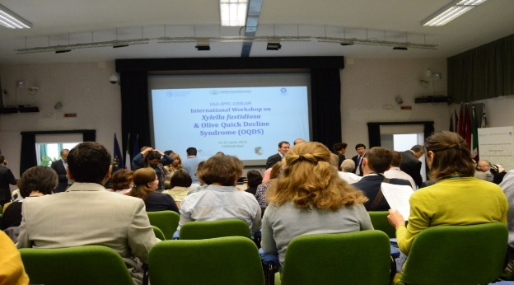
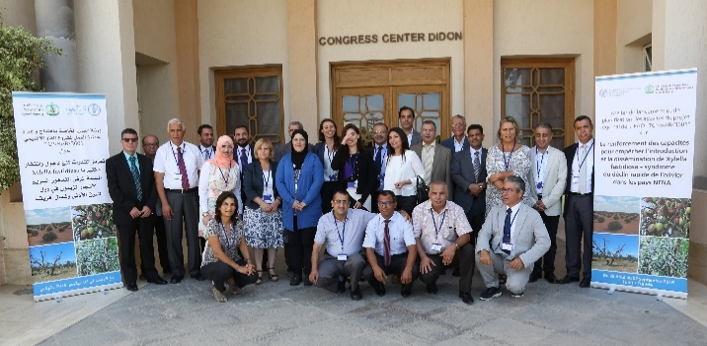
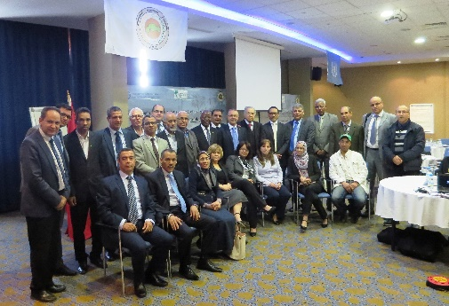
Recent plant health activities and projects
Contributed to the organization of the FAO-IPPC-CIHEAM International Workshop on Xylella fastidiosa & the Olive Quick Decline Syndrome (OQDS), Bari (Italy) 19-22 April 2016 (150 participants from 40 countries)
Launch regional project on Xylella fastidiosa in NENA region. Tunisia. 29/8-2/9/2016 ( Preparation and adoption of countries action plan )
Workshop of North Africa on Red palm Weevil and Xylella fastidiosa, Tangier (Morocco), 11-13April 2016 (Presentation of the PRA done by NEPPO)

Slide 4
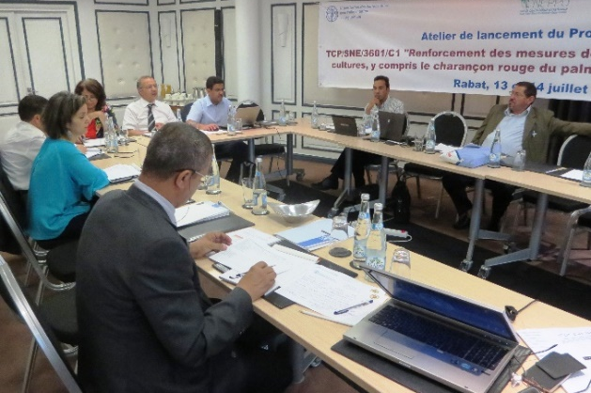
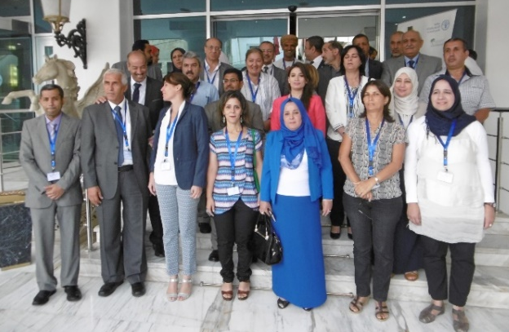
Activities
Contribution to the organization of the launch workshop of strengthen capacities of North Africa countries on Phytosanitary measures (FAO Subregional office and UMA), Rabat (Morocco) 13-14/07/2016,
Contribution to the organization of the IPPC Regional workshop for the Near east and North Africa held in Algiers, Algeria 5-8 September 2016

Slide 5
Technical and capacity development achievements
2014: Development of NEPPO web site to enhance information exchange
2014: Building capacities of NPPOs to enhance skills for better participation in IPPC meetings
2014: Building capacities in pest surveillance and related ISPMs
2015: Building capacities on pest risk analysis and establishment of NEPPO Panel on PRA
2015: Initiation of assessment of national and regional pest laboratories (NPPO and other national stakeholders) infrastructures in one country

Slide 6
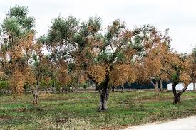
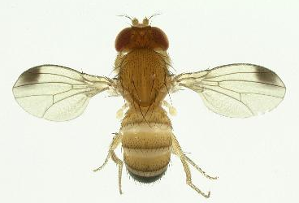
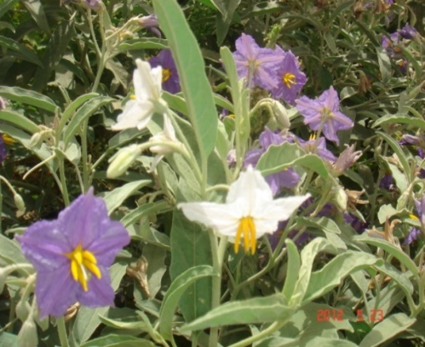
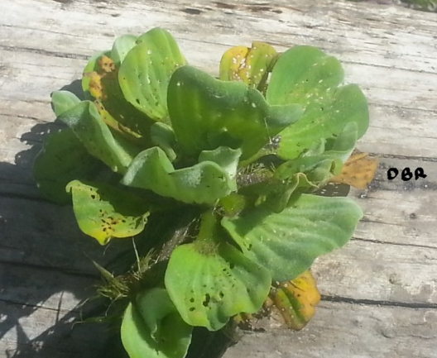
Emerging pests
Red Palm Weevil
Drosophila suzukii EPPO
Xylella fastidiosa
Solanum elaeagnifolium
Pr. Bouhache
Pistia stratiotes, R. Bouzaidi
Fruit flies: Bactrocera zonata and B, dorsalis.
Huanglongbing Citrus Disease (HLB). The Mediterranean and most Near East (Except Saudia Arabia and Yemen) area are free from HLB and its vectors (Except Iran, and currently Spain North). Important threat to Citrus Industry.
Notes:
Xylellla fastidiosa on olive tree,Currently detected in Italy and France (Corsica)
Red Palm Weevil : Rhynchophorus ferrugineus : High threaten and highly negative environment and socioeconomical impact.

Slide 7
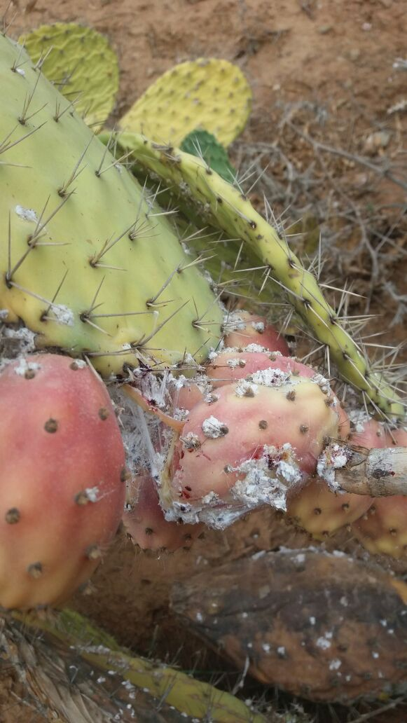
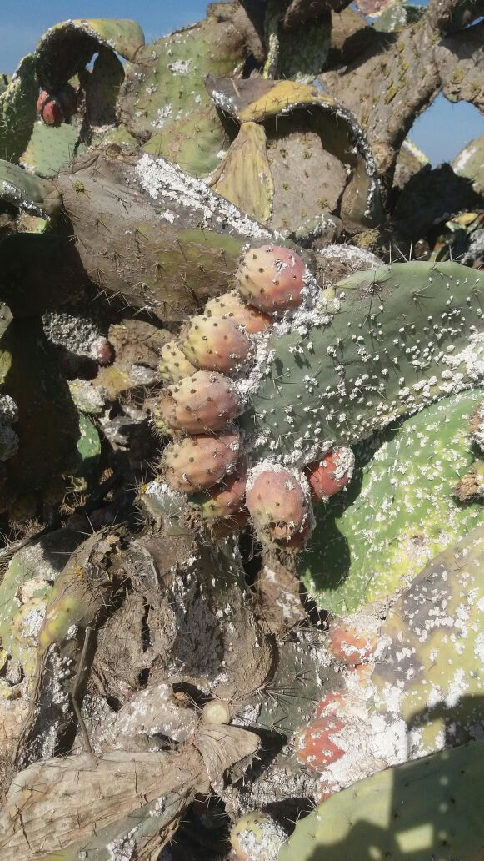
Dactylopius opuntiae
Photos courtesy: Dr Sbaghi M.

Slide 8
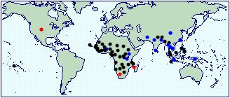
Proposals for inter-regional collaboration
Potential collaboration
Surveillance: Pivotal activity of NPPOs.
build capacity of NPPOs staff
and enhance their skills in surveillance
Establishement of Xylella fastidiosa and Greening diseases (including vectors) survey programme
APPPC
IASPC
Fruit flies: Bactrocera zonata and B. dorsalis High threat for the NENA region.
Building capacity of staff in fruit flies identification
Establishment of survey programme for early detection
B.zonata, Cabi
B.dorsalis, Cabi

Slide 9
Potential collaboration
Phytosanitary Inspection (facilitate trade):
Building capacity of inspectors;
Preparation of manuals and guidelines
Harmonization of inspection procedures
Diagnostic laboratories
Survey to asses the current situation
Identification of gaps and activities to address them
Building staff capacity and upgrade reference laboratories
Improvement of the web site: Establishments of database recording:
National diagnostic laboratories;
National pest status
Roster of national experts
ePhyto
Awareness workshop
Initiation of ePhyto
EPPO, APPPC

