Slide 1


28th TC-RPPO
Golden Tulip Farah Hotel
Rabat, Morocco
14-18 November 2016

Slide 2
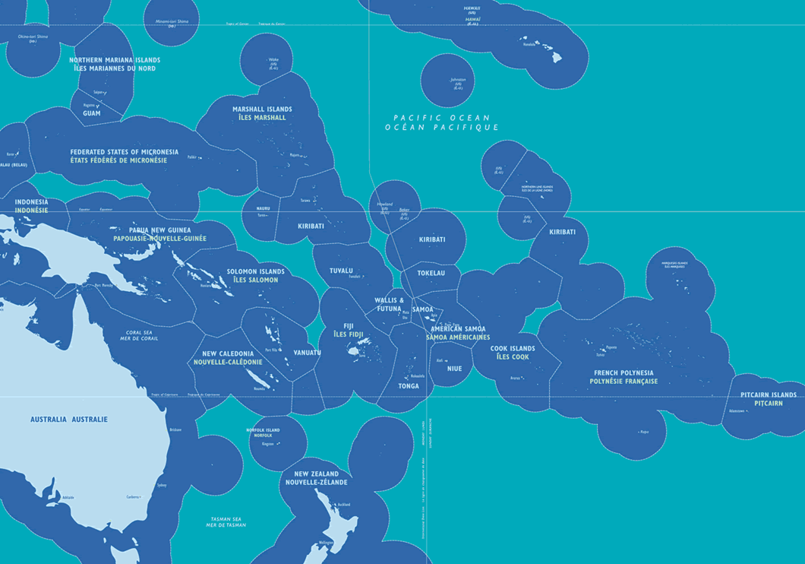
Specificities of the RPPO

Slide 3
Technical and capacity development achievements
PCE Facilitators Training – Chiang Mai (8-19 August 2016)
PPPO members able to use the Online comments system at the last regional IPPC workshop on ISPM
Capacity building on Pest List Database of country administrators

Slide 4
Emerging Issues - PPPO
Emerging Pest and New Incursions as trade increases | 1
Lack of Pest Surveillance / Lack of Practitioners at the border | 2
Lack of Staff Capacity Development | 3

Slide 5
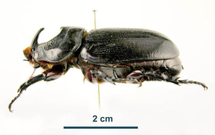
Emerging Pests
Rhinoceros Beetle (Oryctes rhinoceros)-Guam biotype

Slide 8
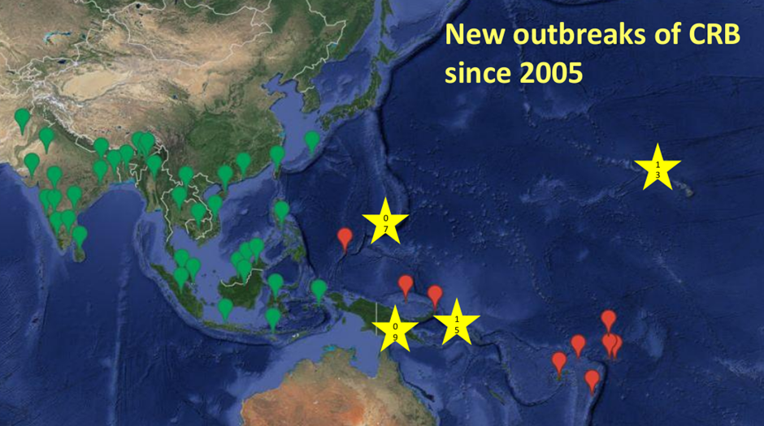

Slide 9
Discovery of the CRB-G Biotype
Marshall, Sean, Maclean Vaqalo, Aubrey Moore, Roland
Quitugua, and Trevor Jackson (2015).
A new invasive biotype of the coconut rhinoceros beetle (
Oryctes rhinoceros ) has escaped from biological control by
Oryctes rhinoceros nudivirus.
Presented at the International Congress on Invertebrate
Pathology and Microbial Control and the 48th Annual Meeting of the Society for Invertebrate Pathology, Vancouver, BC, August 2015.

Slide 10
Characteristics of CRB-G
genetically distinct
resistant to all available isolates of OrNV
more invasive (all 4 recent invasions involve CRB-G)
behavioral differences ???
not highly attracted to oryctalure
higher per-capita damage

Slide 11
CRB-G is a Regional Problem
Jackson, Trevor (2015).
Need for emergency response for a new variant of rhinoceros beetle (Guam biotype).
International Association for the Plant Protection Sciences Newsletter (XI). November, 2015.
Available on-line at https://www.plantprotection.org/portals/0/documents/newsletters/2015/iapps%2011-2015.pdf

Slide 12
Emerging Pest - Rhinoceros Beetle
Vaqalo, Maclean, Sean Marshall, Trevor Jackson, Aubrey Moore (2015).
An Emerging Biotype of the Coconut Rhinoceros Beetle
Discovered in the Pacific. The Pacific Community, Land Resources Division.
Available on-line at: http://www.spc.int/lrd/plant-health-publications/doc_download/2374-ph-agalertno51

Slide 13
Surveillance projects and activities
PPPO – general surveillance from request of the NPPO
2016 – 3 completed
Projects:
Facilitated the HTFA operators training. Attendees: Tonga, Fiji (Research and Private Sector), Samoa. Under the supervision – Dr Mike Williamson
Handicraft manual capacity building for Crafters and producers – Tonga and Fiji

Slide 14
Surveillance projects and activities
Heat block system – looking at the heat tolerance level of the different stages on the fruit fly. Work with Research.
Expand it to other pests such as mealy bugs and mites etc.
Protein Bait Production- PPPO project
Boiler installed in 2017.
Collaborating with Research and the brewery

Slide 15
Proposal for further collaboration
Look at the key emerging issues and what commonalities exists and RPPOs can discuss how to further this through collaboration.

Slide 16

Thankyou.

