Slide 1
Caribbean Agricultural Health & Food Safety Agency 29TH TC-RPPO 30 October – 3 November 2017 Paris, France
Juliet Goldsmith

Slide 2
SPECIFICITIES
Original agreement -March 12, 2010.
Revised Agreement - February 25, 2011
Operational - October 2014
Fully operational October 1, 2015
51st Special COTED (2014)- RPPO decision
71th Special COTED (2017) Confirmed agreement

Slide 3
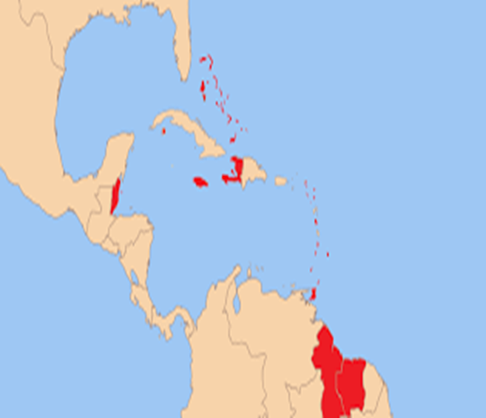
MEMBER STATES: Antigua and Barbuda. Bahamas. Barbados. Belize. Dominica. Grenada. Guyana. Haiti. Jamaica. Montserrat. Saint Lucia. St Vincent and the Grenadines. Suriname. Trinidad and Tobago.
ASSOCIATE MS: Anguilla, Bermuda, British Virgin Islands, Cayman Islands, Turks and Caicos Islands

Slide 4
Mandate
CAHFSA is mandated to perform a coordinating and organizing role for the establishment of an effective and efficient regional sanitary and phytosanitary (SPS) regime
Plant Health Division is mandated to safeguard the region’s agriculture and natural resources from the introduction and spread of plant pests while facilitating safe trade of agricultural products among Member States.

Slide 5
Chief Executive Officer
Food Safety Specialist
Animal Health Specialist
Plant Health Specialist
Board of Directors
Council for Trade & Economic Development (COTED)
Finance & Administrative Officer
Technical Advisory Committees
Secretary

Slide 6
Technical and capacity development achievements
Standards and Implementation
Adopted as regional standards (2017)
Guidelines for preparing a market access proposal
Guidelines for conducting risk analysis for imported plant and plant products adopted
Training
PRA Training
Pest Prioritization Training
Regional Plant Quarantine Training

Slide 7
Rapid Response Mechanism and Safeguarding
National and regional priority pest lists
Voucher specimen collection
List of regionally regulated pests
Technical resource (fact sheets, diagnostic protocols, EPP)

Slide 8
Regional priority pest list 2014
Rank | Priority Pests
10 | Ceratitis capitata (Meditteranean Fruit Fly)
9 | Bactrocera carambolae (Carambola Fruit Fly)
8 | Ralstonia solanaecearum (Races 2& 3)
7 | Fusarium oxysporum f.sp. cubens Race 4
6 | Tuta absoluta (Tomato Leaf Miner)
5 | Rhychophorus ferrugineus (Red Palm Weevil)
4 | Moniliopthora roreri (Cocoa Frosty Pod)
3 | Citrus canker
2 | Citrus leprosis virus
1 | Mononychellus tanajoa (Cassava Mite)

Slide 9
Information exchange and dissemination
SPS information portal on CAHFSA website (WTO-SPS notifications, list of registered pesticides,
Web based databases (PRAs, Regionally regulated pests, Plant health practitioners, Regional trade issues
Regional projects
FAO (Strengthening quarantine services in 3 OECSS)
FAO (Pesticide management)
International Collaboration
IPPC (2017 regional workshop)
IAEA (interregional project for SIDS)
Dispute Resolution

Slide 10
Emerging pests
Ceratitis capitata
Moniliophthora roreri
Rhychophorus ferrugineus
Bactrocera dorsalis complex
Coconut Lethal yellowing disease
Fusarium TR4
Hunglongbing (HLB)

Slide 11
Surveillance Projects and Activities
Red palm weevil
Tephritidae
Ceratitis capitate
Anastrepha spp
Bactrocera spp

Slide 12
Proposal for future collaboration
Improved coordination and collaboration with other RPPOs and International organizations
Pest Risk Analysis
Surveillance programmes
Pest diagnostics

Slide 13
Merci
Dankjewel
Thank You

