Slide 1
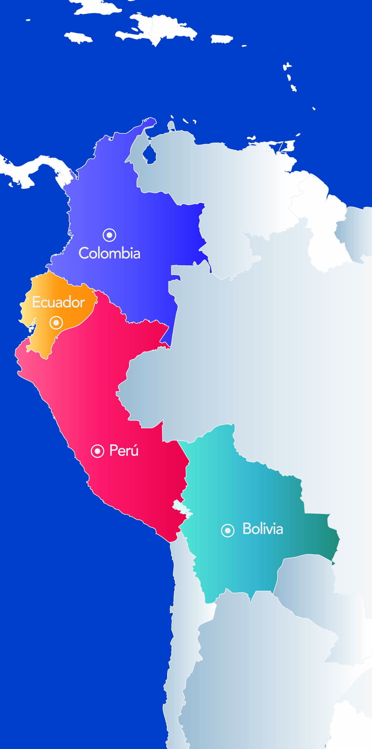
28TH TECHNICAL CONSULTATION AMONG RPPO´s
REPORT: COMUNIDAD ANDINA (CAN)
0ctober 30 to November 3, 2017
Paris, France

Slide 2
Outline
1. Andean System of Animal and Plant Health (SASA)
2. SASA bodies'
3. Subregional norms register
4. Standards update
4.1 Plant health
4.2 Pesticides registration
5. Pest Fact Sheets
6. Citrus Huanglongbing disease
7. Banana wilt disease FOCR4T
8. GICSV
Technical and capacity development achievements
Emerging pests and issues and others
RPPO Specifies

Slide 3
RPPO specificities
1. Andean System of Animal and Plant Health (SASA)
Objectives
Protect the agricultural health of the subregion and prevent that phytosanitary measures be unjustified restrictions in the trade
Harmonize plant and animal health legislations
Prevent and control pests or diseases that representing risk for agricultural health
Promote cooperation and development programs of joint action
Promote the adoption of common positions in scientific, technical or trade issues
For more information you can see Decision 515 avalaible on: http://www.comunidadandina.org/Documentos.aspx?GruDoc=07

Slide 4
RPPO specificities
2. SASA Bodies
The Andean Community Commission
Countries member’s NPPOs
General Secretariat of the Andean Community SGCAN
The Animal and Plant Health Committee
COTASA

Slide 5
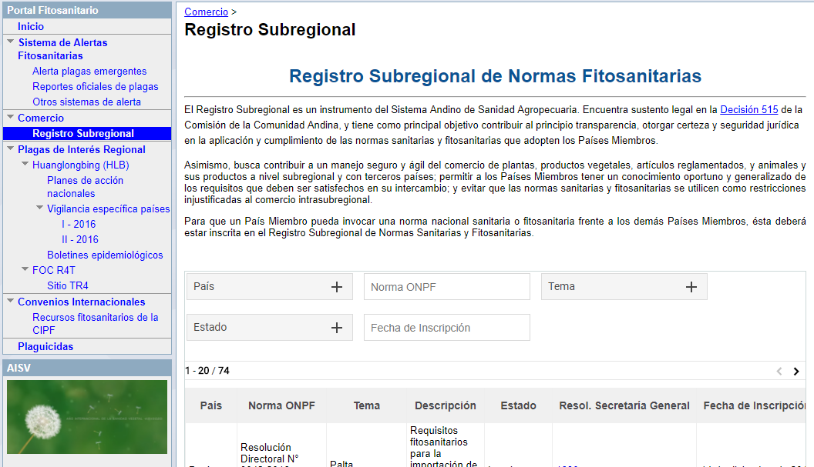
Technical and capacity development achievements
3. Subregional norms register
Subregional Register
The principal objective is provide transparency, legal certainty and security in the application of the phytosanitary standards adopted by our member countries. (Sub regional application)
Based on technical and scientific principles and be compatible with existing sub-regional or international standards
Not constitute an unnecessary , unjustified or covert restriction on intra-subregional trade
Not discriminate arbitrarily and unjustifiably against imports originating products to other countries , when in the territory of which adopted the measure prevail identical or similar conditions
Comply with Community law
(Taked from “Decisión 515)
Members Countries shall register Intra-subregional norms on phytosanitary requirements to could apply them to another Member Country.
100% of requests attended

Slide 6
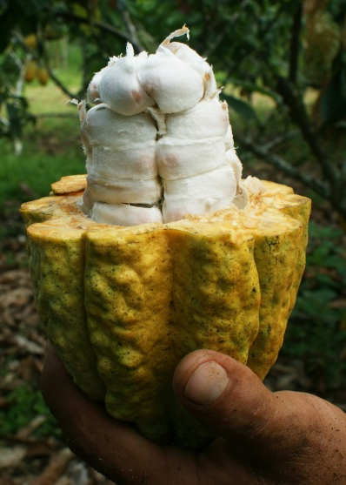
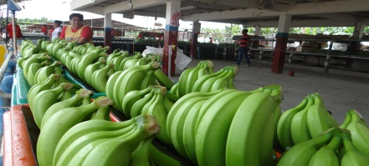
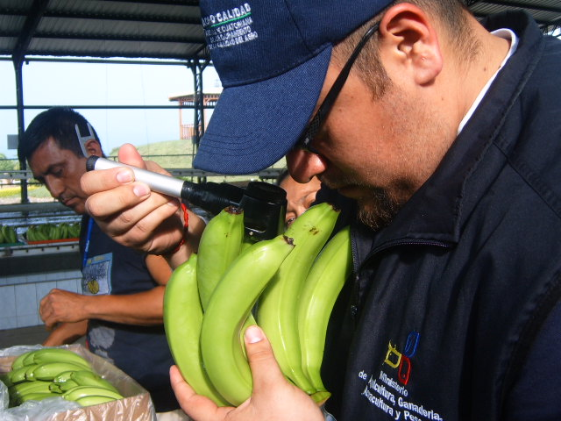
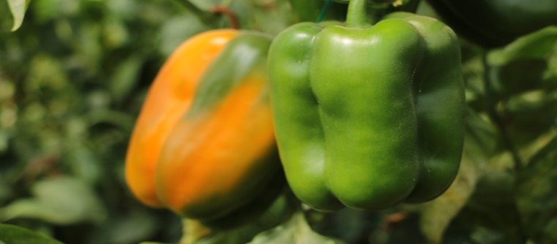
Technical and capacity development achievements
4. Standards update
4.1 Plant health
Res. 1475. Norm on categorization of commodities according to their pest risk (in process of agreement)
Res. 431. Norm on intrasubregional phytosanitary requirements (in process of agreement)
Res. 419. Andean Pest list of economic importance (starting to review)

Slide 7
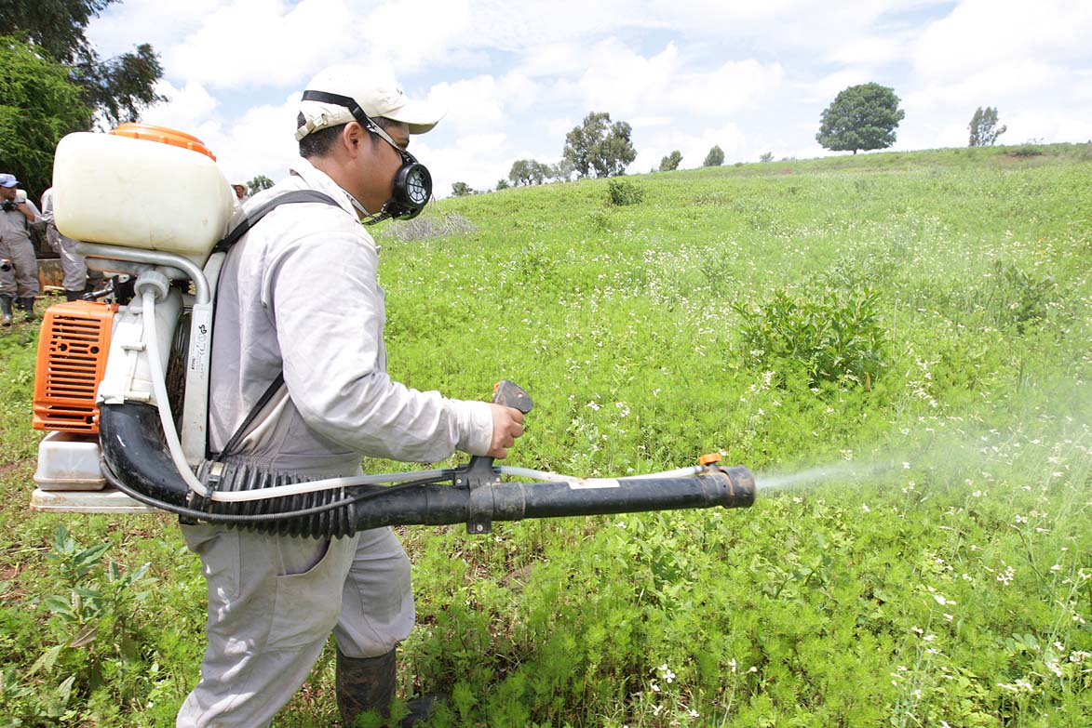
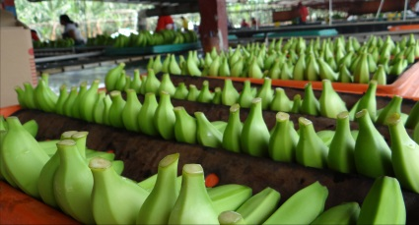
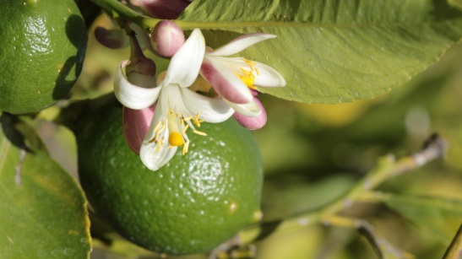
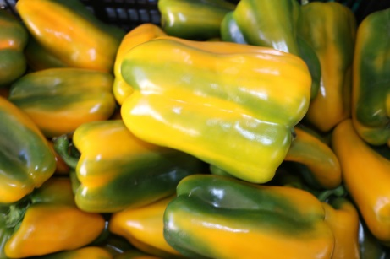
Technical and capacity development achievements
4. Standards update
4.2 Pesticides registrations
Update of the Technical Manual to Register Chemical Pesticides of Agriculture Use (Res. 630)
On 2015 the general framework for pesticides registration was updated (Decision 804) . By such reason The Andean commission created a special High Level Working Group conformed by agricultural, health and environmental authorities; and CAN General Secretariat, to review and update the Technical Manual according with the new general framework for pesticides registrations.
Negotiation period concluded successfully!!!

Slide 8
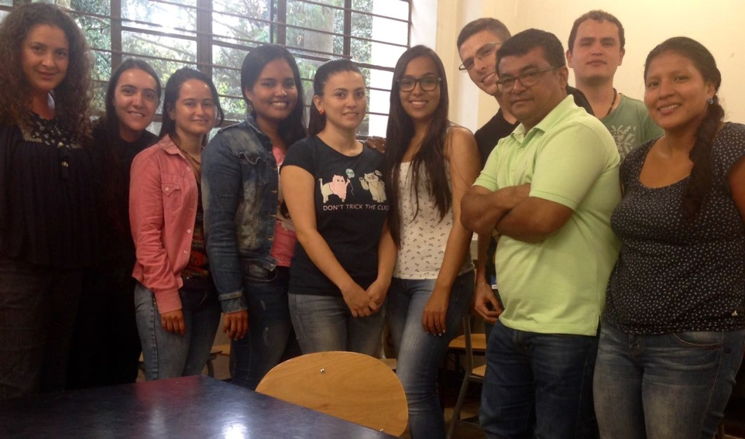
Technical and capacity development achievements
5. Pest Fact Sheets to pest alert
A pilot activity among SGCAN and the Universidad Nacional de Colombia – Sede Medellin (UNALMED) was developed.
The outputs were interesting. 5 Fact Sheets were developed to:
Banana bunchy top virus (BBTV)
FOCR4T
Raffaelea lauricola
Xanthomonas axonopodis pv. Allii
Xylella fastidiosa
PhD, MSc. and undergraduate plant pathology students developed the fact sheets

Slide 9
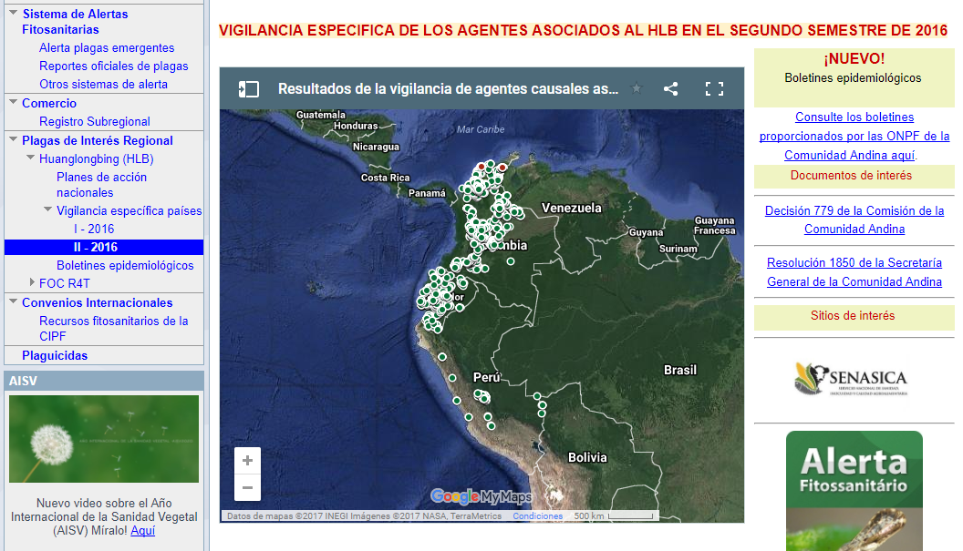
Emerging pests and issues
6. Citrus Huanglongbing disease
Avalaible: https://sites.google.com/a/comunidadandina.org/portal-fitosanitario/plagasregional/huanglongbing

Slide 10
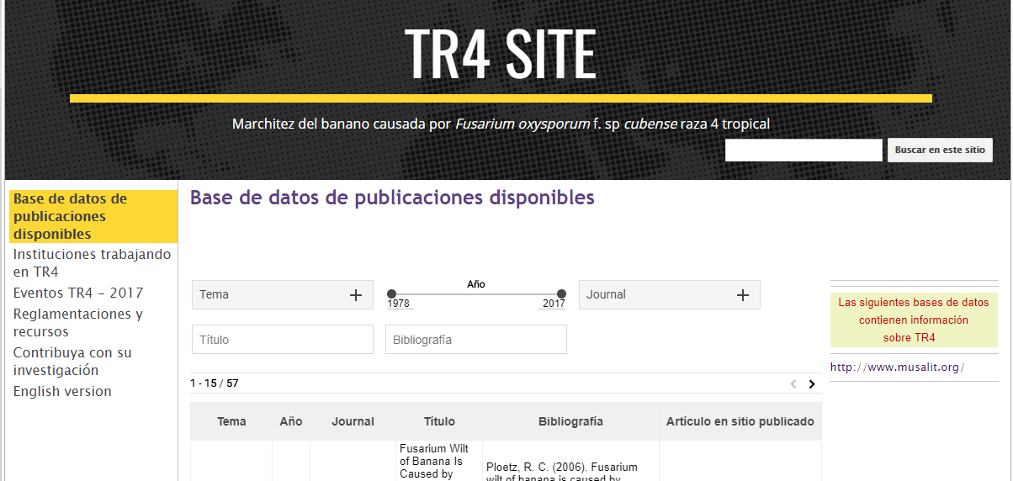
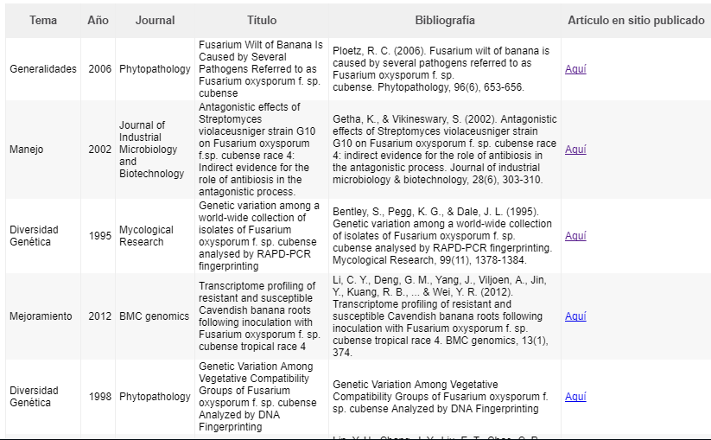
Emerging pests and issues
7. Banana wilt disease FOCR4T
Contains:
Scientific publications;; ii) A directory of institutions working on TR4; iii); A list of regulations and resources ; iv) latest events on TR4; and, v) an area for researchers to contribute their own research on the topic.

Slide 11
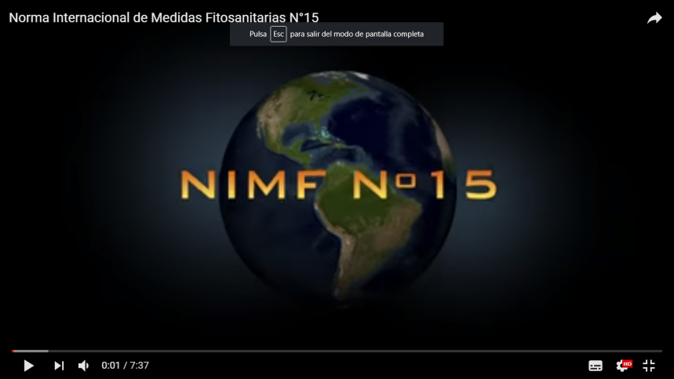
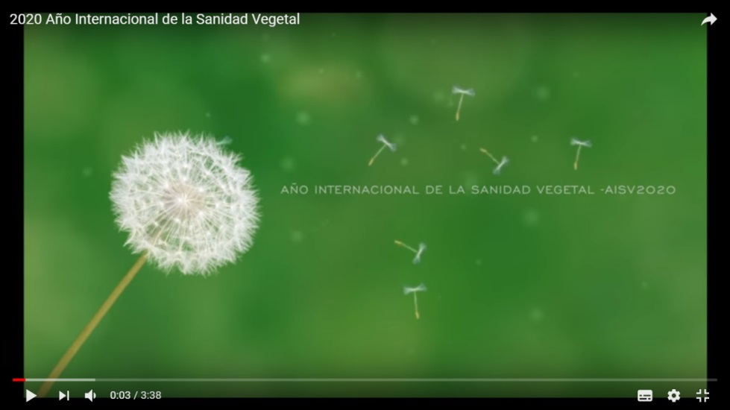
Trabajo con otros Organismos Internacionales
Interamerican Cordinating Group on Plant Helath (GICSV)
HLB working group
ePhyto working group
https://www.youtube.com/watch?v=LJm2x5R0M3w
https://www.youtube.com/watch?v=5npdIwZqYwk
Notes:
El GICSV tiene un Comité de Coordinación compuesto por un representante de cada una de las ORPF miembbro y es coordinado rotativamente por uno de sus miembros, durante períodos bienales.. Actualmente la Secretaría General de la Comunidad Andina ejerce el rol de Coordinación Protempore (2016 - 2018), la cual fue transferida por el Organismo Internacional Regional de Sanidad Agropecuaria.

Slide 12
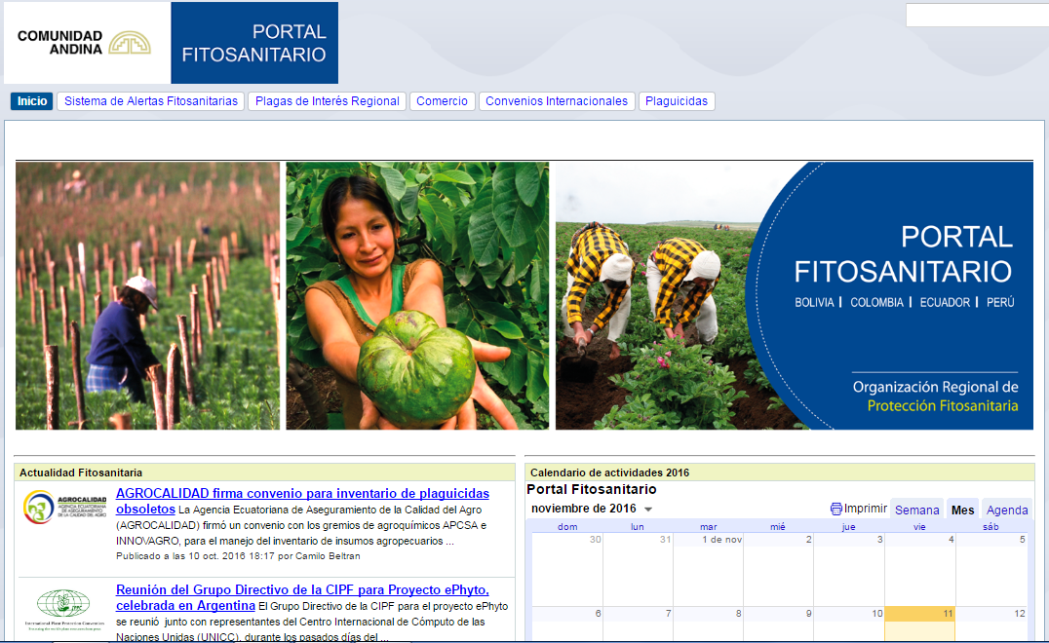
Thank you by your kind attention!
Andean phythosanitary portal avalaible: https://sites.google.com/a/comunidadandina.org/portal-fitosanitario/

