Slide 1
The European and Mediterranean Plant Protection Organisation update * - could say more later!
Event: Technical Consultation among RPPOs
Date: 30 October - 3 November 2017
Martin Ward (Director General) - hq@eppo.int

Slide 2
Specificities in 2017
51 Member Countries, 20 staff
Income 2.1M€ from members and 0.6M€ from projects
Core work programme on phytosanitary regulations
quarantine pests
regulated non-quarantine pests
invasive alien plants
biological control agents
Core work programme on plant protection products
standards for evaluating efficacy
2 hosted activities
Euphresco network of research funders and managers*
EU Minor Uses Co-ordination Facility
Participation in research projects

Slide 3
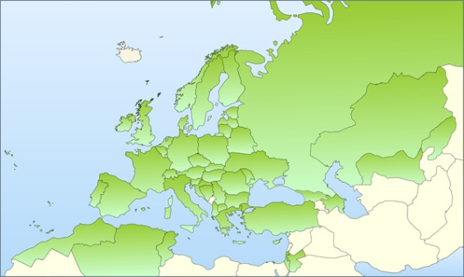
1951 EPPO Convention – 15 countries Now 51 member countries

Slide 4
Organisation
National Plant Protection Organisations
EPPO Secretariat (20 staff)
National Experts

Slide 5
Active Panels
Phytosanitary Regulations
Global Affairs
Phytosanitary Measures
Forestry
Potatoes
Inspection Procedures
Information
Diagnostics (General) +
Entomology
Nematodes
Bacteria
Fungi
Virology
Invasive Alien Plants
Biological Control Agents
Plant Protection Products
General Standards
Herbicides
Insecticides and Fungicides
Resistance
Harmonisation of Data Requirements

Slide 6
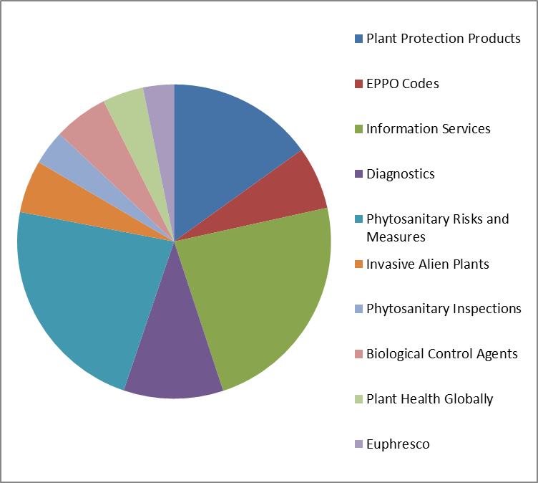
Core programme spend by activity

Slide 7
Information Services and EPPO Codes*
Achievements in 2017 include
Second webinar for EPPO Codes users - 58 participants
2000 gaps in EPPO Codes for e-Phyto filled
Dual pest reporting to EU and EPPO now working
"Kits" for information campaigns
More information integrated to EPPO Global Database
Plans for 2018 include
Redesign of website and new updating arrangements
Start project to update EPPO datasheets
More work to fill gaps on EPPO Codes
More work on dual pest reporting to EPPO and IPPC

Slide 8
Information toolkits
Images, text and ideas for member countries to use in awareness campaigns
NOT an EPPO information campaign!
Need adapting nationally for language, style, audience
Powerpoint format: familiar and easy to rearrange
Under development for three example pests:
Popillia japonica
Citrus greening
Agrilus planipennis

Slide 9
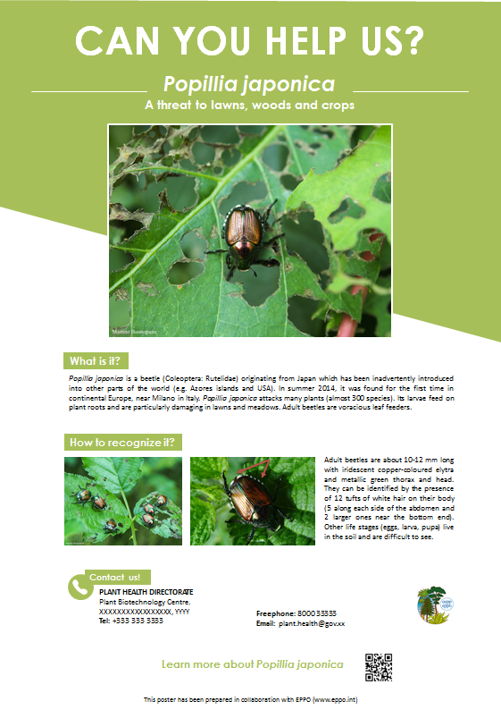
Poster and Leaflet Kits

Slide 10
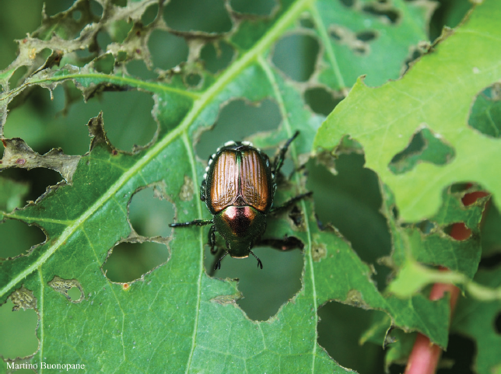
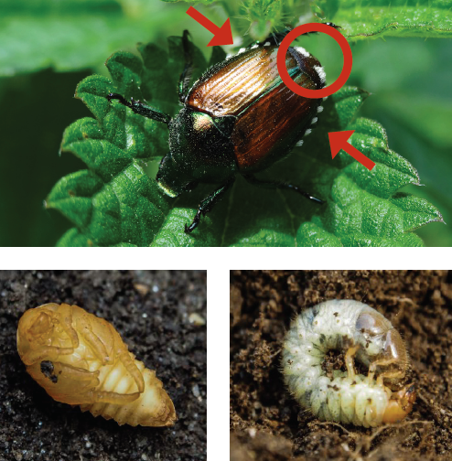
CAN YOU HELP US?
Popillia japonica
An insect pest threatening our lawns, wood and crops
How to recognize it? Please help us!
Adult beetles are about 10-12 mm long with iridescent copper-coloured elytra and metallic green thorax and head. The presence of 12 tufts of white hair can be seen on their body (5 along each side of the abdomen and 2 larger ones near the bottom end). The presence of these white hair tufts is quite distinctive of Popillia japonica. Adults can be seen mainly during late spring and summer. Other stages of the insect (eggs, larvae and pupae) live in the soil and are therefore more difficult to see. In addition, their identification is more complex.
Because Popillia japonica can seriously damage many wild and cultivated plants, it is important to report any sightings to plant protection authorities. Early detection will allow a rapid implementation of appropriate measures against Popillia japonica.
^{If you see Popillia japonica:}
- Check the presence of tufts of white hairs
^{on both sides of the abdomen}
- Whenever possible, take a picture of the
insect, record exact location and the name
of the host plants on which it was ^{observed}
^{- Contact us (see below)}
Contact details
Logo and name of authority
Prepared in collaboration with EPPO – www.eppo.int

Slide 11
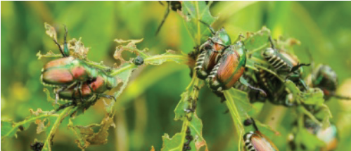
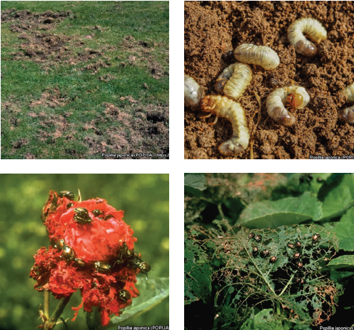
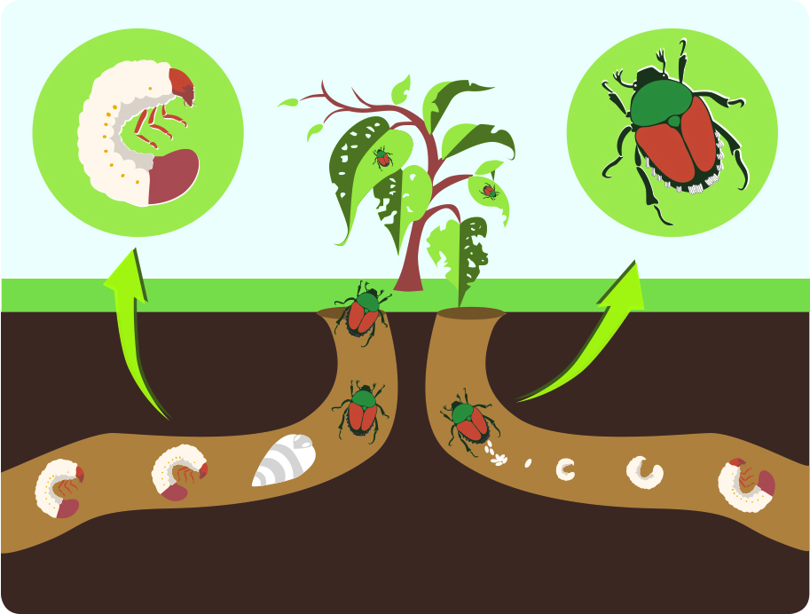
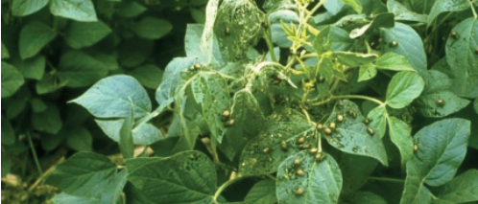
What is Popillia japonica? Damage Biology
Larvae consume plant roots and are particularly damaging in lawns and meadows. Adult beetles are voracious feeders and can attack many different plant species (approximately 300 wild and cultivated plant species). Among the most vulnerable plants the following can be mentioned: apple, bramble, grasses, elm, grapevine, linden, maize, maple, rose, peach, soybean.
The adults skeletonize leaves by chewing out the tissue between the veins, thus leaving a vein skeleton. They can also feed on flowers and fruit. The adults are gregarious and many beetles group together on a single plant, so individual plants or trees may be completely defoliated.
Popillia japonica (Coleoptera: Rutelidae) usually produces one generation per year but under cold climates, the life cycle can be extended to two years. Adult beetles usually emerge from the soil in May/June and mate. Females lay eggs in the soil. After hatching, larvae (white grubs) develop in the soil where they feed on roots of grasses. The insect overwinter in a larval stage in the soil. In spring, larvae resume feeding and become pupae (metamorphosis). After emergence, adult start feeding on the aerial parts of the plants and a new cycle begins again.
Popillia japonica is a beetle originating from Japan which has been inadvertently introduced into other parts of the world such as the Azores islands and the USA. These introductions most probably resulted from human-mediated activities (e.g. agricultural trade, transports). In summer 2014, Popillia japonica was found for the first time in continental Europe. It was discovered in several localities near Milano in Italy. Popillia japonica is considered to be a serious threat to cultivated and wild plants.
At present, Popillia japonica has not been detected in XXX. However, in the event of its introduction in XXX, its presence should be reported immediately to us.
Life cycle

Slide 12
Diagnostics*
Achievements in 2017 include
Standard on Reference Laboratories adopted
Workshop on flexible scope for accreditation of labs
Workshop on nematode collections
Workshop on DNA barcoding
Workshop on Next Generation Sequencing (NGS)
2 new and 9 revised diagnostic protocols adopted
Now over 130 pests covered by EPPO DPs*
Plans for 2018 include
Prepare for Standard on NGS by 2020
Draft new section of Standard PM 7/76: communications between diagnosticians and risk managers

Slide 13
Risks and Measures
Achievements in 2017 include
Listing of 9 plant pests and 4 alien invasive plants
New PM9 Standard on zebra chip pathogen and vector
New methodology for PRA for RNQPs in EU project
EWG to revise PM 9 Standard: Bursaphelenchus xylophilus
EWG for rose rosette virus in September
Plans for 2018 include
PRAs on
Grapevine red blotch-associated virus
Massicus raddei on oak (Quercus) and chestnut (Castanea)
Bark beetles on non-coniferous wood
New Standard on "sentinel plants"
Platform to share information on PRAs
Guidance on setting buffer zones

Slide 14
Emerging Pests and Issues?
Newly recommended for regulation including
Candidatus Phytoplasma phoenicium
Prodiplosis longifila
Thekopsora minima
Platynota stultana
EPPO Alert List including
Xylosandrus compactus
Rose rosette virus and vector Phyllocoptes fructiphilus
Gymnandrosoma aurantianum
Neodiprion abietis
Former EPPO Alert List including
Halyomorpha halys - brown marmorated stink bug

Slide 15
Emerging pests definition (from Bureau)
pests that had made a continental jump
pests that have a wide host range
hosts are widely distributed
large potential for damage
economic loss across continents
shift in the risk
impact on natural environment as well as production
ability for crop destruction
and/or?
ability to eliminate entire production areas.
Examples are Tuta absoluta, and pine wood nematode.

Slide 16
Newly recommended for regulation in 2017
Candidatus Phytoplasma phoenicium
Bactrocera latifrons
Ceratothripoides brunneus
Ceratothripoides claratris
Prodiplosis longifila
Thekopsora minima
Platynota stultana
Salvinia molesta
Pistia stratiotes
Gymnocoronis spilanthoides
Cardiospermum grandiflorum

Slide 17
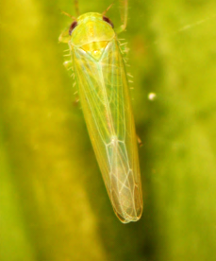
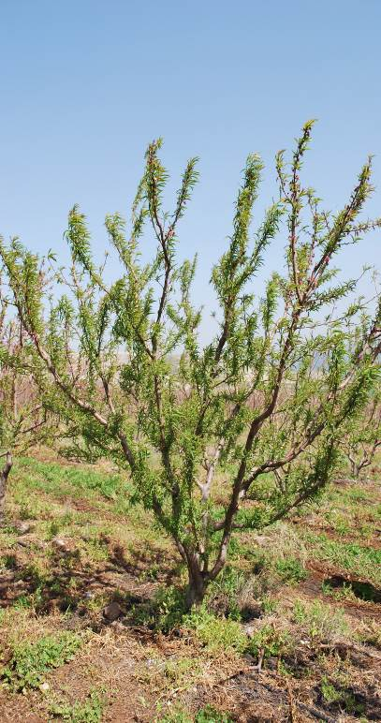
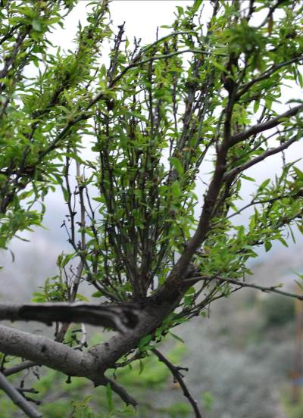
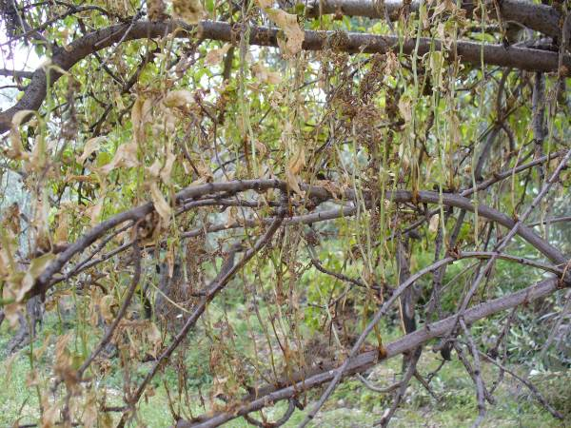
‘Candidatus Phytoplasma phoenicium’
almond witches’ broom
Transmitted by grafting and insect vectors
Vectors: leafhoppers or planthoppers Asymmetrasca decedens (Cicadellidae) + Tachycixius species + others?
Vectors in Iran not known
Only reported from Lebanon and Iran
Host plants: Prunus species (+ weeds)

Slide 18
Conclusions Phytoplasma phoenicium
Endangered area: where almond, peach, nectarine and apricot are cultivated and known vectors occur = Mediterranean Basin and Portugal, north to the southern part Germany and East towards the West of Russia, as well as the Near East and Central Asia
Phytosanitary risk: High with moderate uncertainty
Entry: plants for planting(partly regulated for EU: Iran but not Lebanon) and natural spread to neighbouring countries
Measures to reduce probability of entry:
Prunus plants for planting (except seed): PFA or grown under physical isolation or tested in vitro plants

Slide 19
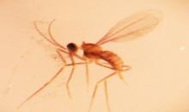
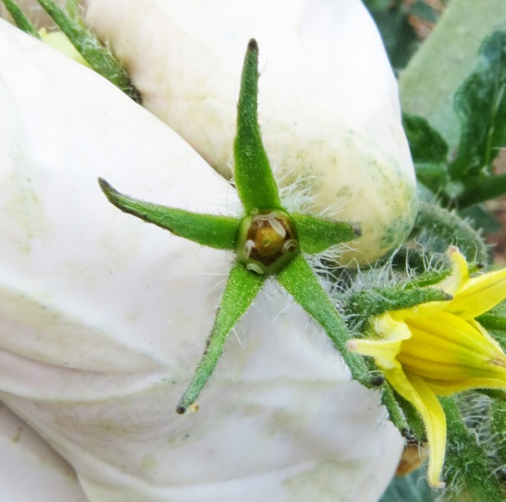
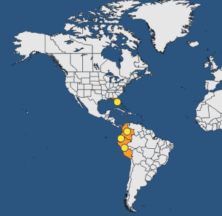
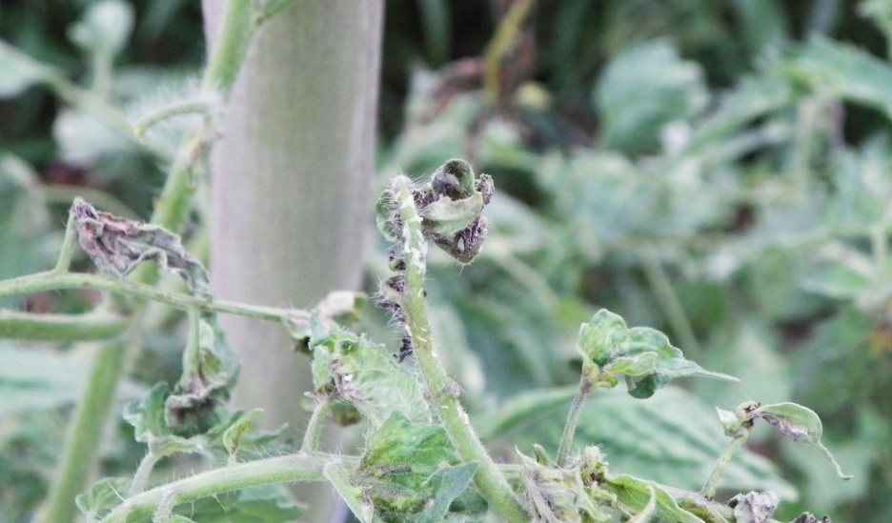
Prodiplosis longifila
Diptera: Cecidomyiidae
Adults, eggs, larvae above-ground, pupae in soil
Different hosts at different locations
South America: tomato in all countries + asparagus and Capsicum annuum in Peru, or potato in Ecuador
USA: Gossypium, Citrus x latifolia
Confirmed hosts in 11 families

Slide 20
Conclusions Prodiplosis longifila
Endangered area:
Mediterranean region, Portugal and the southern Black Sea coasts (and with a higher uncertainty the oceanic part of Western Europe),as well
indoors production
Phytosanitary risk: high (uncertainty: moderate)
Measures to reduce probability of entry:
Plants for planting (except seeds) of cultivated hosts
Fruits (e.g. tomato, Capscum, Cucumis leki
Cut plant parts (cut flowers and branches, cut herbs, leafy vegetables,) of cultivated hosts hosts (e.g. asparagus)
Raising awareness for travellers and inspection of luggage

Slide 21
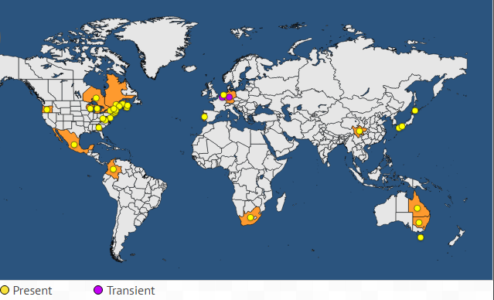
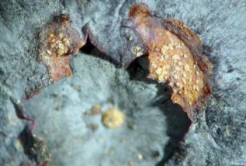
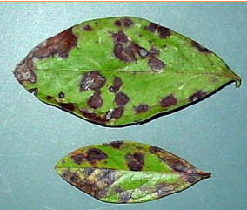
Thekopsora minima (Blueberry rust)
Heteroecious rust (leaves of ericaceous plants / needles of Tsuga spp.)
Main hosts :
Vaccinium angustifolium, V. ashei, V. corymbosum, V. erythrocarpum
Other Ericaceae (incl. Rhododendron)
Alternate host: Tsuga spp.
Damage: defoliation, premature fruit drop

Slide 22
Conclusions Thekopsora minima
Endangered area: where hosts are grown (outdoor and indoor), in particular evergreen Vaccinium. Damage higher in warm and wet conditions
Phytosanitary risk: moderate with moderate uncertainty (very high impact if wild European Vaccinum susceptible)
Measures to reduce probability of entry:
Vaccinium plants for planting (except seeds, tissue cultures, pollen): PFA, or Grown under complete physical isolation, or systems approach
Other host plants (Tsuga, other Ericaceae): no measure as low probability of entry (with moderate uncertainty)
No measures for fruit (but producers should be encouraged not to import bulk fruit to be repacked in place of production)

Slide 23
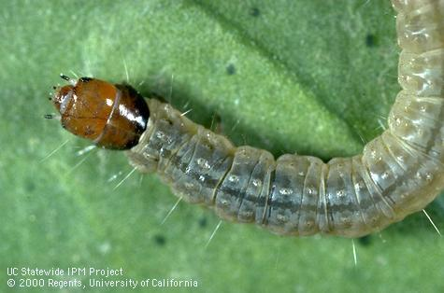
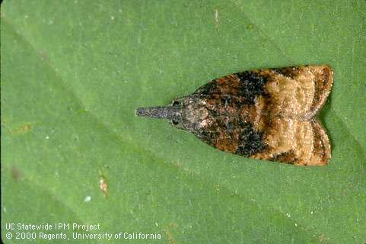
Platynota stultana - omnivorous leafroller
Recommendations based on Spanish PRA
Lepidoptera: Tortricidae
Distribution: USA, Mexico, Spain (restricted distribution)
Hosts: highly polyphagous. Preferred hosts: kiwifruit, bell pepper, Citrus, carnation, cotton, apple, plum, peach, pomegranate, pears, roses, blackberry, raspberry and grapevine
Impact: high in USA and Mexico (low in Spain)
Entry more likely with fruits in which larvae feed

Slide 24
Conclusions Platynota stultana
Endangered area:
outdoors: Southern Europe and Mediterranean Basin
Indoor: entire EPPO region
Phytosanitary risk: high with medium uncertainty
Measures to reduce probability of entry:
Entry from Spain is considered unlikely so measures could be less stringent (but further information to provided by Spanish NPPO)
Host plants for planting except seed (preferred hosts): PFA or grown under physical isolation, or dormant plants without fruit and leaves, or in vitro plants
Pomegranates, blackberries and raspberries, grapes and sweet peppers: PFA, or grown under physical isolation or Systems approach
Citrus, apples, plums, peaches, pears: without leaves and green parts
Cut flowers: PFA, or grown under physical isolation

Slide 25
Recent additions to Alert List
Xylosandrus compactus
Zaprionus indianus
Zaprionus tuberculatus
Curtobacterium flaccumfaciens pv. poinsettiae
Rose rosette virus (Emaravirus) transmitted by the eriophyid mite, Phyllocoptes fructiphilus
Gymnandrosoma aurantianum
Neodiprion abietis

Slide 26
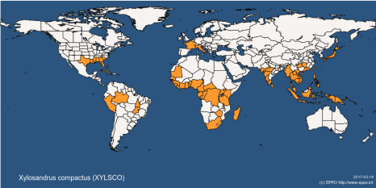
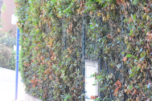
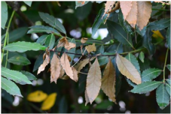
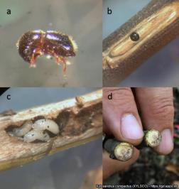
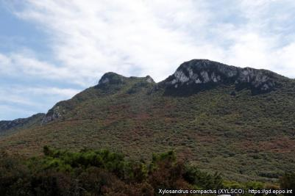
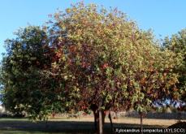
Xylosandrus compactus (Coleoptera: Scolytidae)
X. compactus (ambrosia beetle) is polyphagous. Asian origin, has invaded other continents. Recent introduction in Europe (IT, FR). Serious damage observed in Lazio (maquis) but not in FR (ornamentals). PRA recently published (Anses).
@cosave
@cosave

Slide 27
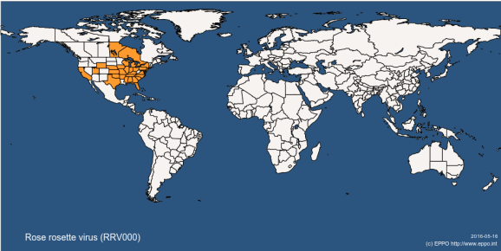
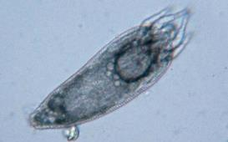
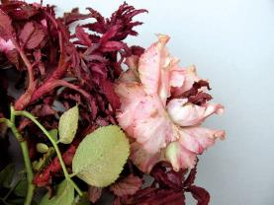
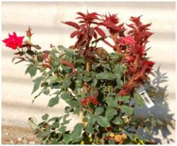
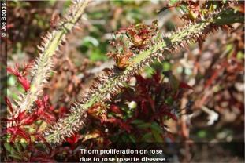
Rose rosette virus (Emaravirus) transmitted by the eriophyid mite, Phyllocoptes fructiphilus.
Present since the 1940s in the USA but its importance has grown exponentially in cultivated roses

Slide 28
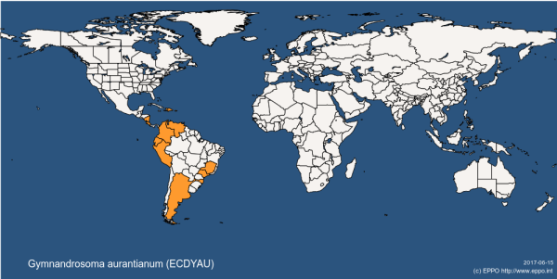
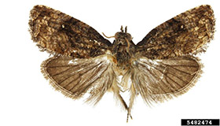
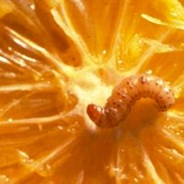
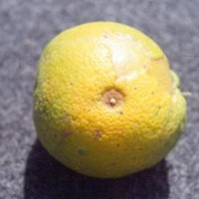
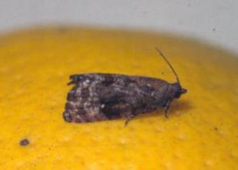
Gymnandrosoma aurantianum (Lepidoptera: Tortricidae)
Fruit borer of Citrus and other fruit. Present in South America. Intercepted in Spain

Slide 29
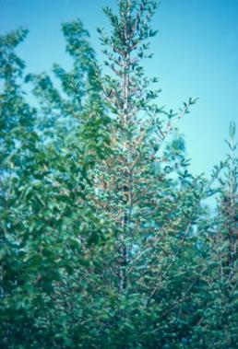
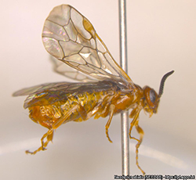
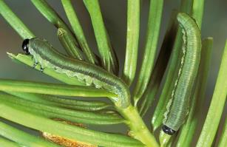
Neodiprion abietis (Hymenoptera: Diprionidae)
balsam fir sawfly
Intercepted on cut branches of Gaultheria from the USA.
Cause severe defoliation on conifers in parts of North America

Slide 30
Invasive Alien Plants*
Achievements in 2017 include
First 6 of 16 PRAs under an EU funded project approved
Remaining 10 being completed this year
PM9 Standard on Microstegium vimineum adopted
Plans for 2018 include
Complete EU project - 10 more PRAs to approve
Review EPPO work in this area

Slide 31
Phytosanitary Inspections
Achievements in 2017 include
Inspectors Workshop in December in UK - ISPM 15 and new detection technologies (e.g. drones)
One new Standard adopted (Fragaria plants)
Plans for 2018 include
Draft Standards on
wood commodities
Phytoplasma pyri
Bursaphelenchus xylophilus (linked to new PM9 Standard)
Guidance on pheromones for surveillance?
Contingency exercise workshop near EU/non-EU border

Slide 32
Biological Control Agents
Achievements in 2017 include
Terms of Reference for Panel agreed
Better process for adding organisms to PM 6/3 agreed
Questionnaire distributed on how BCAs are regulated
Draft Decision Support Scheme for releases tested against a range of examples
Plans for 2018 include
Adopt process for adding organisms to PM 6/3 list
Country consultation on Decision Support Scheme
Continue to push for questionnaire responses (slow returns reflects unclear responsibilities in countries)

Slide 33
Plant Protection Products
Achievements in 2017 include
Updated database of PP1 (efficacy) Standards ready
Workshop "integrated management of oilseed rape pests"
PP1 Standard "Low Risk PPP" adopted
Nine new Specific Standards adopted
Plans for 2018 include
Database on resistance cases
Moving extrapolation tables to a database
Explore links between phytosanitary regulations and regulation of plant protection products

Slide 34
Global Phytosanitary Affairs
Achievements in 2017 include
Three meetings of "Global Affairs" Panel
April in Korea and by teleconference
September in Georgia with IPPC Regional Workshop
Experts nominated for EWGs, Sea Container Task Force
Comments on draft ISPMs and Specifications
Meetings with NAPPO and COSAVE at CPM
Hosting 29th TC!
Plans for 2018 include
More EPPO co-ordination at CPM
Development of more detailed plans for IYPH2020

Slide 35
Improving Processes
Achievements in 2017 include
Revised Terms of Reference for WPs and Panels
Revised description of EPPO's standard setting process
Plans for 2018 include
Continue to consider optimum size of panels
Consideration of commenting systems for EPPO Standards, building on experience of OCS

Slide 36
Proposals for further collaboration
Open to a future joint workshop on ISPM15 compliance - depends on outcome of Inspectors Workshop in December
Other RPPO input to Euphresco would be welcome
Experience with developing recommendations for Regulated Non-Quarantine Pests - happy to share

