Slide 1
29th Technical Consultation among Regional Plant Protection Organizations
Paris (France) 30 October – November 2017
Mekki Chouibani
www.neppo.org

Slide 2
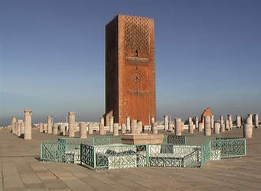
1. Spécificity
Signed on February 18, 1993
Recognized by 7th CPM (March 2002)
Entered into force in January 2009
Members
Algeria, Egypt, Jordan, Iraq, Libya, Malta, Morocco, Pakistan, Oman, Sudan, Syria, Tunisia
Executive Committee
Algeria, Jordan, Libya, Pakistan, Syria, Tunisia
Staff
Executive Director, Assistant director

Slide 3
Objectives
To promote regional co-operation in strengthening plant protection activities and capabilities with the aim of:
controlling pests of plants and plant products in an appropriate manner;
preventing the spread and the introduction of pests of plants and plant products;
Facilitating international and regional trade resulting from phytosanitary measures.

Slide 4
2. Technical and capacity development achievements
Contribution to the organization of the FAO-CIHEAM International Workshop on Red Palm Weevil, Rome (Italy) 29-31 March 2017
Organization with FAO Sub regional bureau and UMA of a workshop on Red Palm Weevil and Xylella fastidiosa in North Africa. Hammamet (Tunisia) March 13-15, 2017
Contribution to the organization of the training workshop for reporters on pest risk, their economical and social impact and impact on food safety. Tangier (Morocco); May 15-18, 2017

Slide 5
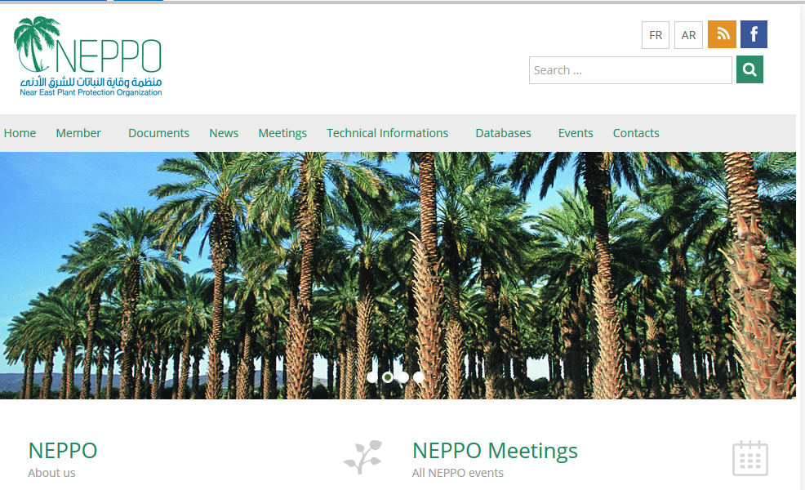
2. Technical and capacity development achievements (Cont..)
Improvement of the web site: Establishments of database recording: National diagnostic laboratories; National pest status, Roster of national experts. Hammamet (Tunisia) March 13-15, 2017. Tangier (Morocco) 13-15 May 2017.

Slide 6
3. Emerging pests of concern for the NEPPO region
Xylella fastidiosa
Red Palm Weevil
Drosophila suzukii
Solanum elaeagnifolium

Slide 7
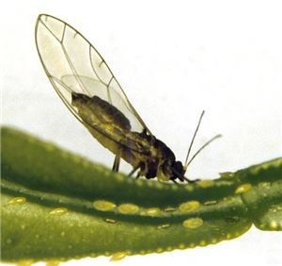
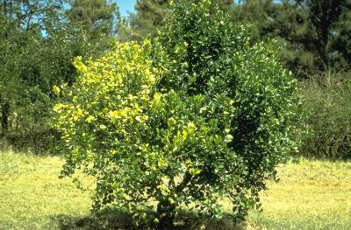
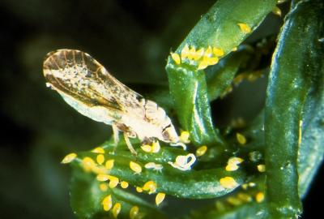
3. Emerging pests (Cont…)
©CABI
EPPO
EPPO
Fruit flies: Bactrocera zonata and B, dorsalis.
Notes:
Xylellla fastidiosa on olive tree,Currently detected in Italy and France (Corsica)
Red Palm Weevil : Rhynchophorus ferrugineus : High threaten and highly negative environment and socioeconomical impact.

Slide 8
3. Emerging pests (Cont…)
Dactylopius opuntiae
Opuntia cochineal scale
© Dr Sbaghi M
Spodoptera frugiperda
Fall armyworm
©James Castner

Slide 9
4. Surveillance projects and activities
Xylella fastidiosa (Algeria, Egypt, Libya, Lebanon, Morocco, Tunisia, West Bank and Gaza Strip , Iraq and Jordan)
Red Palm weevil
Participated in the 12th session of CPM, April 5-11, 2017. Incheon (South Korea)
Participated in the Standard meeting, Rome, May 8-12, 2017

Slide 10
5. Proposals for inter-regional collaboration
Surveillance: Pivotal activity of NPPOs.
build capacity of NPPOs staff and enhance their skills in surveillance
Establishement of Greening disease (vectors) survey programme
Fall armiwarm survey programme
Fruit flies: Bactrocera zonata and B. dorsalis High threat for the NENA region.
Building capacity of staff in fruit flies identification
Establishment of survey programme for early detection
Diagnostic laboratories
Survey to asses the current situation
Identification of gaps and activities to address them
Building staff capacity and upgrade reference laboratories
ePhyto
Awareness workshop
Initiation of ePhyto system

Slide 11
Thank you
Merci
Gracias
谢谢

