Slide 1
29th Technical Consultation of RPPOs Paris, France .
International Plant Proctection Convention
International Regional Organization of Plant and Animal Health
Carlos Ramon Urias Morales
Regional Plant Health Director

Slide 2
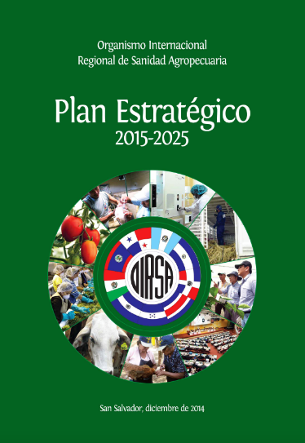
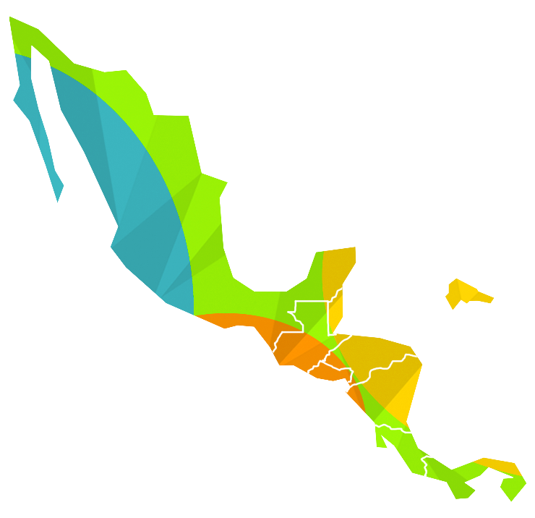
En 2014
Establece su
Plan Estratégico
2015-2025
En 1983
Historia
Se abren oficinas de
Representación en los Estados miembros
En 1961
El Organismo establece
su sede permanente
en El Salvador
En 1953
El OIRSA se crea en la V Conferencia de ministros de Agricultura de Centroamérica y México realizada en El Salvador
En 1947
Se crea
el CICLA
¡Más de sesenta años salvaguardando el patrimonio agropecuario de la región!

Slide 3
Technical Areas: Programs and transverse axles
ANIMAL HEALTH | PLANT HEALTH | QUARANTINE SERVICES | FOOD SAFETY
REGIONAL PROGRAMS
Bovine | Basic grns | International Quarantine | Safety products of animal origin
Poultry | Horticulture crops | Treatment Service | Safety products of plant origin
Swine | Ornamental crops | Agricultural Protection Service (SEPA)
Aquaculture | Fruit crops | Strenghtening of National
Apiary | Agroindustrial crops | Quarantine Services
Equine | Forest species | Quarantine Communication and Outreach Program
Minor species
Livestock alternative
TRANSVERSE AXLE
Integrated Risk Management | Climate change and agricultural health | Harmonization of regulations | Agricultural traceability | Agricultural health and laboratory safety | Linkages with the agricultural productive sector | Relationship with international organizations

Slide 4
TECHNICAL CAPACITIES AND ACHIEVEMENTS
ACHIEVEMENTS
HLB: 27 greenhouses with the capacity to produce two millions healthy plants, diagnostic capacity in the region, regional harmonized legislations for the certificaction of healthy plants, 27 pilot plots for technical asistance
Fusarium TR4: Regional PRA, formation of latinamerican comando to deal with posible TR4 outbreaks and specialized simulations
Coffee rust: Strenghtening of the early alert system for rust and other coffee pests
Xylella fastidiosa: Strenghtening of the diagnostic and training in the certificacion of sites and places
Fruit flies: Support to Dominican Republic in the elimination of Ceratitis capitata outbreak and reestablishment of their exportation
Formation of the Regional Pest Risk Assessment Unit system
Phytosanitary geoportal for pest predictions using climatic variables
OIRSA gives support in the custom’s negociation for the facilitation of trade in Central America (starting with: Guat & Hd)

Slide 5
TECHNICAL CAPACITIES AND ACHIEVEMENTS
CAPACITIES | State
Virtual platform: 16 virtual courses especially Citrus HLB | In process
Diploma course of pine bark beetle | In process
Carry out phytosanitary simulations | For TR4 and Fruit flies
Regional Reference Laboratory for diagnostic of seven citrus diseases for certification | Eg. Guatemala for HLB
Development and updating of action plans and contingency plans | (TR4, fruit flies, Coffee Berry Disease, Khapra beetle)
Give support for none intrusive inspection tool using dogs | EG. Guat, Hd & Pn
Strenghtening of the distance digital diagnostic imaging capacities in the region | In regional ports
Implementation of the early alert quarantine system | Eg. Reports of Kapra beetle in regional ports

Slide 6
SURVEILLANCE PROJECTS AND ACTIVITIES
Surveillance route for early HLB detection in El Salvador and Panamá
Early alert system for rust, coffee borer, and other coffee pests
Monitoring of fruit flies for example: Ceratitis capitata, Anastrepha spp., Bactrocera spp., Ragoletis spp.
Surveillance of Fusarium TR4 in commercial areas planted with Cavendish banana
Surveillance of Tuta absoluta in countries that have free condition of this pest
Surveillance for the detection of outbreaks of locust: Schistocerca piceifrons
In 2018, it’s projected the implemention of a regional surveillance system

Slide 7
EMERGENT PESTS AND PHYTOSANITARY PROBLEMS
EMERGING PESTS | EMERGENY DECLARATION IN 2017 (The application of funds for emergency and technical assistance) | MAJOR PESTS 2017
New coffee rust strain: (Hemileia vastatrix) (Process of confirmation) | Centralamerican locust: (Schistocerca piceifrons), El Salvador and Nicaragua | El Niño Year: Thrips, scales, whiteflies, powdery mildew, virusis
Giant snail: (Achatina fulica) | Sorghum Yellow Aphid (Melanaphis sacchari) El Salvador and Honduras | La Niña Year: Blight, bacteriosis, rusts, anthracnosis, sigatoka
 | Citrus HLB in Panamá

Slide 8
PROPOSAL FOR FURTHER COLLABORATION
To strengthen the coordination with other RPPOs and international organizations
To participate in the development of phytosanitary topics of international interest, such as: the prevention of the introduction of Foc TR4 of banana and plantain and IPM of HLB in citrus, among others
To support the harmonization of agricultural regional legislations
To extend trainings on different phytosanitary topics: Integrated pest Management of Citrus HLB.
To line up with the topics of interest of IPPC

Slide 9
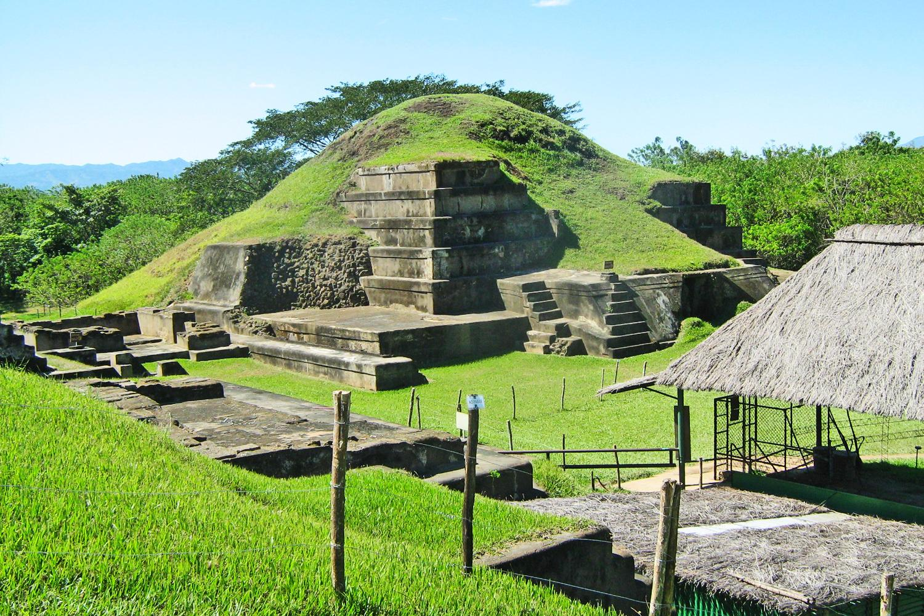
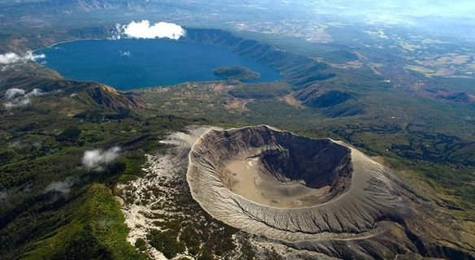
El Salvador's less-travelled Mayan ruins to yourself on a trip around this beautiful and richly historical country and volcano of Santa Ana
THANKS VERY MUCH FOR YOUR ATTENTION
THANKS VERY MUCH FOR YOUR ATTENTION

