Slide 1
Elements of plant protection legislation
The IPPC Secretariat
With the financial support of the STDF project 401
Phytosanitary Capacity Evaluation (PCE) facilitators training

Slide 2
Plant Protection Act - Basic elements
PRELIMINARY
Preamble
Scope
Definitions
PART I
Administration (NPPO, Inspections, Labs, Coordination)
Duties of Inspectors
Powers of Inspectors
PART II
Import
PART III
Export
Phytosanitary certification for export
PART IV
Surveillance and Control of Pests
PART V
Offences and Penalties
PART VI
Miscellaneous (Liability, Appeals, Repeal and Savings, Power to Make Regulations)

Slide 3
SCOPE (IPPC)
Cultivated plants
Natural flora
Plant products
Materials capable
of harboring pests
(optional)
_

Slide 4
DEFINITIONS (INTERPRETATION)
Based on the IPPC, ISPM 5, SPS, other international agreements
Serve to interpret the text of the law
Only those terms that are in the text and are open for interpretation
_

Slide 5
Administration
The basic Law defines mandates, roles and basic rules:
the body or bodies responsible for administering the phytosanitary system; NPPO
The inspection corps and the powers and responsibilities of phytosanitary inspectors;
The national laboratory system and reference laboratories.
Decentralization?? (national system)
Coordination/implementation
  Plant Boards (PP)
  Decentralization
  Manuals of Inspection

Slide 6
Inspection service
Appointment of inspectors. Mandate. Qualifications (official/authorized-appointed inspectors)
Delegation/Coordination
Powers and duties of inspectors
Inspectors must identify themselves
Operators have a duty to assist the inspectors

Slide 7
Duties of Inspectors
  Inspection of consignments, plants, plant products under cultivation, in the wild, in storage or in transit, to report the existence, outbreak and spread of pests;
  Inspection of consignments for export and import;
  Inspection of storage and transport facilities;
  Disinfection of consignments;
  Control of waste disposed from aircrafts, ships or premises;
  Issuance of phytosanitary certificates (public officers authorized by the NPPO).

Slide 8
Exercise: Powers of Inspectors
In groups of 4/5 (including a lawyer) identify the key powers of inspectors that should be included in national legislation (10 minutes)
(change your group!)
Group 1: at the border (road)
Group 2: internal quarantine
Group 3: at the airport

Slide 9
Powers of Inspectors
  Inspector must be vested with powers as a public authority, to:
  Enter and search in areas or premises and require any documentation required under the Law;
  Inspect, examine and make copies of such documentation, take extracts of registers or records and seize them;
  Stop and search any person, baggage, packaging conveyance or other regulated article for the implementation of the Law;
  Stop the distribution, sale or use of any plant, plant product or other regulated article which the inspector has reason to believe is harboring a regulated pest, for a specific time period;
  To seize, destroy, detain, treat or otherwise dispose of any plants, plant products or other regulated articles or order that any such action is taken.

Slide 10
Imports
The country has sovereign authority to regulate the entry of plants and plant products (import requirements)
Right to prescribe and enforce phytosanitary measures on the basis of :
  pest risk analysis.
  inspections or phytosanitary actions to be carried out as promptly as possible.

Slide 11
Phytosanitary certification
In conformity with the IPPC model (Schedule)
Taking into account international standards (ISPM 12)
On the basis of inspection under the authority of the NPPO
To spell out phytosanitary certification for export and re-export
To regulate consignments in transit

Slide 12
Enforcement
Infringements and sanctions
Specific infringements & sanctions for inspectors/civil servants
Remedies/appeals
Derogations
Provisions to enhance coordination
Duties of collaboration of other institutions (information, data)
Provisions for participation of the private sector
Schedules (model certificates – such as phytosanitary certificate and re-export certificate)
Regulations

Slide 13
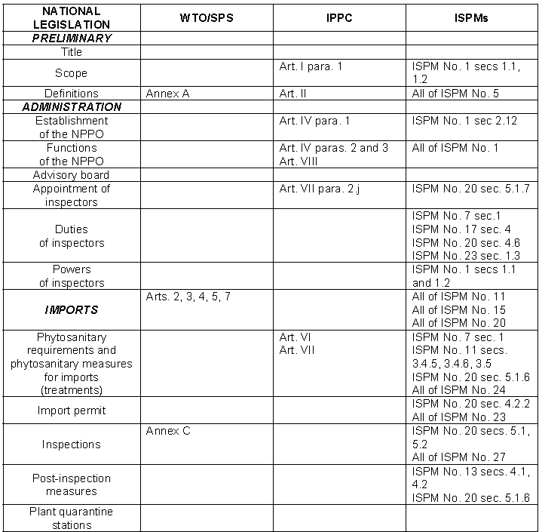
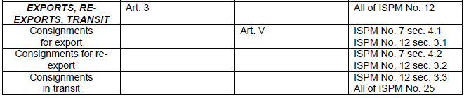

Slide 14
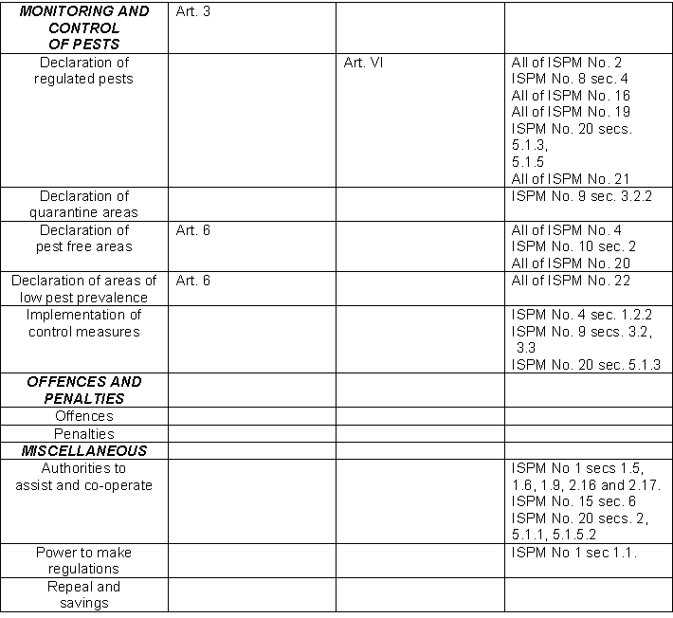

Slide 16

Thank you very much
Carmen Bullon - Carmen.Bullon@fao.org
Lalaina Ravelomanantsoa- Lalaina.Ravelomanantsoa@fao.org
Legal Officers -FAO Development Law Service

