Slide 1
NRO Workshop
NRO Programme Overview
with a Special Support by the FAO-China South-South Cooperation Programme
IPPC Secretariat
7-8 September 2018, Moscow, Russia

Slide 2
National Reporting Obligations Programme
NRO Support staff joined the Secretariat: June 2014
1st meeting of National Reporting Obligations Advisory Group (NROAG): July 2014
The monthly “NROs Update”: since October 2014
NRO thematic years
new section on the IPP with materials in languages
Technologically revised IPP website (new manual): February 2015
New and improved layout of countries NRO information
Registration and archiving of new Contact Points; nomination forms updated
Pre-CPM-10 training session: March 2015
Verification of IPP editors: August 2015
2015, 2017, 2018 IPPC Regional Workshops: 1 training exercise

Slide 3
National Reporting Obligations Programme
NRO General and Specific Procedures: CPM-10 (2015) and CPM-11 (2016)
Advocacy and awareness raising materials: 2016
new Guide
tables listing NROs
13 detailed factsheet for each NRO
4 NRO leaflets (benefits of reporting, consequences of not reporting and networking): a new improved layout
System of automated IPP NRO reminders: July 2016
1st NRO Workshop in Beijing, China: September 2016
2nd NRO Workshop in Nadi, Fiji: August 2017
Scripts for NRO e-learning (5 modules): 2016, prototype: 2017/2018
Automatic NRO statistics: January 2017

Slide 4
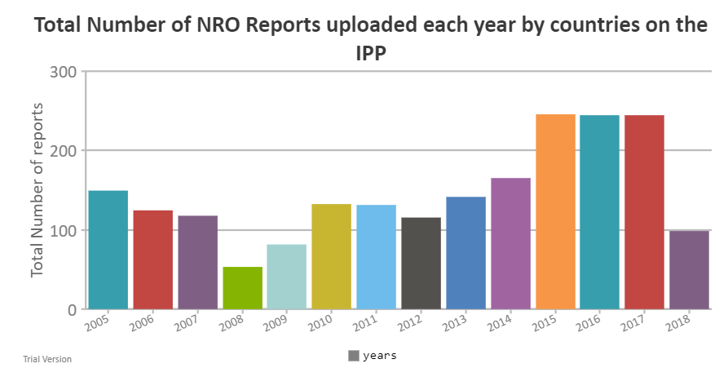
Figure 1.
TEXT
Notes:
eplanation

Slide 5
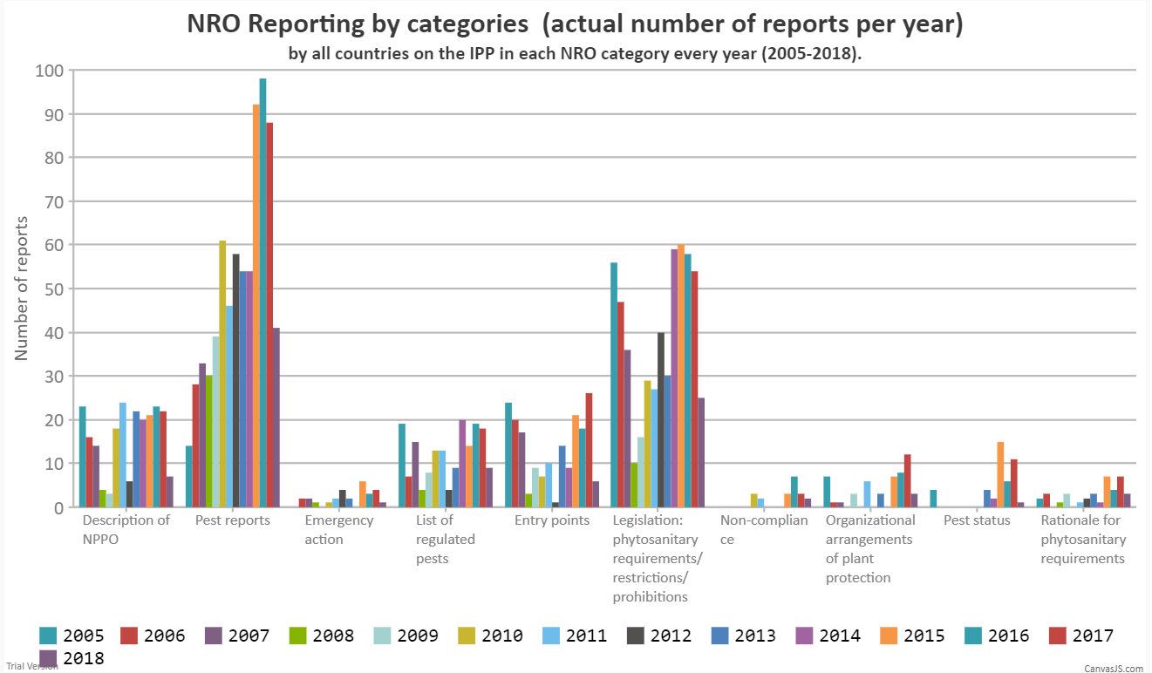
Figure 2.
Figure 1. Total Number of NRO Reports uploaded each year by countries on the IPP
TEXT
Notes:
eplanation

Slide 6
Contacts
IPPC Secretariat
Food and Agriculture Organization of the United Nations
Viale delle Terme di Caracalla, 00153 Rome, Italy
Tel.: +39-0657054812 Email: IPPC@fao.org
Dorota Buzon, NRO Programme Officer: dorota.buzon@fao.org
Paola Sentinelli, IPPC Knowledge Manager: paola.sentinelli@fao.org
Websites:
www.fao.org
www.ippc.int

