Slide 1
Pacific Plant Protection Organization (PPPO) Report
30th Technical Consultation Among the Regional Plant Protection Organization’s
29th October – 02nd November 2018 in Lima, Peru
Presented by the PPPO Secretariat. LRD, SPC

Slide 2
General Information - PPPO
PPPO Full Board
PPPO Executive committee members
Consist of 26 member countries in SWP region
22 Pacific Island Countries & Territories (PICTS)
4 Metropolitan Members (Australia, New Zealand, France and USA)
3 Sub-regions (Micronesian, Polynesian & Melanesian)
2 member countries represented from the 3 sub-regions (Chairmanship rotates amongst the 3 sub-regions, Vice-Chairman is elected between the Metropolitan members)
Meets triennially and its mission, vision is supported and mandated in the PPPO constitution.
Opportunity to meets every year & discuss PPPO priorities/ issues/ PPPO new work plan (2019 – 2023)
PPPO Executive Secretariat
Housed in the LRD, SPC and look for potential funding from donors
Provides the secretariat role and the glue for the PPPO members
Sharing of information at the National, regional & international level (PLD: http://www.spc.int/pld/ )
Attend regional and international meetings, shares information with PPPO Member countries
NPPPO’s
National Reporting Obligations (NRO’s)
All other Phytosanitary issues at Pre-border, Border & Post-Border
Capacity building for the PPPO members (Surveillance, ID & Authentication, Early Warning Systems, Market Access Requests)
The PPPO Constitution was enacted in 1994 and was amended and revised in 2006.

Slide 3
PPPO - 3 Sub-Regions

Slide 4
Pacific IPPC and RPPO members
Membership | IPPC | PPPO | APPPC
American Samoa
Cook Islands
FSM
French Polynesia
Guam
Kiribati
RMI
Nauru
New Caledonia
Niue
CNMI
Palau
PNG
Fiji
Pacific IPPC and RPPO members
Membership | IPPC | PPPO | APPPC
Pitcairn
Samoa
Solomon Islands
Tokelau
Tonga
Tuvalu
Vanuatu
Wallis and Futuna
Australia
France
New Zealand
USA

Slide 5
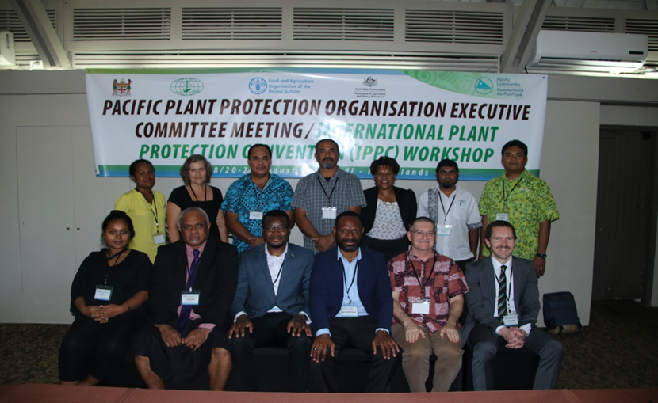

Slide 6
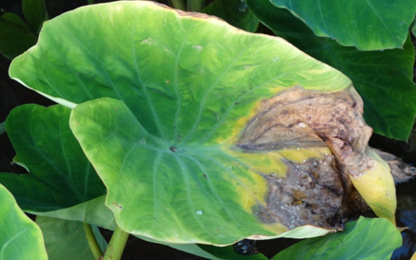
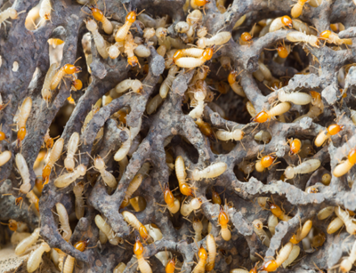
Some of the activities that are done by the Pacific Plant Protection Organization Secretariat
Establishing a framework for regional and global cooperation in Phytosanitary matters for the trade of plants and plant products.
Developing and implementing effective and scientifically justified Phytosanitary measures to protect plant health and life for the PPPO member countries (e.g: PRA’s).
Providing and facilitating flow of information concerning Phytosanitary measures, including prohibitions, restrictions and specifications for entry of plants and plant products and means of deriving particular specifications, and the operational procedures used, if requested (ie: SOP’s)
Reporting as soon as practicable to the Secretariat for communication to other members the existence, outbreak and spread of economically important pests of plants and plant products in their countries (i.e: NRO’s).

Slide 7
PPPO 5 year Work Plan
Output 1: PICTs undertake monitoring and structured detection and delimitation surveys for pests of economic and environmental concerns
Output 2: PICTS identify pests of significant economic and environmental concern within seven (7) days and report them in the Pacific Pest List and via the IPPC portal
Output 3: PICTS undertake Phytosanitary inspections of regulated goods to verify Phytosanitary status
Output 4: Model legislation is enacted and implemented by all PICTs

Slide 8
Cont’d
Output 5: Regional Biosecurity information and material is used by PICTs to improve biosecurity behaviour and compliance
Output 6: A regional coordination framework supports emergency response and longer term management strategies to reduce the impact of new pest incursions into the region
Output 7: A regional fruit fly strategy is developed and implemented to deliver a viable, cost effective and sustainable regional approach to fruit fly management
Output 8: Trade and market access opportunities are promoted by technical submissions incorporating scientifically based Phytosanitary measures, international standards and contemporary approach to pest risk management.
Output 9: The PPPO provides support to member countries to implement the International Plant Protection Convention and international and regional standards

Slide 9
Emerging & Priority Pests of concern for the PPPO region
Coconut Rhinoceros Beetle – Guam Strain (CRB-G). Currently only present in Guam, PNG, Solomon Is, Hawaii.
Brown marmorated stink bug – Not present in PPPO member countries
Taro Bobone and Alomae Virus diseases – currently only present in Solomon Is and PNG.
Huanglongbing (HLB) disease of Citrus – Not present in the PPPO member countries.
Cassava brown streak virus – Not present in PPPO member countries.
Banana Tropical Race 4 disease – Only present in Australia.
Banana Blood disease - Ralstonia solanacearum Race 2 (Moko disease) – Not present in PPPO member countries.
Taro Leaf Blight – Present in Samoa & PNG.
Bacterial Blight on Cassava – Present in Solomon Is
Lethal yellowing disease on palms – Not present in the PPPO member countries.
Exotic harmful fruit flies that are not present in the PPPO member countries.

Slide 10
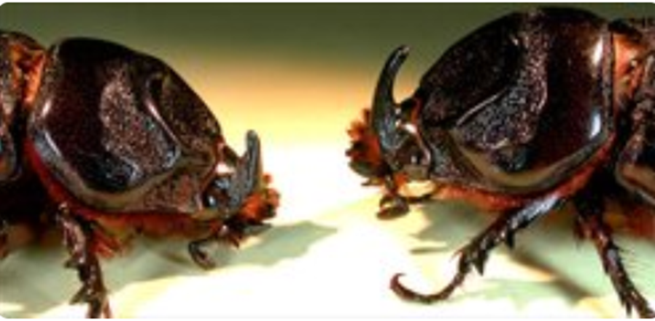
Coconut Rhinoceros Beetle (CRB) symptoms
FEMALE
MALE

Slide 11
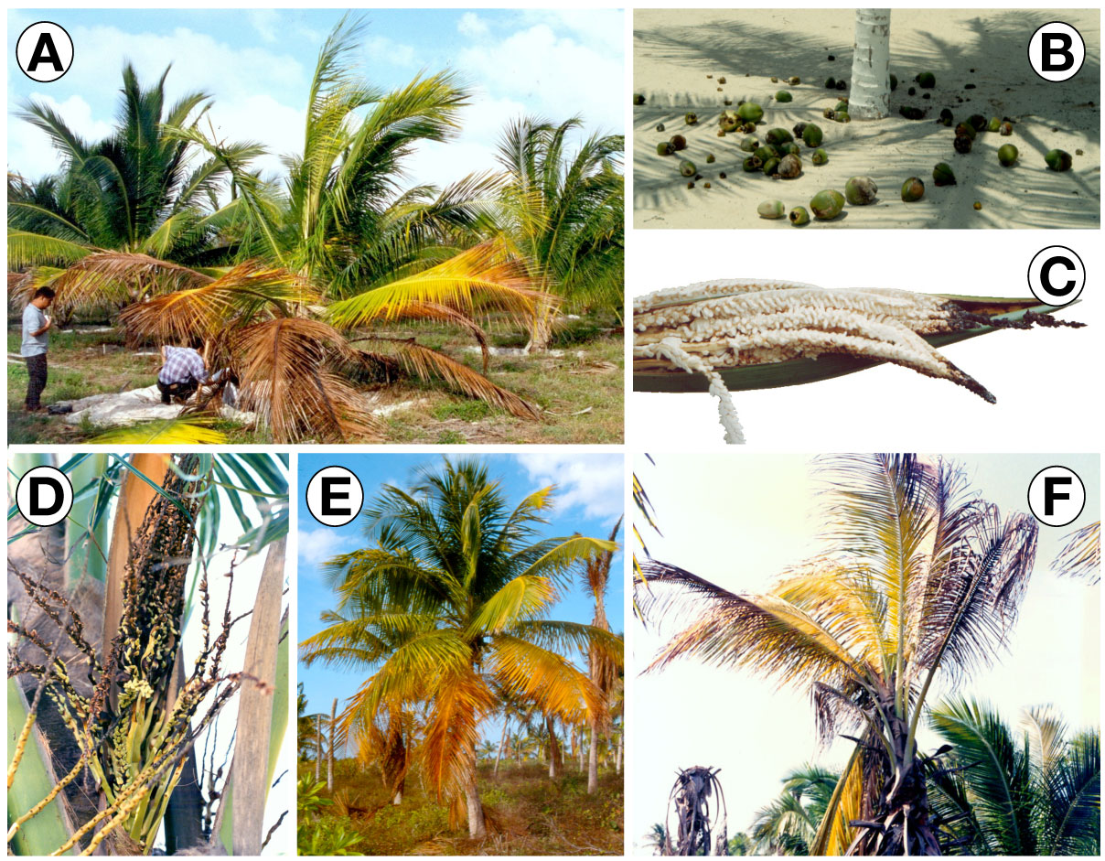
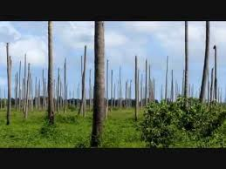
Symptoms of Palm lethal yellowing phytoplasma.
G
A. Non-bearing palms showing foliage yellowing.
B. Bearing palms started showing nut fall.
C and D. Inflorescence necrosis.
E. Foliage yellowing started in older leaves.
F. and continued with younger ones.
G. Acute stage of lethal yellowing.

Slide 12
Other issues of concern and possible collaboration:
Climate Change & Impacts to the PPPO region.
Potential need for the involvement of RPPO’s on the ephyto implementation after getting lessons learned from pilot countries.
False reporting on pests present in some of the PPPO countries in some of the existing regional Pest List Databases (PLD’s). Concern for the PPPO members and potential to work with these RPPO’s to take these of their regional PLD’s.
The potential role of RPPO’s on the upcoming IYPH 2020.

Slide 13
Some Challengers for the PPPO members:
Funding is always a concern for the PPPO given that we are small PICT’s and our levies are not much to cover the work in our PPPO work plan. Need funding and opportunities to sell our PPPO work plan to funding agencies.
Technical expertise in the PPPO region is not many thus the ongoing need on RPPPO collaboration and help on capacity building of various NPPO’s.
Proper diagnostic equipment and facilities for the NPPO’s to carry out their work at the pre-border, border and post-border.

Slide 14
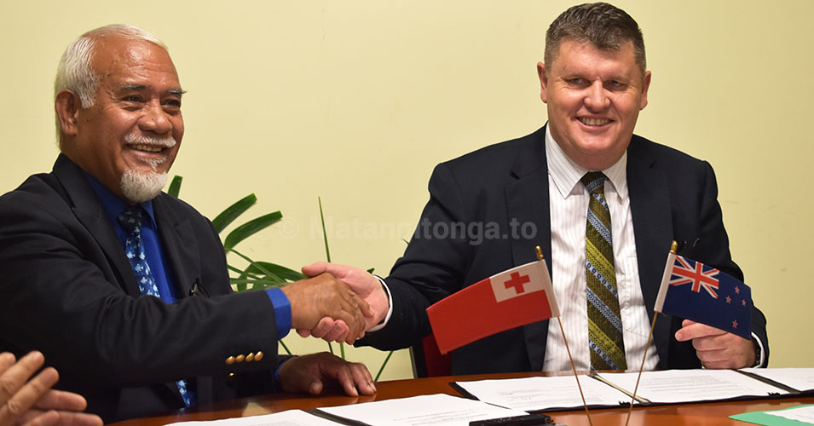
New process for umu packs into NZ
Thursday, October 4, 2018 - 21:50
Nuku'alofa, Tonga
Minister of Agriculture, Food, Forests and Fisheries, Hon. Semisi Fakahau and Head of Biosecurity New Zealand Chief Operations Officer, Roger Smith, sign the MOU. 4 October 2018.
A new process of certification aimed to better facilitate arriving passengers into New Zealand travelling with specific food items in umu packs from Tonga is expected to be implemented in November, after a Memorandum of Understanding was signed on October 4 in Nuku'alofa.

Slide 15
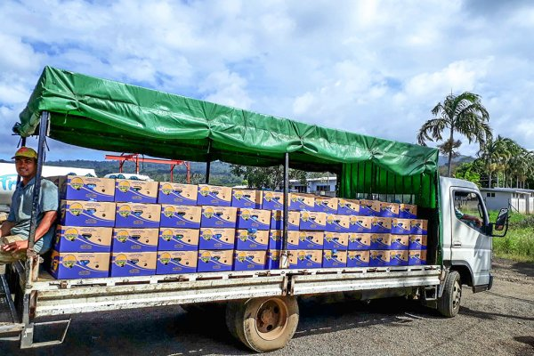
Banana breakthrough for Samoa
By Sapeer Mayron , 17 October 2018
1485 Hits
A PROMISING FUTURE: The first commercial shipment of export ready bananas to New Zealand yesterday. Photo / Supplied.

Slide 16
visonit@spc.int

