Slide 1
Caribbean Agricultural Health & Food Safety Agency 30TH TC-RPPO 29 October – 2 November 2017 Lima, Peru
Juliet Goldsmith

Slide 2
SPECIFICITIES
1967- CPPC established in 1967 by FAO Council
1999-Mandate to establish an independent body to replace the CPPC
2010- Original agreement establishing CAHFSA
2011- Revised Agreement - February 25,

Slide 3
SPECIFICITIES
2014 – CAHFSA Operational
2014 - CPPC abolished
2015 – CAHFSA Fully operational
2018 - Recognition as RPPO conferred

Slide 4
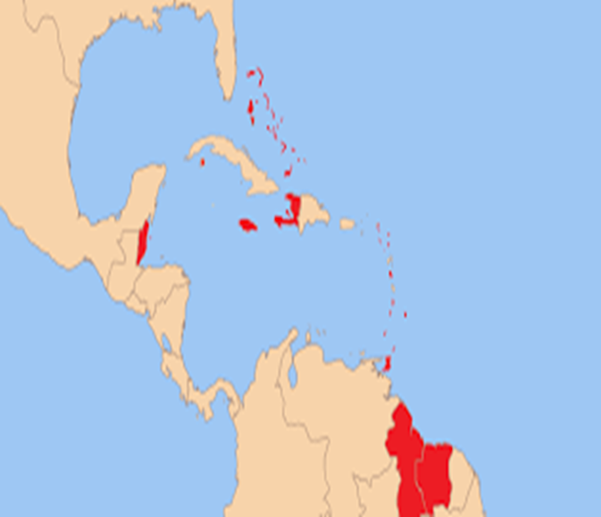
MEMBER STATES: Antigua and Barbuda. Bahamas. Barbados. Belize. Dominica. Grenada. Guyana. Haiti. Jamaica. Montserrat. Saint Lucia. St Vincent and the Grenadines. Suriname. Trinidad and Tobago.
ASSOCIATE MS: Anguilla, Bermuda, British Virgin Islands, Cayman Islands, Turks and Caicos Islands

Slide 5
Mandate
CAHFSA is mandated to perform a coordinating and organizing role for the establishment of an effective and efficient regional sanitary and phytosanitary (SPS) regime

Slide 6
Chief Executive Officer
Food Safety Specialist
Animal Health Specialist
Plant Health Specialist
Board of Directors
Council for Trade & Economic Development (COTED)
Finance & Administrative Officer
Technical Advisory Committees
Secretary

Slide 7
Community Agricultural Policy Thematic Areas
Research and Human Resource Development
Climate Change and Natural Resources Management
Agricultural Health and Food Safety
Business Development
CAHFSA operates within the framework of the CAP and directly under the thematic area Agricultural Health and Food Safety

Slide 8
MAIN AREAS OF FOCUS
Legislation and Standards
Capacity Building
Information Exchange and Dissemination
Rapid Response and Safeguarding
Regional and International Cooperation
Regional Trade Facilitation and Dispute Settlement
Notes:
The CAHFSA work programme is organizes under 6 broad headings: Legislation and standards, capacity building, rapid response mechanism and safeguarding, information exchange, regional and international cooperation, dispute avoidance and settlement.

Slide 9
Technical and capacity development achievements
Regional Training
8th Annual Regional Plant Quarantine Training
National Pest Prioritization Trainings

Slide 10
Regional priority pest list 2018
1. Ceratitis capitata (Mediterranean fruit fly)
2. Fusarium oxysporum f.cubens Race 4 (Banana Wilt)
3. Tuta absoluta (Tomato Leaf Miner)
4. Ralstonia solaranaecearum (Races 2 [Moko Disease] & 3)
5. Monilliophthora roreri (Frosty Pod Rot)
6. Lethal yellowing of Palms
7. Xanthomonas axonopodis (Citrus canker)
8. Citrus leprosis virus
9. Fiji Disease (Sugarcane)
10. Bacterial Panicle Blight (Rice)

Slide 11
Information exchange and dissemination
Phytosanitary portal on website
Web based databases
list of registered pesticides,
PRAs,
Regionally regulated pests,
Plant health practitioners,
Regional trade issues

Slide 12
Regional /International Collaboration
FAO (Strengthening quarantine services in 3 OECSS)
FAO (Pesticide management)
FAO (Knowledge sessions at Plant Health Directors Meeting)
IPPC
2018 regional workshop for the Caribbean
High-level Symposium in China
IAEA
Interregional project for SIDS
Regional capacity building project
Practical arrangement

Slide 13
Dispute Settlement
Draft document for consultation
RPPO Guidance Document
Draft Constitution for consultation

Slide 14
Emerging pests
Ceratitis capitata
Fusarium TR4
Moniliophthora roreri
Rhychophorus ferrugineus
Coconut Lethal yellowing disease
Tuta absoluta

Slide 15
Surveillance Projects and Activities
Rhychophorus ferrugineus (Red palm weevil)
Tephritidae
Monilliophthora roreri (Frosty Pod Rot of cocoa)

Slide 16
Proposal for future collaboration
Pest diagnostics
Pest Risk Analysis
Surveillance programmes
Improved coordination and collaboration with other RPPOs and International organizations

Slide 17
Merci
Dankjewel
Thank You

