Slide 1
REPORT: ANDEAN COMMUNITY (CAN)
October 30, 2018
Lima, Peru,

Slide 2
Content
Introduction. CAN and Andean System of Animal and Plant Health (SASA). Subregional norms
Activities. Upgrade Subregional norms register, case pesticides. Joint work of countries on prioritized pests. Collaborative work
Future. CAN as executor of projects. Increase inter-institutional coordination

Slide 3
Introduction

Slide 4
Introduction

Slide 5
Introduction
COTASA
STANDARDS UPDATE
PRIORIZED PESTS AND THEMES
INTERINSTITUTIONAL COORDINATION
The Andean Community Commission
The General Secretary of the Andean Community

Slide 6
Activities. Norms
Subregional register
2 new norms
Standards update
Resolution 431
Resolution 419
1 previous concept
Andean technical manual for pesticide registration
Phase of consultation in the WTO
Notes:
Hemp and, quarantine measures, flowers
Phytosanitary requirements for subregional trade
Subregional Inventory of Pests and Diseases of Vegetables

Slide 7
Activities
HLB
FOC R4T
ELECTRONIC CERTIFICATE
FRUIT FLY
INFORMATION EXCHANGE. DIAGNOSIS
EXCHANGE WORKSHOP
WORKPLAN
TECHNICAL PANEL CREATION
Notes:
Plagas priorizadas

Slide 8
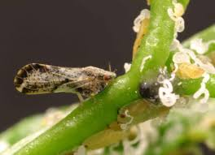
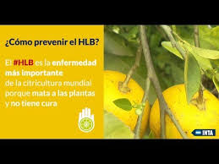
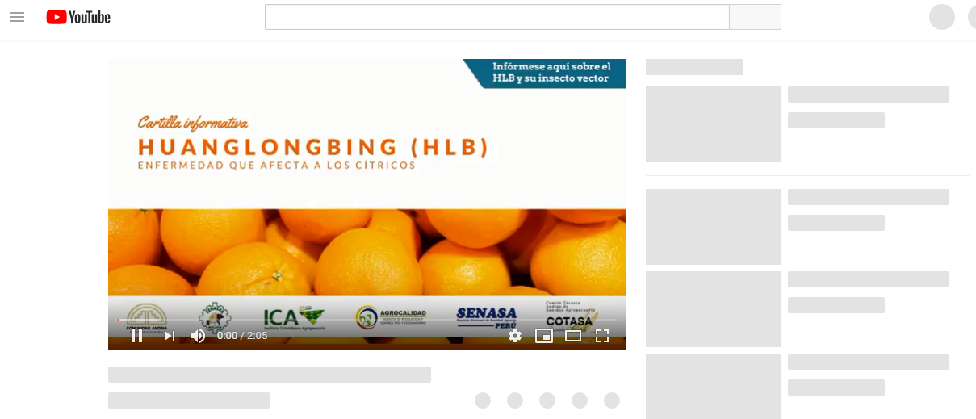
Activities. HLB
https://www.youtube.com/watch?v=9BH9kCNhINE
Notes:
HLB

Slide 9
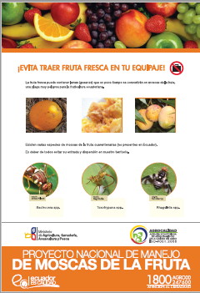
Activities. Fruit fly
Regional Workshop
Conceptualization
Proposalas development
Project
Fruit fly control in urban areas
15-16 March
Technical Panel
Prioritization of topics
Exchange of dissemination material
Notes:
• Collaborative research on non-host species of fruit fly
• Preparation of joint disclosure material.
• Preparation of projects or proposals to strengthen surveillance in the countries, both preventive surveillance of quarantine flies not present in the region, and monitoring of flies present.
• Exchange of experiences of specialists in information systems, including the use of Geographic Information Systems and new modalities of data capture and processing.
• Exchange of experiences in control methodologies in urban centers.
• Exchange of experiences in the development and adoption of national standards related to the fruit fly.

Slide 10
Activities. FOC R4T
Technical reunion
Between laboratories of Bolivia, Colombia and Ecuador
Project
Formulated by technical panel (Leveling of technical capacities, standardization of the protocol and interlaboratory tests)
March 6
Prioritization of topics. Diagnostic capabilities
Information exchanges
Financed by the CAN
Presented to the IDB
Notes:
Leveling of technical capacities, standardization of the protocol and interlaboratory tests

Slide 11
Activities. Electronic certification
Juin 7, 2018
Technical
compatibilization of standards
Interoperability
Normative
Topics to work
Conclusions
Regional Workshop
Update Resolutions 240 and 241
Notes:
Colombia and peru works together Pacific Aliance, Bolivia and Ecuador works preferently with IPPC hub.

Slide 12
Activities. Coordination
IPC (workshps)
OIRSA (meeting, formalization of understanding)
GICSV (presidency pro tempore)
IPPC. CPM (regional workshop)
FAO (regional workshop)
IICA (regional workshop, institutional agreement)
Notes:
Coordinación
International potato center
OIRSA

Slide 13
Future
Project executor
CAN
Coordination
Notes:
Coordinación

Slide 14
www.comunidadandina.org
Secretaría General de la Comunidad Andina
Paseo de la Republica 3895, Lima 27 – Perú
Teléfono: (511) 710 6400
Fax: (511) 221 3329
Thanks!
Síguenos en:
/comunidadandina
@comunidadandina

