Slide 1
30th Technical Consultation among Regional Plant Protection Organizations
Lima (Peru) 29 October - 2 November 2018
Mekki Chouibani
www.neppo.org

Slide 2
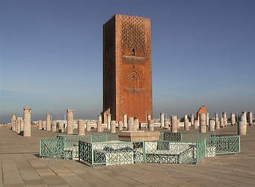
1. Specificities
Agreement
signed in February18, 1993
entered into force on January 8, 2009
Recognized officially in March, 2012, by 7th CPM:
Heaquarter: Rabat
Members: Algeria, Egypt, Jordan, Iraq, Libya, Malta, Morocco, Pakistan, Oman, Sudan, Syria, Tunisia
Signed but not ratified: Iran, Mauritanie, Yémen
Executive Committee: Algeria, Jordan, Libya, Pakistan, Syria, Tunisia
Staff: Executive Director, Assistant director

Slide 3
NEPPO aims to….
Promote regional cooperation and capabilities of its members through :
Preventing the spread and introduction of pests
Controlling pests in an appropriate manner
Facilitate safe regional and international trade
By:
promoting information exchange (Pest status, pest report, regulations, phytosanitary measures, ..);
harmonizing phytosanitary regulations and measures
developing regional strategy to face spread and introduction of pests
enhancing capacity building of NPPO

Slide 4
2. Technical and capacity development achievements-1
Participation to the 3rd ePhyto Global Symposium, organized by IPPC and APPPC. Kuala Lumpur (Malaysia) 22 – 26 January 2018
Contributed to the organization of the Consultation Workshop on: “ One Health: Addressing Transboundary Plant, Animal and Fish Pests and Diseases: A Case for Regional Cooperation”. Rabat (Morocco) 5-6 February 2018 to prepare a document for the NERC
Contributed to the organization of the wrap-up workshop of project TCP/RAB/3601 “Preventive Measures for the Introduction and Spread of Xylella fastidiosa -Olive Quick Decline Syndrome in NENA Countries” . Tunis, 13 -14 February 2018

Slide 5
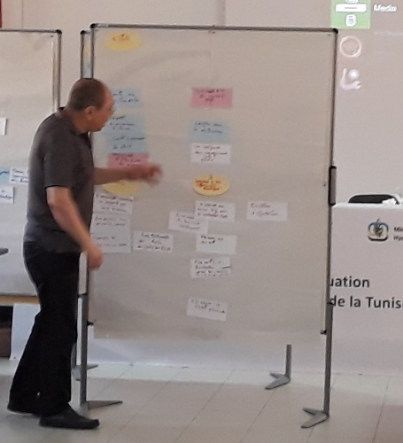
2. Technical and capacity development achievements-2
Contributed to the organization of the IPPC regional workshop held in Muscat (Oman). 17-19 September 2018
International Meeting on Innovative and sustainable approaches to control the Red Palm Weevil “RPW”. CIHEAM & FAO. CIHEAM Bari, 23 - 25 October 2018
Encourage Members to conduct the Evaluation of their phytosanitary capacities : Facilitation of 3 workshops for the phytosanitary capacity evaluation of Tunisia:
March 13-16, 2018
June 26-28, 2018
November 5-9, 2018

Slide 6
3. Emerging pests
Xylella fastidiosa
Curent and real threat
Drosophila suzukii
Risk
no information on its status
RDW
High risk of dissemination
Bactrocera zonata
Risk of dissemination
Bactrocera dorsalis

Slide 7
3. Emerging pests (2) Huanglongbing Disease
Trioza erytreae
(AFINOA) Spain
Diaphorina citri
(EPPO)(Iran, KSA)
HLB (EPPO)
KSA, Iran, Yemen

Slide 8
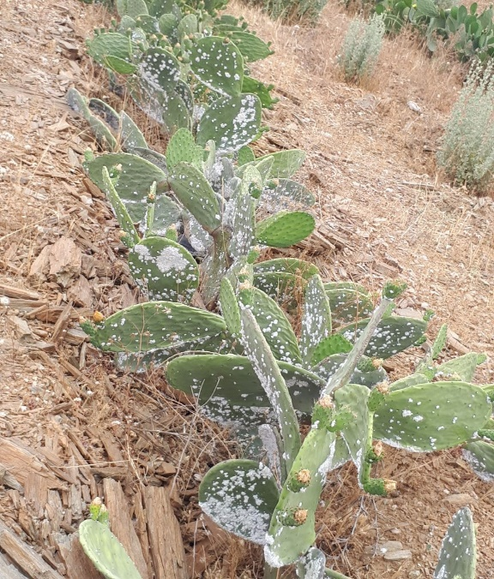
3. Emerging pests (3)
Fall Armyworm: Spodoptera frugiperda (Photo: Georg Goergen)
80 host plant,
2016: 4 countries infested,
2018: most African countries infested
NENA: Sudan, Yemen
Prickly pear cochineal: Dactylopius opuntiae (Photo: Sbagui)
Spreading in Morocco, Lebanon,Jordan.Risk for Algeria

Slide 9
4. Proposal for further collaboration
Surveillance: Pivotal activity of NPPOs. Xylella, HLB, Fruit flies
Fall Armyworm (Spodoptera frugiperda)
ePhyto

Slide 10
Thank you, Gracias,留言Merci

