Slide 1
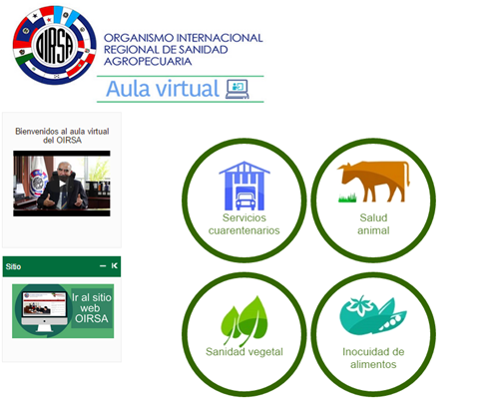
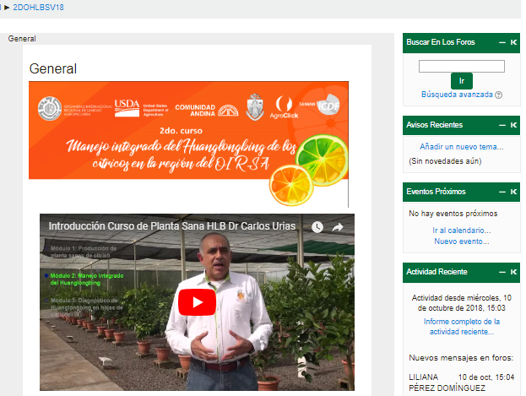
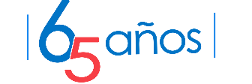
ACHIEVEMENTS 2018 OF PLANT HEALTH - OIRSA
CONTENT:
IPM Program citrus HLB
Fruit Crop Program: Fruit flies and Foc TR4
Industrial Crop Program: Rust and other coffee pests
Basic Crops Program: Central American Locust
Horticulture Program and Forest: Phytosanitary surveillance, watermelon virus
Traceability
Pest Risk Analysis System
International System of Quarantine Treatments (SITC)
Program of climatic variables and agricultural health

Slide 2
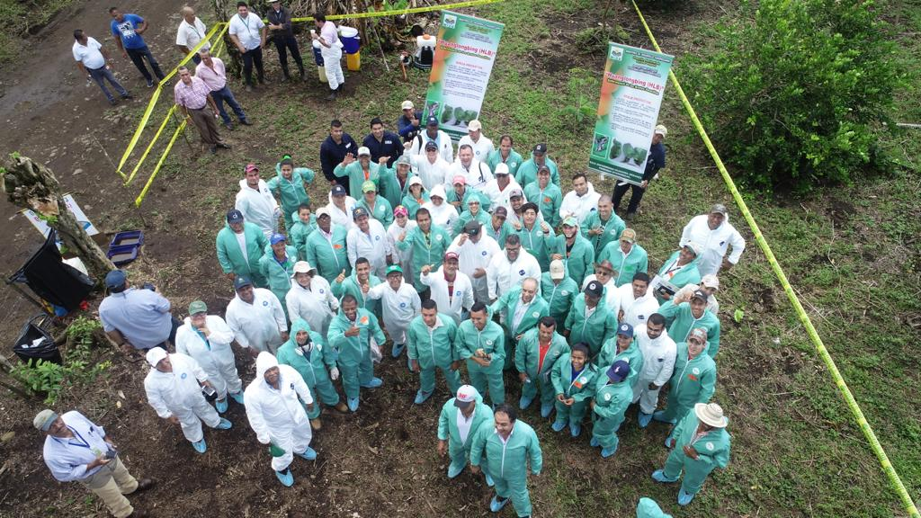
FRUIT PROGRAM : HLB MANAGEMENT AND CONTROL PROJECT
  Citrus sector strengthened for the IPM- HLB in the region of OIRSA
  HLB Project is structured as a regional program for the control of citrus HLB
  Production of 1.2 million healthy citrus plants per year
  More than 1,000 persons trained in 2018 in IPM - HLB
  Simulations for the evaluation of the response capacity of the citrus chain, in case of possible scenarios

Slide 3
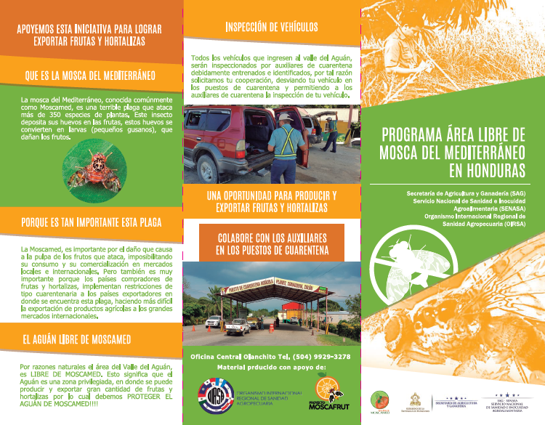
Fruit Flies
The status of country and Medfly-free areas is maintained in the OIRSA region
There´s no exotic flies established in the OIRSA region
A socialization campaign of fruit flies is developed
It is based on the recognition of new production areas in surveillance and admissibility

Slide 4
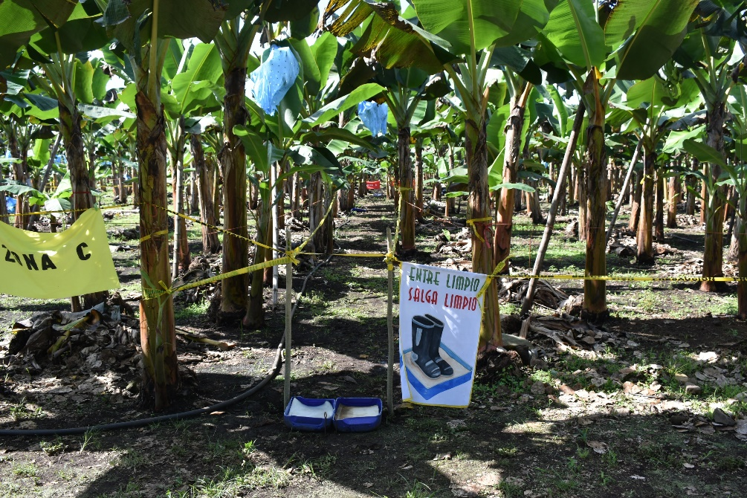
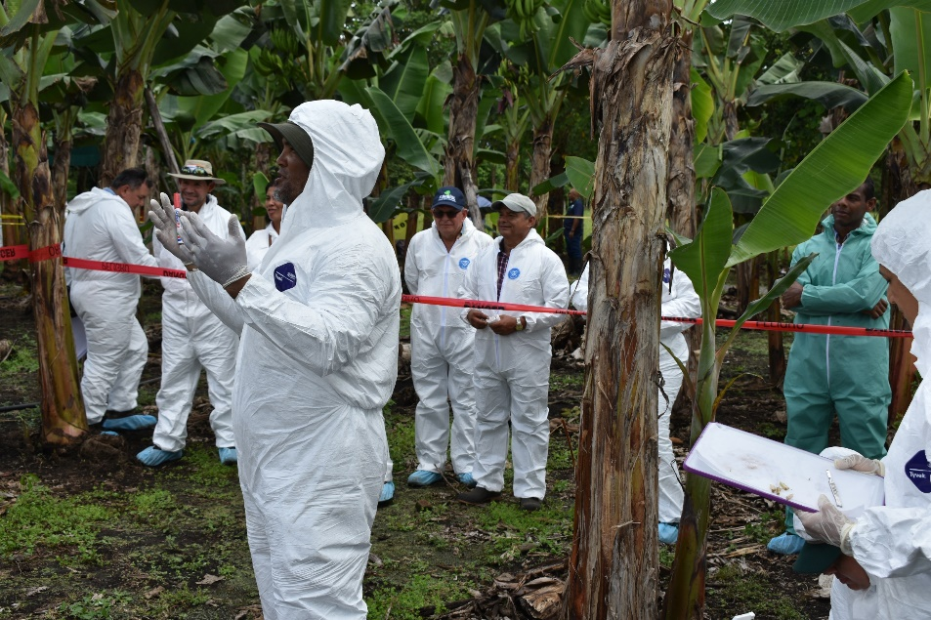
Foc TR4
The prevention capacities have been strengthened to minimized their introduction and control of outbreaks in the countries of the OIRSA region
Simulations for the evaluation of capacities in Mex, RD., Gt, Hn, and Pa.
Scheduled: Simulations in El Salvador and Costa Rica
OIRSA – FAO agreement for prevention actions in the OIRSA region

Slide 5
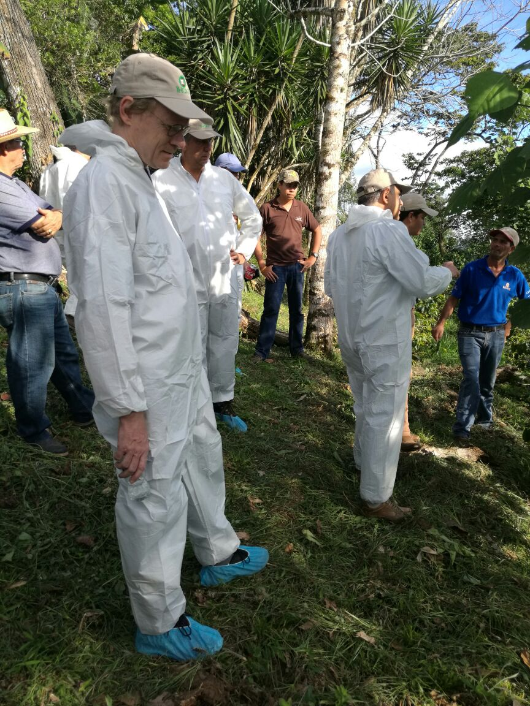
Rust and other coffe pests
Strenghtening capacities for monitoring and control of coffee rust
Virtual coffee course with emphasis on phytosanitary in December 2018
Molecular diagnostic protocols of rust races
Simulations for the attention of emergencies of coffee pests

Slide 6
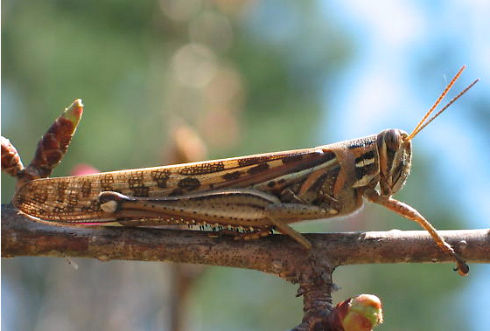
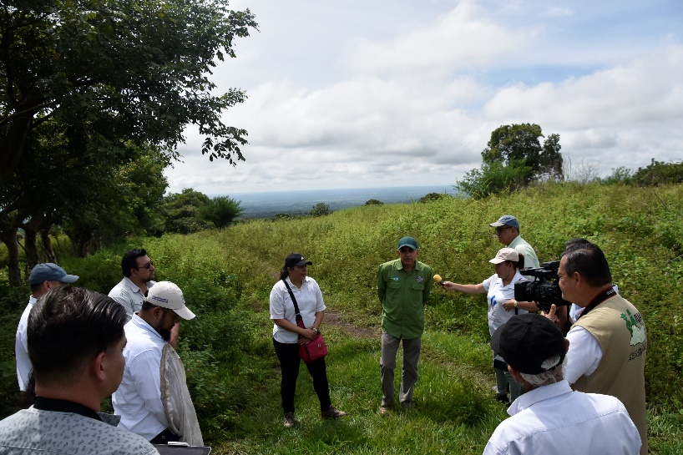
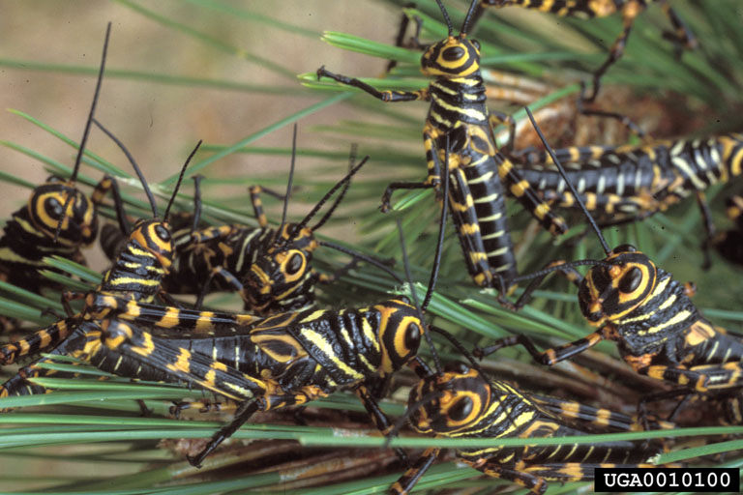
Central American Locust
Achievements: The ability to respond to the emergence of outbreaks is increased
Progress in updating the action plan to address outbreaks in agricultural, forestry, urban and protected areas
Formation of the Regional Commando for the attention of outbreaks

Slide 7
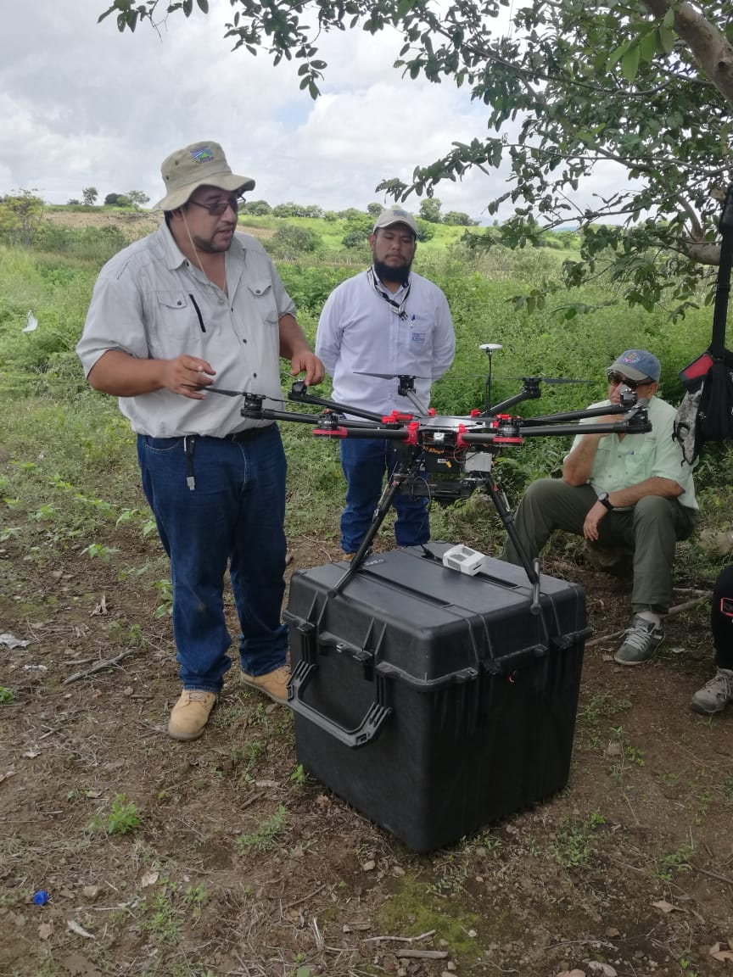
PHYTOSANITARY SURVEILLANCE
Epidemiological surveillance work on coffee rust, fruit flies and forest bark beetle is preliminary harmonized
Virtual and face to face training
Use of high tecnology to improve phytosanitary surveillance

Slide 8
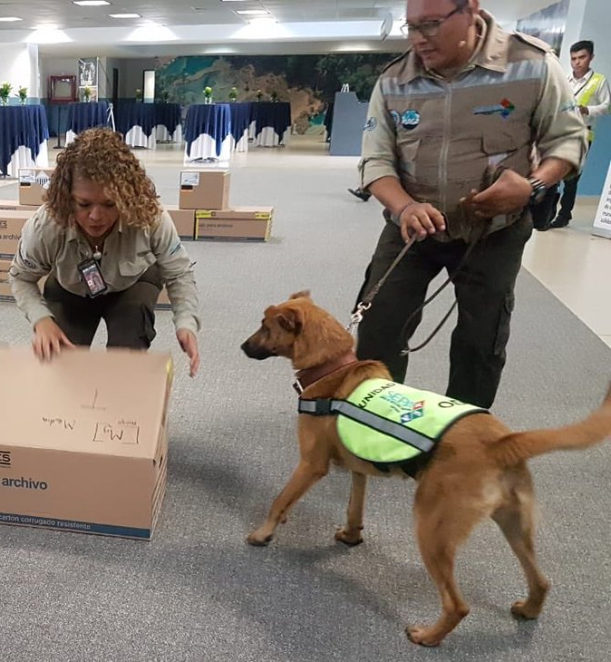
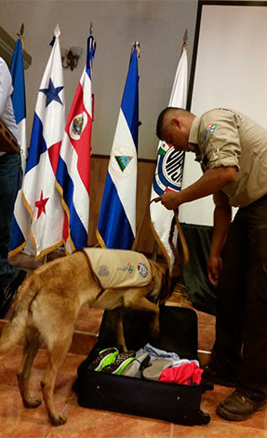
Canine Inspection Unit
Graduation and implementation of Canine Units in Panamá, Guatemala and Honduras, with the support of the Canine School of SENASICA, Mx

Slide 9
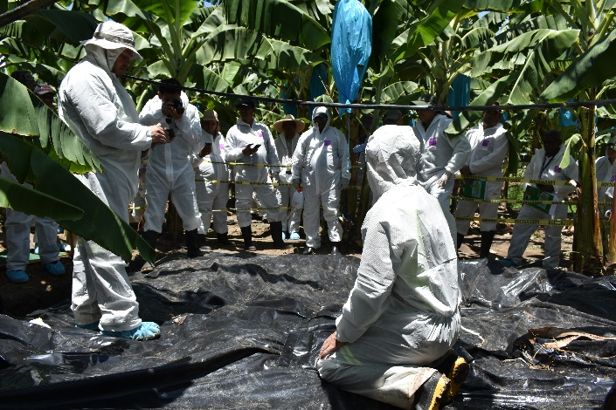
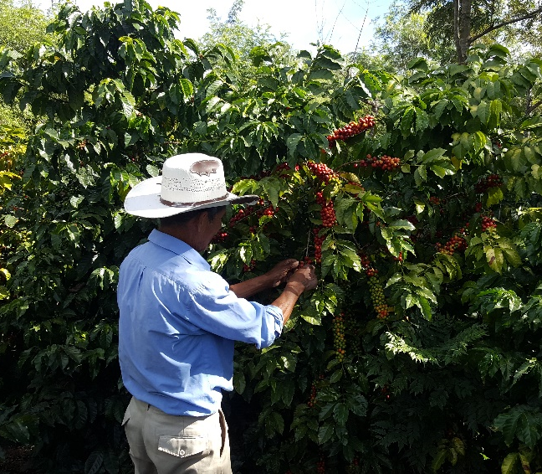
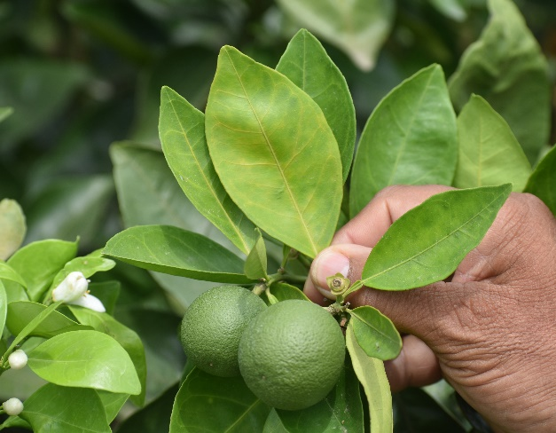

Regional Unit of Pest Risk Analysis
Coordinates the development of Regional Pest Risk Analysis
Supports the OIRSA member States for the development of National Pest Risk Analysis
Provides with technical-scientific based opinions to help the OIRSA members States for decisions making
Provides technical training to create and update technical skills in Pest Risk Analysis
Promotes the adoption of international regulations of the WTO, AMSF Agreement, CODEX Alimentarius, OIE and IPPC.

Slide 10
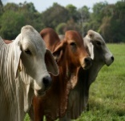
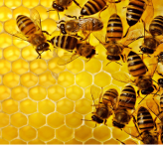
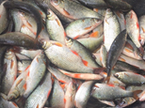
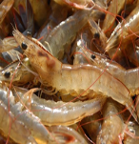
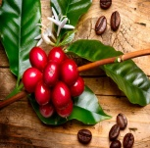

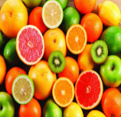
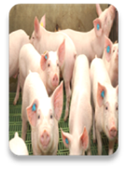
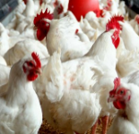
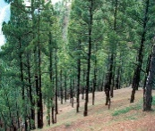
Certification
Fifth level
Food safety
Fourth level
Animal and Plant health
Third level
Traceability of animals,
products and by-products of agricultural origin
Cessation of history and losses
Mobilization control
Identification and registration
Second level
TRACEABILITY
CATTLE
BEES
FISHERY
AQUACULTURE
COFFE
FRUITS & VEGETABLES
CITRUS
SWINE
POULTRY
FORESTRY
Registration of persons and establishments
First level

Slide 11
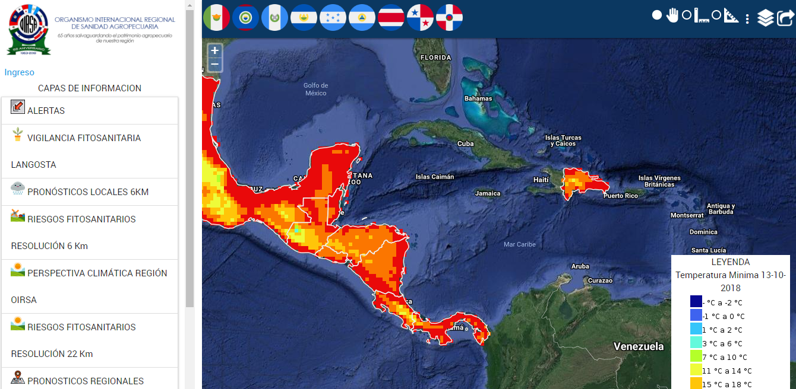
CLIMATE VARIABILITY AND AGRICULTURAL HEALTH PROGRAM

Slide 12
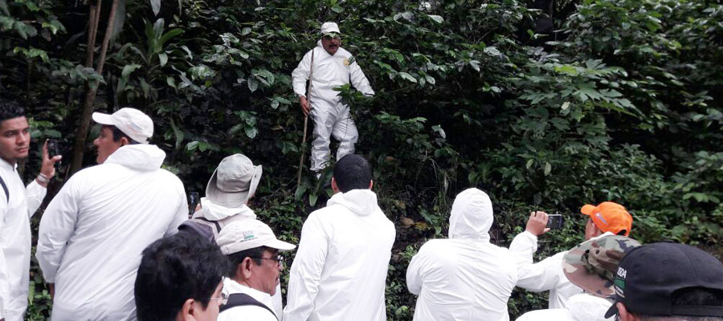
PHYTOSANITARY SIMULATION

Slide 13
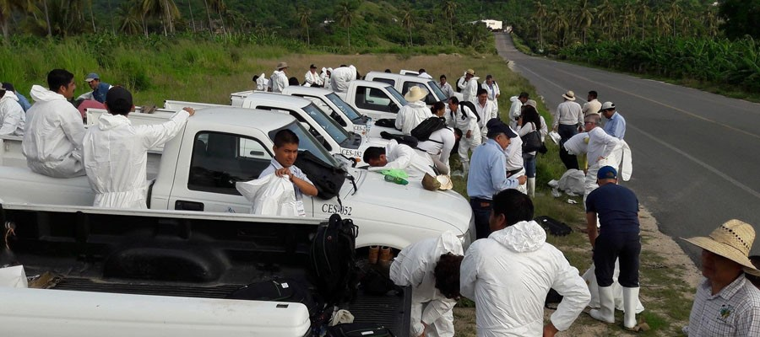
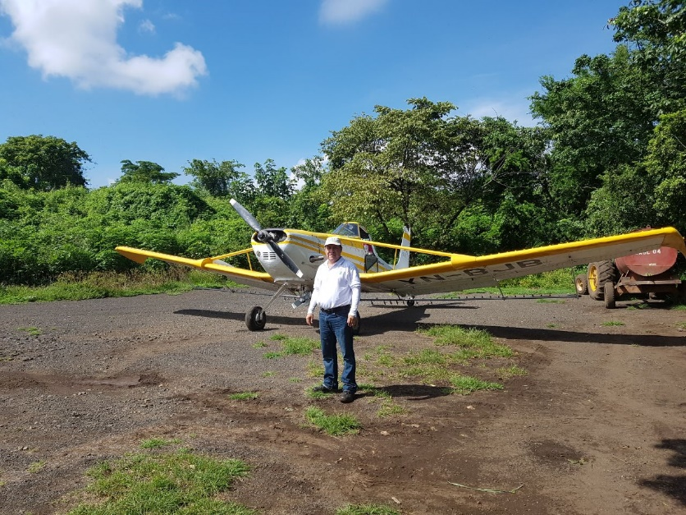
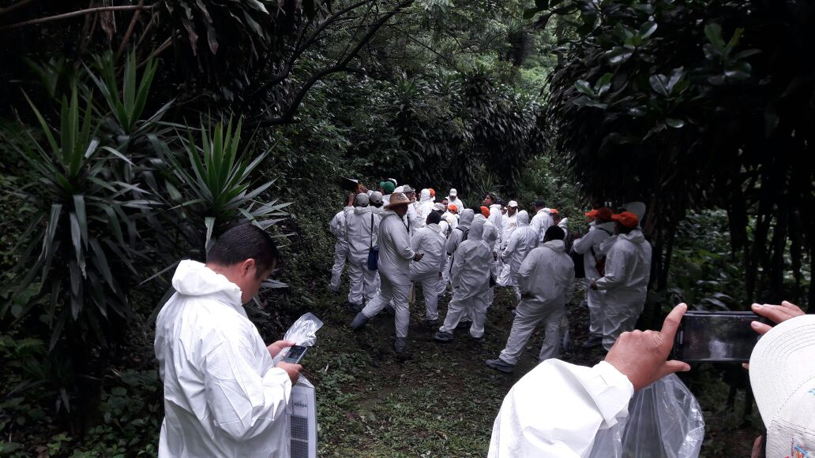
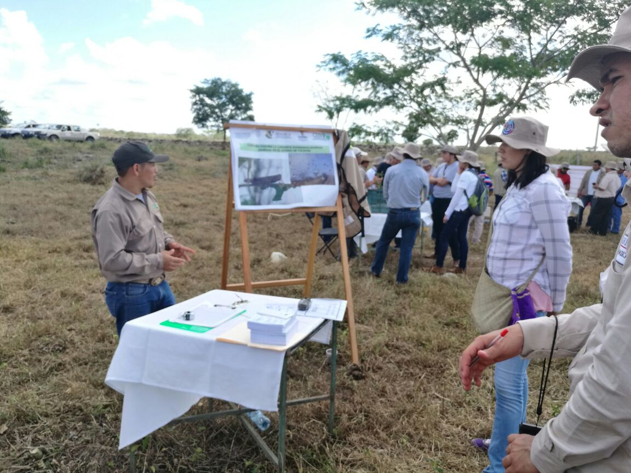

Slide 14
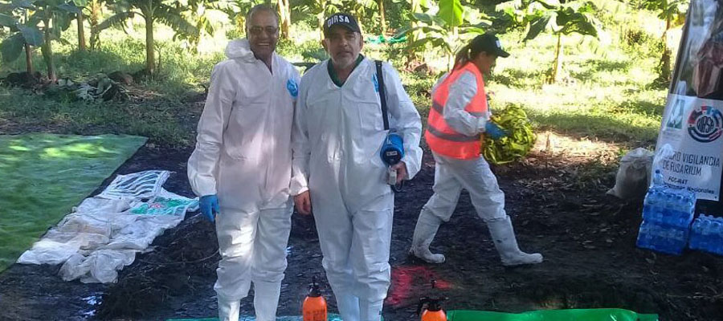
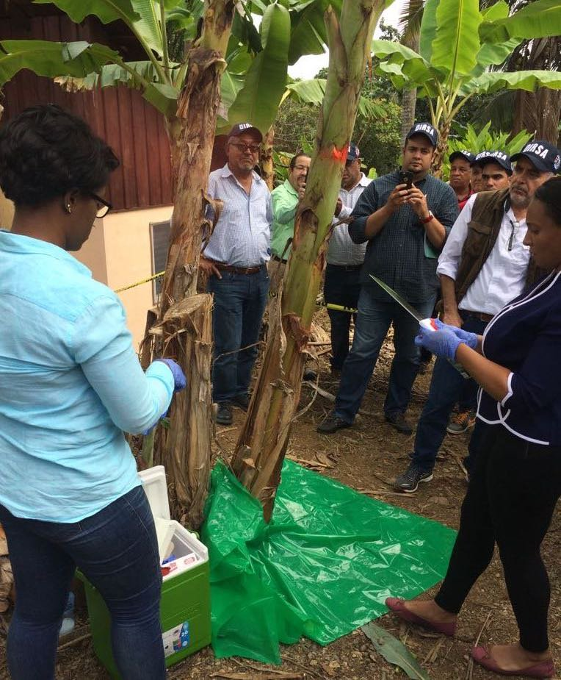
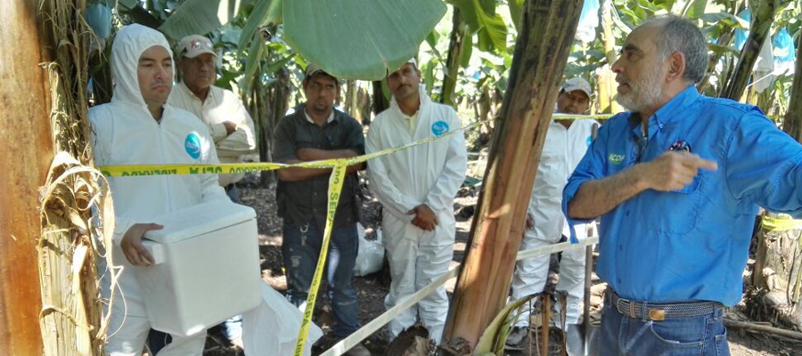

Slide 15
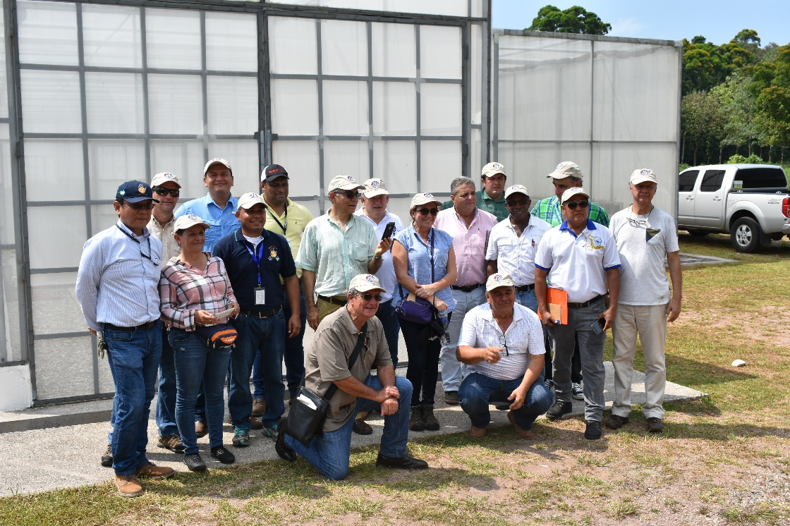
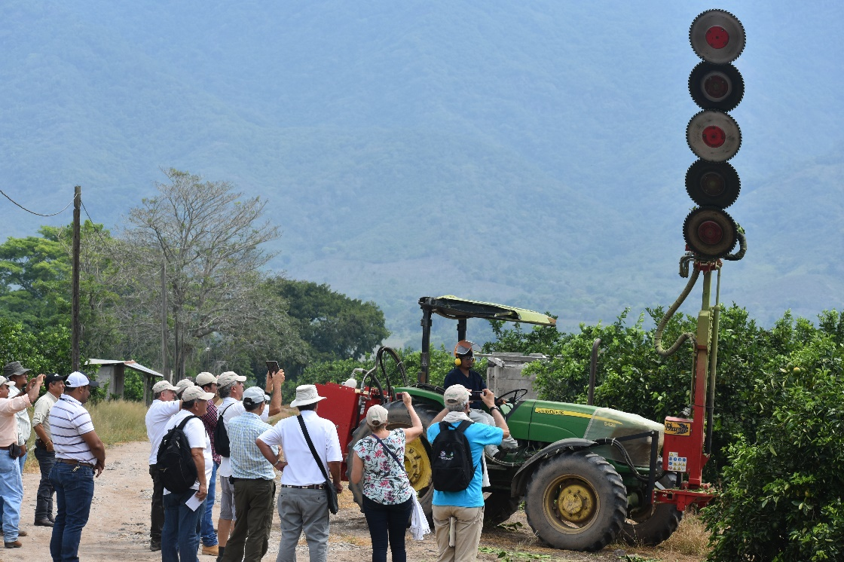
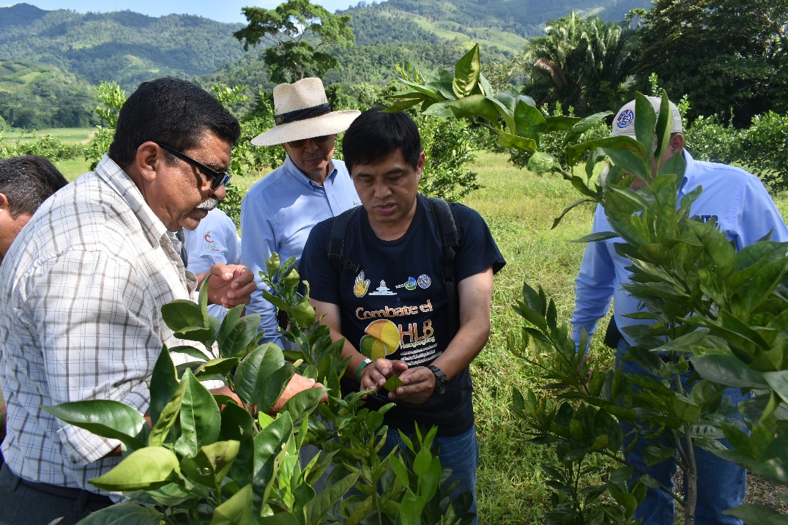
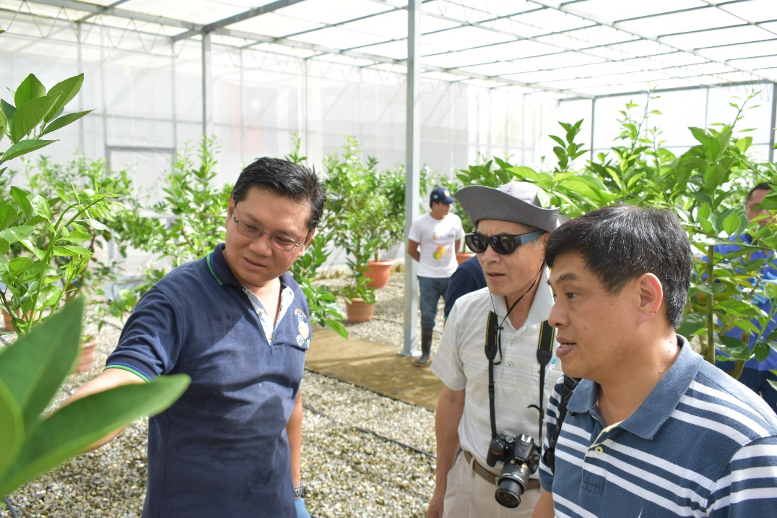
International Missions: Colombia, Panamá, Taiwan ICDF

Slide 16
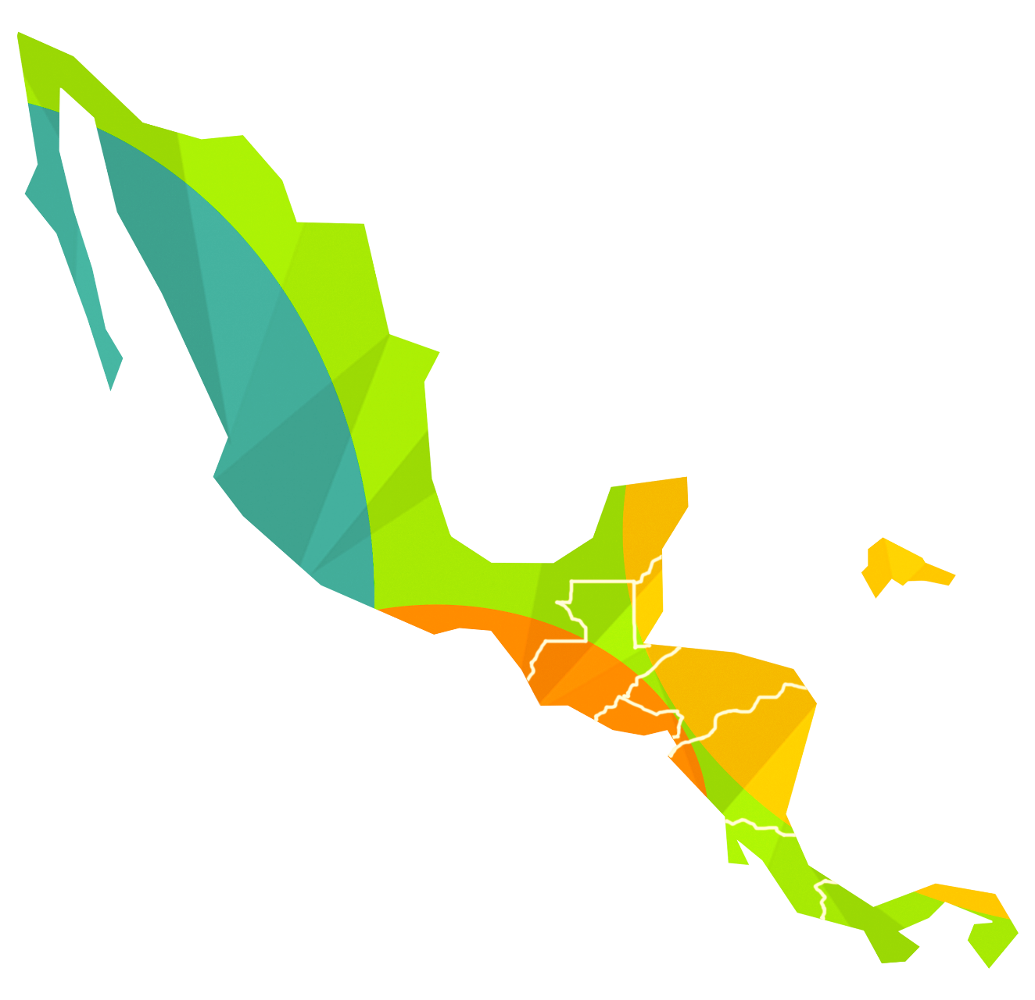


THANK YOU!

