Slide 1

“CGIAR Germplasm health units & CIP’s Health Quarantine Unit: ISO/IEC 17025:2005 Phytosanitary testing, an accredited workflow to assure safe movement of germplasm”
G. Müller & J. Kreuze
Lima, October 31, 2018
30th TC-RPPOs 2018

Slide 2
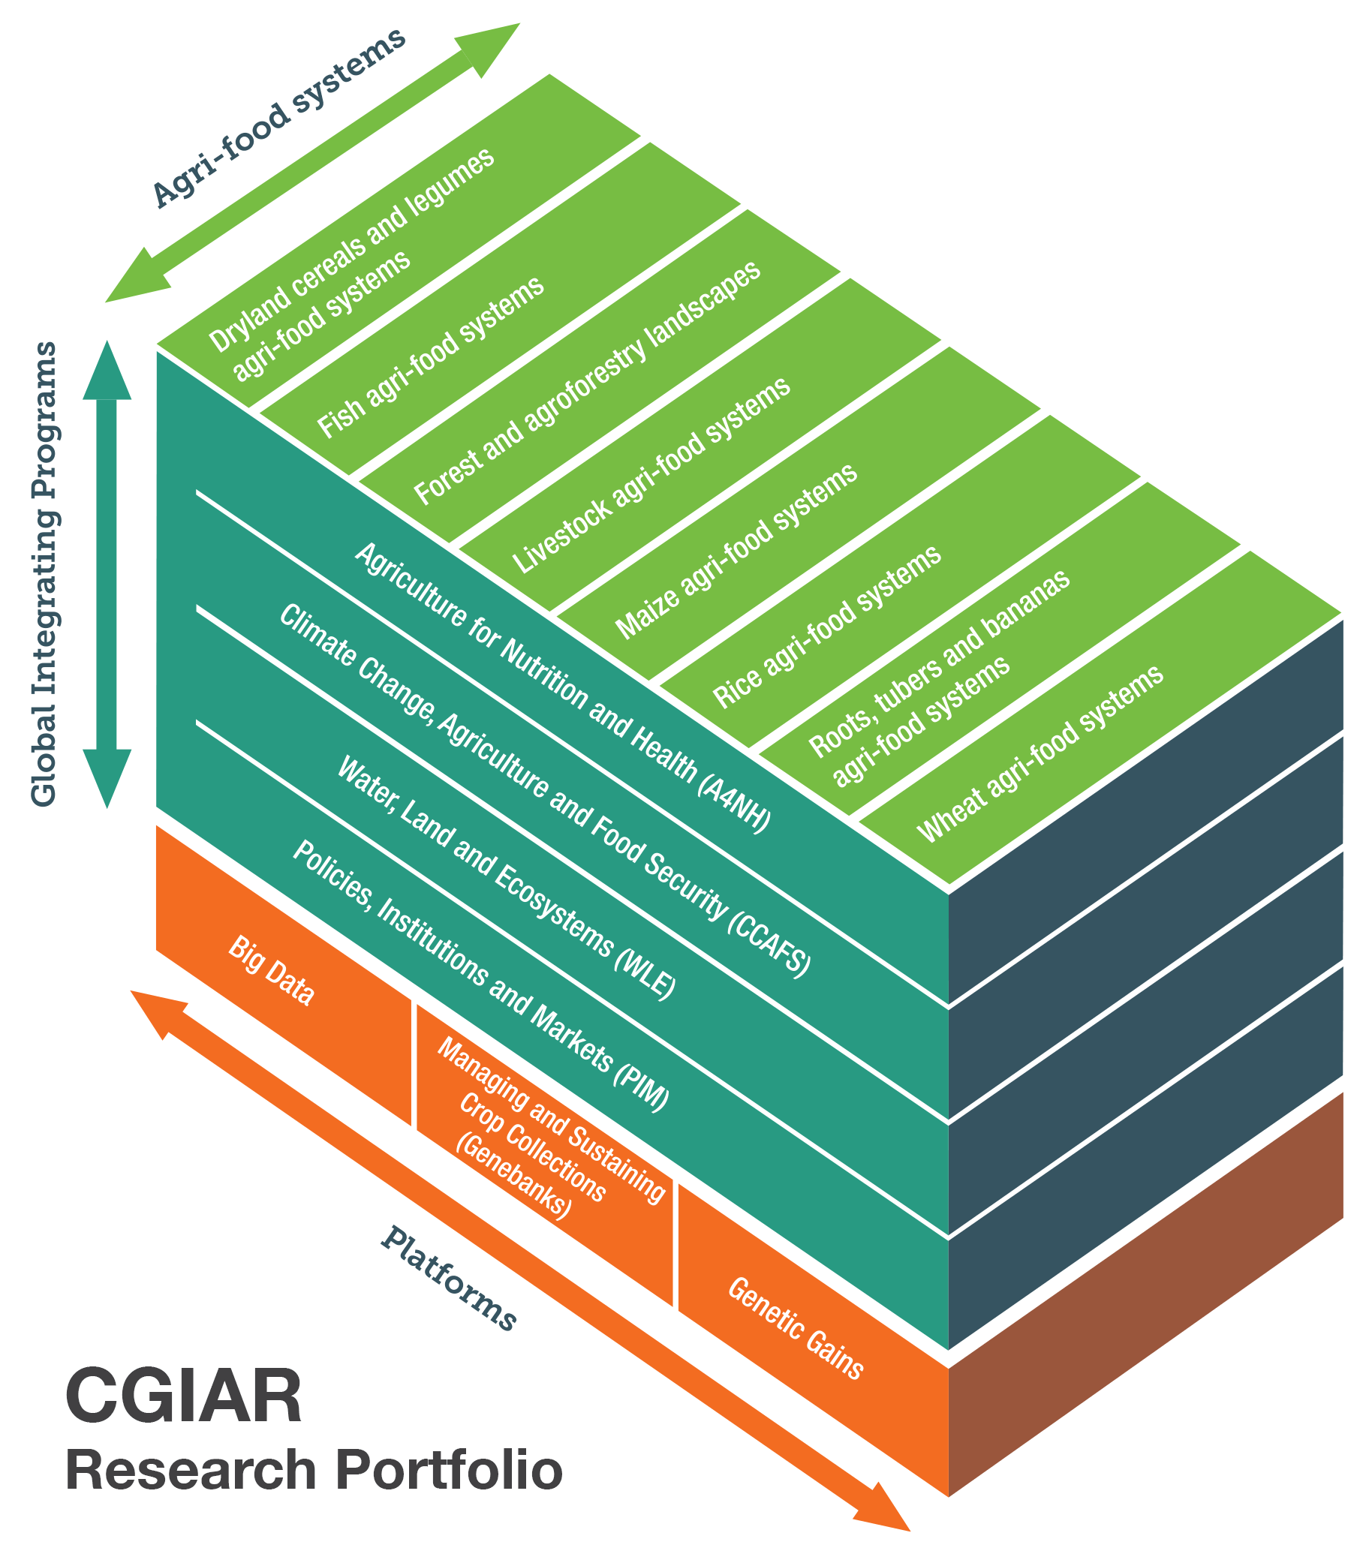
CGIAR
Research Portfolio

Slide 3
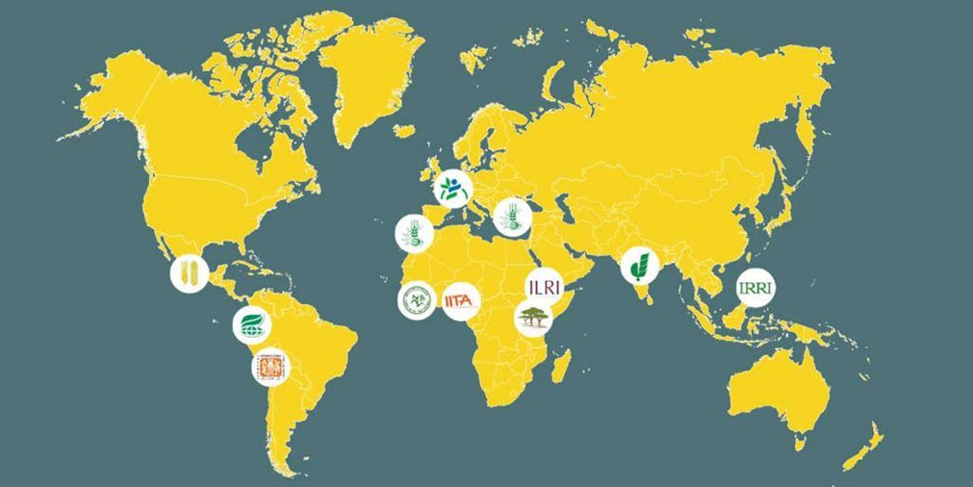
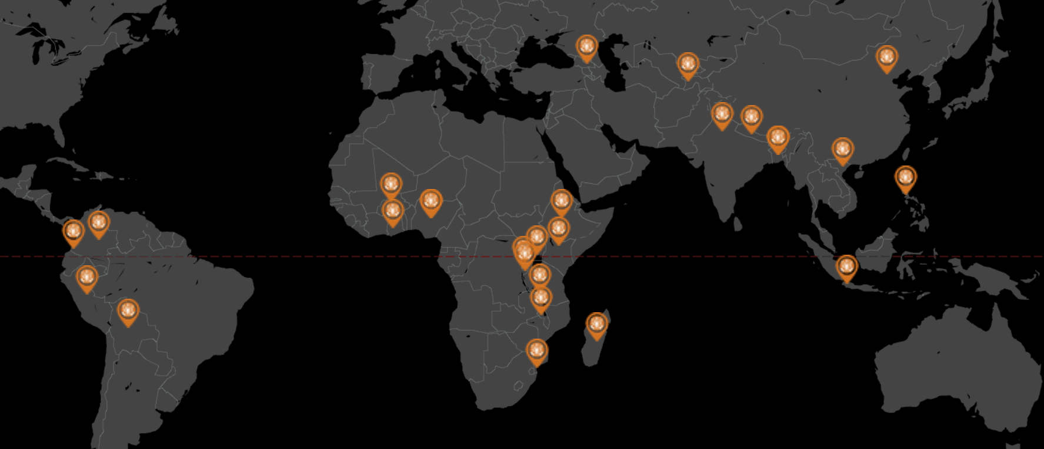

Slide 4
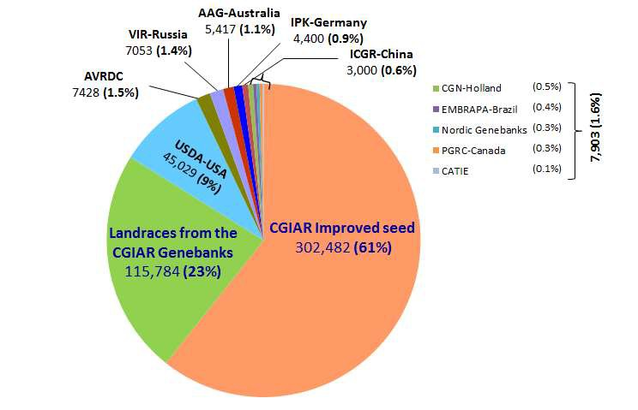
CGIAR leads international distribution of germplasm
Highest percentage of international germplasm distribution
~2,000 requests per year
~100 countries served per year
Seed, clonal and tree germplasm (landraces, improved lines and wild accessions)
Source: GCDT 2008-2010

Slide 5

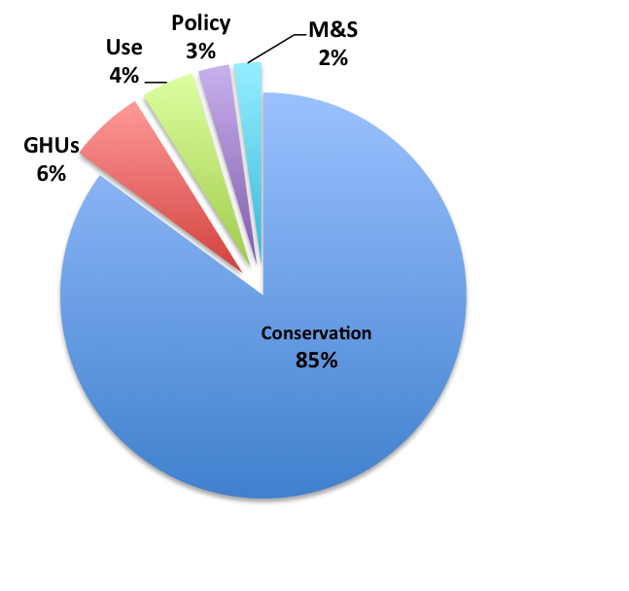
Genebank Platform:
Modules
Conservation Module (with GHU component)
Core genebank operations and ensure ‘disease-free’ germplasm availability
Improve core genebank operations and management
Use Module
To facilitate more effective access and use through
targeted delivery of germplasm that better meets the needs of users
Policy Module
To ensure Centers comply with international policies and laws, increase their influence in policy-making processes and strengthen capacity of national programs

Slide 6
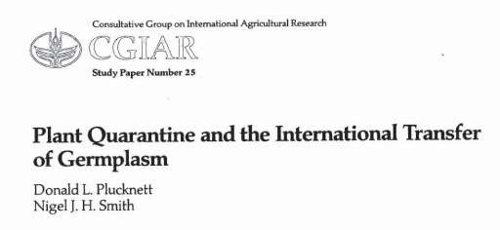
International Germplasm Health Requirements IPPC recommendations in the 6th International Plant Protection Congress (August 1993, Montreal, Canada)
Germplasm distribution activity, has an inherent risk of introducing exotic plant pests – pathogens, insects, weeds, etc. – that could result in potential economic losses.
Each center should take adequate measures to reduce the risk of pest and pathogen spread with germplasm exchange
Standardize procedures for handling plant health to cope with diverse quarantine systems in different countries
Comply with IPPC and NPPO procedures
Led to the establishment of Germplasm Health Units (GHUs)

Slide 7
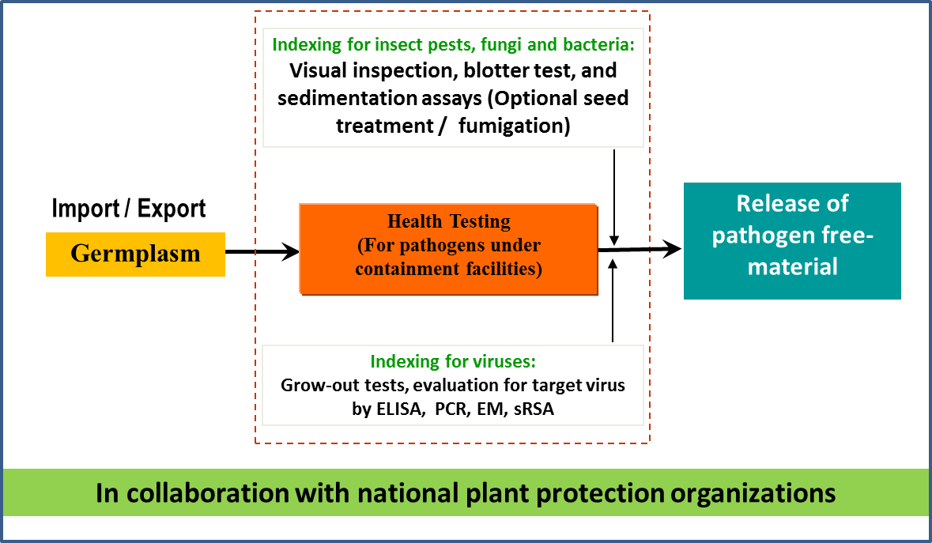
GHUs ensuring safe exchange of germplasm
Eleven CGIAR genebanks manage over 750,000 accessions in 35 collections around the world
GHUs provide phytosanitary services to the 35 collections held by the 11 CGIAR centers
In situ, Ex situ, in vitro and cryo collections

Slide 8
Wild species
Landraces
Improved lines
Research materials
GHU at all stages of germplasm flow
Ex-situ conservation
In-situ conservation
Cryo conservation
Collection
Back-up conservation
Phytosanitation
Phytosanitation
Conservation
Regeneration
(seed increase)
Research (genotyping, other)
Pre-breeding
Phytosanitation
Phytosanitation
Breeding
Distribution
Evaluation trials
Variety
Germplasm
Seed systems

Slide 9

GHUs ensure phytosanitary safety of genetic resources
Research & Service functions
Regulatory
compliance
Development
of Diagnostic
tools and
procedures
Surveillance
and pest risk
assessment
GHU
Clean
planting
material
production &
distribution
Training and
capacity
development
Knowledge on exotic and
endemic pest
and pathogens

Slide 10
CIP – HQU, is aligned with national and international standards
International Standards for Phytosanitary Measures (ISPMs)
RPPOs
Asia and Pacific Plant Protection Commission (APPPC)
Comunidad Andina (CA)
Comite de Sanidad Vegetal del Cono Sur (COSAVE)
European and Mediterranean Plant Protection Organization (EPPO)
Inter-African Phytosanitary Council (IAPSC)
Near East Plant Protection Organization (NEPPO)
North American Plant Protection Organization (NAPPO)
Organismo Internacional Regional de Sanidad Agropecuaria (OIRSA)
Pacific Plant Protection Organization (PPPO)
NPPOs
SENASA
KEPHIS
Etc.
- EPPO technical guidelines PM 7/98 (2010)
- FAO/IPGRI Technical Guidelines for the safe movement of germplasm: Potato N°19 (1997)
- FAO/IBPGR Technical Guidelines for the safe movement of germplasm: sweetpotato (1989)
Next

Slide 11
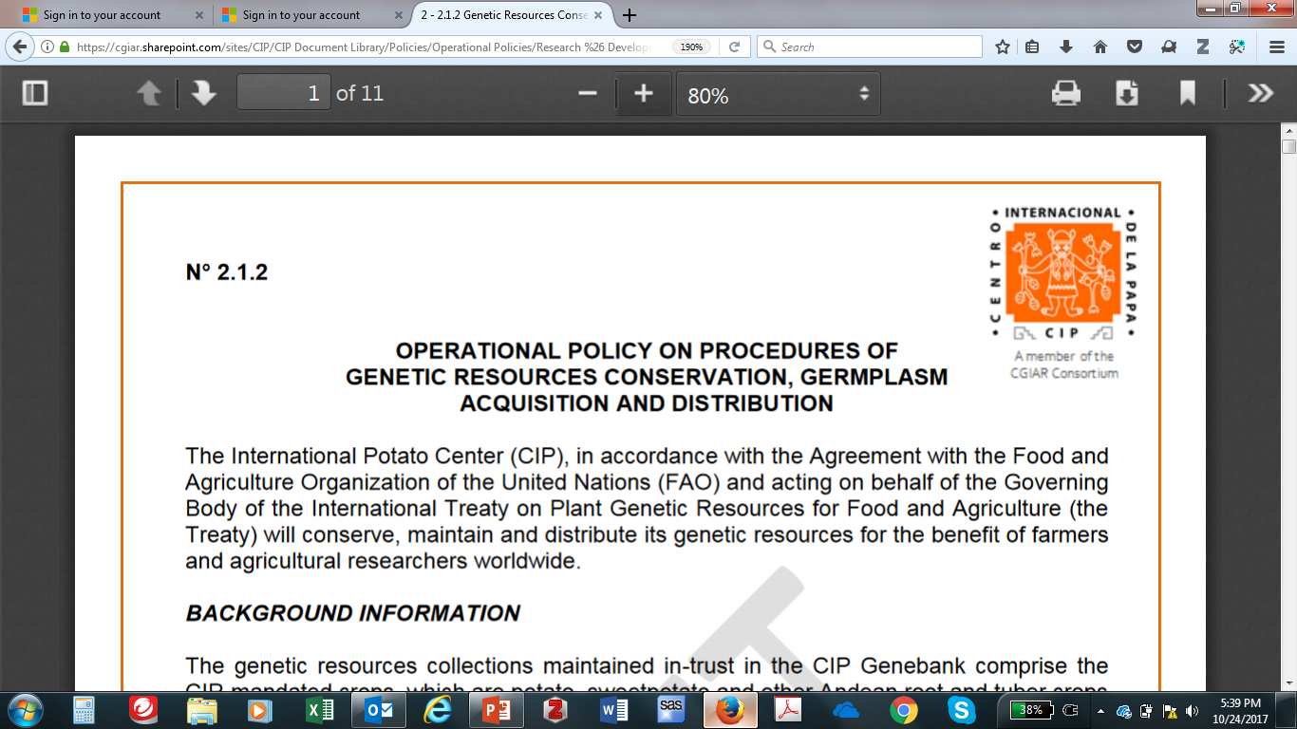
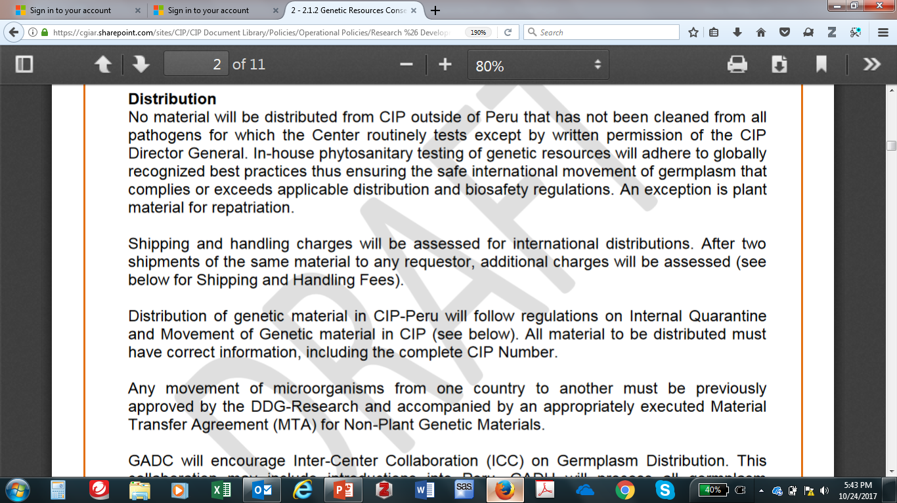
GHUs: Surveillance and Pest Risk Assessment
The main role of CIP’s GHU is to enforce the plant health policy within CIP through the surveillance and monitoring of plant health, control of harmful organisms (HO) and/or perform risk analysis and develop / implement measures to prevent or limit their spread.
Back

Slide 12
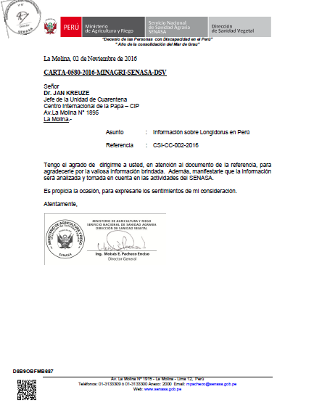
Awareness and exchange of pest distribution knowledge on exotic and
endemic pest and pathogens with NPPOs
Back

Slide 13
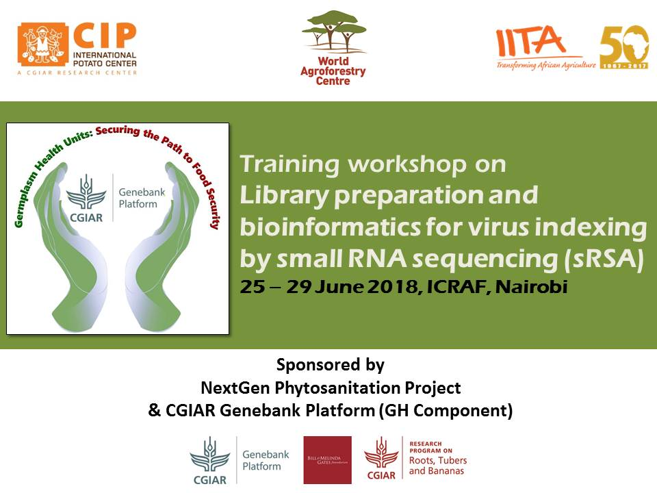
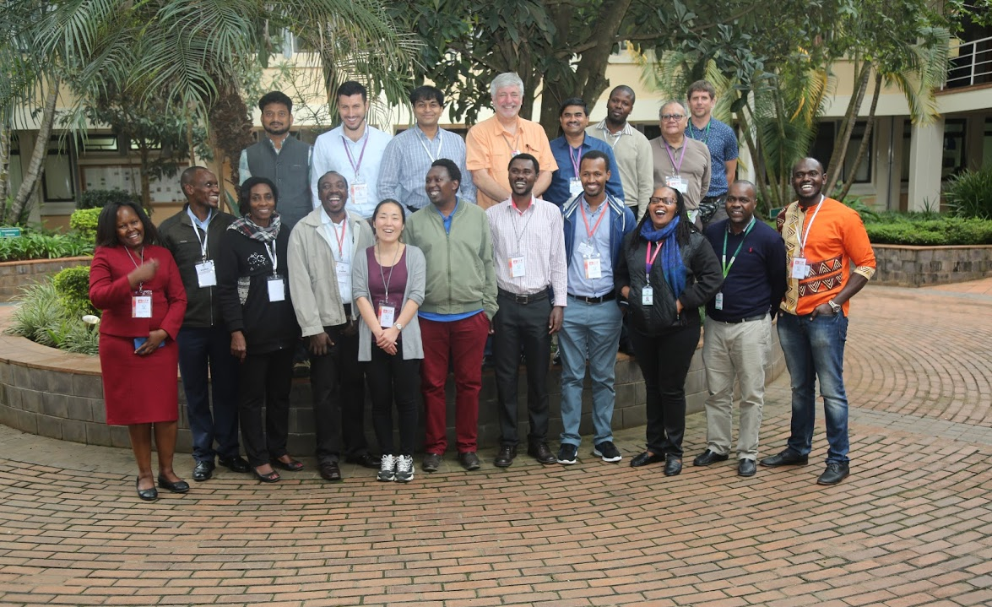
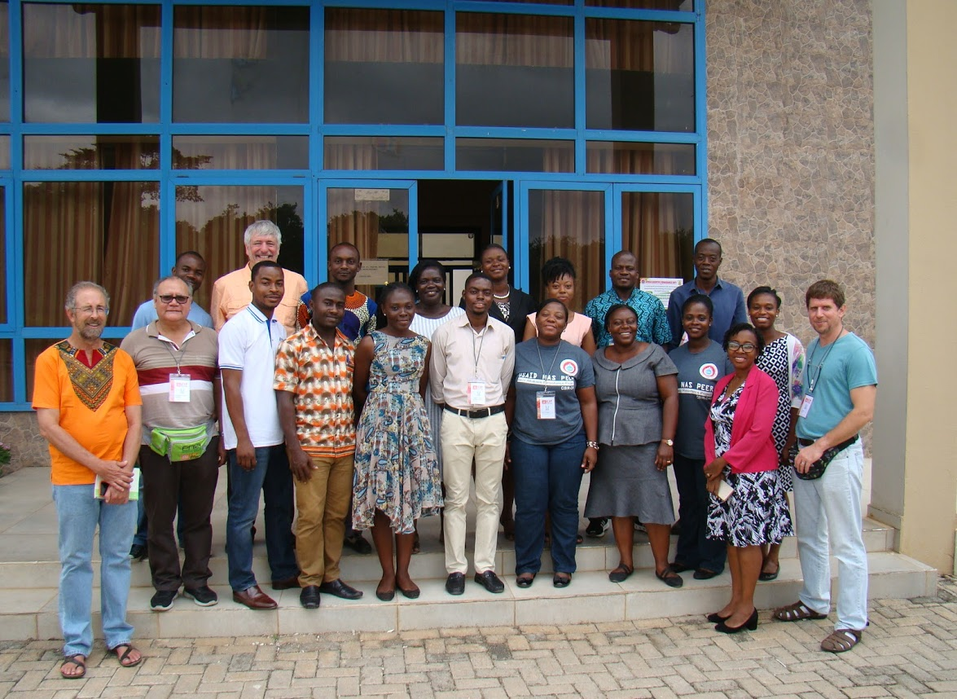
Training courses & capacity development
Preventing risk of pest and pathogen spread with germplasm
National phytosanitary capacity development for innovations, development and extension
Contributions to national clean planting material production systems
Kumasi, 18-22 June 2018
Nairobi, 25-29 June 2018
Since its foundation CIP organize several courses to share knowledge on diagnostic methods
Since 2018, CIP also offers service to prepare libraries and bioinformatic analysis
Next

Slide 14
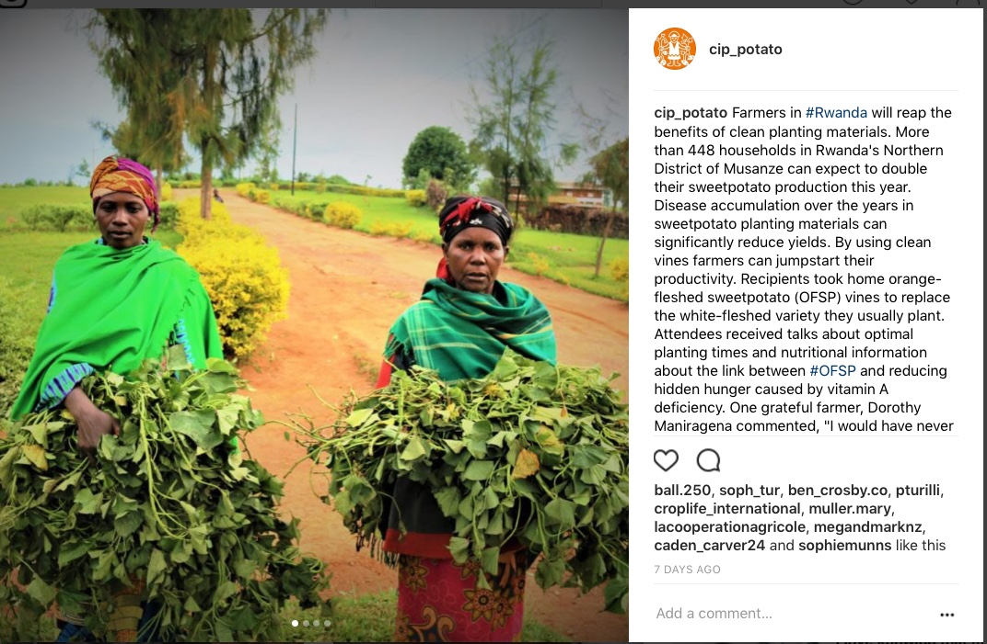
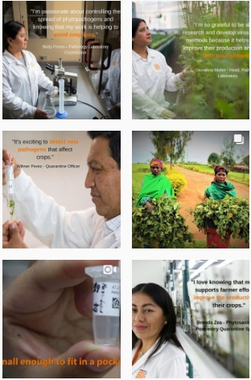
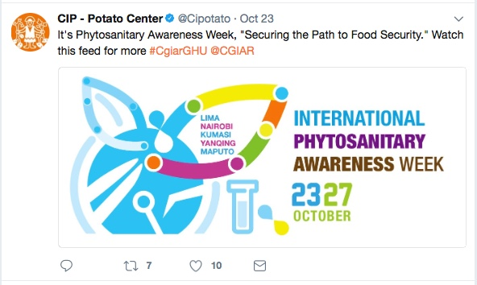
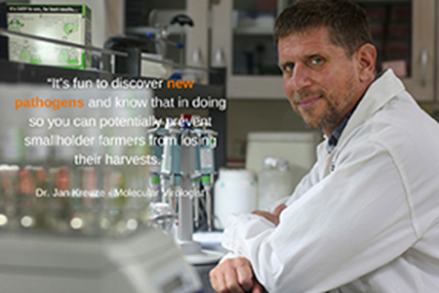
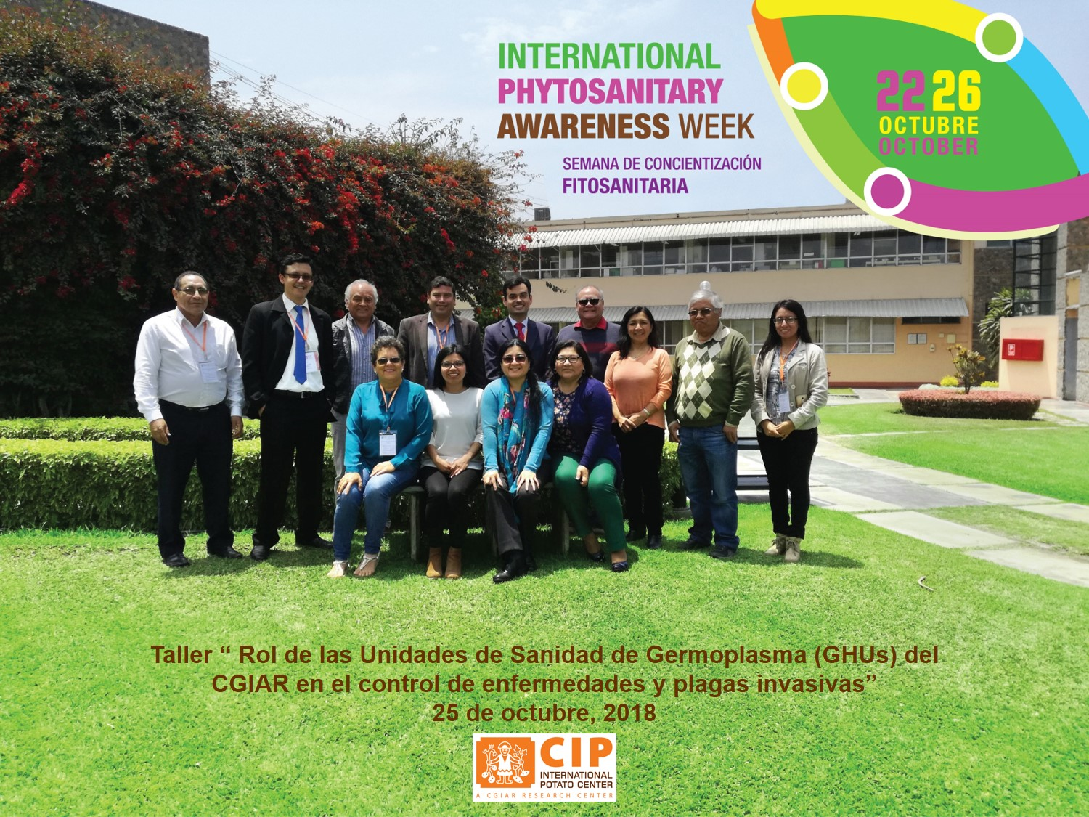
CGIAR & Crop trust: Awareness week campaigns on phytosanitation
Increase awareness on phytosanitary obligations and emerging challenges
Showcase tools and technologies for seed health testing and phytosanitary controls in CG centers
Joint activities with national quarantine authorities
Communication channels (posters, flyers, webinars, blogs, etc.)
Back

Slide 15
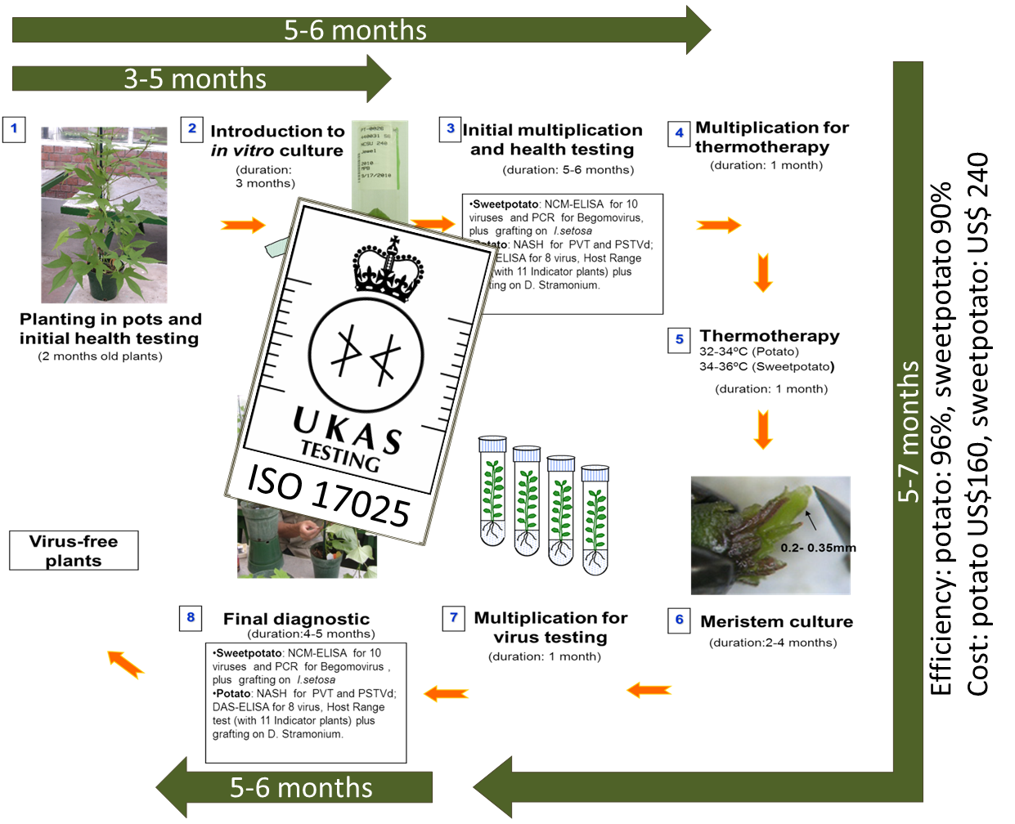
Distribution of CIP’s germplasm and breeding lines – Internal Procedures accredited
Phytosanitary requirement for International distribution = HS2 status
Next

Slide 16
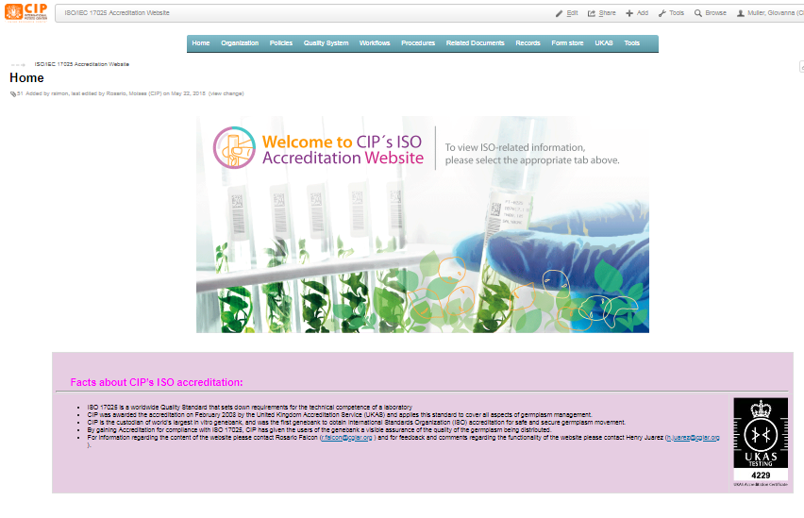
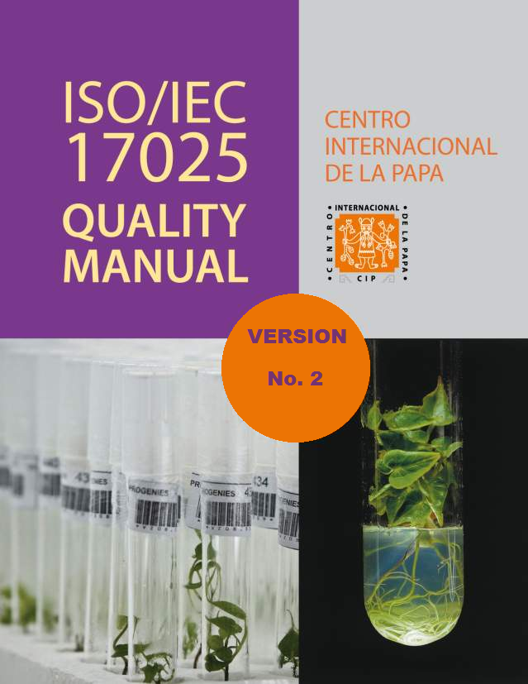
Quality Management System at CIP. ISO/IEC 17025 accredited Phytosanitary testing and cleaning workflows.
Next

Slide 17
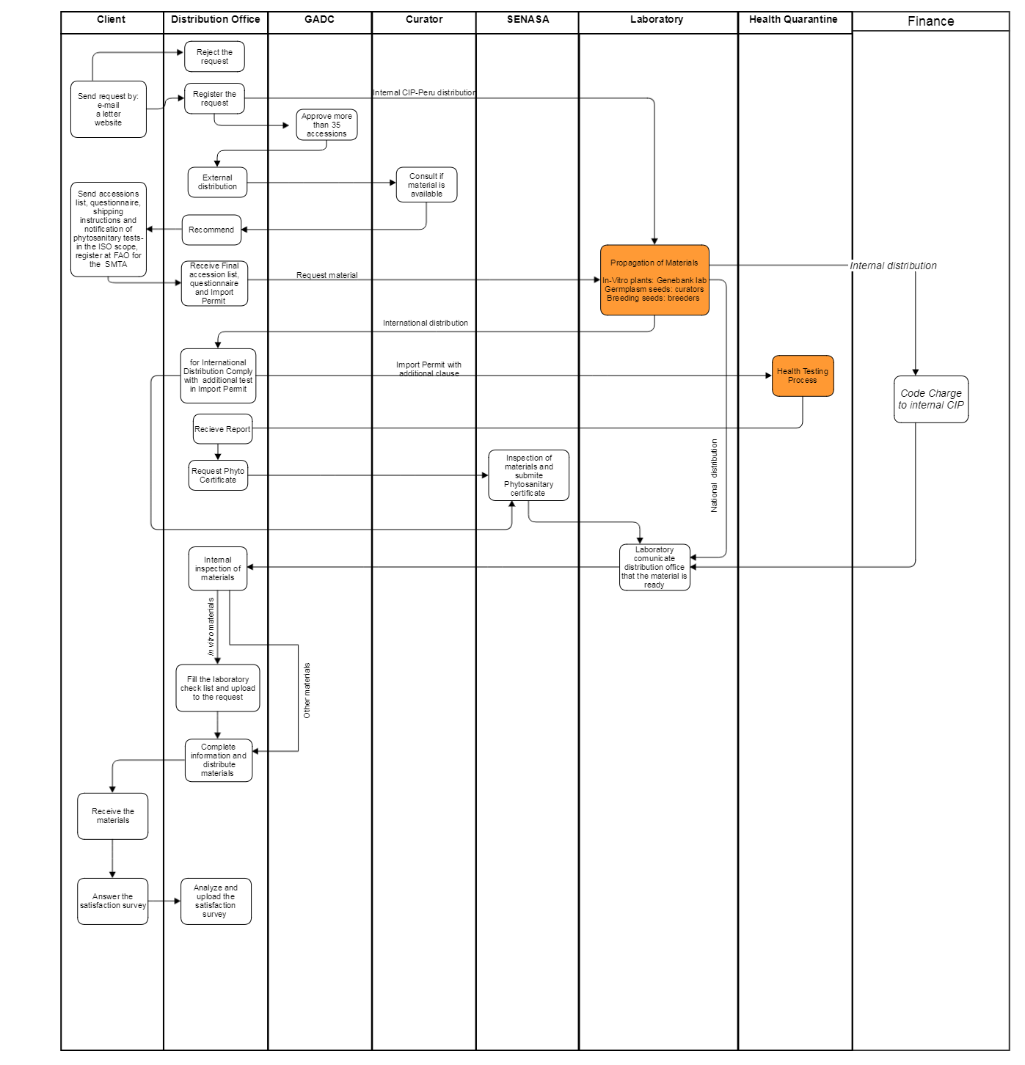
Germplasm Distribution Workflow - WF019
Next

Slide 18
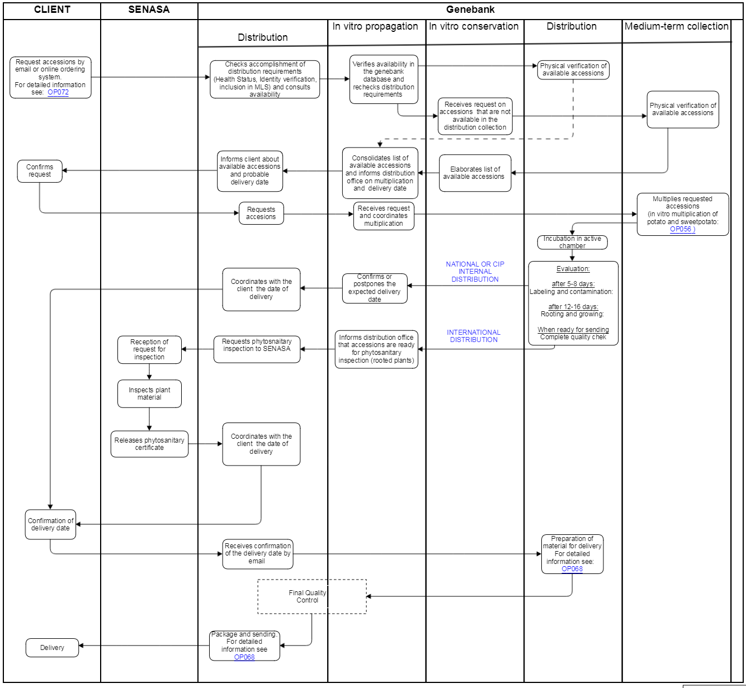
Genebank - Distribution of in vitro material - WF020
Next

Slide 19
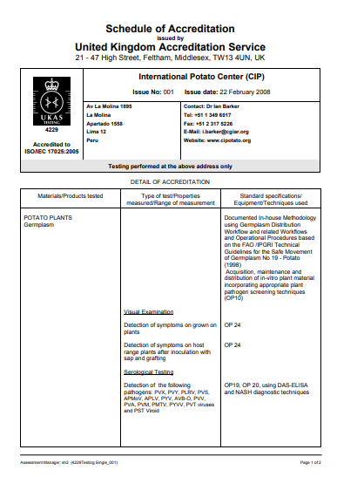
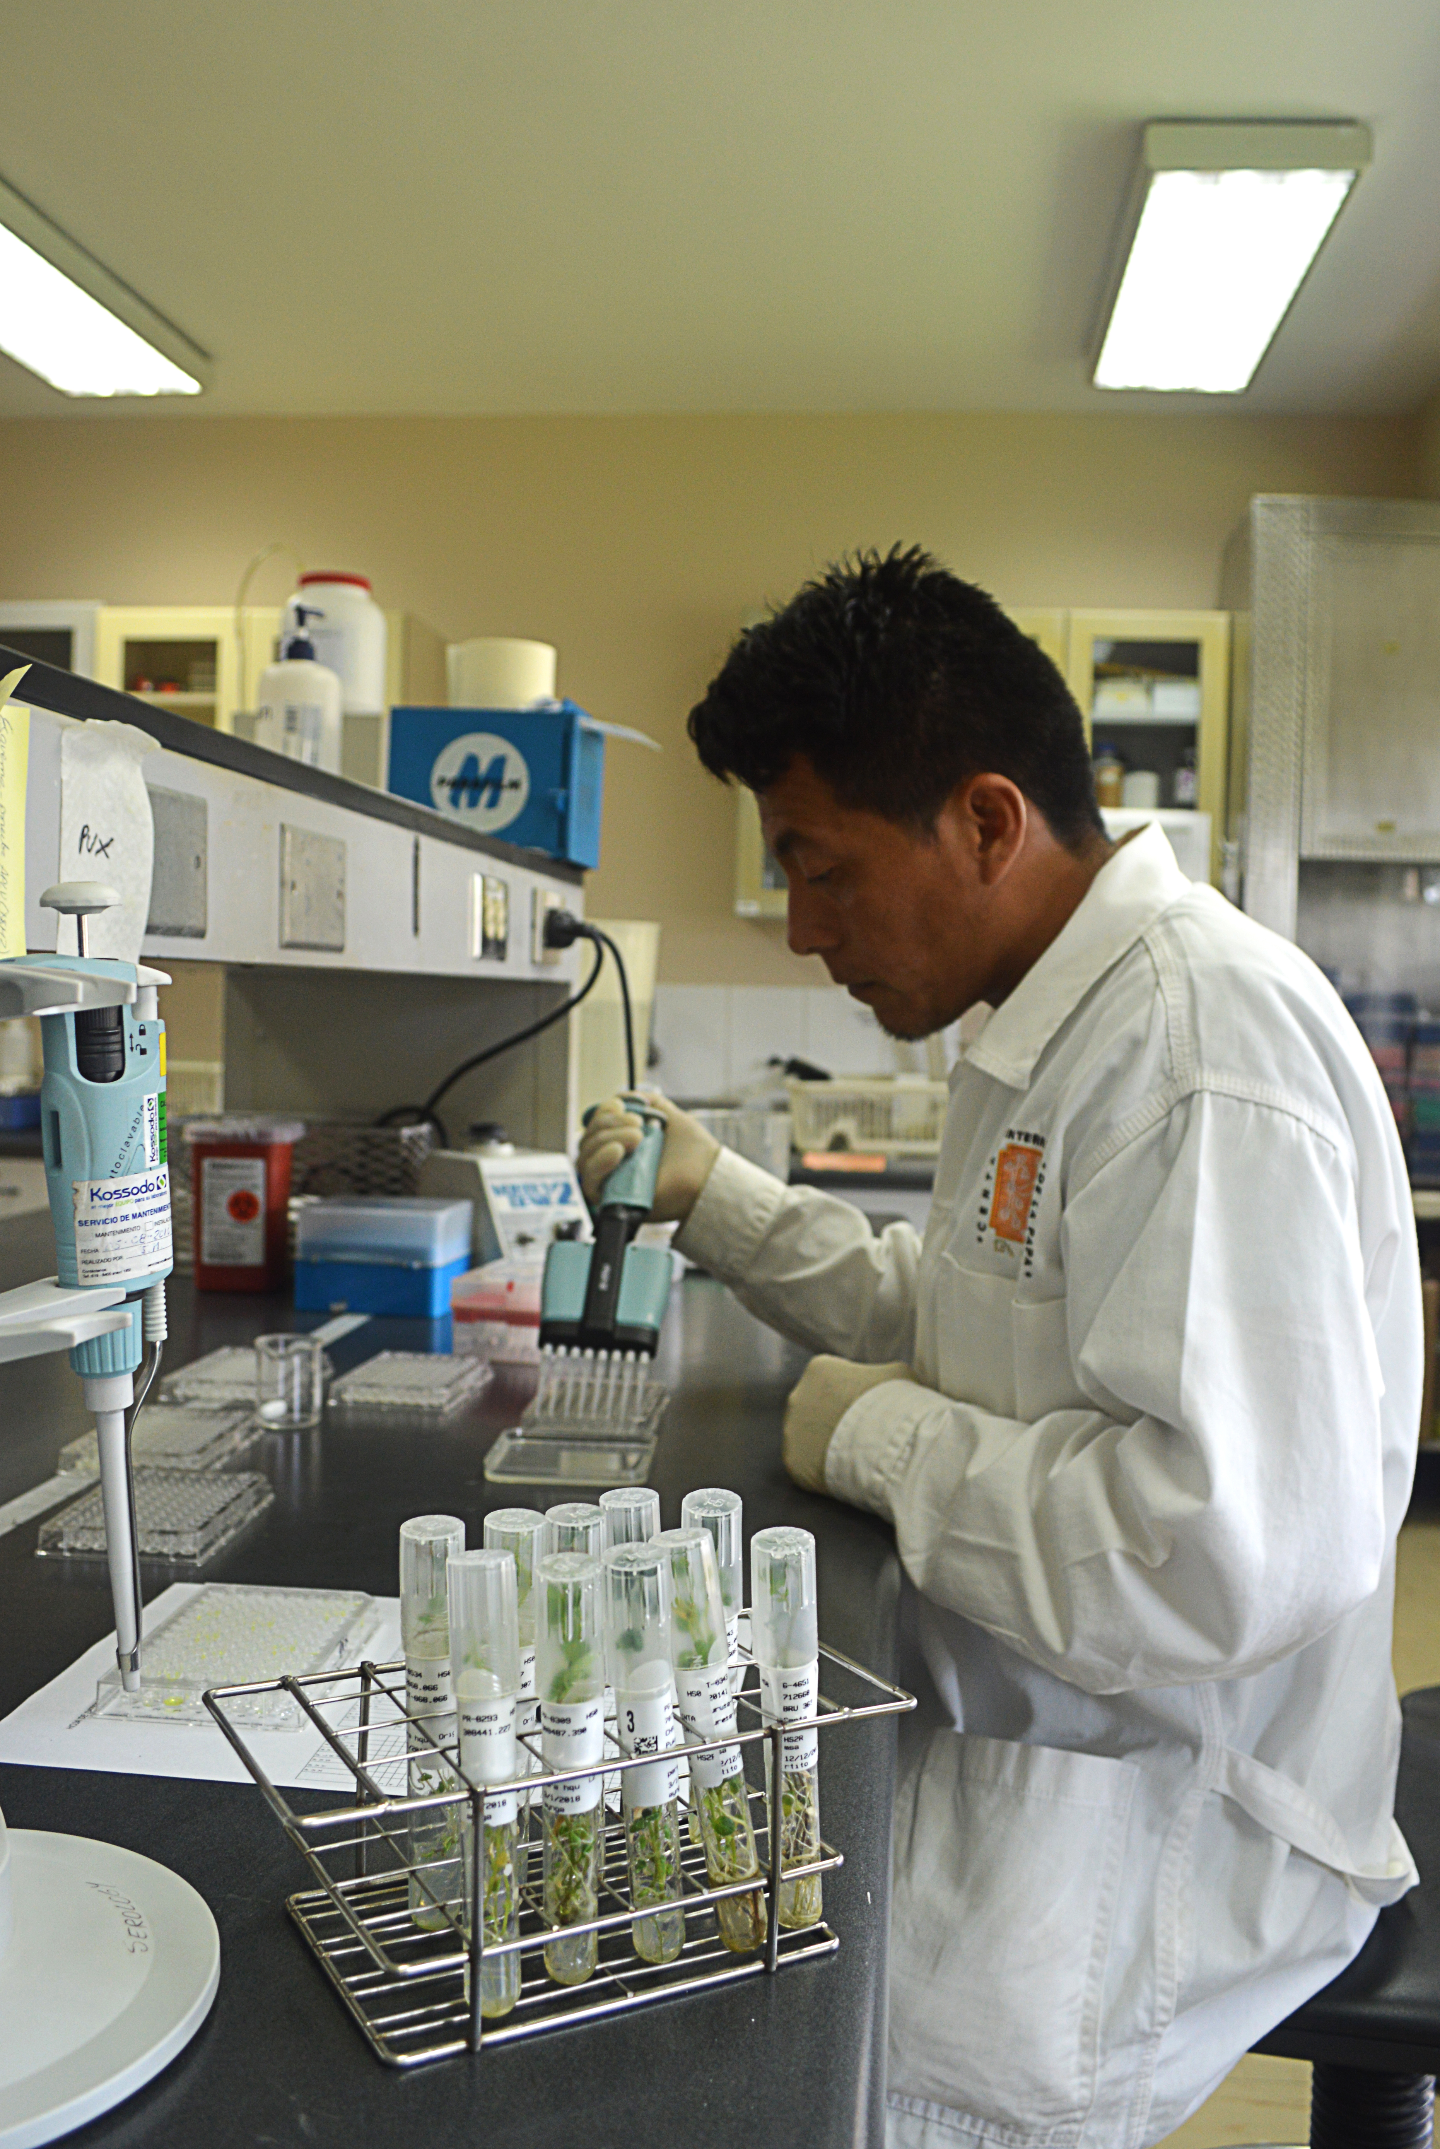
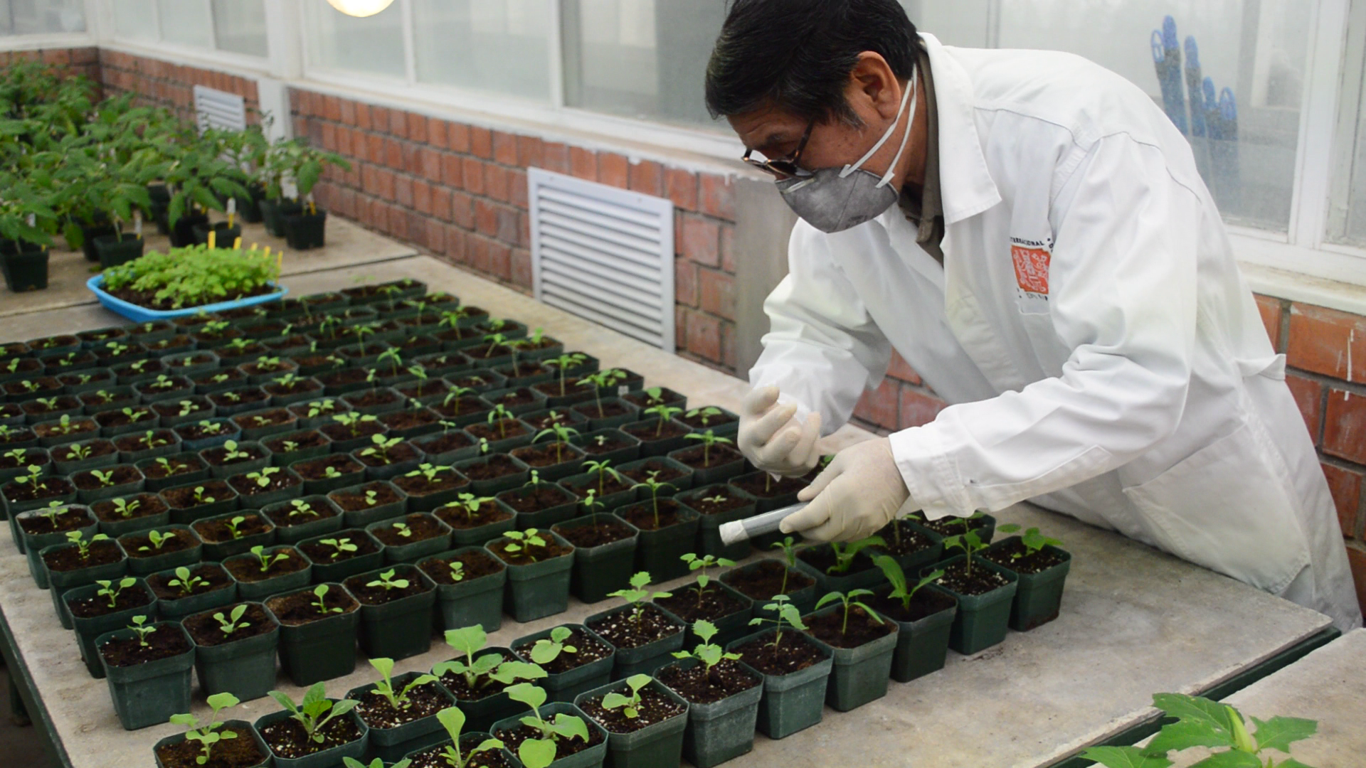
Accredited pathogen testing for potato
Next

Slide 20
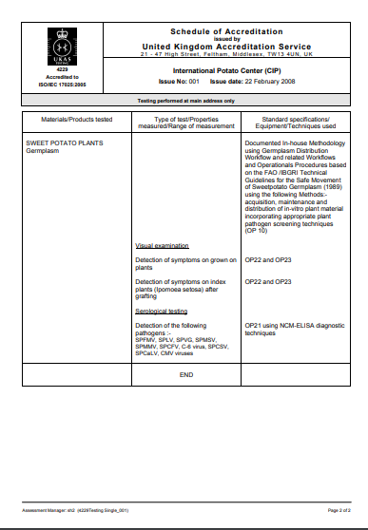
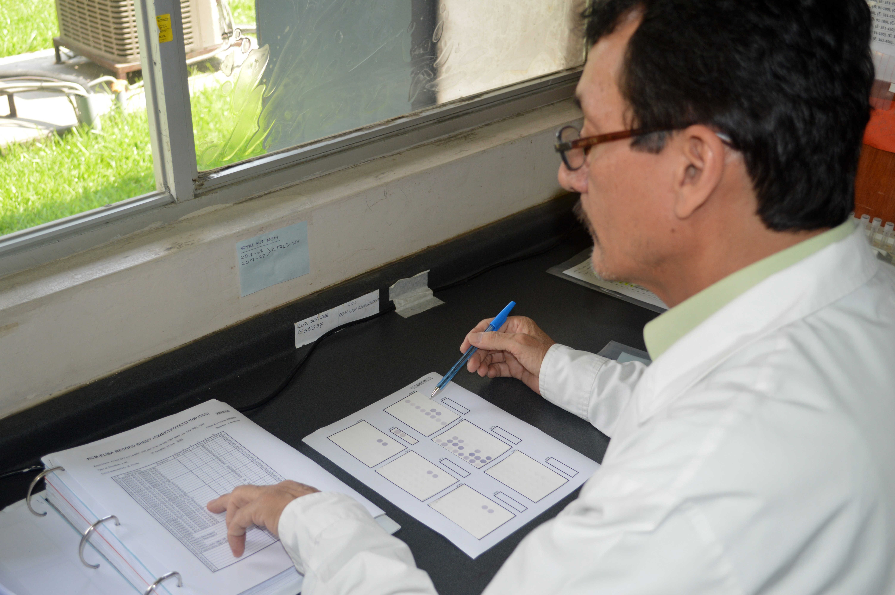
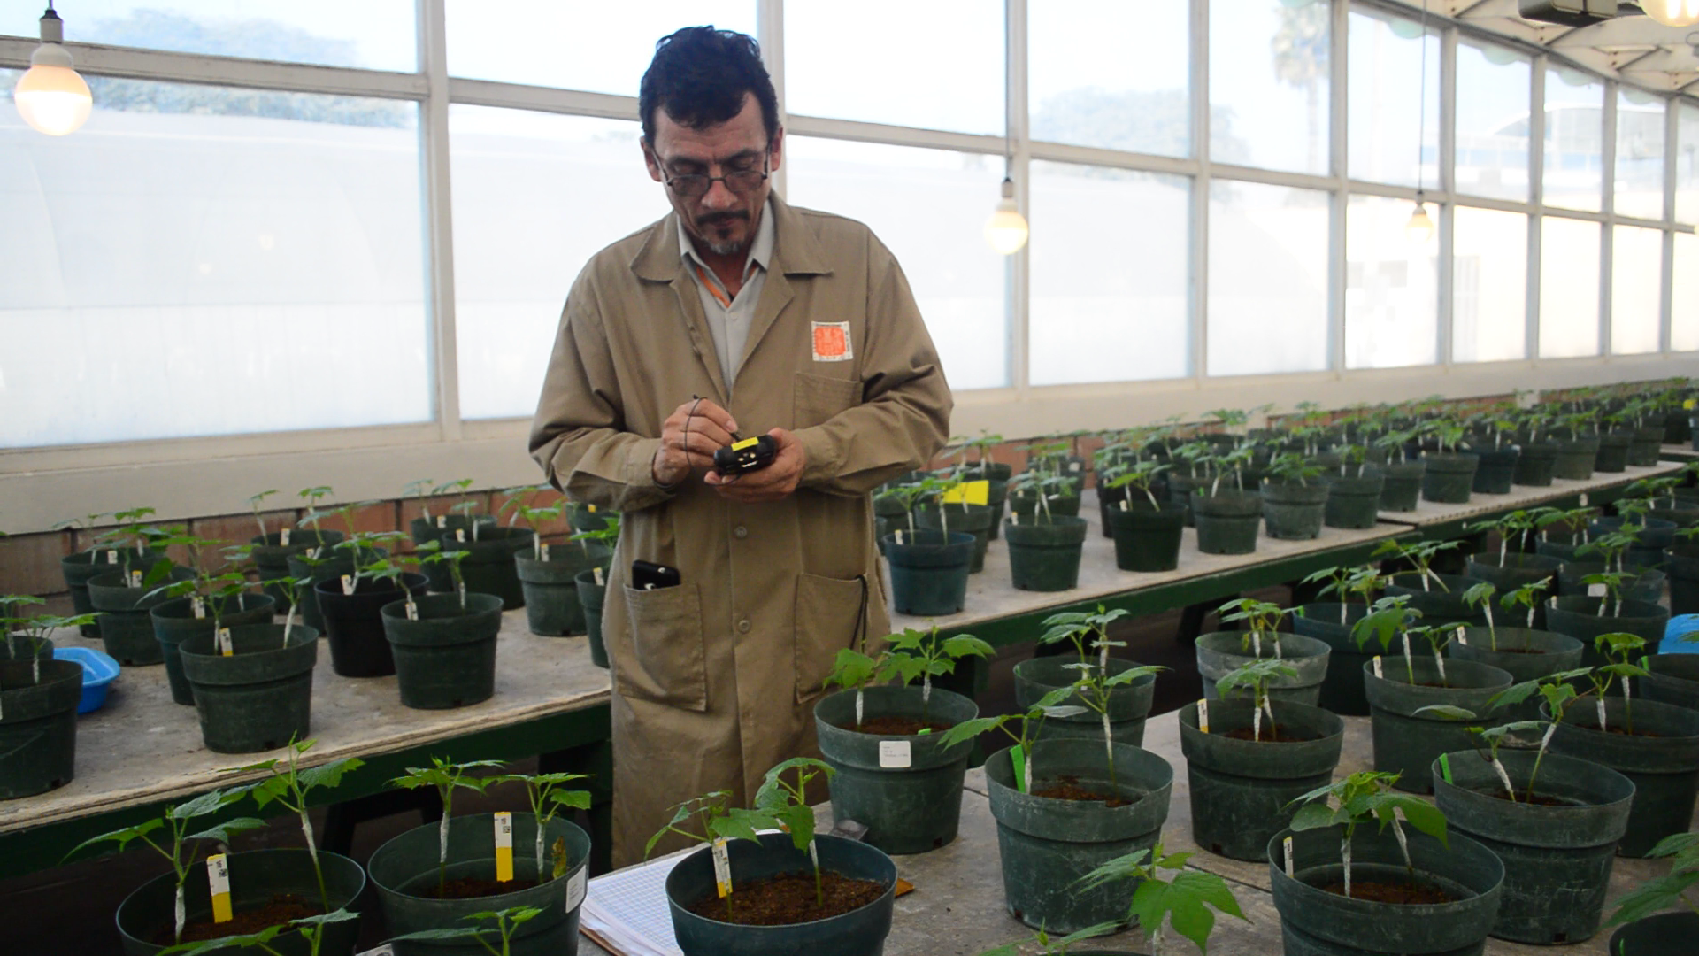
Accredited pathogen testing for sweetpotato
Next

Slide 21
Distribution of CIP’s germplasm and breeding lines – Internal Procedure
Local movement
International distribution
Back

Slide 22
Quality Management Systems (QMS)
for the CGIAR Germplasm Health Units
“QMS for CGIAR GHUs, similar to ISO/IEC 17025, and harmonize quality standards for laboratory management, testing protocols, facilities, equipment and training”
Technical
Policy
Managerial
ME&L
Stage 1: Evaluation of current status
Stage 2: Development of QMS framework
Stage 3: Establishment and implementation of QMS
Stage 4: Feasibility for accreditation
Stage 5: ME&L and assessing the impact and benefit
2017
Framework & workplan
2018
Implementation
2019
Implementation a and verification of establishment

Slide 23

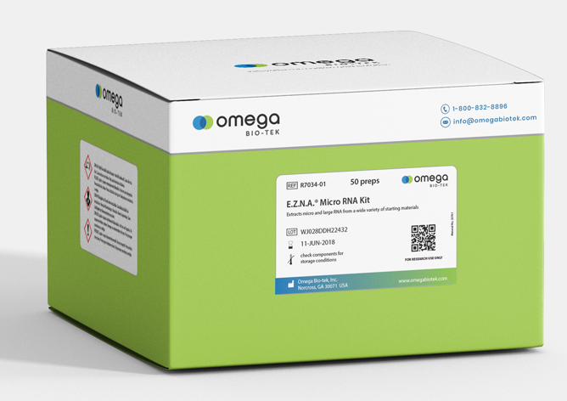
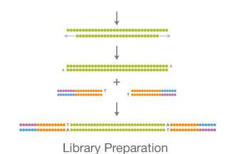
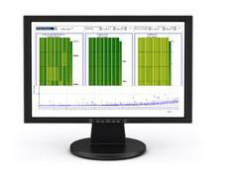
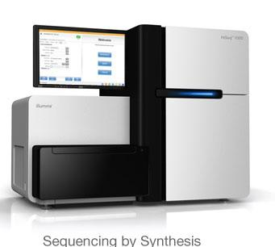
Validation of NGS based approach for virus indexing in clonally propagated crops
2 weeks, 96 samples
~ 30 US$/sample
Cut and purify 20-30 nt band, prepare library
3-5 days
RNA extraction
<1 US$/sample
Send to sequencing provider
Bio-informatics: VirusDetect v1.0
<1 day
cue + 3 days
~20 US$/sample

Slide 24

Conclusion and Prospects
CIP-HQU unit adheres to the highest (inter)national quality standards and strives to keep improving the safety of germplasm movement by developing, adopting and implementing novel diagnostic approaches
Germplasm exchange is a joint endeavor with national partners
GHU initiative of the “CGIAR Genebank Platform” poised to further strengthen collaborations with national partners
  Working towards ‘GreenPass’ certification as a credible phytosanitary quality assurance system for germplasm distribution from CGIAR centers
    The ‘GreenPass’ as innovative mechanism for rapid distribution of CGIAR germplasm (e.g. ISPM on CGIAR germplasm exchange)
    Best standards and practices for conservation and phytosanitation of germplasm (from conservation, seed increase and distribution)
    Procedures for pest risk assessment of genebanks (in situ, ex situ and cryo) and germplasm flows Awareness and advocacy for buy-in and acceptance
    The ‘GreenPass’ certification is expected to provide a credible assurance to national phytosanitary agencies
For more information visit: https://www.genebanks.org/the-platform/germplasm-health/

Slide 25


Slide 26


The International Potato Center (known by its Spanish acronym CIP) is a research-for-development organization with a focus on potato, sweetpotato, and Andean roots and tubers. CIP is dedicated to delivering sustainable science-based solutions to the pressing world issues of hunger, poverty, gender equity, climate change and the preservation of our Earth’s fragile biodiversity and natural resources.
^{www.cipotato.org}
^{CIP is a member of CGIAR}
CGIAR is a global agriculture research partnership for a food secure future. Its science is carried out by the 15 research centers who are members of the CGIAR Consortium in collaboration with hundreds of partner organizations.
^{www.cgiar.org}

