Slide 1
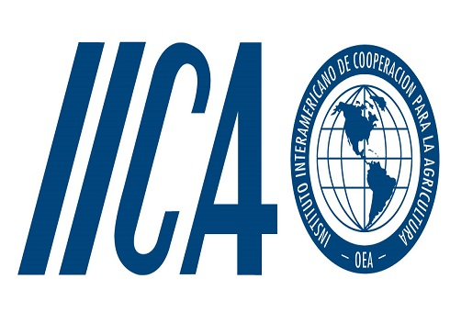
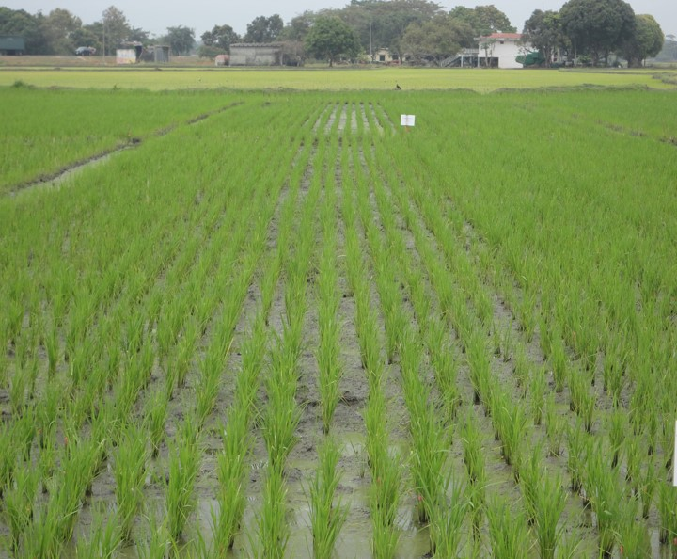
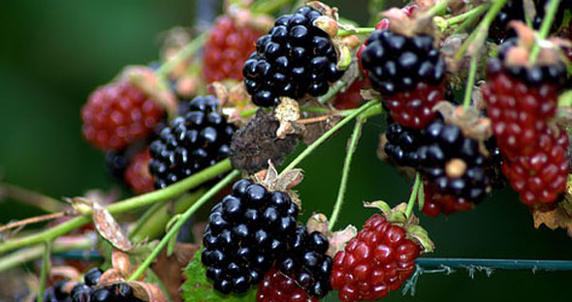
30th TECHNICAL CONSULTATION AMONG RPPOs IICA TECHNICAL COOPERATION September 2017 - Octuber 2018
Lorena Medina R.

Slide 2
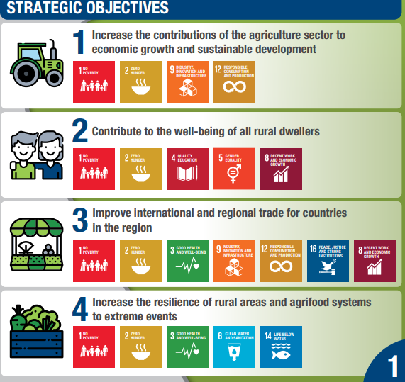
BACKGROUND
Main function technical cooperation
Support overcoming the main obstacles by building on institutional strengths, strengthening technical capacity and capacity to manage knowledge.
Aligned to the 17 Sustainable Development Goals (SDGs) defined by the United Nations Organization
IICA defines four strategic objectives for the 2018-2022 period:
Notes:
Inter-American Institute of Cooperation for Agriculture
On the slide you can see the 4 strategic objetives

Slide 3
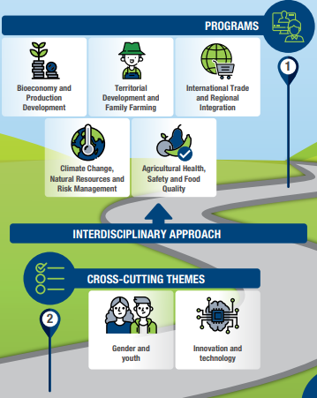
HEMISPHERIC ACTION PROGRAMS
5 Programs of hemispheric action that will be the main institutional mechanism
Through which IICA will coordinate and integrate its technical cooperation and knowledge management actions.
Notes:
In this slide we can see the graph where the framework programs are indicated in which we are going to work in our new plan, these programs can interact and have as cross-cutting themes

Slide 4
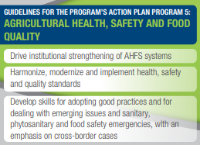
SAIA (AHSF) PROGRAM
The country offices are executing units for technical cooperation at the national level
We have 33 offices in America and 1 in Spain
Being bridges or knowledge management exchange platforms between countries and regional.
Coordination with technical programs
Notes:
for its acronym in English
and as we saw in the previous slide, this is one framework programs SAIA , within which we support initiatives in agricultural health and food safety, and the 3 guidelines are:

Slide 5
MAIN COOPERATION ACTIONS
COOPERATION ACTIONS
sep. 2017 to oct. 2018
Hemispheric and regional Actions
National Actions
Notes:
Then we can divide the activities in the following way, where in the first group there would be the initiatives that COSAVE already mentioned, for the joint work that exists

Slide 6
Aug 28 – 31, Lima, 35 participants from 18 countries.
Technical and financial support: CAN, COSAVE, OIRSA, the MAP of Brazil, the Secretariat of the IPPC and IICA.
Agenda: issues of the IPPC Secretariat, analysis of draft Regional rules and interest topics: Information System for General Surveillance, Fruit fly free area (DSV), Solution ePhyto, FOC R4T Income Concerns to the Continent, Next Generation Sequencing, Vision from the scientific field about the potentials, advantages and disadvantages of using this tool in the regulatory "world" and vision and analysis in relation to the regulatory environment.
September 17 – 19, Port of Spain, Trinidad and Tobago, 17 Officials, 14 Caribbean countries.
Technical and financial support: FAO / Secretariat of the IPPC, USDA / APHIS, IICA.
Agenda: review of draft ISPMs in consultation, updates of recent activities and initiatives of the IPPC, exchange of experiences on plant health issues (participants)
Hemispheric and Regional Actions, co-organizer
CARIBEAN
LATIN AMERICA

Slide 7
Regional Workshop on ePhyto IICA, COSAVE and SENASA Argentina. Buenos Aires, 11 -13 sep.
Experts: Australia, Vietnam, United States. IPPC, STDF / WTO and United Nations.
99 specialists from 17 countries in Latin America and IICA.
Results: identification of the situation of ePhyto in the Latin American countries, possible difficulties for the implementation, experts in the region and possible topics for cooperation.
Regional Workshop "Profile for a study of the incidence of climate change on the behavior and distribution of HLB and its vector in the southern region".
IICA with Procisur, technical and financial cooperation to COSAVE, Montevideo, Uruguay in June.
Technicians of the INIAs and Specialists of NPPOs from Argentina, Bolivia, Brazil, Chile, Paraguay, Peru and Uruguay.
Objective: to exchange lines of work and formulate a project profile that provides knowledge for the management and control of the pest with climate change as the main study axis.
Hemispheric and Regional Actions

Slide 8
Regional Workshop "Risk Management: Good Practices in Decision Making and Sampling Based on Risk: towards its implementation."
Organized by USDA / APHIS, CAN and IICA, Lima, September 25 - 27.
Objective: to improve and consolidate the capacity of Latin America to implement good practices in risk management, understand and advance in the implementation of the basics, concepts and operations of risk-based sampling.
35 professionals, 11 ONPF (Argentina, Chile, Colombia, Costa Rica, Ecuador, Guatemala, Honduras, Panama, Paraguay, Peru and Dominican Republic)
Forum: Phytosanitary Irradiation.
Organized by USDA / APHIS and IICA and developed by virtual media, Sep. 24.
Activity aimed at improving knowledge about the use of irradiation as a phytosanitary treatment upon arrival in the USA.
With the participation around 40 public and private sector stakeholders.
Hemispheric and Regional Actions

Slide 9
Leadership Course in Sanitary and Phytosanitary Measures. Leadership training in Latin America
Objective: to develop leaders in Latin America with the skills to implement significant changes in the scope of SPS and promote intersectoral discussion and collaboration to strengthen the effective implementation of standards at the national, regional and global levels.
SAIA with USDA / APHIS and the University for Peace (UN) 15 leaders in Sanitary and Phytosanitary Measures (MSF)
Support for the construction of a regional strategy for the control of South American lobster (Schistocerca cancellata) in Argentina, Bolivia and Paraguay.
Second semester of 2017 and beginning of 2018, financed by IICA, SENASA, SENAVE and SENASAG.
Articulation of lobster surveillance and control actions in Paraguay, Bolivia and Argentina.
Incorporation of technology for surveillance and monitoring. "International Workshop of Management of the Lobster" (Córdoba, Oct. 31 to Nov. 2)
Objective: to agree and define the main activities of the surveillance and research component for a regional program for pest management and control and to boost regional and national actions
Hemispheric and Regional Actions

Slide 10
Results and products obtained:
1. Phytosanitary surveillance: 54 professionals, 7 countries Implementation of general and specific surveillance systems. Computer tool, Guides and case studies in Spanish, Portuguese and English.
2. Pest Risk Assessment: 37 professionals, 7 countries, Weeds and economic and environmental impact. Guides and case studies in Spanish, Portuguese and English.
3. Virtual Regional School of Phytosanitary Inspection - ERVIF: 54 professionals, International Module hosted on the IICA platform. National Modules are in preparation.
4. Impact evaluation of the implementation of phytosanitary measures: Elaborated methodology, 28 officials, case studies
STDF 502 / COSAVE project. With financing from STDF and support from the Secretariat of the IPPC.
It started in November 2015 and ends in March 2019 with IICA as implementer.
Objective: to strengthen the capacity to implement phytosanitary measures to maintain and improve phytosanitary status, facilitating the trade of agricultural products of the region of the countries that make up COSAVE and helping to maintain current markets and access new ones.
Hemispheric and Regional Actions

Slide 11
National Actions
Fruit Fly Workshops and Good Agricultural Practices for 300 producers of pitahaya for export, June. Joint work with AGROCALIDAD
Preparation of GAP guide for producers in Spanish and Quichua
Study of the potential impact of HLB on citrus fruit in selected areas " Expert workshop for the validation of citrus HLB affectation scenarios” Virtual Technical Forum
"Biological beds in agriculture: A good practice for the protection of health and the reduction of environmental risk". Organized with EMBRAPA, CICA of the UCR, with support from the SFE
Notes:
Late blight in potato with Chile We are working on a project in which there is an exchange of experiences

Slide 12
National Actions
Projects related to the production of Mediterranean flies and sterile Anastrepha species, as well as parasitoids Cooperation in phytosanitary epidemiological surveillance and the National Phytosanitary Reference Center
Training in inspection of agrifood products in ports, airports and borders, the productive use of geospatial information for disaster prevention, the use of drones, the formulation of statistics and the cellular technology platform (applications.). Haití, SAGARPA and SENASICA, Mexico

Slide 13
National Actions
Good Agricultural Practices GAP, regional seminars Training guide in Vegetable GAP for Agro-technical schools, harmonized among the plant health services of Brazil, Paraguay, Chile, Bolivia, Uruguay and Argentina
Regional project for the control and eradication of the Carambola Fly; participate: Guyana, Brazil and Suriname. Possible BID background.
Implementation of the Agricultural Defense Modernization Program - ProDefesa, of the Secretary of Agricultural Defense - SDA of the MAPA.
Guide to Good Agricultural Practices for a more resilient agriculture. Preparation of the Guide and training of government technicians.
Support to the MAPA for the implementation of the IICA / SDA-MAPA Project, the National Program of Control and Eradication of the Carambola Fly in Brazil
Notes:
I would like to recall that IICA is a technical cooperation agency and not a project financier,

Slide 14
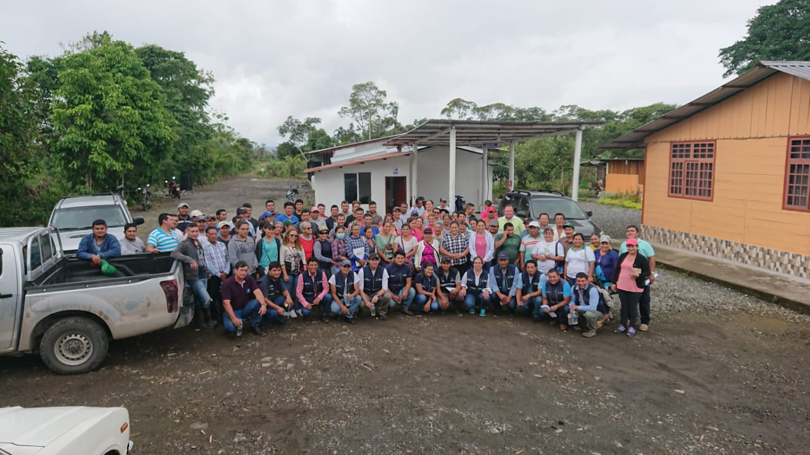
Thank you…
Notes:
that photo is from one of the training workshops for pitahaya producers in Palora, Amazon Region of Ecuador, we was about 100 people.
The people in the first row are the AGROCALIDAD technicians who supported the workshop's development

