Slide 1
Caribbean Agricultural Health & Food Safety Agency 31th TC-RPPO 21-25 October 2019 Abuja, Nigeria
Juliet Goldsmith

Slide 2
SPECIFICITIES
1967- CPPC established in by FAO Council
1999-Mandate to establish an independent body to replace the CPPC
2014 -CPPC Abolished
2010- Original agreement establishing CAHFSA
2011- Revised Agreement - February 25,

Slide 3
SPECIFICITIES
2014 – CAHFSA Operational
2015 – CAHFSA Fully operational
2018 - Recognition as RPPO conferred

Slide 4
MEMBER STATES: Antigua and Barbuda. Bahamas. Barbados. Belize. Dominica. Grenada. Guyana. Haiti. Jamaica. Montserrat. Saint Lucia. St Vincent and the Grenadines. Suriname. Trinidad and Tobago.
ASSOCIATE MS: Anguilla, Bermuda, British Virgin Islands, Cayman Islands, Turks and Caicos Islands

Slide 5
Mandate
CAHFSA is mandated to perform a coordinating and organizing role for the establishment of an effective and efficient regional sanitary and phytosanitary (SPS) regime

Slide 6
COTED
BOARD OF DIRECTORS
TECHNICAL ADVISORY COMMITTEES
OFFICE OF THE CEO
AHFSS THEMATIC WORKING GROUP
ANIMAL HEALTH DIVISION
FOOD SAFETY DIVISION
PLANT HEALTH DIVISION
FINANCE AND ADMINISTRATION DIVISION
CFSC Secretariat
RPPO Secretariat
Secretarial Service
CGPC Secretariat
Cleaning Service
Transportation

Slide 8
Community Agricultural Policy Thematic Areas
Research and Human Resource Development
Climate Change and Natural Resources Management
Agricultural Health and Food Safety
Business Development
CAHFSA operates within the framework of the CAP and directly under the thematic area Agricultural Health and Food Safety

Slide 9
MAIN AREAS OF FOCUS
Legislation and Standards
Capacity Building
Information Exchange and Dissemination
Rapid Response and Safeguarding
Regional and International Cooperation
Regional Trade Facilitation and Dispute Settlement
Notes:
The CAHFSA work programme is organizes under 6 broad headings: Legislation and standards, capacity building, rapid response mechanism and safeguarding, information exchange, regional and international cooperation, dispute avoidance and settlement.

Slide 10
Operationalization of the RPPO
Governance documents
RPPO Operations Manual adopted
Discussion on a Plant health strategic profile has begun

Slide 11
Harmonisation of Technical Procedures
Import Permit Application
Notice of Intention to Import/Export
Notice of Product Detention Form
Integrated Import/Export SPS Inspection “One Stop Centre” Organizational Framework
Harmonized Phytosanitary Measures
National Surveillance Protocol of Plant Pests
Guidelines and Procedures for Certification of Crops for Export
Packing House Requirements Guidelines
In Progress
Finalization/development of plant health protocols developed under the CAHFSA consultancy and agreed to at a regional consultation in 2011

Slide 12
Priority pests
Regulated pest database

Slide 13
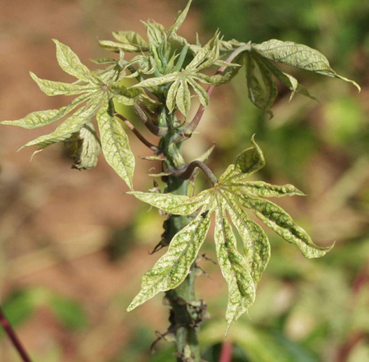
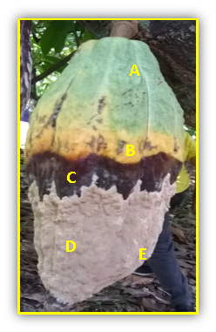
Diagnostic protocols for priority pests
Included in the IPPC Standard setting workprogramme through the 2018 call for topics
Cassava mite - Priority 1 (no longer on the list)
Citrus leprosis virus - Priority 1
Frosty pod rot - Priority 3

Slide 14
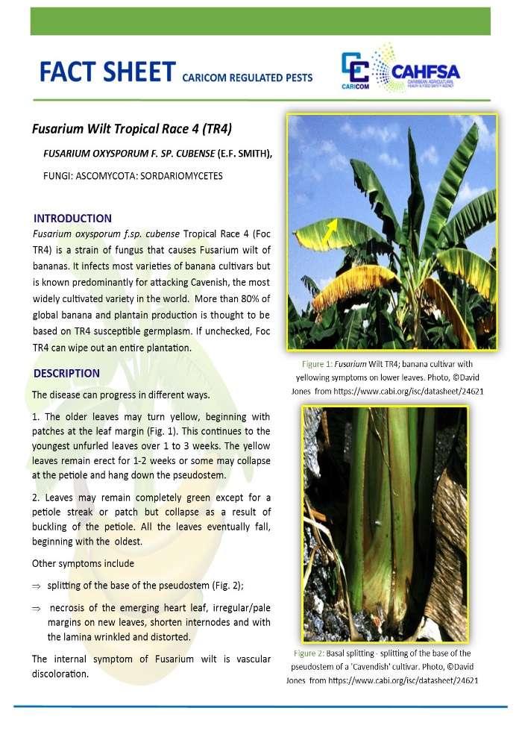
Fact sheets

Slide 15
Manual in progress
A GUIDE
TO THE DETECTION OF
REGIONAL PRIORITY PESTS

Slide 16
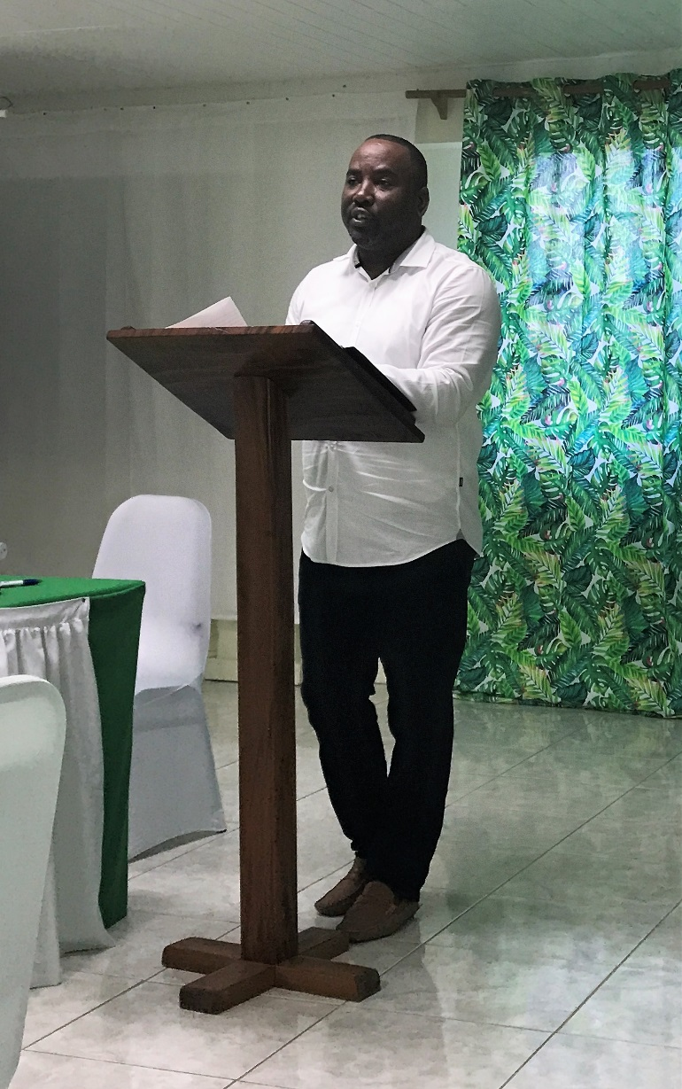
Capacity building
Plant quarantine training

Slide 17
Capacity building
Pest Risk Analysis training in Guyana

Slide 18
Surveillance Projects and Activities
Trainings on monitoring and surveillance for quarantine pests
National Framework for Monitoring and surveillance developed for 3 countries

Slide 19
Surveillance Projects and Activities
Tephritidae
Monilliophthora roreri (Frosty Pod Rot of cocoa)
Fusarium wilt of bananas TR4
Tuta absoluta

Slide 20
Collaboration with international Organization )
CABI
IAEA
Regional projects to address AHFSS with plant health related components
Networks
SIT
Pest detection
MOU specifically to support the work of the RPPO
Pest diagnosis
PRA
Pest surveillance
Pest management

Slide 21
Trade Facilitation
Member, Regional Trade Facilitation Agreement Committee
Supports the CARICOM Regional TFA Strategy (approved by COTED)
WTO Regional Workshop on The Trade Facilitation Agreement St Lucia, January 2019

Slide 22
Dispute Avoidance
Draft Mechanism was presented to the Heads of Government Meeting held in Trinidad and Tobago I December 2018.
To be finalized

Slide 23
Proposal for future collaboration
Pest diagnostics
Contingency planning
Surveillance programmes
Improved coordination and collaboration with other RPPOs and International organizations

Slide 24
Merci
Dankjewel
Thank You

