Slide 1

CGIAR Germplasm Health:
How “Germplasm Health Units (GHUs)” ensure biosecurity to germplasm conservation and distribution for use, and prevent transboundary spread of pests
Lava Kumar (IITA)
Representing Germplasm Health Units of CGIAR Centers &
CGIAR Genebank Platform
23 Oct 2019, 31st Technical Consultation Among RPPOs, Abuja, Nigeria

Slide 2
Outline
About CGIAR and IITA
Genebanks and Germplasm Health Phytosanitation
How CGIAR GHUs and national programs
IITA and NAQS
Conclusions

Slide 3
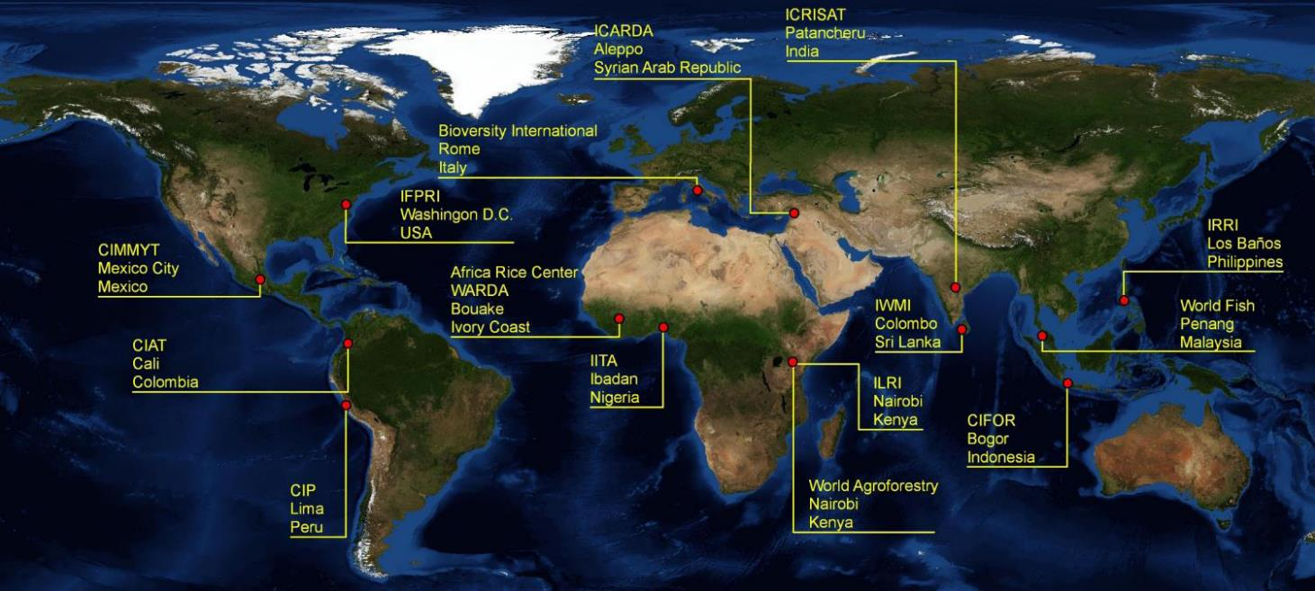
About CGIAR
A global organization for international agricultural research for sustainable development

Slide 4


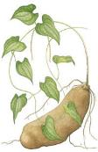

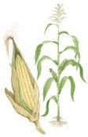

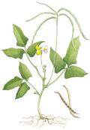
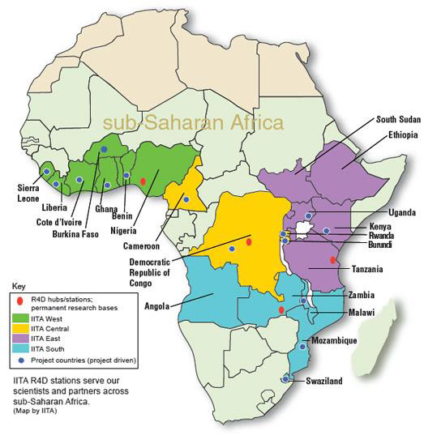
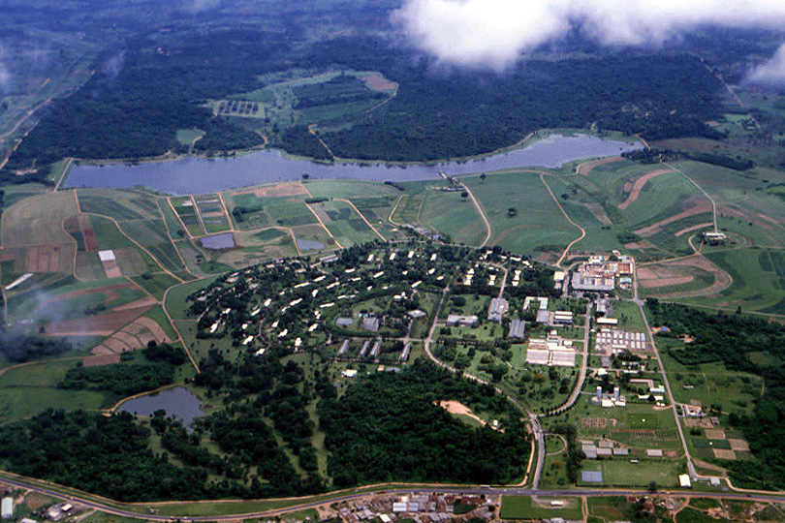
About IITA
International R4D center
20,000 + accessions of mandate crop in IITA genebank
Cassava
Yam
Musa
Maize
Soybean
Cowpea
IITA-Ibadan Campus

Slide 5

About IITA
Examples of major plant health projects
Fall army worm – IPM
Cassava mealy bug - Biocontrol
Cassava green mite - Biocontrol
Desert locust control - Biocontrol
Papaya mealybug - Biocontrol
Cassava virus disease (CMD and CBSD) – Host resistance and phytosanitary procedures
Banana bunchy to and FoC TR4 - phytosanitary procedures
Maize lethal necrosis
IITA-Ibadan Campus

Slide 6
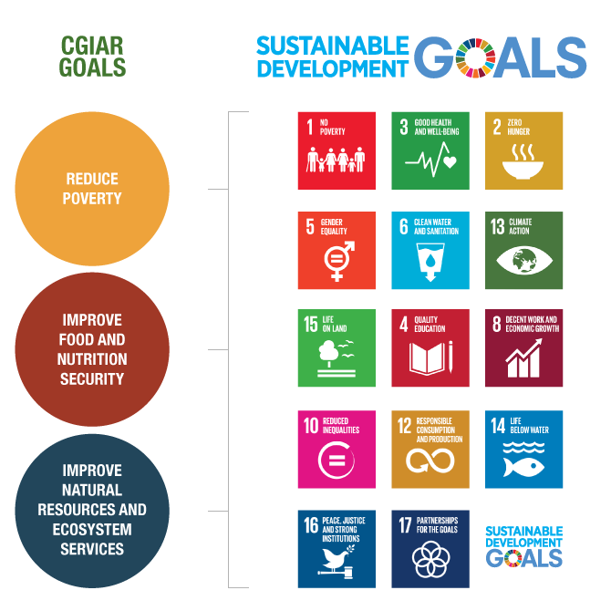
CGIAR global lead in providing valuable genetic resources to countries
Genebanks and Breeding Programs
Genetic Improvement
Plant Health & Protection
Environmental health and biodiversity protection
Climate adaptation
Gender, youth and social equity
Partner capacity development

Slide 7
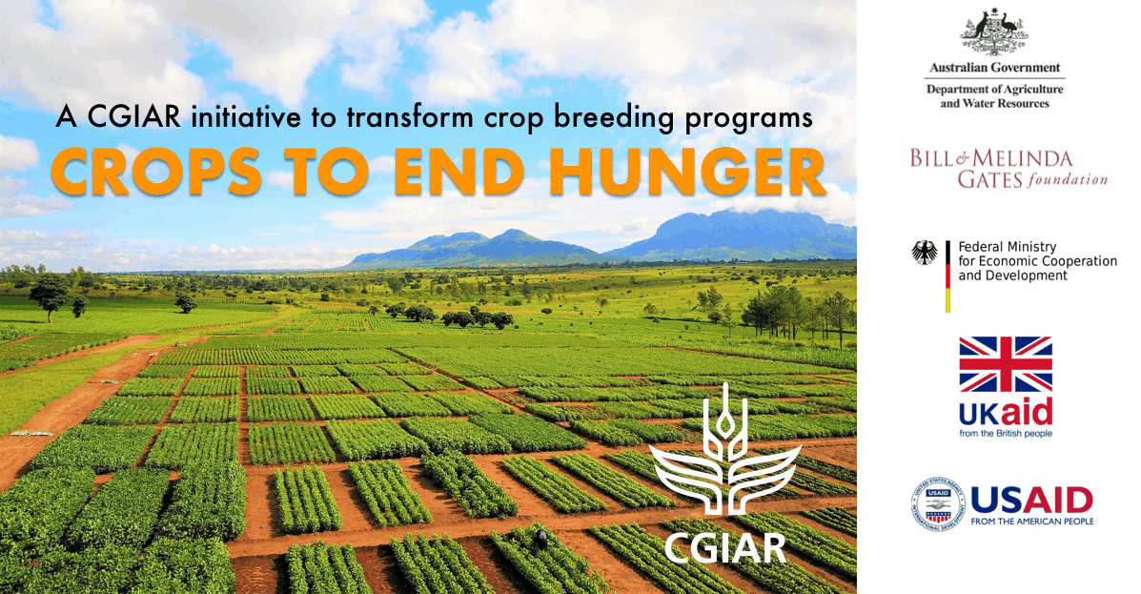
CGIAR global lead in providing valuable genetic resources to countries
Genebanks and Breeding Programs

Slide 8
Genebanks and Germplasm Health Phytosanitation

Slide 9
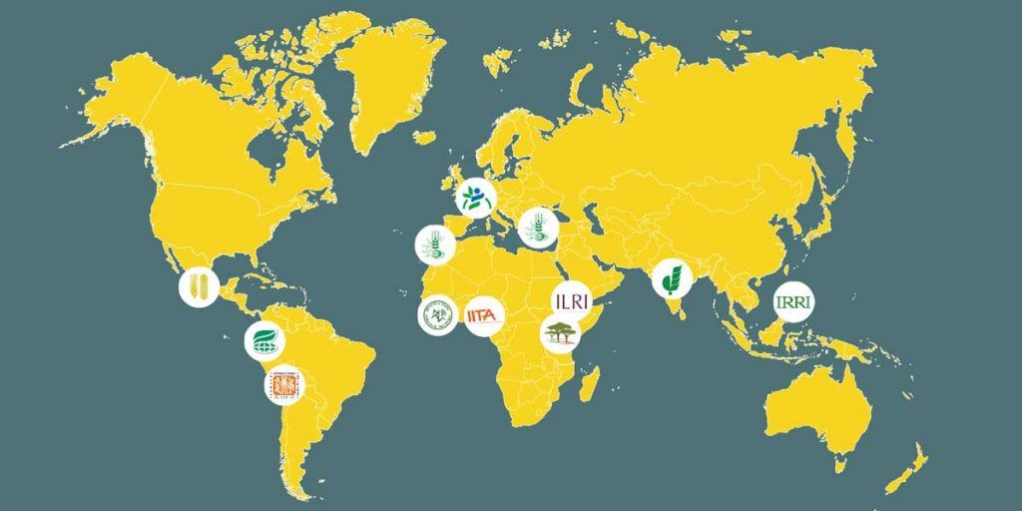

CGIAR global lead in providing valuable genetic resources to countries
Genebanks and Breeding Programs
Banana/Plantain
Barley
Cassava
Chickpea
Cowpea
Forages
Groundnut
Lentil
Maize
Millet
Potato
Rice
Sorghum
Soybean
Sweetpotato
Wheat
Yam
768,576: Total germplasm accessions in CGIAR
  715,212: Seeds (93%)
  25,301: In vitro (clonal crops) (3.3%)
  28,063: Trees (3.7%)

Slide 10
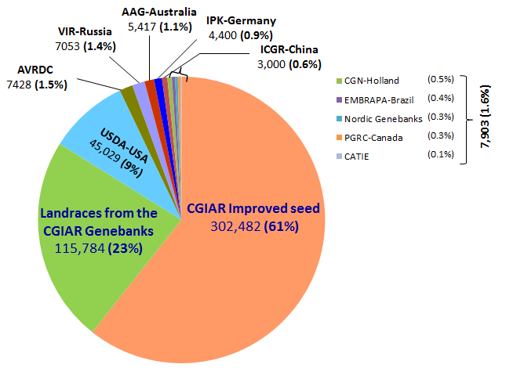
Global distribution of germplasm
Highest per cent of international germplasm distribution (~85%)
>2,000 requests per year
>100 countries served per year
Seed, clonal and tree germplasm
(landraces, improved lines and wild relatives)
Source: GCDT 2008-2010

Slide 11
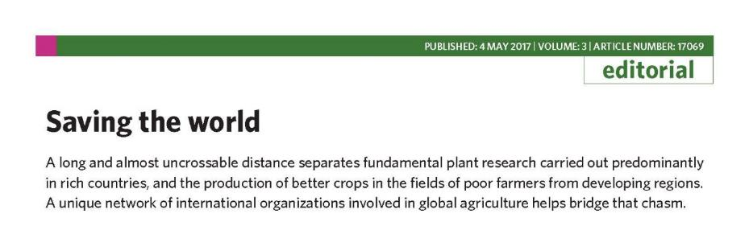
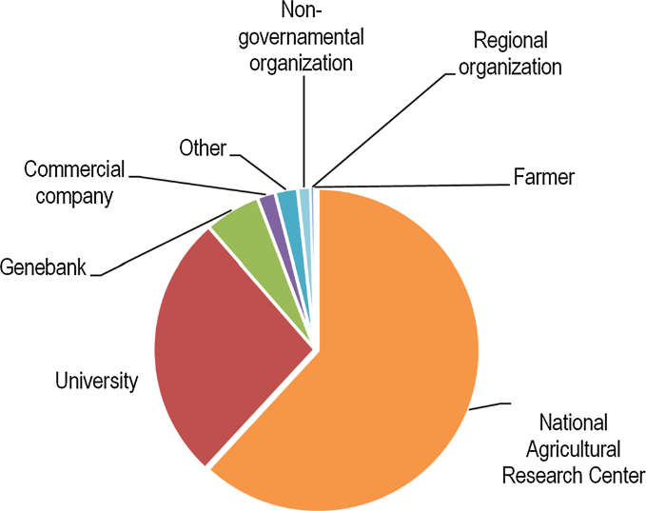
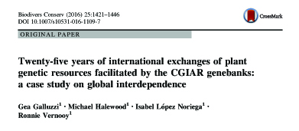
Global distribution of germplasm
(Source: Galluzi et al 2016)

Slide 12
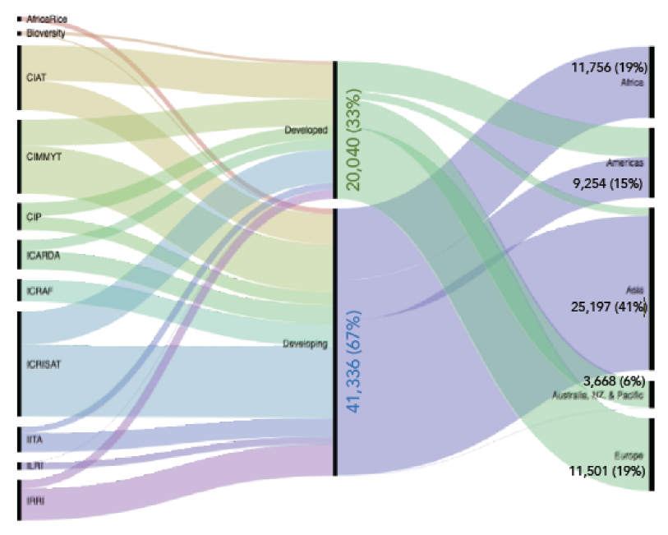
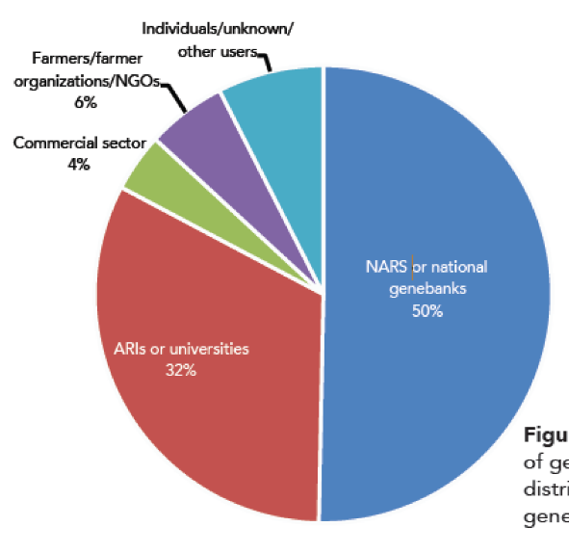
Global distribution of germplasm - 2018
Source: 2018 CGIAR Genebank Platform Annual Report

Slide 13
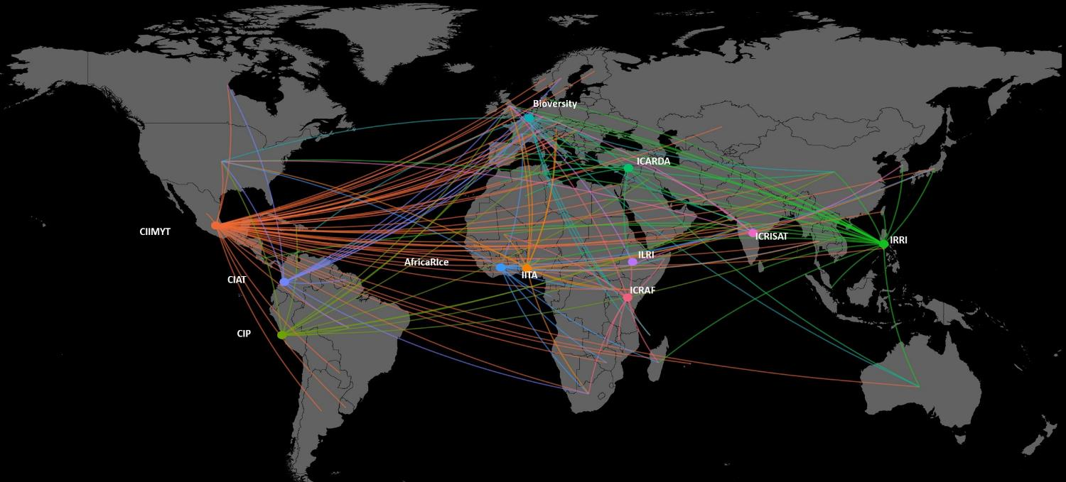
Global distribution of germplasm from CGIAR Centers - 2018
95 Countries
61,376 samples distributed
1,349,533 diagnostic tests (~UD$10 sample; 10 million in 2018)

Slide 14
Global distribution of germplasm from CGIAR Centers
Source: 2018 CGIAR Genebank Platform Annual Report

Slide 15
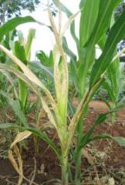
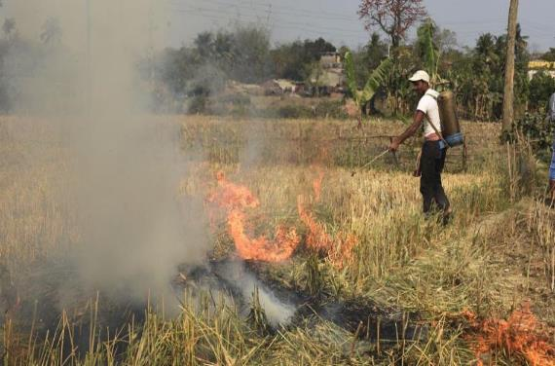
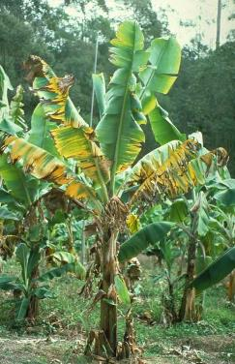
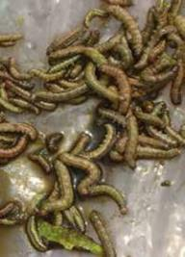
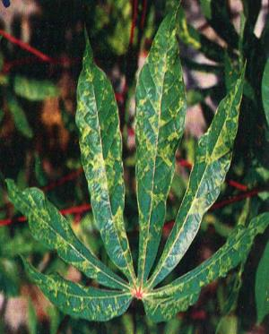
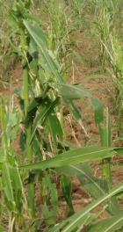
Intercontinental spread of pathogens and pests
Maize lethal necrosis: East Asia to East Africa
Wheat blast (Magnaporthe oryzae): Latin America to Bangladesh
Fusarium wilt race TR4: East Asia to Southern Africa, and Latin America
Fallarmy worm: Americas to Africa and Asia
Cassava mosaic: South Asia to East Asia
MLN CMD Wheat blast FoC TR4 FAW
http://www.hindustantimes.com/kolkata/deadly-wheat-blast-symptoms-enters-india-through-the-bangladesh-border-bengal-govt-burning-crops-on-war-footing/story-3zoWQ0H7sdMU4HxQyzWUsN.html

Slide 16
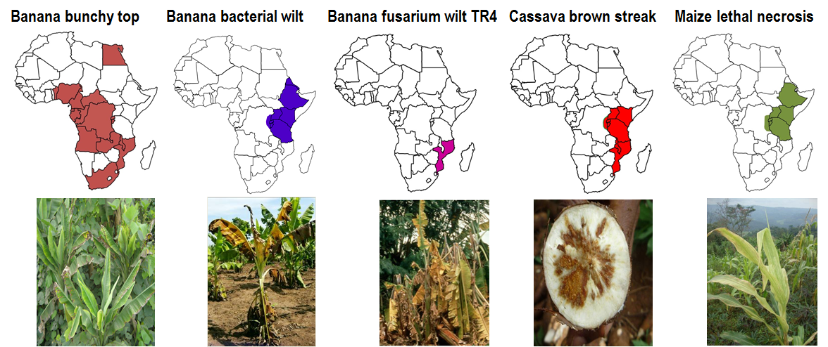
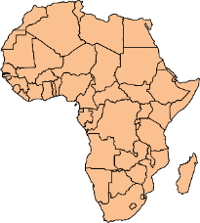
Emerging and Remerging Diseases of 21st Century in Africa
Pan-Africa spread of invasive species
Fall armyworm (Spodoptera frugipreda)
Papaya mealybug (Paracoccus marginatus)
Taro blight (Phytophthora colocasiae)
Tomato leafminer (Tuta absoluta)

Slide 17
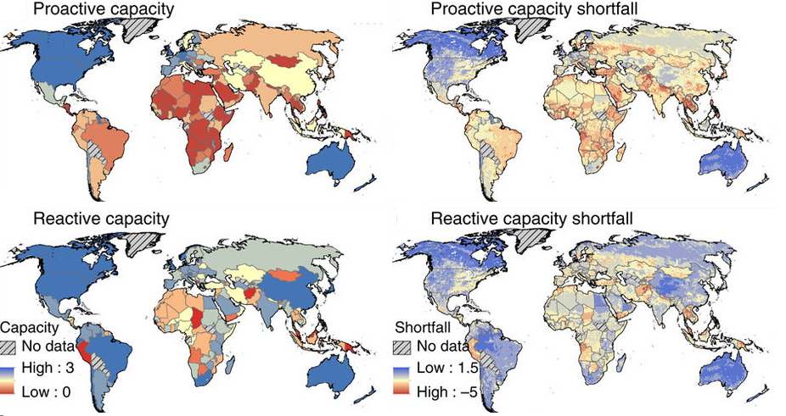
State of phytosanitary capacity to respond
Source: Early et al. 2016
Contact: L.kumar@cgiar.org

Slide 18


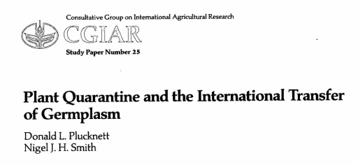
CGIAR Germplasm Health Units
CGIAR centres should take adequate measures to reduce the risk of pest spread with germplasm exchange
Standardize procedures for handling seed and plant health in different countries
Comply with IPPC and NPPO procedures
IPPC recommendations (Montreal 1990)

Slide 19
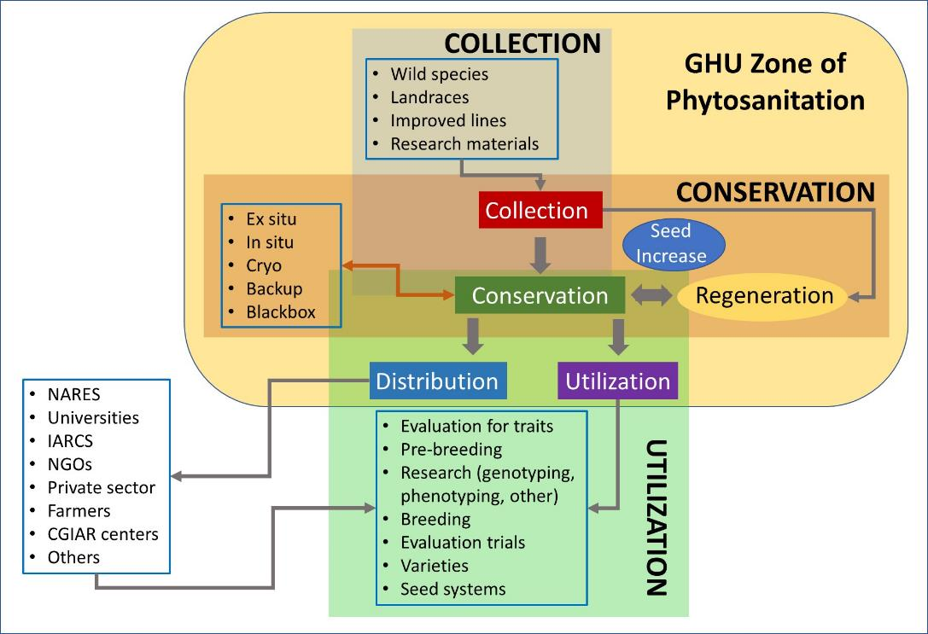
CGIAR Germplasm Health Units

Slide 20
CGIAR Germplasm Health Units
Guard against the introduction of exotic pests and new virulent forms of existing pests
Help scientists to safely distribute plant germplasm
Ensures centers’ compliance to domestic and international procedures
IPPC recommendations (Montreal 1990)

Slide 21

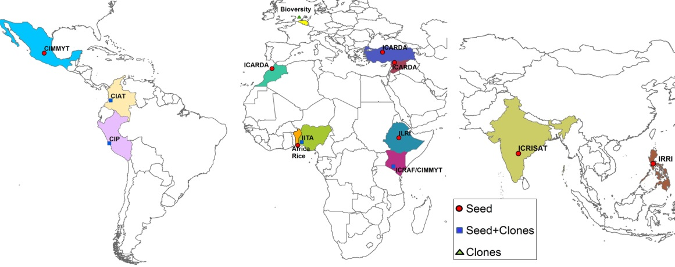
Germplasm Health Units: Ensuring pest-free plant genetic resources to partners
Global network committed to ensuring phytosanitary compliance and safe distribution of pest-free germplasm
Prevention of transboundary spread of pathogens through germplasm

Slide 22
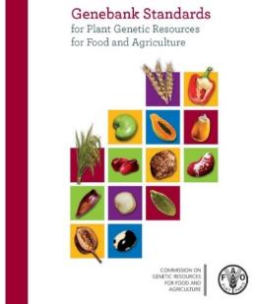
Biotic threats to germplasm, and mitigation
Strict adherence to national and international phytosanitary standards (FAO-IPPC)
Phytosanitation of newly acquired germplasm
Risk assessment and risk mitigation in germplasm flows and gene banking activities
Distribution of ready to use clean, and pathogen-tested germplasm
Development of tools and procedures for phytosanitation and virus indexing
NPPO

Slide 23
Research & Service functions
How CGIAR interacts with national partners in mitigating phytosanitary risks
CGIAR Germplasm exchange is a joint endeavor with NPPOs
Knowledge sharing
Pest and pathogen distribution
Diagnostics for health indexing
Phytosanitary procedures
Compliance to phytosanitary policies and regulations
Advocacy and awareness raising
Capacity development
GHU
Regulatory compliance
Surveillance and pest risk assessment
Training and capacity development
Clean planting material production & distribution
Knowledge on exotic and endemic pest and pathogens
Development of Diagnostic tools and procedures

Slide 24
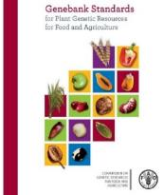
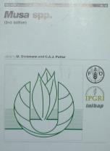
Guidelines for distribution of germplasm
International Plant Protection Convention (IPPC)
WTO-SPS guidelines
Regional and Country-specific guidelines
Germplasm testing
Active growth stage testing
Physical inspection
Diagnostics tests
Pests
Regulated
Not regulated
Quarantine pests
Regulated non-quarantine pests

Slide 25
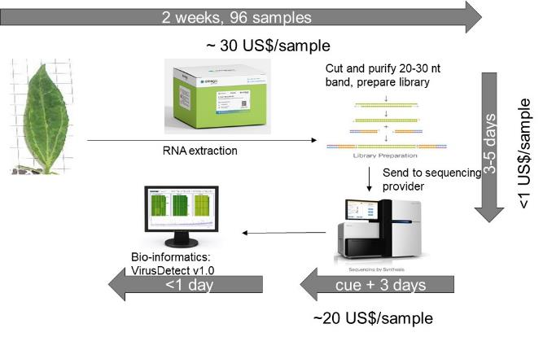
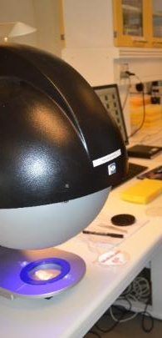
Phytosanitary management
Phytosanitary testing for “sanity” and “safety” of germplasm distributed from its 35 collections held around the world
Known knowns
Known unknows
Unknown unknows
Application of state of the art diagnostics

Slide 26
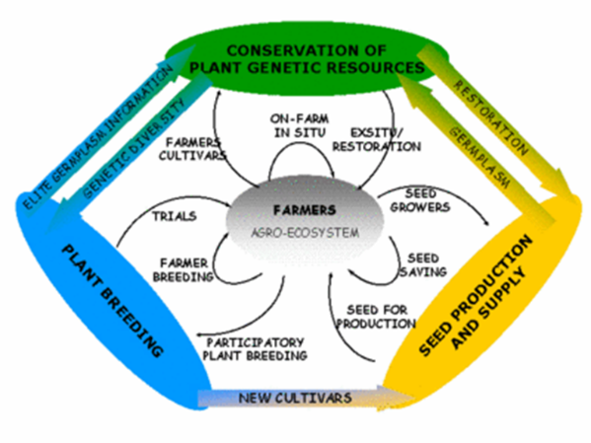
Phytosanitary management
Phytosanitary testing for “sanity” and “safety” of germplasm distributed from its IITA geneabnk and crop improvement programs
Pathogen elimination and phytosanitation of germplasm
Indexing for known pests
Safeguards against unknown risks
Categorization of germplasm based on pest risk
  Distribution ready
  Required testing
©FAO

Slide 27
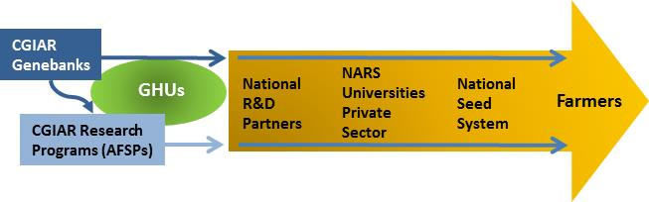
Three steps to ensure germplasm phytosanitary safety
Proactive assessment of germplasm health (import and export)
Decision on distribution based on health status
Traceability

Slide 28
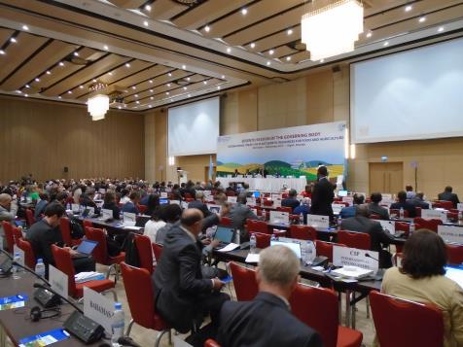
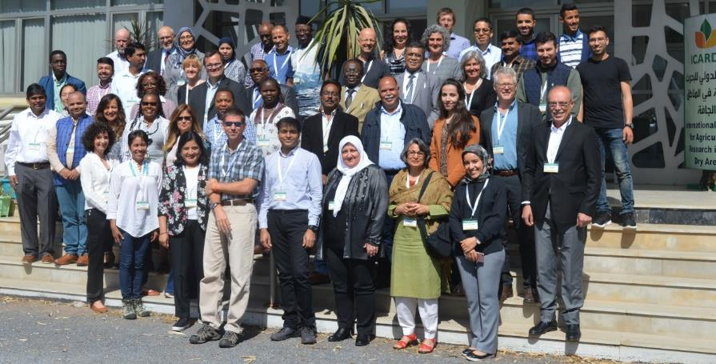
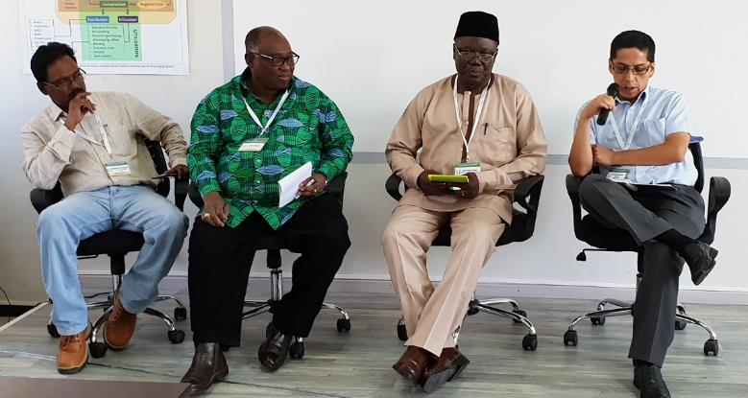
Consultations
Innovations and Strategies to Stay Ahead of the Curve
GHU Genebanks
FAO Treaty
NPPO

Slide 29
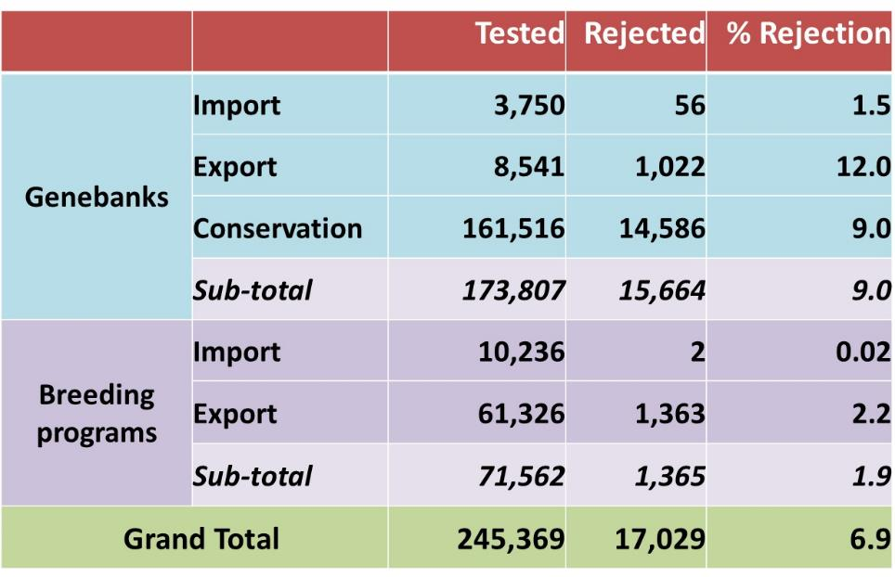
GHU testing in 2018
1,349,553 diagnostic assays used
$10 per sample distributed (>10 million US$ per year)

Slide 30
Outline
How CGIAR GHUs and national programs

Slide 31
How CGIAR interacts with national partners in mitigating phytosanitary risks
1
Compliance to national and international phytosanitary norms
Germplasm import and export activities are closely coordinated with national plant protection organizations (import permits & phytosanitary certificates)
Participation in the national “Pest Risk Assessment (PRA)” activities
Exchange of pest distribution knowledge, and updating national pest lists

Slide 32
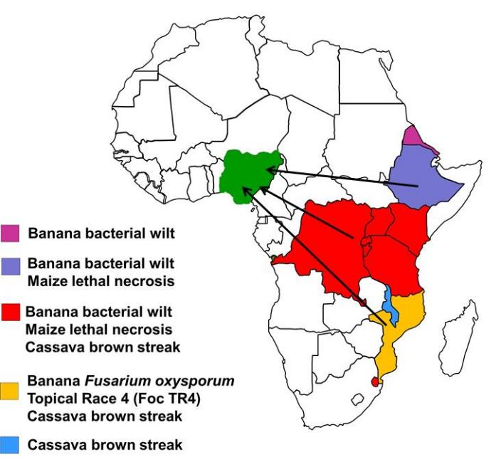
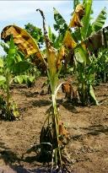
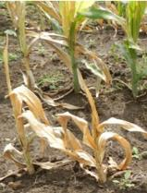
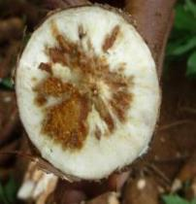
How CGIAR interacts with national partners in mitigating phytosanitary risks
2
Preventing risk of pest and pathogen spread with germplasm
Joint surveillance surveys mapping distribution of pests & diseases
Development and use of tools for rapid diagnosis and communication
Advocacy and awareness raising on
emerging risks
Pre-emptive management
and contingency plans

Slide 33
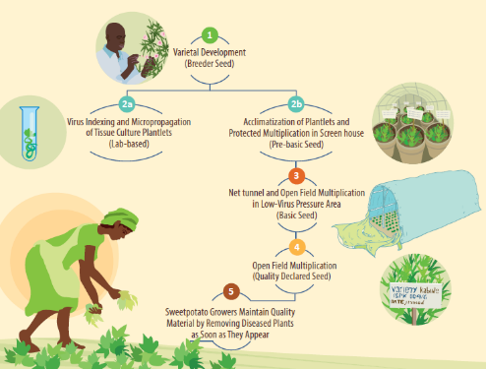
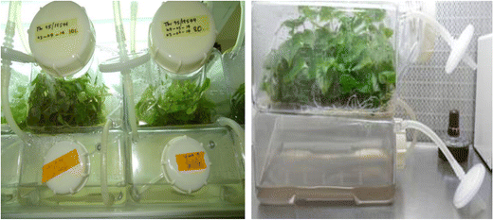
How CGIAR interacts with national partners in mitigating phytosanitary risks
3
Contributions to national seed system development
Developing facilities and capacity for disease-free seed production
    Clonal and grain crops for research and farmers
    Seed quality standards
    Safe propagation and distribution methods

Slide 34
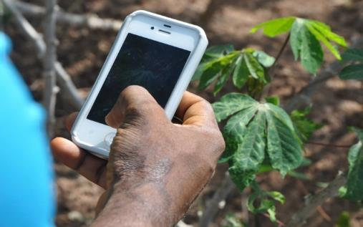

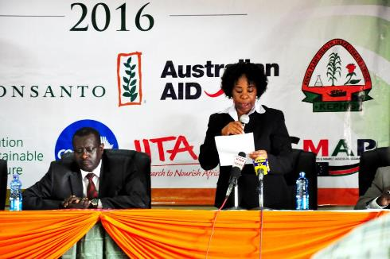
How CGIAR interacts with national partners in mitigating phytosanitary risks
4
National phytosanitary capacity development for innovations, development and extension
Staff training and infrastructure development
Collaborative research on invasive pests and pathogens
  Fall army worm, BBTV, MLN, TR4, CBSD, Wheat rust, and more
Development of new technologies for pest and disease surveillance
Joint workshops on national and regional phytosanitary issues

Slide 35




How CGIAR interacts with national partners in mitigating phytosanitary risks
5
GHU Phytosanitary Community of Practice
Inform
Biorisks to germplasm health
Importance of ‘Germplasm Health’ in preventing transboundary spread of pathogens and pests
Update
Emerging phytosanitary challenges to international distribution of germplasm
Technological advances in phytosanitation and diagnostics
Inspire
Compliance to phytosanitary controls in seed production and seed distribution activities
Engage
National and international phytosanitary communities to work together

Slide 36
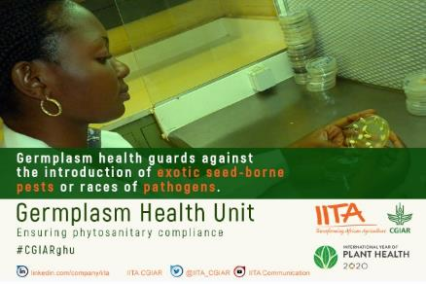
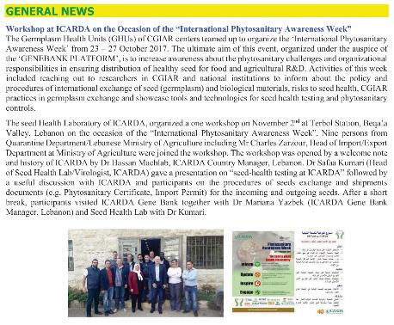
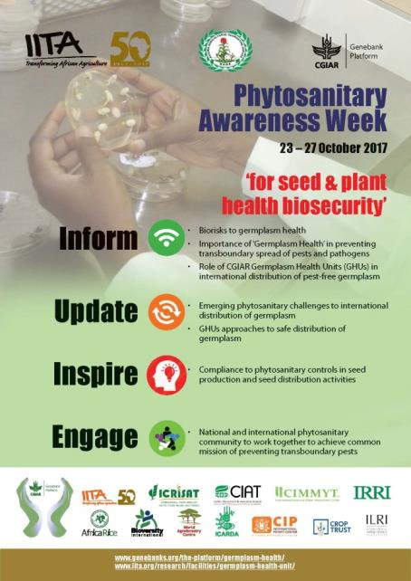



Global distribution of germplasm from CGIAR Centers
Phytosanitary Awareness Week

Slide 37


CGIAR GHUs in IYPH 2020
Awareness, Advocacy, Outreach and Capacity Development
“Germplasm Phytosanitary Safety for Prevention of Transboundary Spread of Pests and Pathogens”
Together with NPPOs
Monthly “phytosanitary awareness week” targeting different themes
Communications to enhance awareness on phytosanitary obligations and emerging pest challenges
11 Training workshops on seed health testing and phytosanitary controls
Status papers on germplasm phytosanitary issues of CGIAR crops
Communications (posters, flyers, webinars, blogs, etc.)

Slide 38
IITA and NAQS

Slide 39

IITA – CGIAR - NAQS Partnership
New pest reports since 2010 in Nigeria

Slide 40


Global distribution of germplasm from CGIAR Centers

Slide 41



IITA – CGIAR - NAQS Partnership
Stop Bunchy Top Campaign
Containment
Eradication

Slide 42






IITA – CGIAR – DPV, Togo
Stop Bunchy Top Campaign
Containment
Eradication

Slide 43
Outline
Conclusions

Slide 44


Analogy for early warning system for pest outbreak alerts
Smoke detector = early warning
Fire engine = spread of fire and destruction

Slide 45
Conclusions
Invest in early detection and emergency response to contain invasive and emerging threats
Increase in investments to established ‘emerging and invasive’ threats
Funding for implementation and sustainable management
Communique to national governments to increase investments and strengthen national plant protection organizations

Slide 46


Slide 47





Acknowledgments
AU-IAPSC
For more information visit: https://www.genebanks.org/the-platform/germplasm-health/
Contact: L.kumar@cgiar.org

