Slide 1
my job today ..
specificities of NAPPO
The state of NAPPO – 2019-2020
achievements
projects/activities
issues and pests of concern
opportunities for collaboration

Slide 2
1. specificities
A forum for Canadian, United States and Mexican regulatory and industry professionals to collaborate in the protection of (all) plant resources and the environment while facilitating safe trade.
NAPPO …
Promotes harmonized approaches to plant health
Facilitates communication and engagement of/for stakeholders
Cooperates with key strategic partners
Maintains transparency; fosters trust

Slide 3
1. Cooperate with key strategic partners
Technical consultation among RPPOs + IPPC Secretariat
Promoting harmonization
NAPPO
EPPO
IPPC Secretariat
NEPPO
OIRSA
APPPC
CAHFSA
IICA
IAPSC
CAN
PPPO
COSAVE
Sharing information on plant health
Developing and implementing regional and international standards
Hosting international workshops
Inter-regional consultation
Notes:
Technical consultations among RPPOs are convened annually to promote and facilitate the development, adoption and harmonization of phytosanitary measures and discuss shared concerns.
In relation with the involvement of RPPOs in the development of ISPMs, they can host Expert Working Group meeting or international workshops, for example, NAPPO hosted the Open Ended Workshop on the International Movement of Grain, that was held in Vancouver in December 2011.
Not all contracting parties of IPPC belong to a RPPO, and similarly, not all members of RPPOs are contracting parties of the IPPC. Some countries are members of more than RPPOs.

Slide 4
1. NAPPO governance - Management Team
Executive Committee
Advisory & Management Committee
Secretariat
Industry Advisory Group

Slide 5
1. To accomplish the Mission
NAPPO develops products
High priority science-based regional standards, science and technology, discussion and other documents
High-impact workshops and symposia
NAPPO engages stakeholders
Annual Meeting
website
newsletter
participation in stakeholder meetings

Slide 6
1. Expert Groups – 12 total
Government Experts
Industry Experts
NAPPO Secretariat
Advisory & Management Committee

Slide 7
1. NAPPO yearly funding
220,000
300,000
220,000
Salaries, travel, professional development, operational, recurring costs

Slide 8
2. The state of NAPPO – 2019
NAPPO projects can be …
Finite | Always ongoing
Update existing regional standards | 1. Phytosanitary Alert System
Develop new regional standards | 2. Electronic Certification
Offer workshops, symposia | 3. Potato Appendix 1 – pest list
Develop discussion, science & technology or other documents | 4. Stakeholder and 5. Regional engagement - GICSV

Slide 9
2. The state of NAPPO – 2019
ending in 2019-2020
Revision of RSPM 9 – authorization of laboratories
Revision of RSPM 35 – plants for planting – pome, stone fruit, vines
ISPM 38 implementation workshop
Lymantriids S&T Document
Risk-Based Sampling Manual
Foundational Documents

Slide 10
2. The state of NAPPO – 2019
issues and pests of concern
Khapra beetle – Trogoderma granarium
Asian gypsy moth – Lymantria dispar asiatica
European cherry fruit fly – Rhagoletis cerasi
Spotted lantern fly – Lycorma delicatula
Tephritidae
ToBFRV

Slide 11
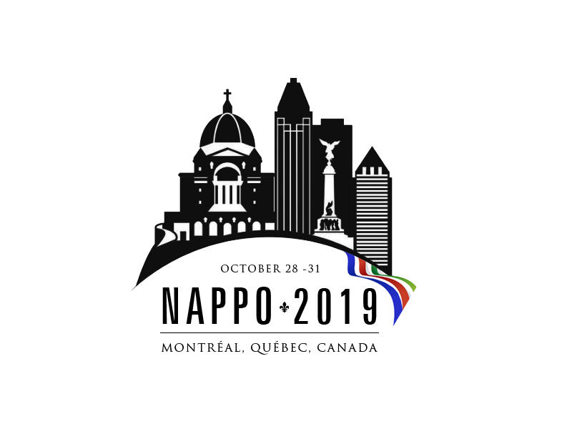
3. The state of NAPPO – 2019
ending in late 2020
Asian Gypsy Moth – validation of risk periods
started in 2019
Revision of RSPM 22 – containment facilities for BCAs
Revision of RSPM 17 – fruit flies
IYPH – each member country activities
Forestry S&T – contaminants
Revision of RSPM 5 - glossary

Slide 12
Opportunities for collaboration
Technical consultation among RPPOs + IPPC Secretariat
Promoting harmonization
NAPPO
EPPO
IPPC Secretariat
NEPPO
OIRSA
APPPC
CAHFSA
IICA
IAPSC
CAN
PPPO
COSAVE
Developing and implementing regional and international standards
Sharing information on plant health
Hosting international workshops
Inter-regional consultation
Notes:
Technical consultations among RPPOs are convened annually to promote and facilitate the development, adoption and harmonization of phytosanitary measures and discuss shared concerns.
In relation with the involvement of RPPOs in the development of ISPMs, they can host Expert Working Group meeting or international workshops, for example, NAPPO hosted the Open Ended Workshop on the International Movement of Grain, that was held in Vancouver in December 2011.
Not all contracting parties of IPPC belong to a RPPO, and similarly, not all members of RPPOs are contracting parties of the IPPC. Some countries are members of more than RPPOs.

Slide 13
Gracias por su atención
Thanks for your attention
Merci pour votre attention
Stephanie.Bloem@NAPPO.org

