Slide 1
FAO Global Action for FAW Control
in Relation to the IPPC Mandates
Jingyuan Xia, IPPC Secretary
June 2020, FAO-HQs, Rome, Italy
Notes:
Excellencies,
Distinguished Guests,
Esteemed Colleagues,
Ladies and Gentlemen,
Good Afternoon
In the context of the International Year of Plant Health we are here to present you the Global Action for FAW control, its key elements and how the action will be implemented

Slide 2
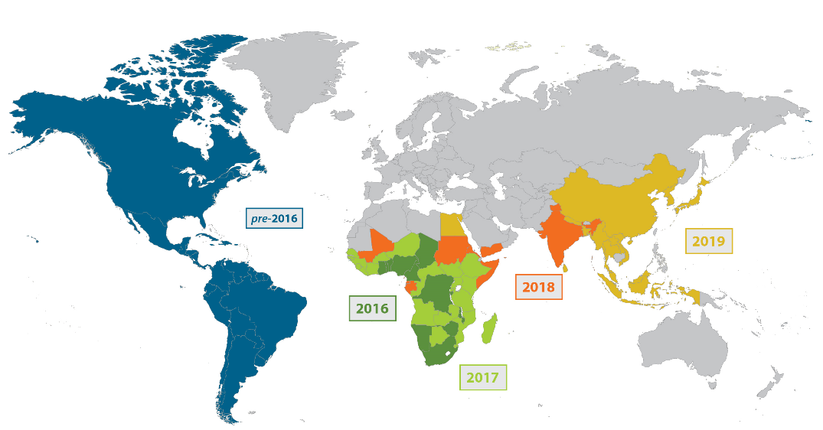
A Global Threat
Notes:
Excellencies,
Distinguished Guests,
Esteemed Colleagues,
Ladies and Gentlemen,
Good Afternoon
In the context of the International Year of Plant Health we are here to present you the Global Action for FAW control, its key elements and how the action will be implemented

Slide 3
FAO Global Action
● Big coverage of regions: Three FAO Regions (Africa, Near East, and Asia-Pacific); three IPPC RPPOs (PPPO, EPPOs and NEPPO); 60-80 countries (>50% of countries related to FAO’s hand-in-hand initiative)
● Big coverage of disciplines: From plant quarantine, IPM, and pesticide management to host plant resistance, healthy cultivation, and agro-machinery
● Big coverage of stakeholders: Government, Regulation, Extension, Research, Academia, Education, Private Sectors, and Recourse Organizations
Notes:
Excellencies,
Distinguished Guests,
Esteemed Colleagues,
Ladies and Gentlemen,
Good Afternoon
In the context of the International Year of Plant Health we are here to present you the Global Action for FAW control, its key elements and how the action will be implemented

Slide 4
Main Objectives:
Coordination at global, regional, national and farmer-level
Reduction of crops losses
Prevention from further spread to new areas
Notes:
Excellencies,
Distinguished Guests,
Esteemed Colleagues,
Ladies and Gentlemen,
Good Afternoon
In the context of the International Year of Plant Health we are here to present you the Global Action for FAW control, its key elements and how the action will be implemented

Slide 5
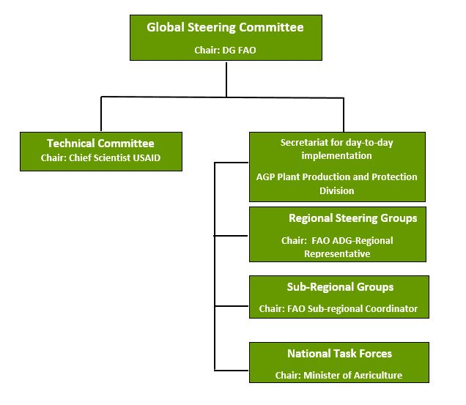
Global Coordination
Notes:
Excellencies,
Distinguished Guests,
Esteemed Colleagues,
Ladies and Gentlemen,
Good Afternoon
In the context of the International Year of Plant Health we are here to present you the Global Action for FAW control, its key elements and how the action will be implemented

Slide 6
Priority Countries for Objective 3
NANE Region (9)
Morocco
Iraq
Syria Arab Republic
Saudi Arabia
Libya
Oman
Lebanon
Jordan
Algeria
South Pacific (7)
Australia
New Zealand
Papua New Guinea
Vanuatu
Fiji islands
Federated States of Micronesia
Guam
South Europe (5)
France
Italy
Spain
Greece
Portugal
Notes:
Excellencies,
Distinguished Guests,
Esteemed Colleagues,
Ladies and Gentlemen,
Good Afternoon
In the context of the International Year of Plant Health we are here to present you the Global Action for FAW control, its key elements and how the action will be implemented

Slide 7
Outcomes and Activities (1/3):
Development of guidance on prevention
Discuss and draft guidance on FAW prevention (standards for inspection and surveillance) by establishing technical working and consultation groups
Improve and release guidance on FAW prevention by organize regional seminars/workshops
Validate and demonstrate guidance on FAW prevention by setting up national pilot sites
Notes:
Excellencies,
Distinguished Guests,
Esteemed Colleagues,
Ladies and Gentlemen,
Good Afternoon
In the context of the International Year of Plant Health we are here to present you the Global Action for FAW control, its key elements and how the action will be implemented

Slide 8
Outcomes and Activities (2/3):
Training on pest risk assessment
Organize national and regional training courses for trainers on pest risk assessment and border control for FAW
Make registration of FAW as a regulated quarantine pest
Notes:
Excellencies,
Distinguished Guests,
Esteemed Colleagues,
Ladies and Gentlemen,
Good Afternoon
In the context of the International Year of Plant Health we are here to present you the Global Action for FAW control, its key elements and how the action will be implemented

Slide 9
Outcomes and Activities (3/3):
Implementation of preventive measures
Organize training courses for trainers on FAW surveillance and inspection, as well as on FAW outbreak and alert system at national level
Implement preventive measures and FAW outbreak and alert system at national level
Notes:
Excellencies,
Distinguished Guests,
Esteemed Colleagues,
Ladies and Gentlemen,
Good Afternoon
In the context of the International Year of Plant Health we are here to present you the Global Action for FAW control, its key elements and how the action will be implemented

Slide 10
Coordination
FAO FAW Tech Committee
FAO FAW Steering Committee
IPPC FAW Steering Group
IPPC-related Tech Group
IPPC FAW Working Group
(IPPC+RPPOs)
RPPO FAW
Task Forces
Notes:
Excellencies,
Distinguished Guests,
Esteemed Colleagues,
Ladies and Gentlemen,
Good Afternoon
In the context of the International Year of Plant Health we are here to present you the Global Action for FAW control, its key elements and how the action will be implemented

Slide 11
Communication
Develop a series of advocacy materials on prevention of the FAW
Disseminate knowledge and information on FAW prevention through all kinds of advocacy tools, such as Digital (website, social media, and videos), Media (press releases, news stories, and interviews), and Printing (booklets, factsheets, and brunches)
Notes:
Excellencies,
Distinguished Guests,
Esteemed Colleagues,
Ladies and Gentlemen,
Good Afternoon
In the context of the International Year of Plant Health we are here to present you the Global Action for FAW control, its key elements and how the action will be implemented

Slide 12
Timelines
Preparation (Jan-June 2020): Baseline, Coordination, Work plan, and Launch event
Pre-implementation (Aug-Dec 2020): IPPC-RPPOs-NPPOs coordination mechanism, Work plan for RPPOs and NPPOs, and Technical documents
Full implementation (2021-2022): Actions at RPPO and NPPO-level
Notes:
Excellencies,
Distinguished Guests,
Esteemed Colleagues,
Ladies and Gentlemen,
Good Afternoon
In the context of the International Year of Plant Health we are here to present you the Global Action for FAW control, its key elements and how the action will be implemented

Slide 13
Thank You
Notes:
Excellencies,
Distinguished Guests,
Esteemed Colleagues,
Ladies and Gentlemen,
Good Afternoon
In the context of the International Year of Plant Health we are here to present you the Global Action for FAW control, its key elements and how the action will be implemented

