Slide 1
2020 IPPC NROs Workshop

Slide 2


Contents
Reference of NROs in the Convention
  ISPM 17
  General review of NRO
  General and specific NRO rules and procedures

Slide 3
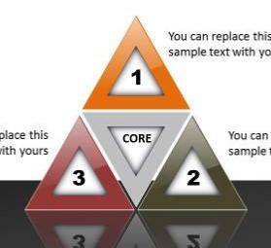
1. General review of NROs
Purpose: Control pests of plants and plant products and preventing their international spread
Obligations: All contracting parties are obliged to the implementation of all reporting obligations
Reason: Ensure available official phytosanitary information for ensuring safe trade and protecting the environment from plant pests
Notes:
Purpose: International cooperation in controlling pests of plants and plant products and in preventing their international spread, and especially their introduction into endangered areas.
Obligations: All countries that signed the Convention are obliged to and are responsible for the implementation of all reporting obligations. All reporting obligations have the same legal value and are of equal importance.
Reason: Having NROs is to ensure that a minimum amount of official phytosanitary information is available that can be used as the basis for ensuring safe trade, safeguarding food security and protecting the environment from plant pests.

Slide 4
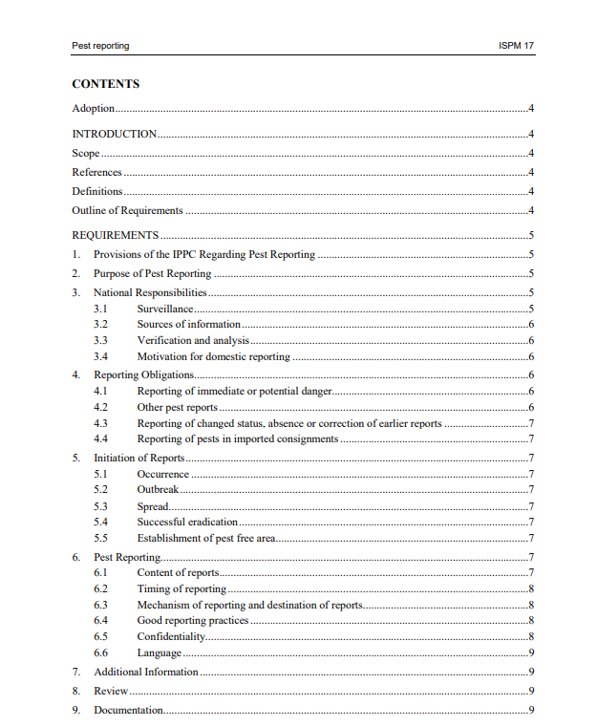
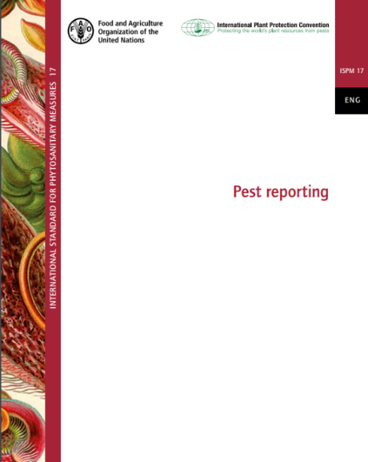
2. ISPM 17
ISPM 17 Link：
https://www.ippc.int/static/media/files/publication/en/2017/06/ISPM_17_2002_En_2017-05-25_PostCPM12_InkAm.pdf

Slide 5
2. ISPM 17
Adoption: This standard was adopted by the Fourth Session of the Interim Commission on Phytosanitary Measures in March 2002.
Scope: This standard describes the responsibilities of and requirements for contracting parties in reporting the occurrence, outbreak and spread of pests in areas for which they are responsible. It also provides guidance on reporting successful eradication of pests and establishment of pest free areas.
National Responsibilities: NPPOs should make provision to ensure the collection, verification and analysis of domestic pest reports: Surveillance; Sources of information; Verification and analysis; Motivation for domestic reporting
Reporting Obligations: Reporting of immediate danger or potential danger.
Other pest reports: Reporting of changed status, absence or correction of earlier reports.
Notes:
Surveillance: Pest reporting depends on the establishment, within countries, of national systems for surveillance, as
required by the Article IV.2(b) of the IPPC
Sources of information: Information for pest reporting may be obtained directly by the NPPO or may be available to the NPPO
from a variety of other sources (research institutions and journals, websites, growers and their journals, other NPPOs etc.).
Verification and analysis: NPPOs should put in place systems for verification of domestic pest reports from official and other sources. This should be done by confirming the identification of the pest concerned and making a preliminary determination of its geographical distribution. NPPOs should also put in place systems of PRA(pest risk analysis) to determine whether new or unexpected pest situations constitute an immediate or potential danger to their countries.
Motivation for domestic reporting : where possible, countries should provide incentives for domestic reporting.
immediate danger: is considered to be one that has already been identified (pest already regulated) or
is obvious on the basis of observation or previous experience
A potential danger is one that is identified as the result of a PRA.

Slide 6
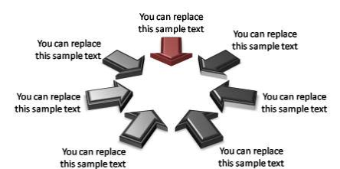
3.1 General review of NROs
What are the public NROs
1. Designation of an Official IPPC Contact Point
5. List of regulated pests
2. Description of NPPO
Must
3. Phytosanitary requirements,
restrictions and prohibitions
6. Pest reports
4. Lists of entry points
7. Immediately report emergency actions
Any examples for these 7 Public Obligations?
Notes:
Contact point is responsible for keeping their countries information on the IPP Up to date. Nomination form need to submitted to IPPC Secretariat.
The form of an organogram. Description of its organizational arrangements: who is responsible for which area and what are the connections between different parts of NPPO
CPs need published phytosanitary requirements,restrictions and prohibitions. These information could be linked through IPP If they are posted on the national website.
List of entry points: specified points of entry need be selected if it required specific consignments to be imported only through these points of entry.
regulated pests: is a quarantine pest and a regulated non-quarantine pest. Quarantine pest is a pest of potential economic importance to the area endangered thereby and not yet present there, or present but not widely distributed and being officially controlled. A regulated non-quarantine pest: a non quarantine pest whose presence affects the economic values of plants, therefore they are regulated .
Pest reports: the occurrence, outbreak or spread of pest that may be of immediate or potential danger should be reported via IPP. We will emphasis it and emergency later.
Emergency action is a prompt phytosanitary action undertaken in a new or unexpected phytosanitary situation.

Slide 7
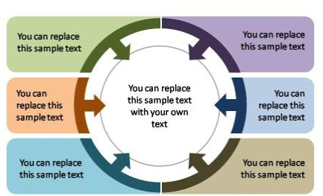
3.2 General review of NROs
What are the Bilateral NROs
1. organizational arrangements of plant protection
4. The result of investigation regarding significant instances of non-compliance with phytosanitary certification
2. Rationale for phytosanitary requirements, restrictions and prohibitions
Bilateral
5. Information on the pest status
3. Significant instances of non-compliance with phytosanitary certification;
6. Technical and biological information necessary for pest risk analysis.
Any examples for these 6 Bilateral Obligations?
Notes:
Bilateral means all CPs should make this information available when required by another CPs.
It need contain a description of functions and responsibilities in relation to plant protection. It can be combined ion one report with the description of a NPPO
CPs need make available to any contracting party the rationale for phytosanitary requirements, restrictions and prohibitions. This report should contain information regarding measures taken for quarantine and regulated non-quarantine pests.
3 and 4 are linked together. NO.3 need be reported by importing country to exporting or re-exporting country. NO.4 should be reported back on request and related to the results of investigations. ISPM 13 contains more guidance.
5. Countries need develop and maintain adequate information on pest status in order to support categorization of pests and for the development of appropriate phytosanitary measures. ISPM8 Provide more guidance.
6. Countries need cooperate in providing the technical and biological information necessary for pest risk analysis to support the pest risk analysis process.

Slide 8
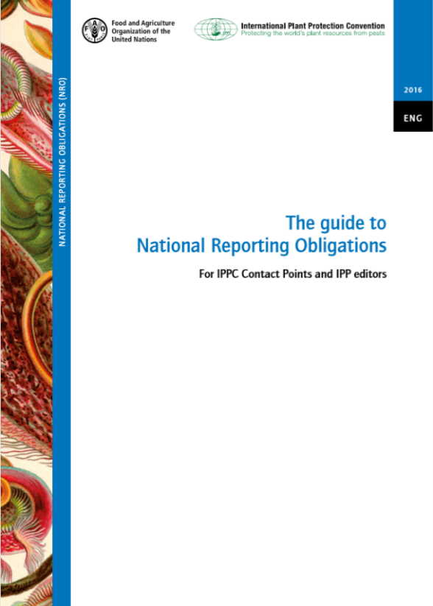
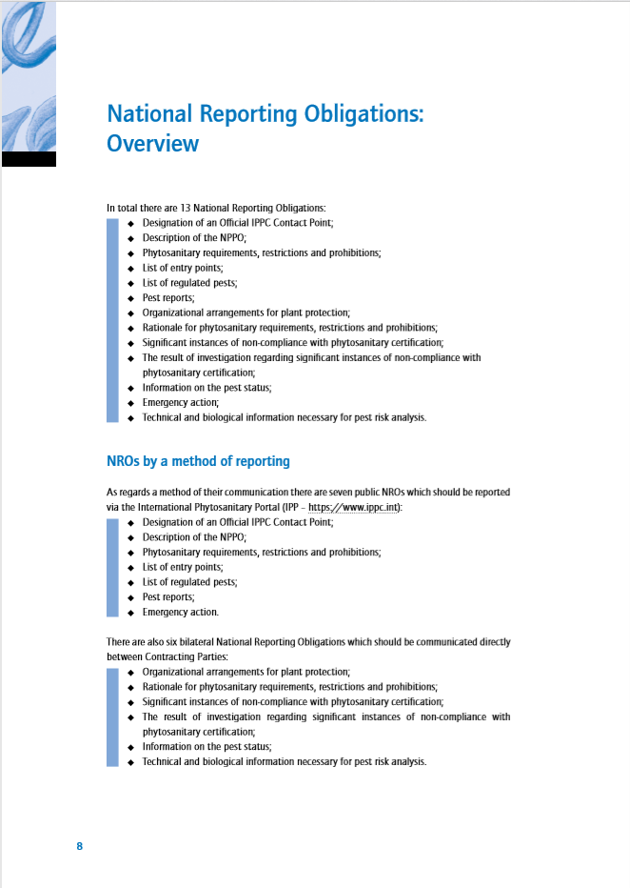
3.3 General review of NROs
NRO Guide: https://www.ippc.int/en/publications/80405/

Slide 9
4.1 General and specific NRO rules and procedures
Adopted by CPM-11 in 2016 for countries to follow
Based on the Convention + recommendations & inputs of the National Reporting Obligations Advisory Group
Include previous CPM decisions
To be found:
  Appendix 9 to the Report from CPM-11
  NRO Guide (Annex III)
  As separate tables on IPP

Slide 10
4.2 General and specific NRO rules and procedures
General:
  Use of electronic media
  Use of the IPP
  Pest reporting through RPPOs
  Priority to NROs while posting info
  Non-contracting parties encouraged to use the IPP
Specific:
  Details on each NRO including remarks, recommendations and guidance
Notes:
Communicating NROs is electronically, as this is more efficient than paper communications and substantially reduces resources needed by the Secretariat to process paper. For the purposes of the IPPC, The phrases “make available to “, “reported to” ”submit to “”transmit to “ and “ communicate to “ the Secretary means the Secretary to IPPC must be notified directly and the preferred mechanism of undertaking this is by publishing on the IPP by contracting parties (apart from the nomination of IPPC official Contact Point).
IPP is the preferred IPPC information exchange mechanism for NPPOs, CPs, the Secretariat and RPPOs to meet NROs. Any NRO that needs to be reported to the Secretary, is reported by CPs on the IPP and hence public. The Secretariat is available to provide guidance to CPs in meeting their NROs, but should not upload NRO information on behalf of CPs.
In accordance with Article VIII.1(a) of the IPPC, CPs cooperate in the exchange of information on plant pests. CPs may also undertake their pest reporting through their RPPOs. CPs need, however, to liaise with their RPPO first to ensure that they have a mechanism to allow pest reporting in this way. Should a CP wish to provide pest reports through its RPPO, the CP needs to provide the Secretariat with a signed form notifying that they are using this possibility for reporting. The CP can withdraw from pest reporting through RPPO and continue reporting directly to the Secretariat. The Secretariat needs to be informed about this change.
CPs can post other information on the IPP that they deem beneficial to other contracting parties, but meeting NROs should be given priority.
Countries that are not CPs are encouraged to use the IPP. They can appoint ÏPPC Information point” and post IPPC-related information on the IPP.

Slide 11





Contacts
IPPC Secretariat
Email: ippc@fao.org
Qingpo Yang, Associate Professional Officer: Qingpo.yang@fao.org
Paola Sentinelli, IPPC Knowledge Manager: paola.sentinelli@fao.org
Web:
www.fao.org
www.ippc.int
www.fao.org/plant-health-2020

