Slide 1
NRO Workshop
Statistics of NROs reports

Slide 2
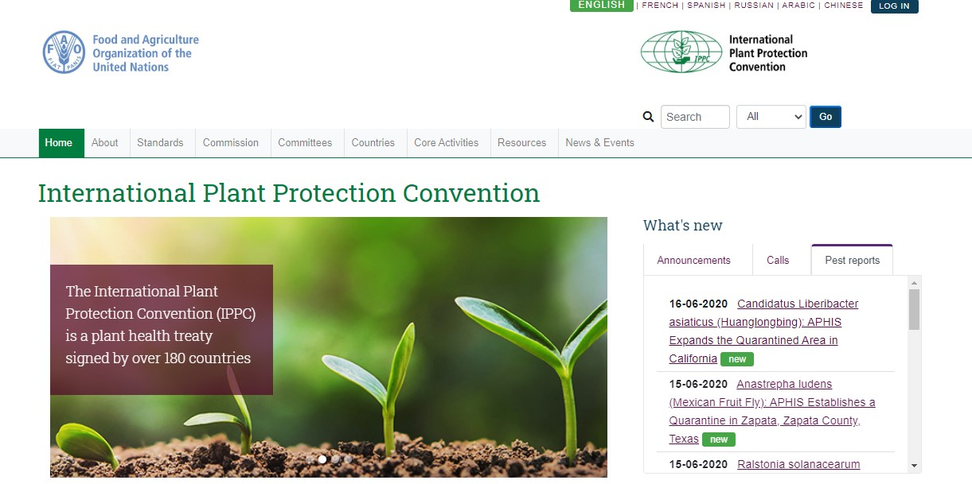
NRO new webpage
Notes:
To show how to find NROs page on new IPP

Slide 3
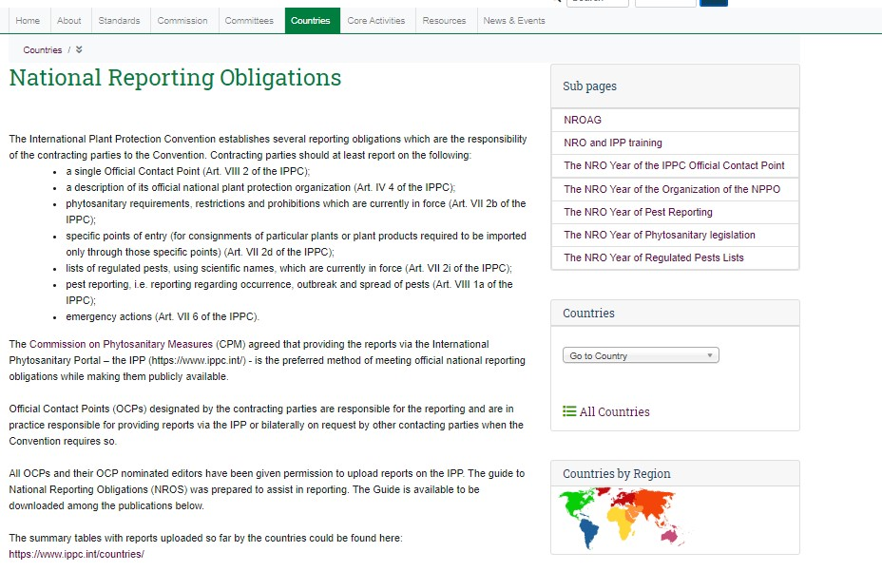

Slide 5
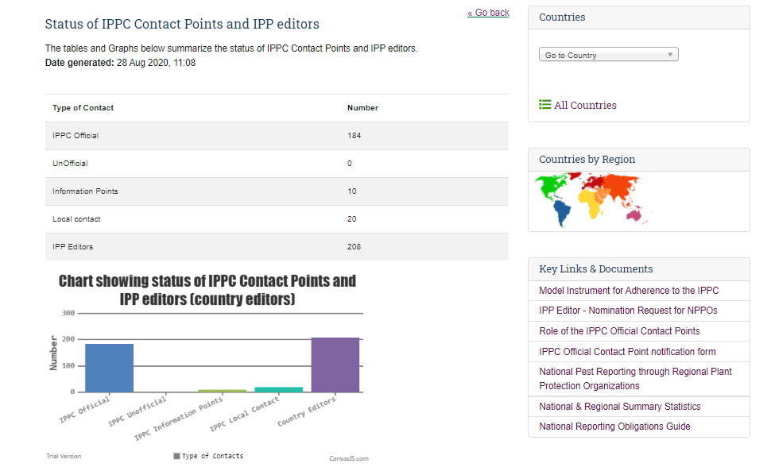

Slide 7
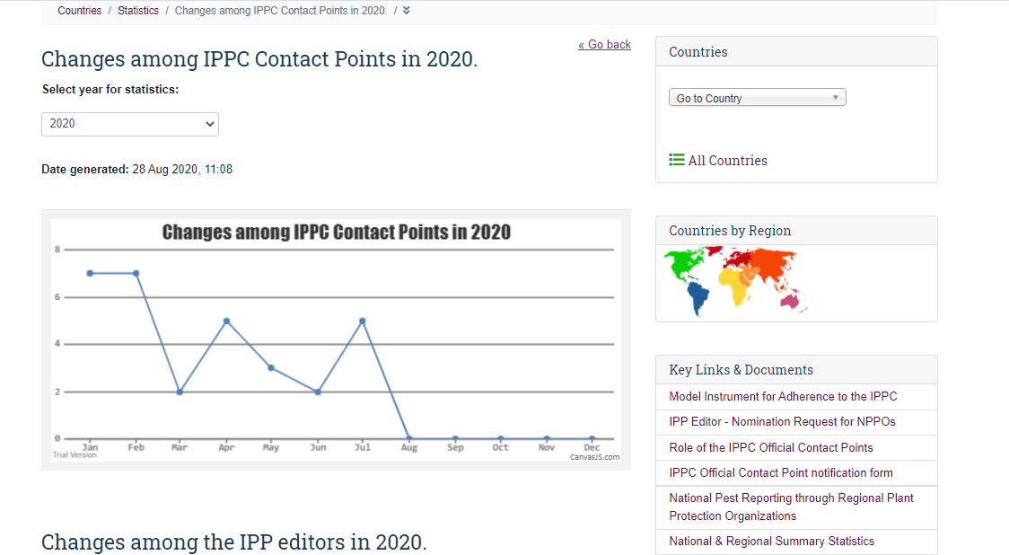

Slide 9
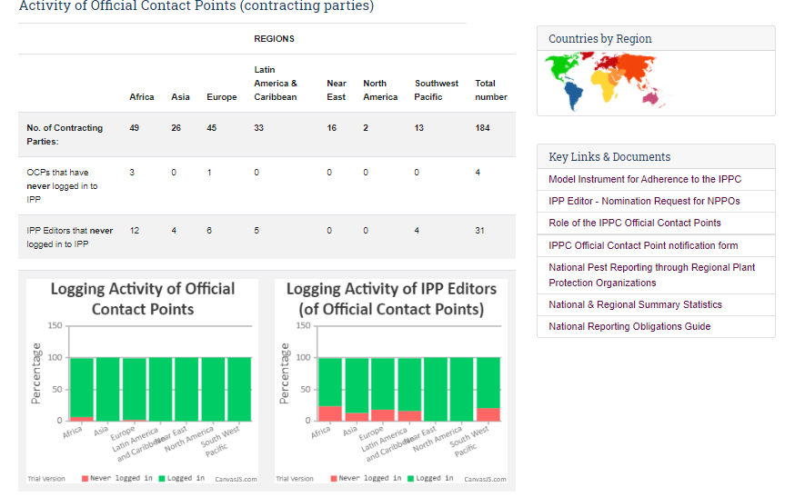

Slide 10
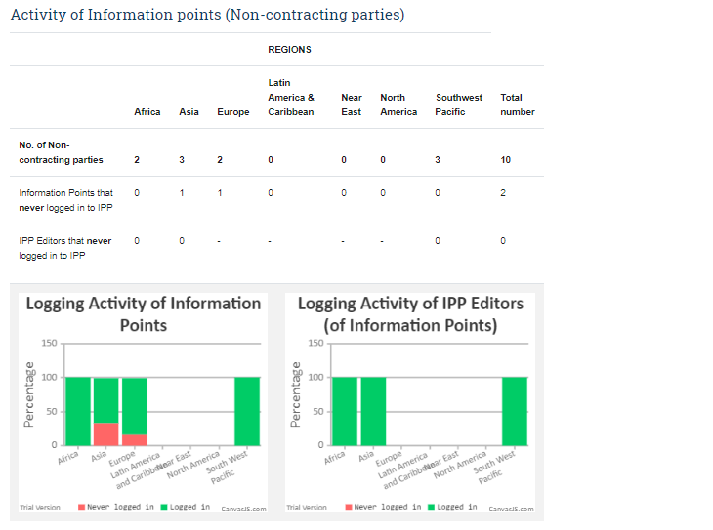

Slide 12
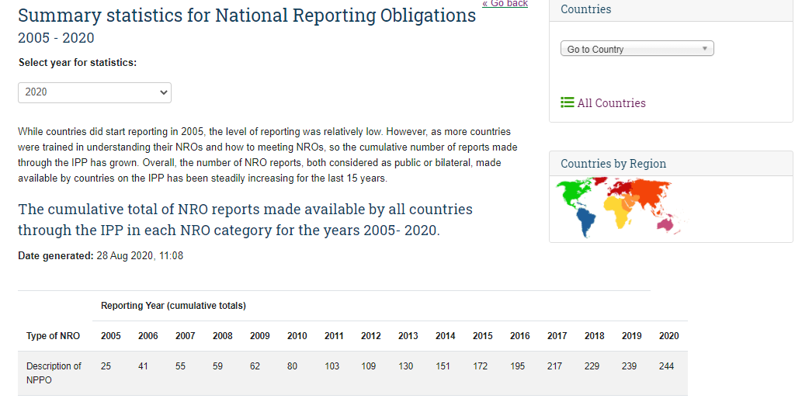

Slide 13
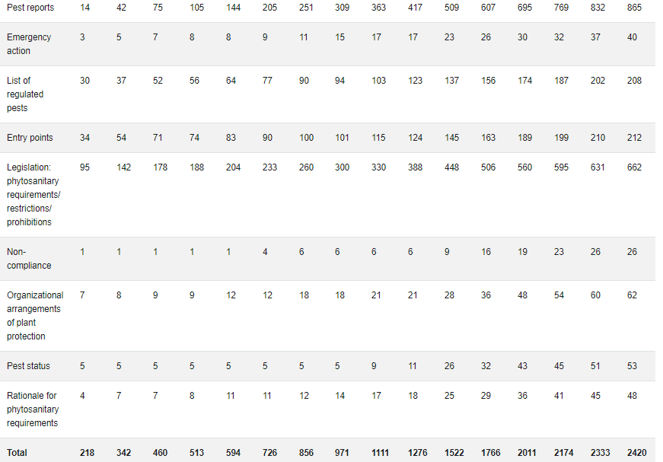

Slide 15
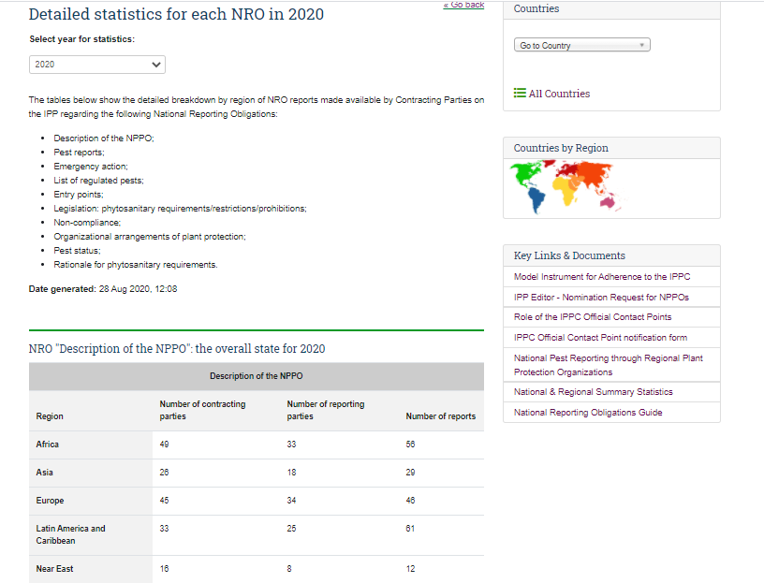

Slide 16
Contacts
IPPC Secretariat
Email: ippc@fao.org
Qingpo Yang, Associate Professional Officer: Qingpo.yang@fao.org
Paola Sentinelli, IPPC Knowledge Manager: paola.sentinelli@fao.org
Web:
www.fao.org
www.ippc.int
www.fao.org/plant-health-2020

