Slide 1
2020 IPPC NROs Workshop
Pest report

Slide 2
Pest report
When did you or your OCP submitted pest report
Pest report
What should be reported under Pest Report
The occurrence, outbreak or spread of pests that may be of immediate or potential danger should be reported via the IPP once they happen.
A pest report should contain important information that allows other countries to adjust as necessary their phytosanitary import requirements and to take actions taking into account any changes in pest risk.
Ref. ISPM-17: Pest reporting and
NRO Guide: Chapter 2.5
Notes:
More detail information about creating a pest report can be found in the International Standard for Phytosanitary Measure No. 17:
More details on the technical editing of Pest reporting see NRO Guide: Chapter 2.5 Detailed example of creating and updating a report: a pest report.
Pest Report can also be made through Regional Plant Protection Organizations:
if a country signs an appropriate form to satisfy the legality of that action and if the technical mechanism exists for data exchange

Slide 3
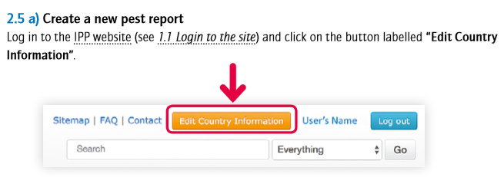
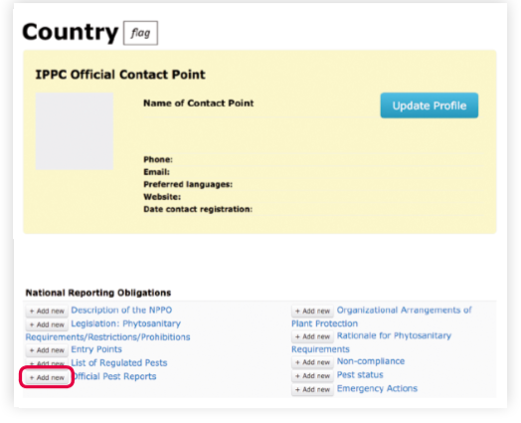
Pest report
How to submit a pest report
Notes:
Underneath the title “National Reporting Obligations” there is a list of reports, including pest reports (Official pest Reports), which can be submitted by the Contracting Parties
1. In order to add a new pest report you need to click on the button labelled “add new” next to a title: Official pest Reports. Clicking on this button activates a form. This form opens enabling you to submit data.

Slide 4
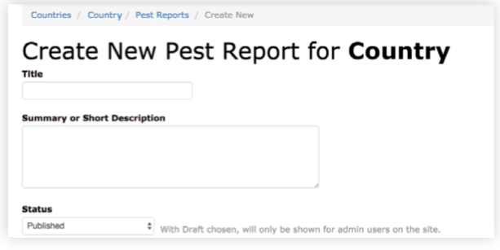
Notes:
1. Fill in a field “Title” of your report. Preferably it should mention at least the pest’s name and geographical area (your country and/or region).
2. Fill in a field “summary or short Description” of your report. Preferably it should at least mention again the pest’s name, and in more detail a geographical area (e.g. your country and/or region) and specific time it refers to (if you decide to use wording like “the latest” indicate at least a year of your report). This field should be more comprehensive if you are not attaching any file with more detail about reported event.
3. A field “status” refers to the status of this report in the system in regard to data entry. Here you have a possibility to save the report as a draft. You can select from the drop down menu either “Published” or “Draft”. If you choose draft it will not be visible to other users unless you change it to “Published”. If you do not need this option, leave “Published” as selected by default.

Slide 5
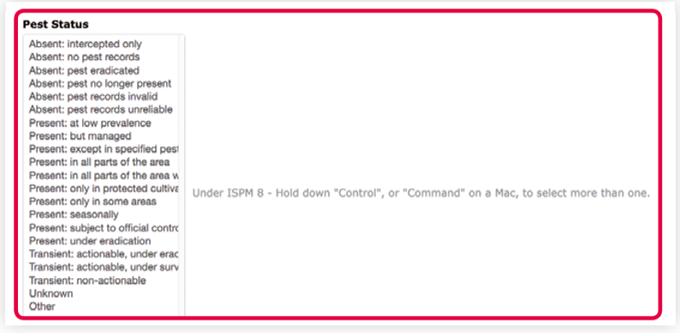
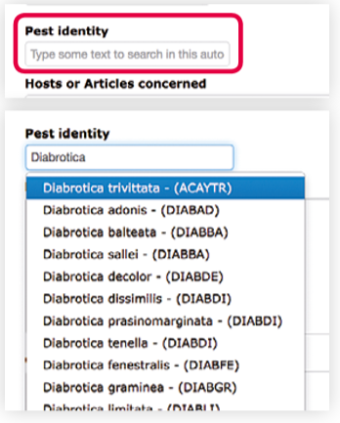
Notes:
A field “Report status” refers to the status of this report in regard to the pest and measures taken and which are communicated in this report. Here you have a possibility to select from the drop down menu “Final” or “Preliminary” or “N/A” (non applicable). If you describe a new pest outbreak you might select “Preliminary” and come back to update the report later in time once more information about the outbreak is known and measures taken are changed or completed. If you do not need this option, leave “Final” as selected by default.
A field “pest status” refers to a status of the pest you are reporting. You estimate it according to the International Standard for Phytosanitary Measure No 8: Determination of pest status in an area. Here you have a possibility to select an appropriate status of the pest from the drop down menu.
A field “pest identity” refers to the Latin name of the pest that you are reporting. You need to type here at least the genus name of the pest and wait for the system to display a drop down selection of relevant species. You need to select an appropriate name from that list. The systems pulls the Latin pest names from the database which is updated daily, however if the name you would like to select is not showing on the list, you need to contact the IPPC Secretariat.

Slide 6
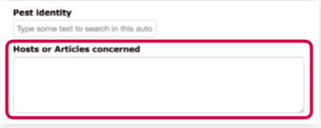
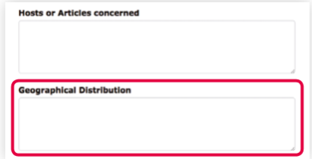
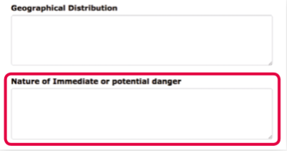
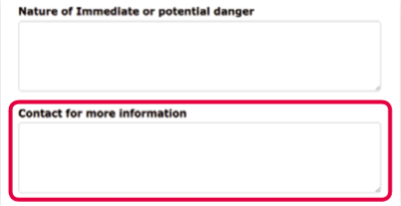
Notes:
A field “Hosts or articles concerned” refers to plants or plant products which have been affected by the pest you are reporting. Fill in this field with relevant plants names or names of plant families or description of plant groups or products of concern.
A field “geographical Distribution” refers to the areas where outbreak of the pest you are reporting has occurred or which are affected by the measures. Indicate at least your country’s name and the name of the region/s concerned preferably specifying where within your country they are situated.
A field “Nature of immediate or potential danger” refers to a type of danger that the pest you are reporting is posing. Indicate here information regarding that danger, e.g. if the pest is already regulated in your country or not.
A field “Contact for more information” refers to a person who can be contacted in relation to the contents of this report. Indicate a person’s name and their email address

Slide 7
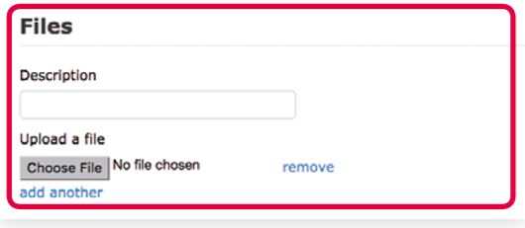
Notes:
A field “issue Keywords” refers to key words that could describe best the contents of the report. You need to type here preferably one word (e.g. pest, outbreak, measure, trade, export, import, etc.) and wait for the system to display a drop down selection of relevant words. You need to select an appropriate word or words from that list. A field “Commodity Keywords” refers to plants or plant products affected by the pest you are reporting. You need to type here preferably one word (e.g. fruit, plant, wood, pallet, etc.) and wait for the system to display a drop down selection of relevant words. You need to select an appropriate word or words from that list.
“Files”: here you have a possibility to attach documents to your report. In a field “Description” you insert a title of a document you would like to attach. To upload a document you need to click on a button “Choose File” and then select a document stored on your computer. You can add several documents by clicking on a button “add another” and follow the same procedure. To remove the document you need to click on the button “remove”.
“Websites”: here you have a possibility to attach links to websites relevant for the report. For example that could be a link to your national or regional website with more information about the outbreak. In a field underneath “Url for more information” you insert an url address of a relevant website. You can add several links by clicking on a button “add another” and follow the same procedure. To remove the link you need to click on the button “remove”.

Slide 8
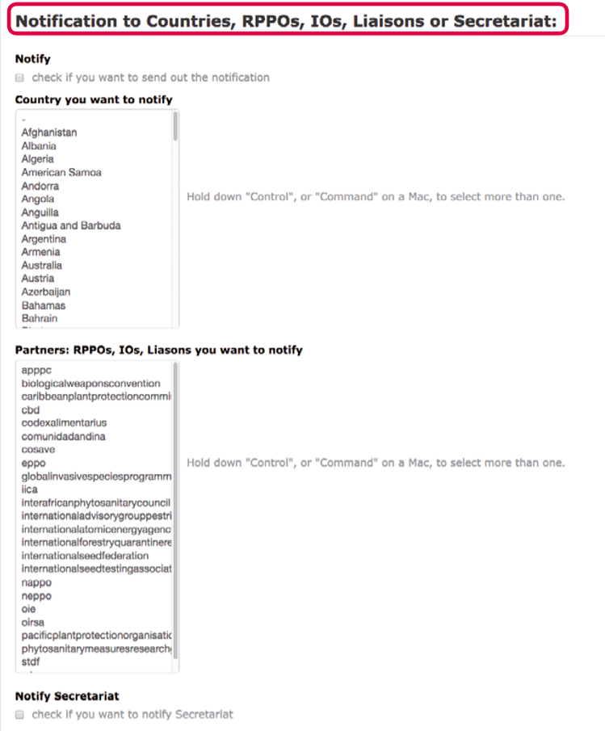
Notes:
1.“Notification to Countries, RppOs, iOs, liaisons or secretariat”. Here you have a possibility to inform other countries, Regional Plant Protection Organizations, international organizations or the IPPC Secretariat about the report you will have uploaded. If you choose this option an automatic email with a relevant link to the IPP will be send to an official email address of an Official Contact Point of a chosen country or a RPPO.
2. To use this option you need to check the box (by clicking on it) under “Notify” and then select from the lists a chosen country and/or organizations. You can select more than one country or organization from the lists.
3. To notify the IPPC Secretariat you need to check the box (by clicking on it) under “Notify secretariat”:
4. When you have finished filling in the form remember to save the data by clicking on the button labelled: “submit” at the bottom of the page.

Slide 9
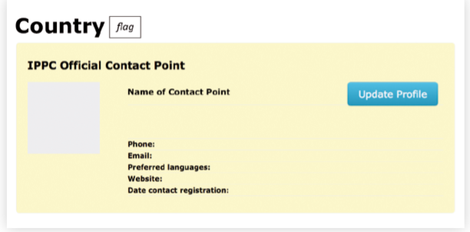
How to update a pest report
Notes:
1. click on the button labelled “edit Country information”.
2. Underneath the title “National Reporting Obligations” there is a list of reports, including pest reports (Official pest Reports), which can be submitted by the Contracting Parties
3. To see the list of all pest reports submitted by your country you need to click on the “Official pest Reports”
4. From the list of all pest reports submitted by your country you need to select the report you would like to update by clicking on “edit” on the right.

Slide 10
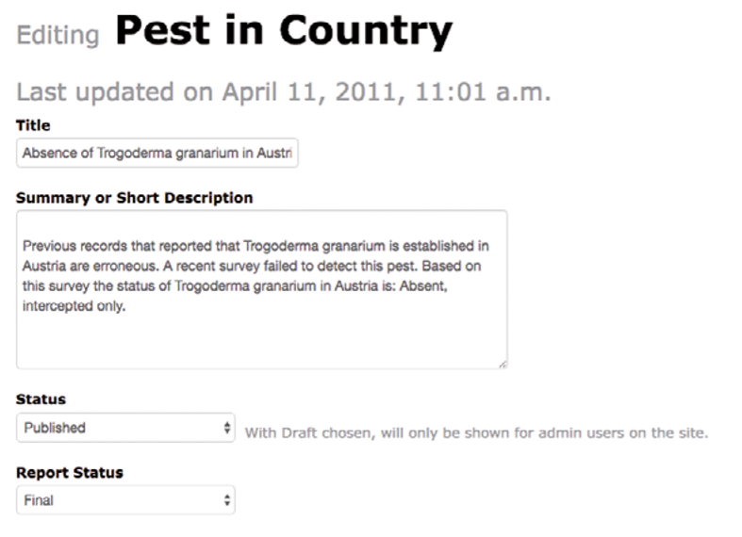
Notes:
Clicking on this button activates a form. This form opens enabling you to update data submitted before in that report.
When you have finished filling in the form remember to save the data by clicking on the button labelled: “Update Report” at the bottom of the page

Slide 11
Contacts
IPPC Secretariat
Email: ippc@fao.org
Qingpo Yang, Associate Professional Officer: Qingpo.yang@fao.org
Paola Sentinelli, IPPC Knowledge Manager: paola.sentinelli@fao.org
Web:
www.fao.org
www.ippc.int
www.fao.org/plant-health-2020

