Slide 1
2020 IPPC NROs Workshop
Latest development

Slide 2
1 NRO oversight body
NROAG: meeting in July 2014 → by email → dissolved by CPM-12 (2017)
1st IC meeting: December 2017: Agreed to establish a sub-group on NROs
2nd IC meeting: May 2018 agree the Oversight mechanism for NROs activities
2018 to now: on going
Directions for NRO Programme:
Awareness raising → NROs UPDATE, leaflets, factsheets, NRO Years
Reminding to report → automatic reminders
Educational materials → Procedures, Guide, e-learning
Removal of IT barriers → New technology for IPP

Slide 3
1.2 NRO oversight body
Current IC NROs Team
Sally Jennings, New Zealand (Lead)
Ms Olga LAVRENTJEVA, Estonia,
Ms Magda GONZALEZ ARROYO, Costa Rica
Mr Mamoun ALBAKRI, Amman, Jordan

Slide 4
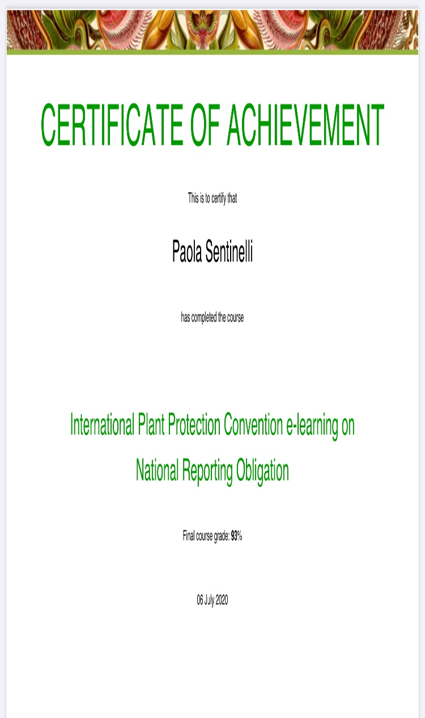
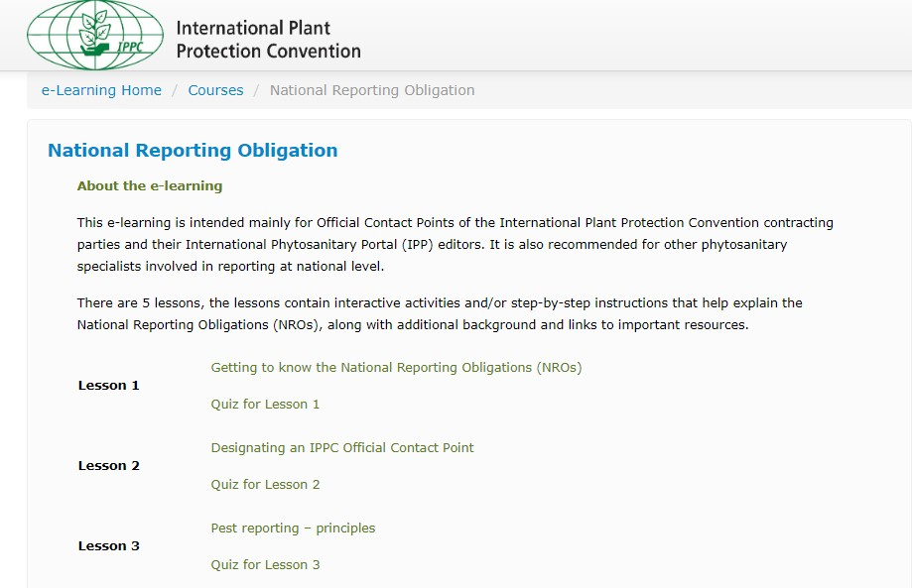
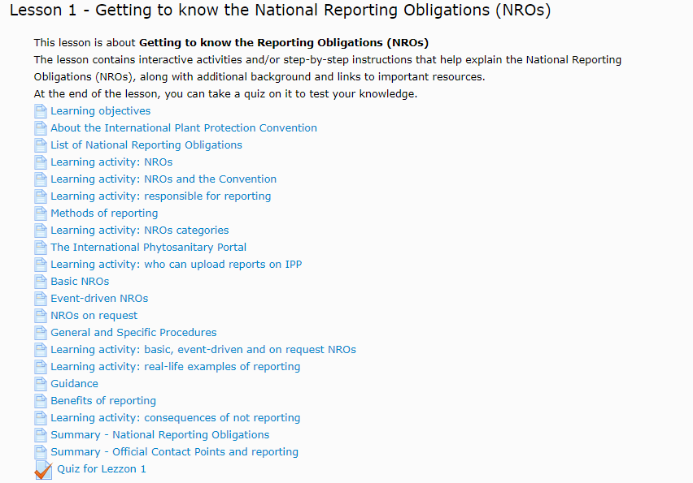
2.1 NROs recent achievements
E-learning page
NROs e-learning course
Name:XX
Notes:
Emphasis e-learning on this slide and pest report bulletin on next slide
This slide show what the NRO e-learning looks like. Just click the “NROs e-learning course”, register it. You will be guide to the course page.

Slide 5
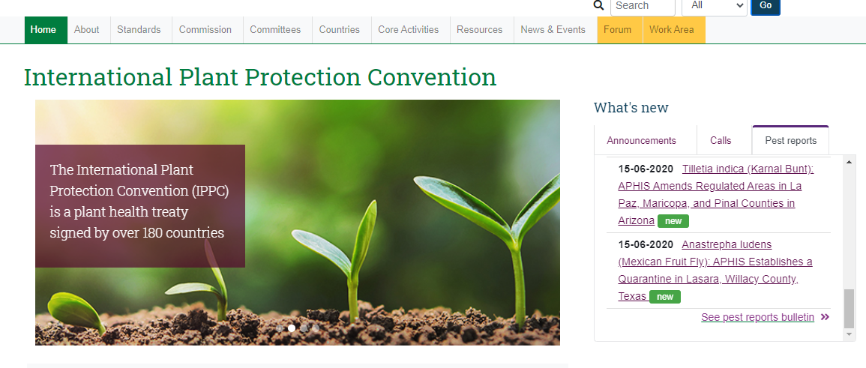
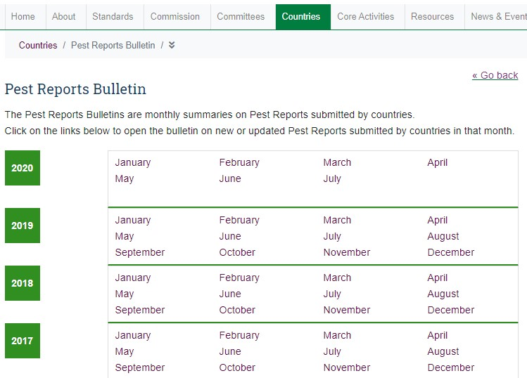
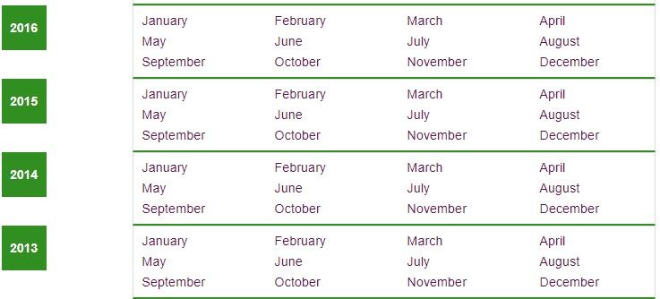
2.2 NROs recent achievements
Pest report bulletin
Notes:
This slide show how to find pest report bulletin. Pest report is one of public obligation. Pest report bulletin allow contact points to check the all the pest reports more easily.

Slide 6
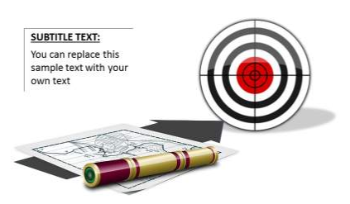
2.3 NROs recent achievements
Subscription to NROs report
Notification email will be send to subscribers’ email. Subscribers can choose reports in which they are interested.
IN PROGRESS
Notes:
This subscription allow users to receive notification when there is a new report on ipp. IPPC Secretariat is going to make this function available after IC APPROVAL

Slide 7
3 FAQs and Guidance links
NRO Guide: https://www.ippc.int/en/publications/80405/
Pest report bulletin: https://www.ippc.int/en/countries/reportingsystem-summary/all/
Factsheets on each NRO: https://www.ippc.int/en/core-activities/information-exchange/nro/
Tables (lists on NROs)
NROs UPDATE (educational newsletter)
Statistics (summaries for CPMs and IPP live statistics)
Reports lists

Slide 8
Contacts
IPPC Secretariat
Email: ippc@fao.org
Qingpo Yang, Associate Professional Officer: Qingpo.yang@fao.org
Paola Sentinelli, IPPC Knowledge Manager: paola.sentinelli@fao.org
Web:
www.fao.org
www.ippc.int
www.fao.org/plant-health-2020

