Slide 1
2020 IPPC NROs Workshop

Slide 2
New report: what to do first?
Check if a similar report already exists on the IPP.
↓
It is better to update the existing report than add a new one!
↓
Nonetheless if you decide to add a new report, make sure reports are clearly labelled (in title or description). It should be clearly indicated which is the most recent.
Note that:
All changes that you save are tracked = all previous versions of reports (revisions) are on IPP

Slide 3
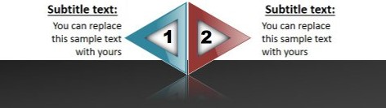
Guidance on deleting old reports
General rule based on FAO Legal Advice:
Report should not be deleted
Report on the IPP = official information for other countries
The deletion can be done by the IPPC Secretariat only in specific cases
Contact point can delete the invalid information:
Delete all the data including removal of all files
Rename the report
IPP will save the revision as history record.
Notes:
a report/information uploaded by a country on the IPP = official information transmitted to other countries and the Secretariat. So report should not be deleted. However, contact point can delete invalid information.
Delete all the data including removal of all files (attachments)
Rename the report (change title and/or description) to e.g.: “Report/measures no longer valid” or “N/A”
IPP will save the revision as history record.

Slide 4
Deleting old reports (Part II)
If this is not your case but you would like to still “delete” the report as the information is no longer valid:
↓
Log in to the IPP, go to: “Edit Country Information”.
↓
Go to the report and click on “EDIT” on the right
When the form opens: delete all the data appearing in all lines/windows including removal of all files (attachments)
Rename the report (change title and/or description) to e.g.: “Report/measures no longer valid” or “N/A”
↓
Save the data by clicking on “UPDATE REPORT”

Slide 5
Publication Date (of a report)
Means the date when it was uploaded on the IPP
Done automatically by the system
Cannot be changed
Used for statistics
Past: meant a real date of Publication of e.g. the legislation and a user could type it → Now: mention it in e.g. Description if needed

Slide 6
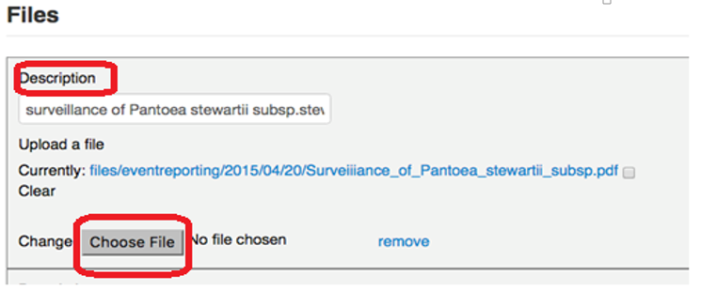
How to replace files/attachments
Log in to the IPP, go to: “Edit Country Information”.
↓
Go to the report and click on “EDIT” on the right
When the form opens: scroll down to see “Files”.
To replace the previously uploaded file (shown after “Currently:”), click on: “Choose file” below it and then select a document stored on your computer (remember to click on Open in a dialogue box which should appear on your screen).
↓
Save the data by clicking on “UPDATE REPORT”

Slide 7

Guidance on update of Contact details of Contact Points
What can Contact point do
What can IPPC Secretariat do
Change all their contact details (email, address, organization’s name, etc.) apart from their name and title
To change the name or title of Contact Point you need to contact the Secretariat (ippc@fao.org)
Change information after receiving new Contact Point nomination form.
Nomination form need to be signed by a senior officer than the new official contact point and stamped with the Organization stamp
Notes:
Emphasis the nomination form need to be signed by senior officer than the new official contact point and stamped with the organization stamp. After that , IPPC Secretariat will change the name and title of Contact point.

Slide 8
NPPO Description versus Organization of NPPO
“Each contracting party shall submit a description of its official national plant protection organization and of changes in such organization to the Secretary. A contracting party shall provide a description of its organizational arrangements for plant protection to another contracting party, upon request.”
NPPO Description:
  Public
  General structure of an NPPO
  In the form of an organogram
NPPO Organization:
  Bilateral on request
  Should contain a description of functions and responsibilities in relation to plant protection (Article IV.2 & 3: surveillance, inspections, issuance of certificates, etc.).
  Both can be combined in one report and made public on the IPP as a single report, e.g. in the form of organogram indicating who is responsible for which area and what are the connections between different parts of the NPPO.

Slide 9
New phytosanitary certificates: report or not?
There is no obligation to report new models/templates of phytosanitary certification as such
However, as it is important to inform other countries about the change which is usually done through updating national legislation, you can report it on the IPP under Phytosanitary legislation
Remember to check the box under “Notify” and select countries when uploading this report on the IPP

Slide 10
Pest report: status fields
“Status” = the status of this report in the system in regard to data entry.
  A possibility to save the report as a draft. Select from the drop down menu either “Published” or “Draft”.
  If you choose draft it will not be visible to other users unless you change it to “Published”.
  If you do not need this option, leave “Published” as selected by default.
“Report Status” = the status of this report in regard to the pest and measures taken and which are communicated in this report.
  A possibility to select from the drop down menu “Final” or “’Preliminary” or “N/A” (non applicable).
  If you describe a new pest outbreak you might select “Preliminary” and come back to update the report later once more information about the outbreak is known and measures taken are changed or completed.
  If you do not need this option, leave “Final” as selected by default.
“Pest Status” = a status of the pest you are reporting.
  You estimate it according to the International Standard for Phytosanitary Measure No 8: Determination of pest status in an area.
  A possibility to select an appropriate status of the pest from the drop down menu.

Slide 11
Pest report: report a pest or not?
“The contracting parties shall cooperate with one another to the fullest practicable extent in achieving the aims of this Convention, and shall in particular (…) cooperate in the exchange of information on plant pests, particularly the reporting of the occurrence, outbreak or spread of pests that may be of immediate or potential danger (...)
When in doubt as to the qualification of a pest as a “pest of immediate or potential danger” and therefore its reporting, the reporting of any pest is desirable.
Other countries may see a pest as of immediate of potential danger even if you don’t.

Slide 12
Emergency action: what is it?
ISPM 5 Glossary of Phytosanitary Terms:
“emergency action: a prompt phytosanitary action undertaken in a new or unexpected phytosanitary situation”
“phytosanitary action: an official operation, such as inspection, testing, surveillance or treatment, undertaken to implement phytosanitary regulations or procedures”.
Information on emergency actions are often included in pest reports.
ISPM 13 Guidelines for the notification of non-compliance and emergency action contains partial (connected only to non-compliance of imported consignments) guidelines for the notification of emergency actions

Slide 13
Notifying other countries
When entering a new report:
  check the box (by clicking on it) under “Notify”
  select from the lists a chosen country and/or organizations (under “Notification to Countries, RPPOs, IOs, Liaisons or Secretariat” “Country you want to notify”)
If you forgot to do it while uploading a new report, you can still do it later:
  log in to the IPP, go to the report and click on “Edit”
  check the box (by clicking on it) under “Notify”
  select from the lists a chosen country and/or organizations (under “Notification to Countries, RPPOs, IOs, Liaisons or Secretariat” “Country you want to notify”)
  click on “Update report”. That should send out the notifications to your chosen countries.

Slide 14
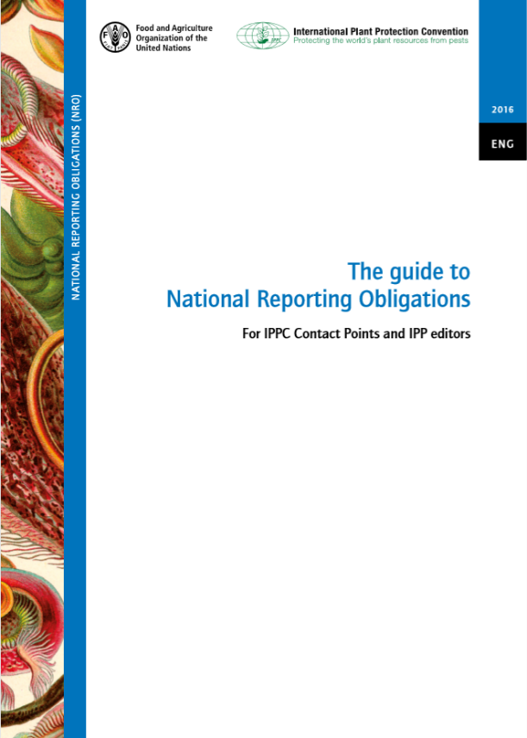
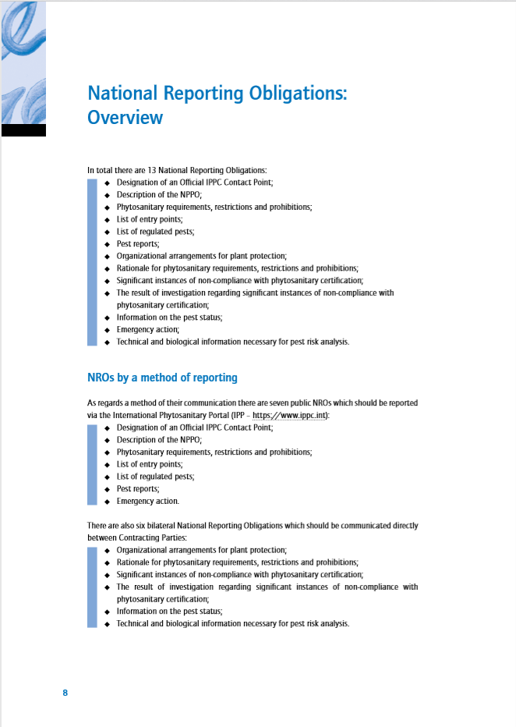
NRO Guide: https://www.ippc.int/en/publications/80405/

Slide 15





Contacts
IPPC Secretariat
Email: ippc@fao.org
Qingpo Yang, Associate Professional Officer: Qingpo.yang@fao.org
Paola Sentinelli, IPPC Knowledge Manager: paola.sentinelli@fao.org
Web:
www.fao.org
www.ippc.int
www.fao.org/plant-health-2020

