Slide 1
IPPC ePhyto Solution
Facilitating Safe Trade in Plants and Plant Products

Slide 2
The IPPC ePhyto Solution - Background
“ePhyto” is short for electronic phytosanitary certificate. In simple terms, it is the data contained in a phytosanitary certificate in digital form.
The 2019 UNESCAP/ADB Innovation Award-winning IPPC ePhyto Solution helps countries comply with the Trade Facilitation Agreement of the World Trade Organization, specifically Articles 7.9 (release of perishable goods) and 10.1 (simplifying formalities and documentation requirements for cross-border trade)
The Solution also meets the requirements of International Standard for Phytosanitary Measures (ISPM) 12 Annex 1.
The ePhyto Solution allows countries to electronically exchange ePhytos with each other through a central hub, quickly, accurately and at no purchase cost. Countries can join the system for free once they meet the necessary requirements.
The risk of loss, damage or fraud to the certificate is greatly reduced, as is the administrative burden on both border agencies and business.

Slide 3
The IPPC ePhyto Solution - Background
The system was initially set up to exchange electronic phytosanitary certificates, but any certificate (animal health, food safety, etc.), once coded in XML, can be exchanged.
NPPOs, agricultural and forestry industries, as well as freight forwarders and others are already benefitting from transaction cost reductions, improved trade security, risk management and increased trade flows.
Food gets to where it needs to be faster without sacrificing attention to matters of plant health
The IPPC Secretariat is collaborating with the Global Alliance for Trade Facilitation, industry and the World Bank in implementation efforts in a number of countries around the world.
Special thanks to the STDF for providing the resources to start the project.

Slide 4
Why ePhyto?
Discussed for many years, began in earnest in 2015 with STDF grant award for US$1 million. Fully operational and in service as of July 2019 (Hub and Gens) – May 2020 - 91 countries registered, 53 in production. Argentina, Chile, Sri Lanka, USA, Mexico and others are paperless.
Reduces non-compliant certificates = More paper work rejections than pest finds.
Eliminates inefficient paper processes = labor intensive.
Efficiency gets food faster where it is needed
Reduces the re-issuance of paper phytosanitary certificates = tremendous cost in time and money with paper.
Loss of commodities waiting for clearance.
Reduces industry claims for late deliveries or bad quality.
ePhyto protects legitimate trade.
Fraudulent certificates
Pest introduction
*Source: Union Fleurs

Slide 5
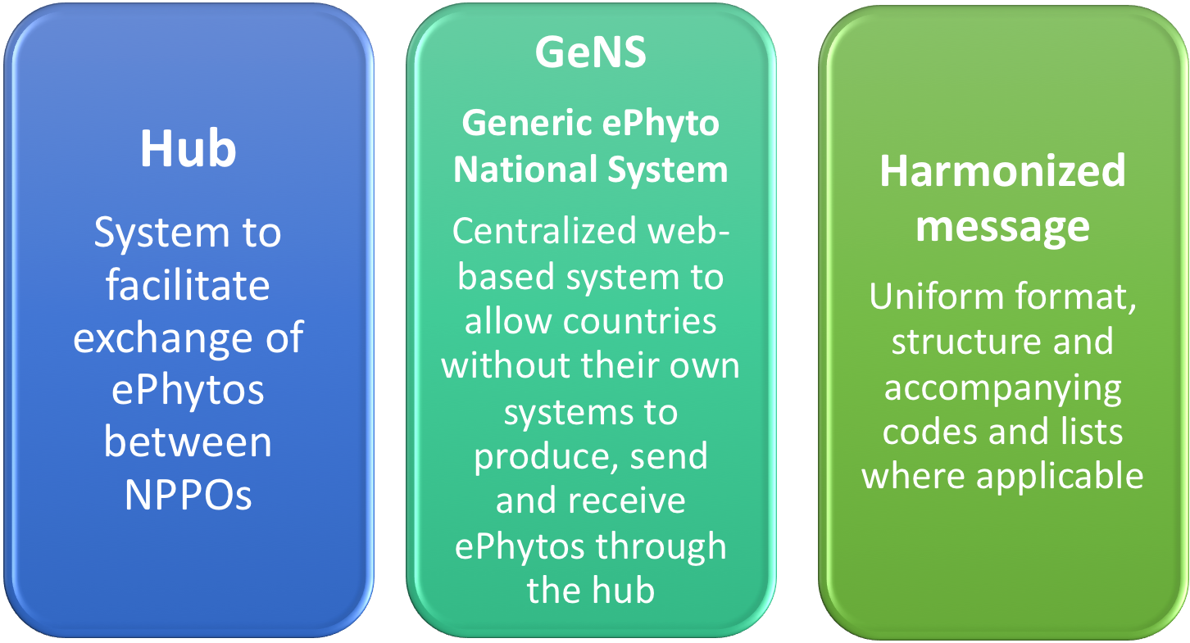
The ePhyto solution

Slide 6
The IPPC ePhyto Solution
The Solution consists of the ePhyto Hub (with direct connections for countries with their own national systems) and the web-based Generic ePhyto National System (GeNS – for countries without their own infrastructure) exchanging harmonized messages in a uniform format and structure.

Slide 7
ePhyto solution
Countries with National Systems
UNICC
GeNS Countries
Argentina
Ghana
New Zealand
Hub
GeNS
Sri Lanka
United States
Myanmar

Slide 8
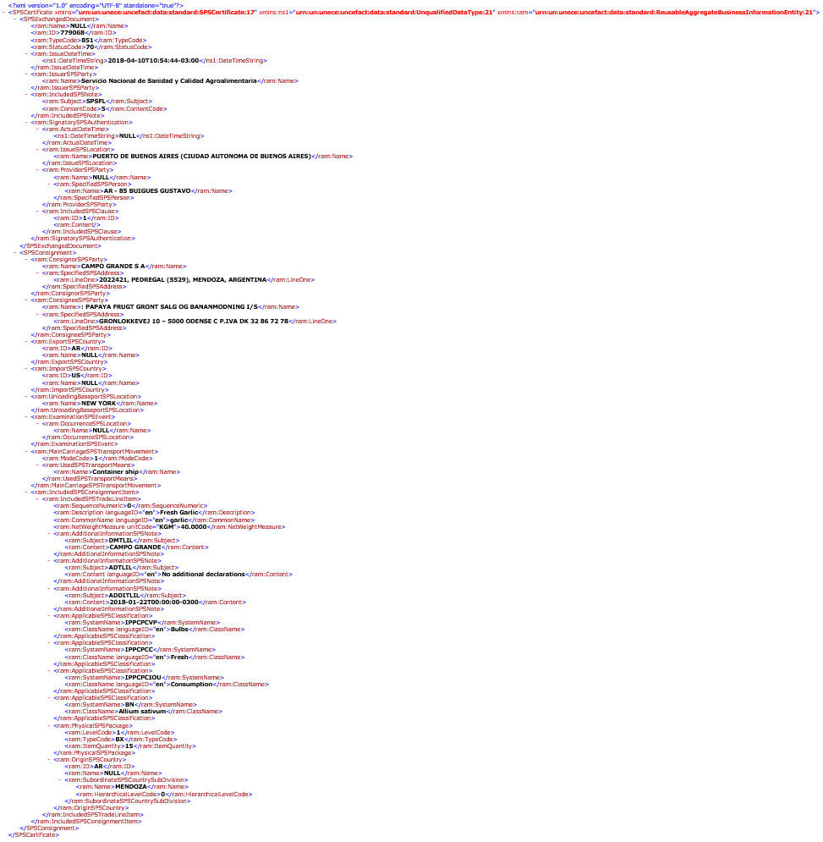
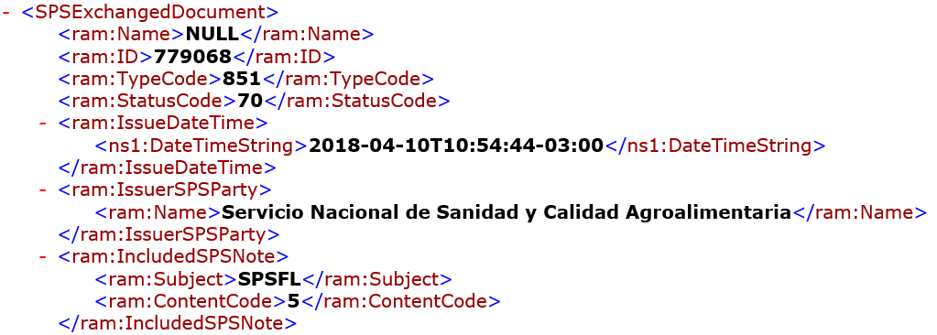
What is an ePhyto?
Notes:
This is the behind the scene look at the actual data coming into the HUB

Slide 9
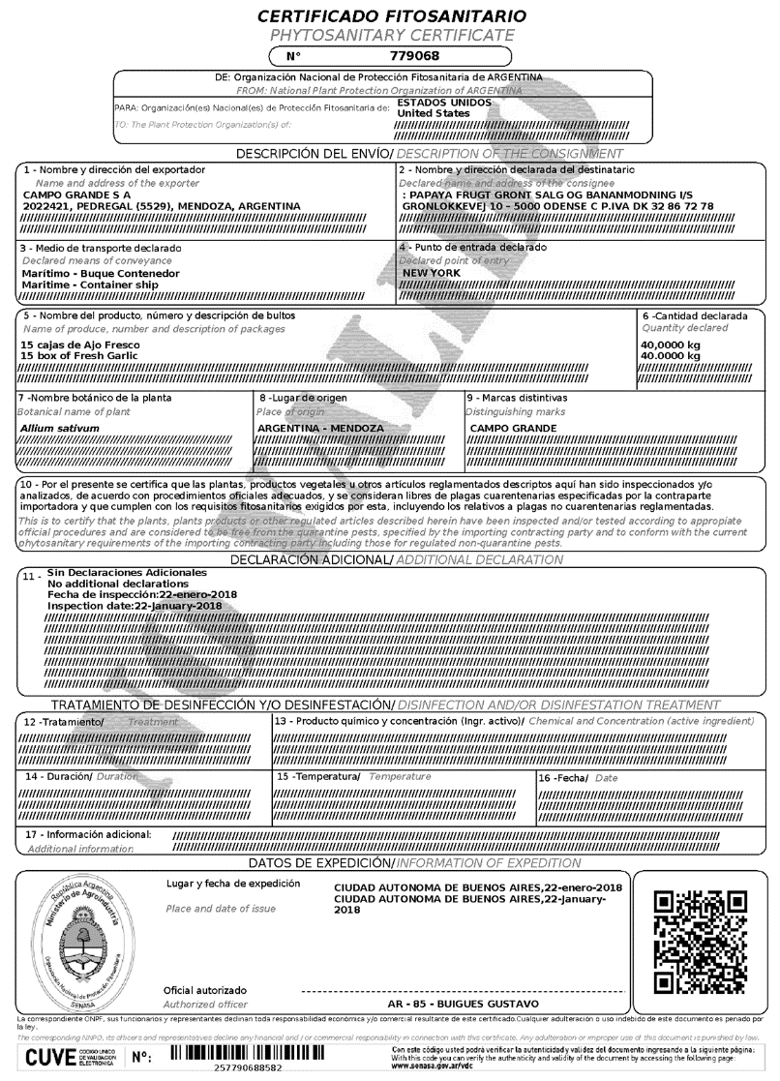
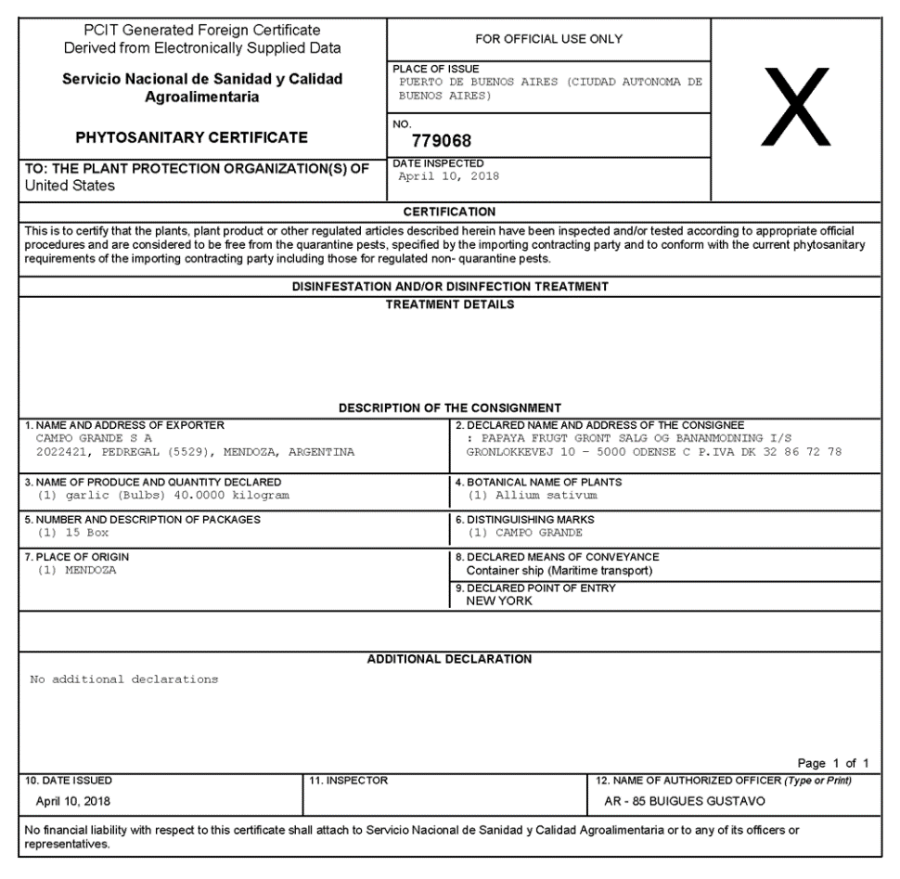
Paper Representations
Argentina certificate (from their system) Same certificate received from Argentina via ePhyto in US
Standardized format leads to easier document review
Notes:
Now this is a more familiar view
On the left – this is Argentina’s paper phytosanitary certificate
On the right – this is the ePHYTO’s standardized format – all of the same information in the paper version is here in the ePhyto.
ALL countries’ ePhyto will look like this one.

Slide 10
Country Participation – Hub and GeNS May 2021

Slide 11
The IPPC ePhyto Solution
The system is effortlessly handling approximately 95,000 certificates per month, with the capacity to handle (in the current configuration) up to 100,000 certificates per day.

Slide 12
Continued Success Depends on Collaboration
The IPPC Secretariat is working with a number of international organizations and groups to make the ePhyto Solution a trade facilitation tool for any country (or organization) wishing to use it. These include:
The Global Alliance for Trade Facilitation of the World Economic Forum
The ePhyto Industry Advisory Group
The Standards and Trade Development Facility
The World Bank and International Finance Corporation
The World Customs Organization and,

Slide 13
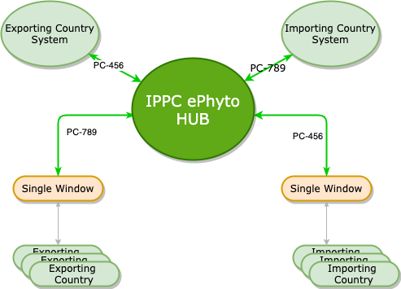
Channel Delegation
Single Window systems can now connect to the HUB to send/receive ePhytos on behalf of countries they manage.
The delegation rule can be adjusted on the following criteria:
Incoming/Outgoing messages
Document Type (Regular and Re-export)
Document Status (Issued, Withdraw)
The EU Traces system is using this feature.
Countries can send ePhytos to any EU member (or any country on the ePhyto Solution ) through the HUB, and the message will be pulled by the Traces system and delivered to the intended country.

Slide 14
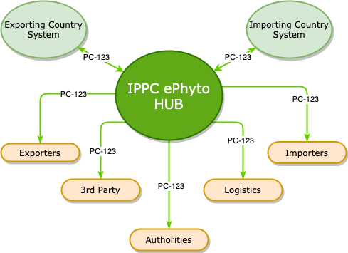
Channel Forwarding
A country will be able to specify multiple recipients on the ePhyto envelope while sending it to the destination country.
The sender will add the forwarding channel codes on the envelope header of the ePhyto.
Currently need to pilot this use case.

Slide 15
The IPPC ePhyto Solution – The ePhyto Hub
For a country to participate in the Hub with a national system it is mandatory to have the capacity to produce electronic phytosanitary certificates (ePhytos).
The national system needs to have at least the following functionality:
Enter phytosanitary certificate data electronically
Produce phytosanitary certificates (ePhytos and/or paper)
Send ePhytos
Store of electronic phytosanitary certificate data
Receive ePhytos
Decrypt ePhytos
Validate the structure of the ePhyto message
Read/view/print/produce pdf of ePhytos

Slide 16
The IPPC ePhyto Solution – GeNS
Review, fill-out and submit the GeNS on-boarding document (https://www.ephytoexchange.org/doc/GeNS_NPPO_OnBoarding_V5.pdf)
Get executive support, assign a project manager and establish a working group
Raise awareness with local industry and other stakeholders
Determine whether domestic legislation supports electronic data exchange and allow off shore data storage
Finalise the project plan for GeNS implementation
Identify ePhyto training requirements before and after implementation, Number of staff, Locations, Roles
Ensure sufficient local resources are in place to use GeNS after implementation

Slide 17
www.ephytoexchange.org
Online Video Training for GeNS

Slide 18
What’s Next with ePhyto?
ePhyto Solution – Hub and GeNS
Exchange Notices of Non-Compliance
Inspection findings
Further collaboration with non-phytosanitary agencies/organizations (OIE/Codex/Others)
Linkage to other government systems (Single Windows, Customs, ASYCUDA, etc.)
Linkage to industry systems (Blockchains)
Routine maintenance and enhancements
Translation into other languages (GeNS)
Sustainable funding

Slide 19
Thank you
IPPC Secretariat Food and Agriculture Organization of the United Nations (FAO) ippc@fao.org | www.ippc.int

