Slide 1
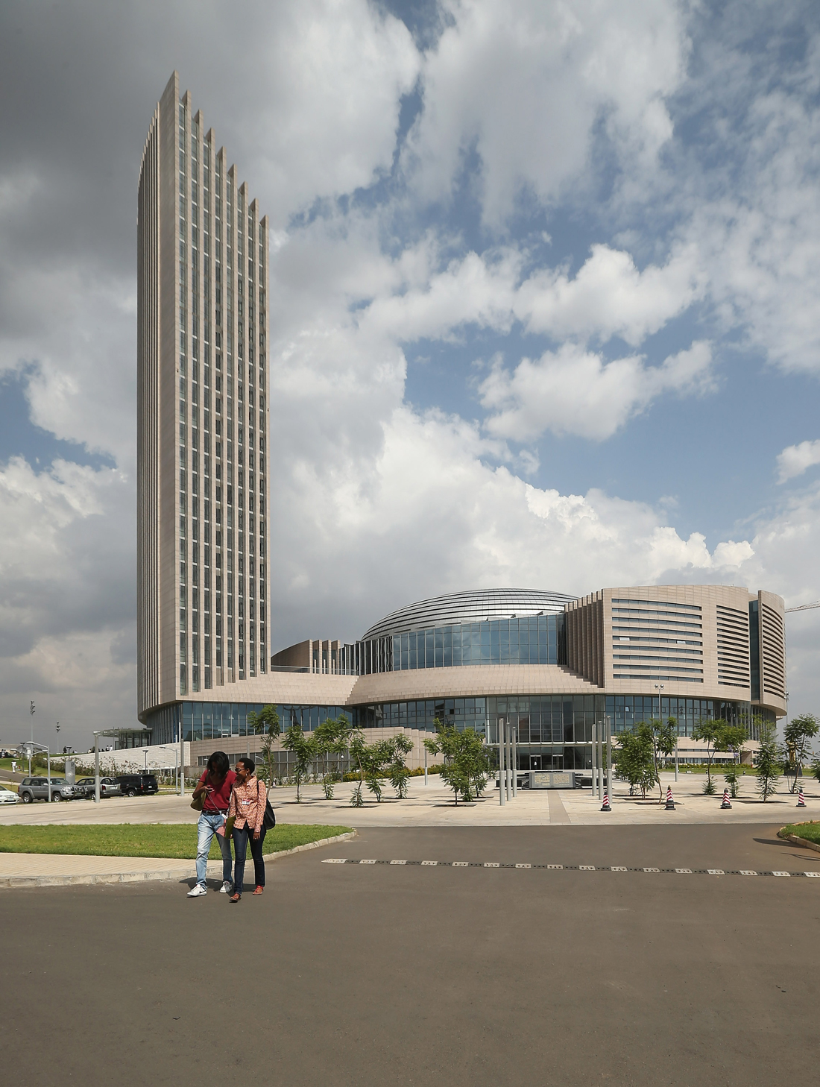


IPPC REGIONAL WORKSHOP FOR AFRICA 2021
21 – 24 SEPTEMBER 2021
Update on RPPO-AFRICA Activities
Maryben CHIATOH
Inter-African Phytosanitary Council

Slide 2


Outline
IAPSC Vision, Mission and Goal
IAPSC organization: core activities
Update on IAPSC implemented activities from October 2020 to August 2021
Outcome of implemented activities
Way forward

Slide 3
IAPSC Vision, Mission and Goal
Vision: Robust plant health systems and reduced pest risks contribute to better livelihoods, enhanced trade and biodiversity preservation in Africa;
Mission : To develop, promote and coordinate sustainable plant health systems among continental, regional and national actors for increased agricultural production, market access and trade;
Goal: Continental plant health management systems improved by 2023.

Slide 4
Core Coordination activities of IAPSC as RPPO for Africa
Quarantine pests; Regulated non-quarantine pests;
Laboratory Assessments; phytosanitary treatments
Transboundary, Migratory pests; Invasive alien species
IPM
Phytosanitary Inspections(import, export inspection and certification)
PRA
ISPMs implementation and compliance
SPS agreement provisions
Harmonization of pesticide legislation, registration, regulation

Slide 5
Update on IAPSC activities: October 2020 to August 2021
Workshops and meetings organized by IAPSC
Capacity building and implementation of Integrated Pest Management (IPM) strategies and migratory/transboundary pests management workshops (12 – 16 October 2020);
Workshops on strengthening Member States capacities on invasive alien plants risks assessment and management, Pest Biological control and biological control agents (23-27 November 2020);
Preparatory meeting for the fifteenth session of the Commission on Phytosanitary Measures, CPM (23-25 February 2021);
Thirteenth session of Inter-African Phytosanitary Council Steering Committee (12-13 April 2021);

Slide 6
Update on IAPSC activities: Oct 2020 to Aug 2021 (cont’)
Twenty-ninth session of the General Assembly of the Inter-African Phytosanitary Council (14 - 16 April 2021);
Strengthening Member States, RECs and National Plant Protection Organizations (NPPOs) capacity in inspection services, quarantine pest detection methods and management of trans-boundary pests (21 – 23 July 2021).
Other workshops / meetings
Participation at the virtual meeting on Phytosanitary awareness (9 – 13 November 2020);
Participation at the AU-STRC victual 3rd Congress of the African Scientific Research and Innovation Council – ASRIC (15 – 17 December 2020);
Thirty-third Technical Consultation meeting among RPPOs (28 Feb 2021);

Slide 7
Update - IAPSC activities, October 2020 to August 2021 (cont’)
Continental Training of National Experts on Malabo Declaration Biennial Review Reporting Tools (15 March 2021);
Fifteenth Session of the Commission on Phytosanitary Measures (16 March, 18 March and 1 April 2021);
National conference on the Fall armyworm in the DRC (14 – 15 April 2021);
Training on the International Plant Protection Convention online Comment System (OCS) for the Africa region (8 July 2021);
Third Phytosanitary Conference organized by the Kenya Plant Health Inspection Services – KEPHIS (13 September 2021)

Slide 8
Update - IAPSC activities, October 2020 to August 2021 (cont’)
Plant health related activities in collaboration USDA, EU and other Development partners
Consultative Meeting on Africa Food Safety Agency, Food Safety Laboratory, Food Safety Strategy, and Plant Health Strategy (28 – 30 October 2020);
Consultative meeting on the progress of implementation of Continental SPS Committee Policy Framework held on October 19 – 21, 2020;
Advisory Group Meeting on the development of a Plant Health Strategy for Africa (18 May 2021);
Continental consultative meeting for the development of a Plant Health Strategy for Africa (1 – 4 June 2021)
Technical Validation meeting for the Plant Health Strategy (16 Sept 2021)

Slide 9
Outcomes of implemented activities
Several recommendations towards strengthening national plant health systems and improving surveillance, emergency response, prevention and management of pests in Africa;
Draft Plant Health Strategy for Africa to be presented to AUC Policy organs for adoption during the Specialized Technical Committee on Agriculture, Rural Development, Water and Environment, 13 – 17 December 2021;
New partnerships developed with research and development institutions within and out of the region;
Increased access to effective phytosanitary information among stakeholders;

Slide 10
Outcomes of implemented activities
Efforts towards maintaining safe trade at national, regional and continental levels during the continued phase of the Covd-19 pandemic
Increased knowledge of good pest management practices
Improve public participation in pest control efforts.
Improved standards setting and implementation by MS and enhanced public and private awareness of IPM.

Slide 11
Way forward
Continued implementation of RPPO related activities despite social distancing measures imposed by COVID-19;
Develop post – COVID-19 contingency plan to handle Plant Health related challenges exacerbated by the pandemic;
Source for funding and partnerships to continue handling pest outbreaks in the region such as desert locusts and other emerging pests;
Strengthening collaboration and commitment of both member states and RECs to build a strong plant health system in the region
Implementation of the Plant Health Strategy for Africa

Slide 12
Thanks for your kind attention

