Slide 1
How NAPPO member countries meet their IPPC National Reporting “pest” Obligations - NROs
Stephanie Bloem, North American Plant Protection Organization
2021 IPPC Virtual Regional Workshop for Africa
Theme – International Year of Plant Health Legacy
Day 4 – Friday, September 24, 2021
Agenda item 7.3

Slide 2
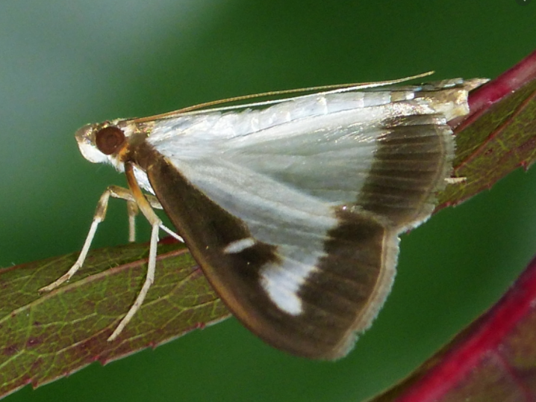
NAPPO Phytosanitary Alert System - PAS
Presentation initially developed by the PAS Chair, Ignacio Baez, U.S. NPPO
Adapted and recorded for this audience by Stephanie Bloem, NAPPO
Cydalima perspectalis – box tree moth

Slide 3
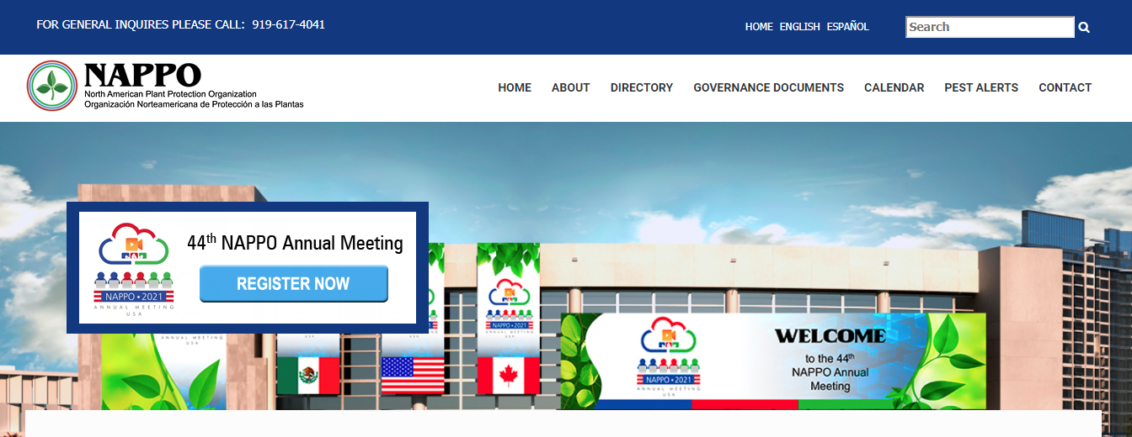
NAPPO Phytosanitary Alert System - PAS
www.NAPPO.org

Slide 4
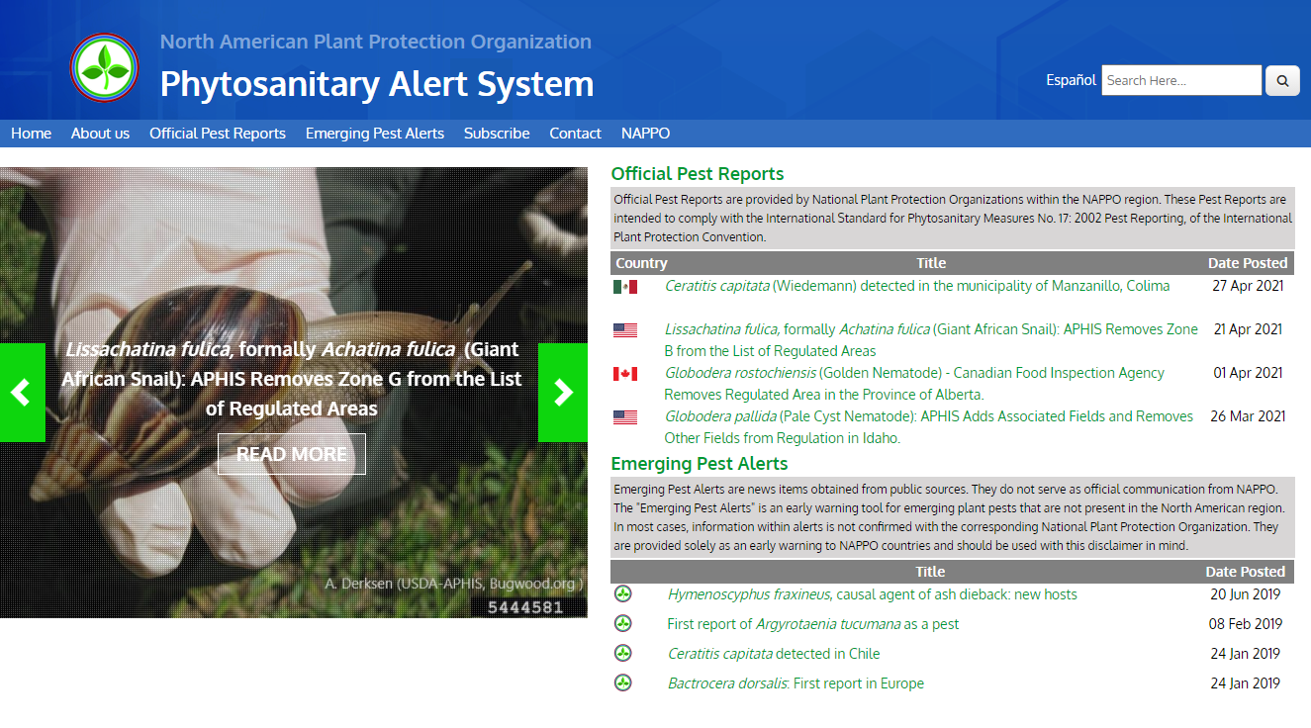
NAPPO Phytosanitary Alert System - PAS
www.pestalerts.org

Slide 5
What is the NAPPO Phytosanitary Alert System or NAPPO PAS?
The NAPPO PAS is a public web-based notification system
Mechanism to share pest information, both official communications and scientific intelligence, concerning plant pests
Primarily focused on plant pests of quarantine significance that affect North American agriculture, forests or natural habitats
www.pestalerts.org

Slide 6
NAPPO PAS Expert Group Members
An Expert Group (EG) provides/oversees the information
EG composed of members from each regional NPPO
System platform managed by the NAPPO Secretariat
Canada (CFIA)
Rajesh Ramarathnam
United States (USDA-APHIS-PPQ)
Ignacio Baez (Chair)
Amanda Kaye
Mexico (SENASICA-DGSV)
Ana Lilia Montealegre

Slide 7
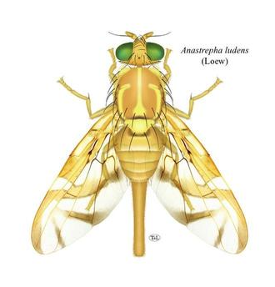
NAPPO PAS Objectives and Products
Objectives
Meet the IPPC National Reporting “pest” Obligations (NROs)
Facilitate awareness, detection, prevention and management of potentially harmful exotic plant pest species in North America
Products
Official pest reports – OPRs
Emerging pest alerts – EPAs

Slide 8
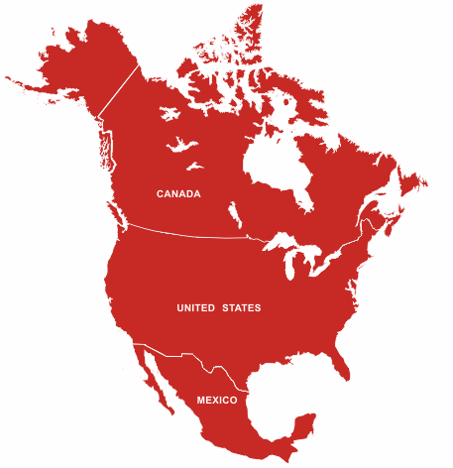
Official Pest Reports - OPRs
Provided by each regional NPPO – official*
Canadian Food Inspection Agency – CFIA
United States Dept. of Agriculture, Animal and Plant Health Inspection Service, Plant Protection and Quarantine – USDA-APHIS-PPQ
Servicio Nacional de Sanidad, Inocuidad y Calidad Agroalimentaria, Dirección General de Sanidad Vegetal – SENASICA-DGSV
* established, authorized or performed by the NPPO – ISPM 5

Slide 9
Official Pest Reports - OPRs
“Anoplophora glabripennis (Asian Longhorned Beetle): APHIS Removes the Remaining Regulated Area in Brooklyn and Queens, New York”
Official notifications/communications to our region and to all IPPC Contracting Parties
Comply with IPPC “pest” NROs and ISPM 17 on Pest Reporting
OPRs posted on the NAPPO PAS are manually linked to the International Phytosanitary Portal - IPP

Slide 10
Official Pest Reports
Official Pest Reports
Developed and communicated by each NPPO
Provide the status of a quarantine significant pest
May report on incursions, modification of quarantine areas, eradication or other official actions
Ceratitis capitata (Mediterranean Fruit Fly): APHIS Removes the Quarantine Area in Devore, San Bernardino County, California
APHIS Takes Additional Actions to Safeguard U.S. Agriculture Against Tomato Brown Rugose Fruit Virus
Ralstonia solanacearum race 3 biovar 2: Eradicated from U.S. Greenhouses

Slide 11
Why provide OPRs?
All NAPPO NPPOs are Contracting Parties to the IPPC
Sharing timely information is essential to protect from “immediate or potential danger”
Timely communication fosters trust and “may” allow trade to continue
VIII 1a, “The contracting parties shall cooperate with one another to the fullest practicable extent in achieving the aims of this Convention, and shall in particular: a) cooperate in the exchange of information on plant pests, particularly the reporting of the occurrence, outbreak or spread of pests that may be of immediate or potential danger, in accordance with such procedures as may be established by the Commission…” (FAO, 1997)

Slide 12
Reporting Obligations – example for U.S. NPPO
USDA-APHIS-PPQ - responsible for issuing OPR
For U.S. NPPO, the OPR is developed from
state plant regulatory official (SPRO) letter or
through requests approved by PPQ’s Emergency and Domestic Programs
A sentence is added concerning pest status (terminology ISPM 8)
Present – not widely distributed and under official control
Present - transient
Posted on NAPPO-PAS and manually linked to IPPC-IPP

Slide 13
Process for Official Pest Reports
NPPO
NAPPO Phytosanitary Alert System
IPP
NPPO drafts OPR and sends to EG member for posting
EG member from each country manually links OPR in PAS on the International Phytosanitary Portal of IPPC
EG member from each country posts directly to PAS
Official Pest Report Posted
An automated notification is sent to PAS Chair, NAPPO Translator, and to subscribers
EG member: Expert Group; designated person(s) from each NAPPO country
NPPO: National Plant Protection Organization
OPR: Official Pest Report
PAS: Phytosanitary Alert System
NAPPO Translator, sends translation to PAS Chair
PAS Chair posts translation to PAS

Slide 14
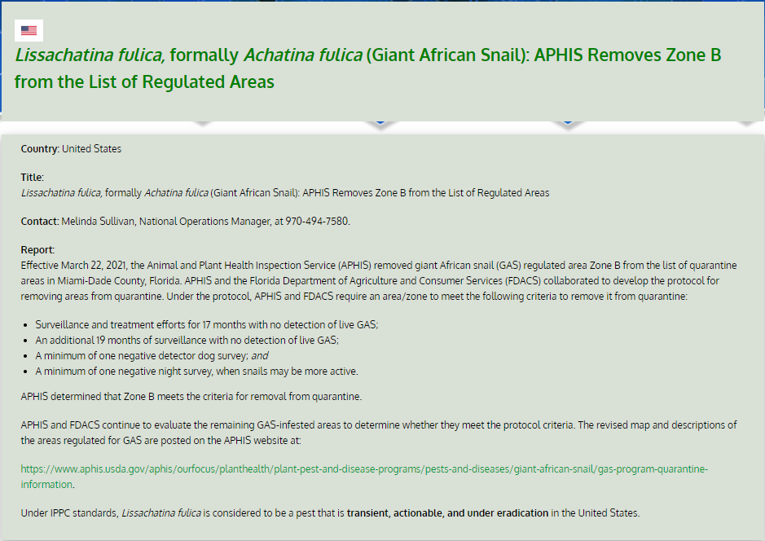
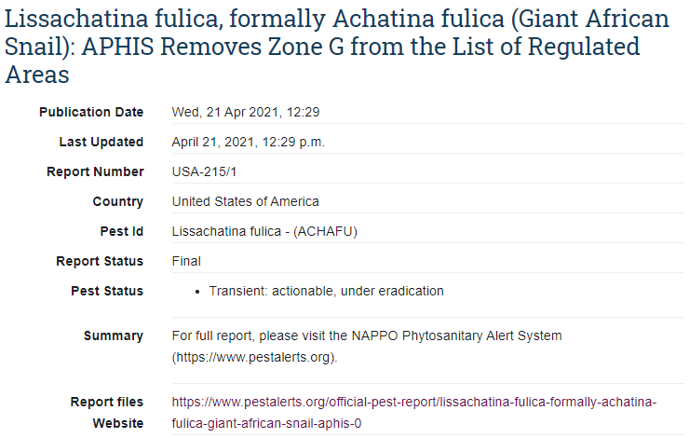
Example from NAPPO PAS to IPP
https://www.pestalerts.org/official-pest-report/lissachatina fulica-formally-achatina-fulica-giant-african-snail-aphis-2
https://www.ippc.int/en/countries/united-states-of-america/pestreports/2021/04/lissachatina-fulica-formally-achatina-fulica-giant-african-snail-aphis-removes-zone-g-from-the-list-of-regulated-areas/

Slide 15
OPR reports in NAPPO PAS
Year | CAN | U.S. | MEX | Total
2016 | 4 | 49 | 1 | 54
2017 | 0 | 33 | 5 | 38
2018 | 1 | 36 | 3 | 40
2019 | 3 | 30 | 2 | 35
2020 | 8 | 20 | 3 | 31
*2021 | 1 | 16 | 1 | 18
*from Jan. to mid-August 2021

Slide 16
Emerging Pest Alerts - EPAs
“Hymenoscyphus fraxineus, causal agent of ash dieback: new hosts”
Scientific intelligence
Information from public sources
Not official in nature
Provided as early warning information to countries in our region
“First report of Argyrotaenia tucumana as a pest”
“Tuta absoluta: new distribution and detection”
“Mexico intercepts Trogoderma granarium on international consignments”

Slide 17
Process for Emerging Pest Alerts - EPAs
PAS members review pest information
PAS Chair decides whether to draft an Emerging Pest Alert
An automated notification is sent to PAS Chair, NAPPO Translator, and subscribers
Emerging Pest Alert posted by PAS Chair
Yes
PAS EG receives recommendation to post an EPA
Is information appropriate?
No
PAS Chair works with NAPPO Translator
No action
NAPPO Translator, sends translation to PAS Chair
PAS Chair post translation to PAS

Slide 18
Subscribe to PAS!
For latest postings …
1. Visit the NAPPO website at www.nappo.org
2. Click on the ‘pest alerts’ tab
or
3. Go directly to www.pestalerts.org

Slide 19
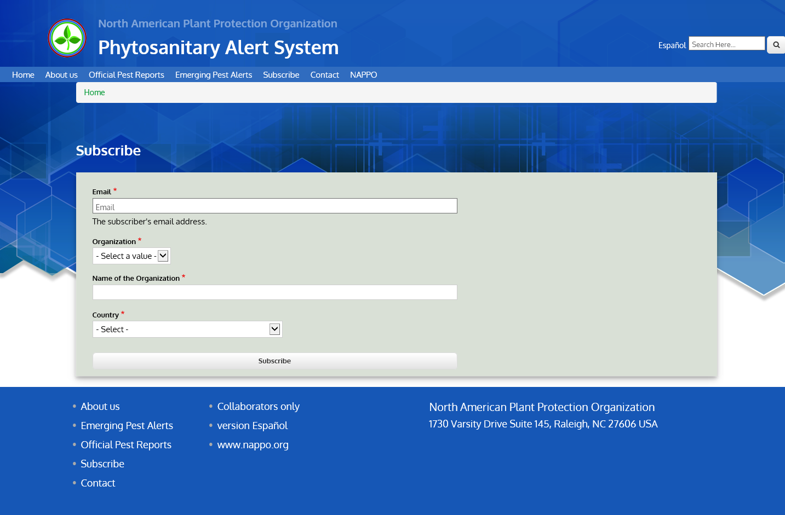
Subscribing to PAS

Slide 20
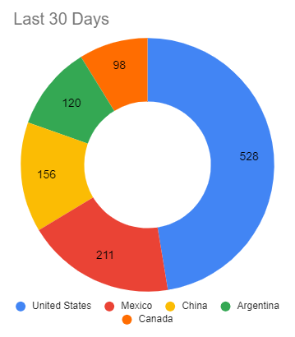
Number of Subscribers - 2,970
Organization Type | Subscribers
Personal | 1,257
Government | 540
NPPO | 218
Academia | 189
Industry | 20
NGO | 8
RPPO | 4
Unknown | 734
Top 5 Visits by Country
Country | Subscribers
United States | 1,630
Canada | 214
Mexico | 189
Other Countries | 192
Unknown | 745

Slide 21
NAPPO Phytosanitary Alert System
Thanks for your attention
If you have questions, please send them to me at Stephanie.Bloem@NAPPO.org
Cydalima perspectalis – box tree moth

