Slide 1
PACIFIC PLANT PROTECTION ORGANISATION (PPPO) UPDATE ON IMPLEMENTED ACTIVITIES
33rd TC-RPPO Virtual Meeting
Update from the PPPO Executive Secretary - 6th October 2021

Slide 2
OUTLINE
Introduction
PPPO Implemented Activities
Partnerships/Collaboration
Challengers
Way forward

Slide 3
Safe Provision Of Food And Other Aid To Prevent The Introduction of Plant Pests During an Emergency
CPM-14 (2019)
approved the draft CPM Recommendation for country consultation
508 comments
were received during consultation period and have been addressed by the IPPC Secretariat in collaboration with submitting country and recommendation was revised accordingly
CPM 15
2019-12 CPM Bureau
considered the points mentioned above along with the responses to comments and was not able to recommend the draft for adoption
agreed to send for second consultation
2020 APPPC Regional Workshop
PPPO Chairman – Dr Dulla was invited to the APPPC RW & he presented the Safe Provision Of Food And Other Aid To Prevent The Introduction of Plant Pests During an Emergency (2018-026).
The Safe Provision Of Food And Other Aid To Prevent The Introduction of Plant Pests During an Emergency (2018-026) was presented under agenda item 10.1.
Interjection and support from Samoa for it to be elevated and considered as an ISPM together with the inclusion of the appendices.
RPPO support on call for Topics
Acknowledge the great team work and SC support from Australia on populating the template for the call of topics that was send to the RPPO’s for considerations, support and feedback.
Over whelming support from other contracting parties as well as RPPOs
The team received feedback and support from the following RPPO’s – CARIBBEAN AGRICULTURAL HEALTH AND FOOD SAFETY AGENCY (CAHFSA); Near East Plant Protection Organisation (NEPPO); Asia Pacific Plant Protection Convention (APPPC) NPPOs :South Korea, Antigua and Barbuda, the Bahamas, Barbados, Jamaica
Brief outline

Slide 4
PPPO Regional ePhyto Programme
Collaboration with Development Partners
Australia & New Zealand Government
Engaged and recruited the ephyto coordinator
Identified countries for the phase 1 roll out plan
Identified countries for the phase 2 roll out plan
Capacity building training – ongoing
Test run on ephyto certificates between phase 1 countries

Slide 5
PPPO FAW TWG
Regional Emerging Risks, Preparedness and Response Presentation
Fall Armyworm (regional and international technical working groups)
Panama Disease-Tropical Race 4 (regional technical working group)
Coconut Rhinoceros Beetle - Guam Biotype (regional technical working group/coordination)
Khapra Beetle (regional technical working group)
DISCUSSION – propose the establishment of PPPO regional ‘priority pests’ technical working group
Country: | Region
Australia | DAWE
New Zealand | MPI
Solomon Is | Melanesia
Fiji | Melanesia
Cook Islands | Polynesia
Samoa | Polynesia
Tuvalu | Polynesia
Guam | Micronesia
SPC LRD | Plant Health & Biosecurity

Slide 6
PPPO Regional Pest List Database Work (Collaboration with DAWE)
Sub-regional PLD meetings
Sub-Region | Date | Time
Melanesia & Timor Leste | Tue 5 October | 11 am Fiji time
Polynesia | Wed 6 October | 11am Fiji time
Micronesia | Thu 7 October | 11am Fiji time
Pacific Island Pest List Database upgrade project
Introduction to the Pacific Island Pest List Database upgrade project including presentation.
Discuss user requirements for interacting with the PLD
Discussion on the PLD vendor upgrade options, and database sustainability requirements.
PLD upgrade - next steps.

Slide 7
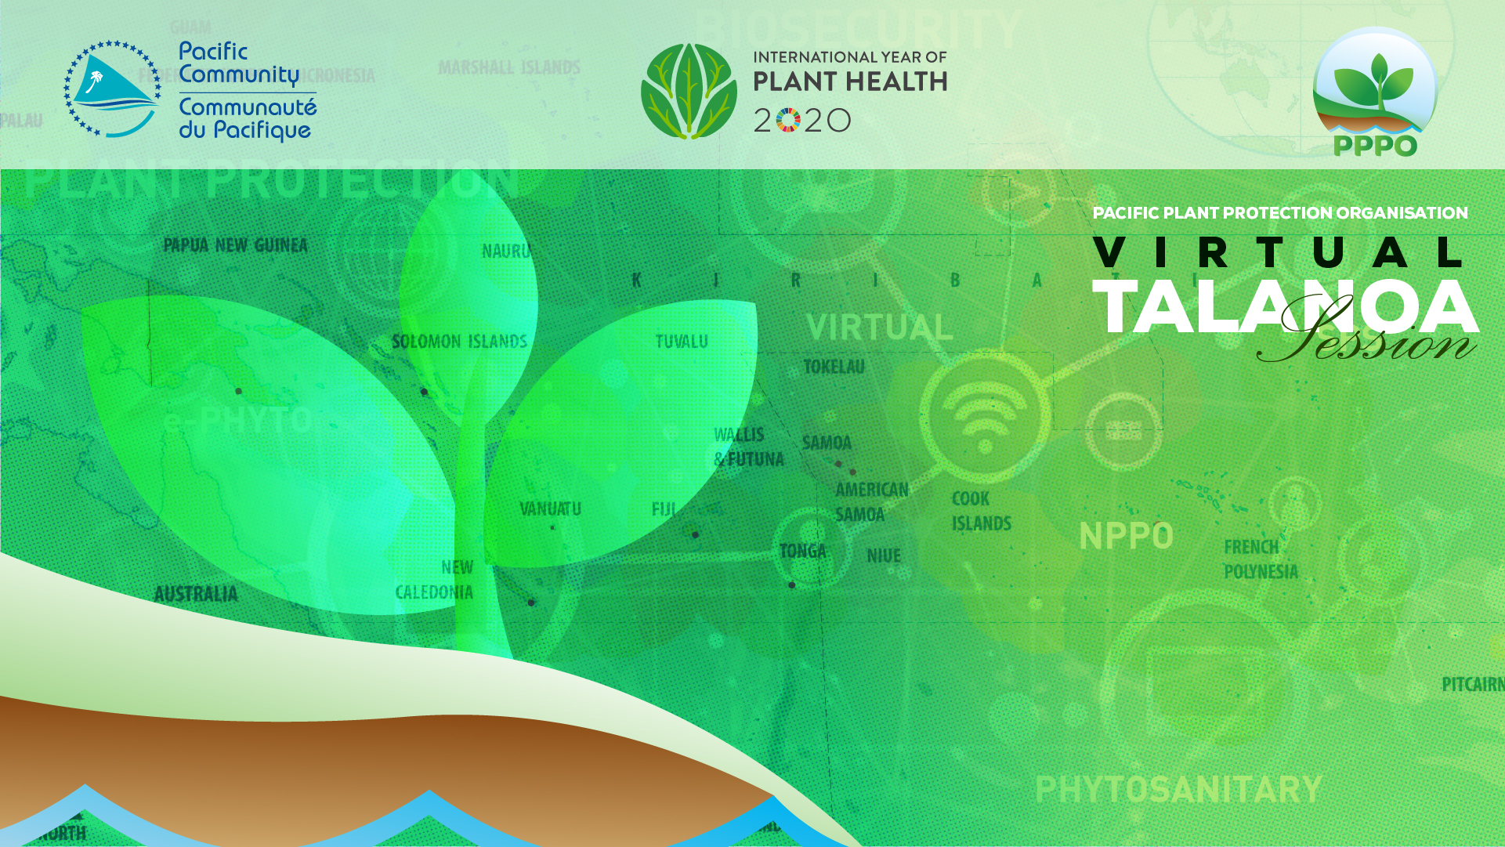
PPPO Talanoa Session
An opportunity to continue to stay connected with the PPPO Members in the region.
Capture the Issues and Challengers, Success Stories, Lessons Learned and Way forward.
THEME: CONNECTED, INFORMED & PREPARED (CIP)
A PPPO family where no member is left behind

Slide 8
Partnership and Collaborations
European Union (EDF 11)
Biosecurity & SPS
Value Chains
Australia Department of Agriculture Water & Environment (DAWE)
Pacific Export Plan (PEP)
Pacific Pest List Database Upgrade
ePhyto
Australia Centre of International Agricultural Research (ACIAR)
Capacity Building Material – Pacific Plant Biosecurity Partnership (PPBP)
Green Climate Fund
Transboundary Pests/ invasive species exacerbated by effects of Climate change
New Zealand Ministry of Primary industries (MPI)
Establishment of a holistic system to facilitate the development, management, monitoring, and evaluation of export systems including export plans
Review of the Phytosanitary Certification System (PCS) and Phytosanitary Capacity Evaluation (PCE)
Establishment of a robust e-operational and GIS information database system for export facilitation
Rollout of ePhyto in line with the Pacific Community, Pacific Plant Protection Organisation, Regional ePhyto Implementation Plan, 2020-2022
MPI contribution to the implementation of PPPO Workplan and core functions – based on approved PPPO Costed Workplans

Slide 9
Updates
Submission of Safe Food Aid – Support from RPPO’s and NPPO’s.
PPPO & NPPO’s support for APPPC submission on the call of topics – Mango Commodity Standard

Slide 10
Challengers
&
Way Forward
COVID 19 situation
Travel restrictions
Procurement and Logistics
Virtual Meeting & Different Time Zones
Deadlines and Responses

Slide 11
THANK YOU

