Slide 1

Inspections and Diagnostics for Fall Armyworm
Valerio Lucchesi, Scientific Officer EPPO

Slide 2
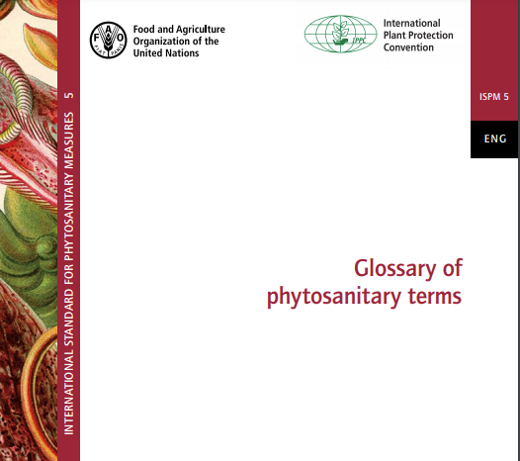
IPPC Definitions, Standards and Resources
ISPM 5 Glossary of phytosanitary terms
Inspection :
Official visual examination of plants, plant products or other regulated articles to determine if pests are present or to determine compliance with phytosanitary regulations
(definition under revision by the TPG)
Official :
Established, authorized or performed by a national plant protection organization (NPPO).

Slide 3

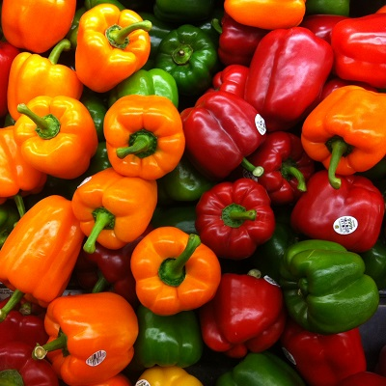
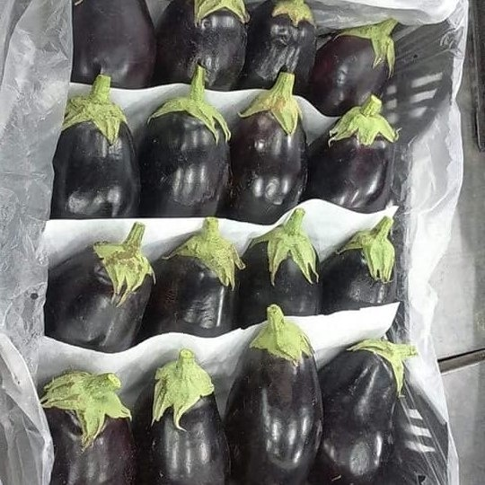

European Food Safety Authority (EFSA) Pest risk assessment of Spodoptera frugiperda for the European Union. EFSA Journal, 16(8) 2018 https://efsa.onlinelibrary.wiley.com/doi/10.2903/j.efsa.2018.5351
FAW Inspections Recommendations
FAW can enter countries through international trade
Phytosanitary inspections of consignments that are likely to be pathways for the entry of FAW should be conducted at the point of entry
Interceptions in the European Union:
Capsicum spp
Solanum melongena
Zea mays

Slide 4

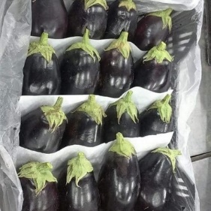

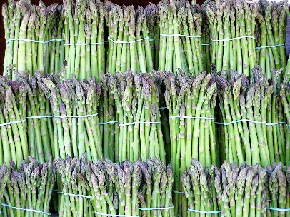
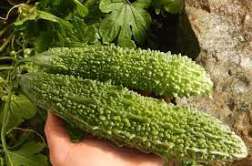
Australian Government, 2020.
Fall armyworm and other exotic armyworms. In: Department of Australian Government, Department of Agriculture, Water and the Environment [online]. https://www.agriculture.gov.au/ pests-diseases-weeds/plant/exotic-armyworm
FAW Inspections Recommendations
FAW can enter countries through international trade
Phytosanitary inspections of consignments that are likely to be pathways for the entry of FAW should be conducted at the point of entry
Interceptions in Australia
Solanum melongena
Zea mays
Capsicum spp
Cut flowers
Asparagus
Bitter melon Momordica spp

Slide 5


Cock, M.J.W., Beseh, P.K., Buddie, A.G., Cafá, G. & Crozier, J. 2017. Molecular methods to detect Spodoptera frugiperda in Ghana, and implications for monitoring the spread of invasive species in developing countries. Scientific Reports, 7: 4103
FAW Inspections Recommendations
Contaminating pest on international flights
Egg masses found in various parts of aircraft coming from Central and South America
Travellers luggage - inspection of luggage from high risk locations should be conducted

Slide 6
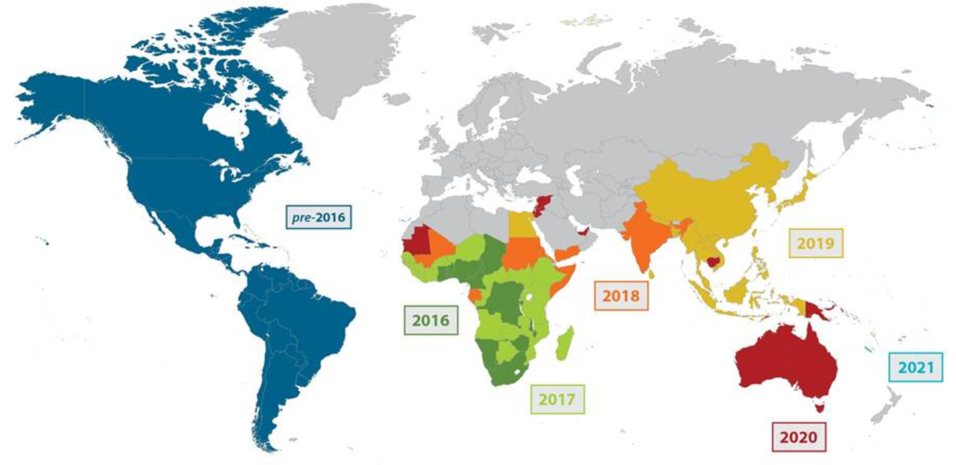
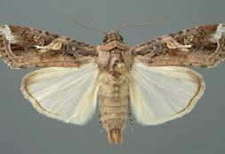
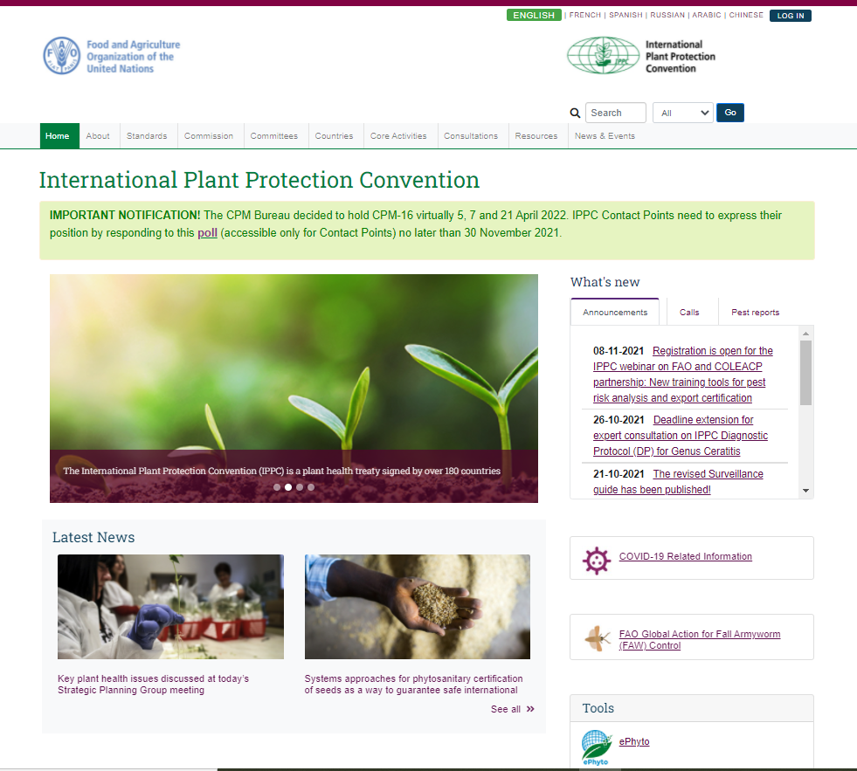
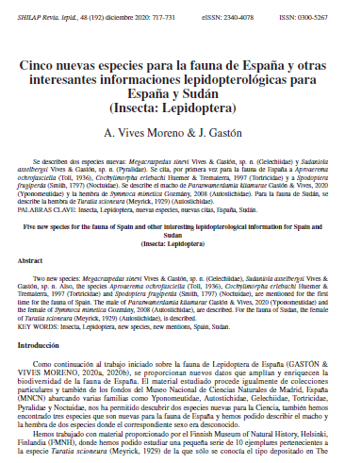
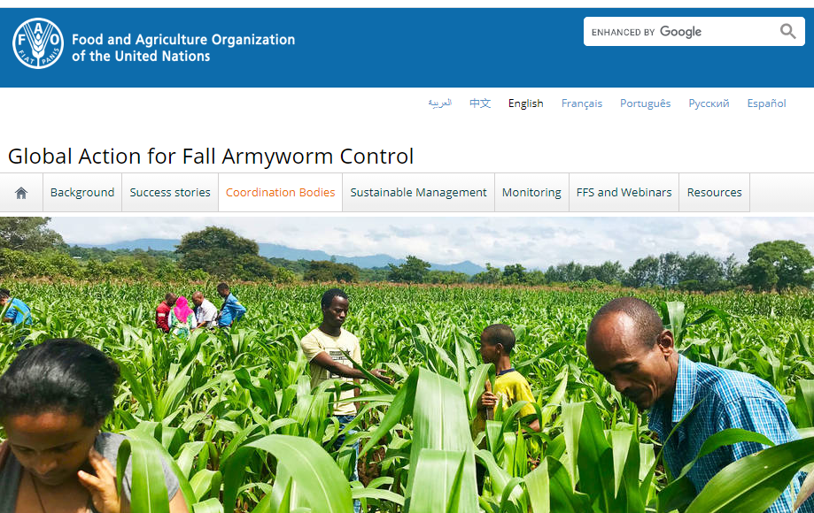
FAW Inspections Recommendations
Targeting of quarantine border inspections should be based on the FAW presence in the exporting country and on the host commodity
Countries are encouraged to make available up-to-date information on FAW distribution and the pest status in their territory
Refer to the International Phytosanitary Portal and relevant papers and journals.

Slide 7

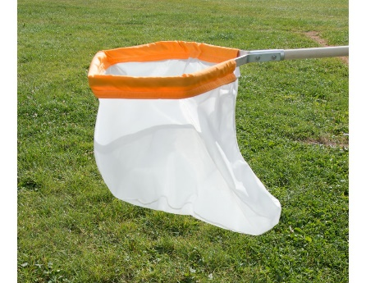
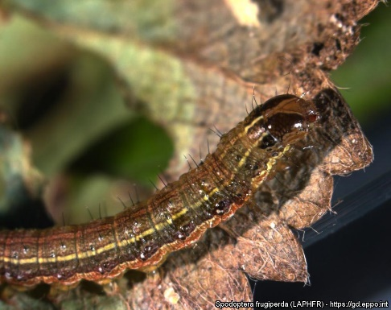
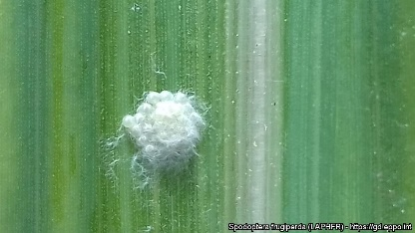
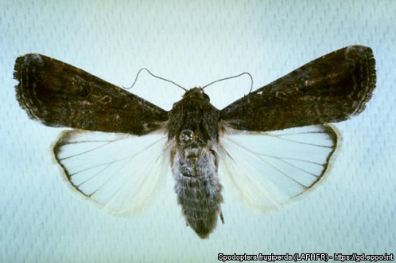
FAW Inspections Recommendations
Visual Examination
Plant-health inspectors should be equipped with a torch, knife and magnifying lens (10×),
Well lit place where the inspection is conducted,
Begin with an overall examination of the commodity
Determine if any eggs, larvae or adults are present on any of the surfaces,
All stages of the pest can be detected visually (hand lens for early stages),
Specimens can be collected by hand or a sweep net (adults),
Eggs can be found on all above-ground plant parts mostly on the underside of leaves.

Slide 8
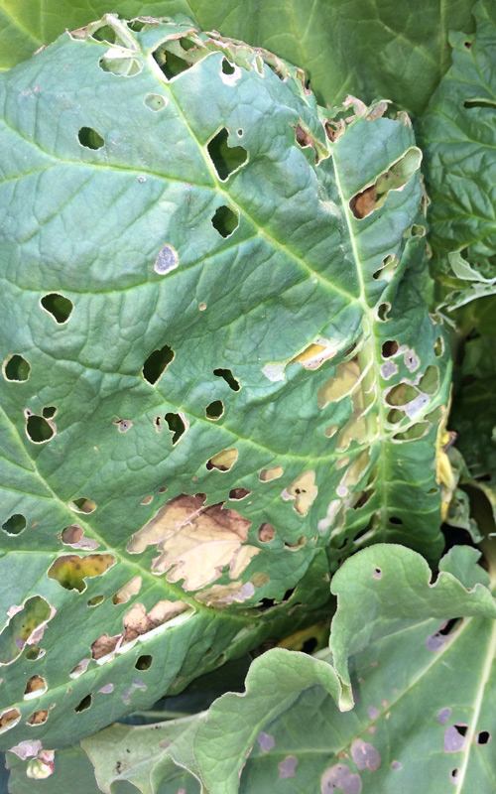

FAW Inspections Recommendations
Visual Examination
Any part of the plant sample with characteristic symptoms of lepidopteran feeding damage should be removed for further thorough examination,
Destructive sampling of a number of randomly selected samples from consignments (e.g. corn cobs, cut flower bunches, asparagus bunches) may be conducted to look for larvae which may have bored into the commodity (plant material).
In addition to inspection, pheromones traps can be used at borders to detect accidental introduction.
To identify specimens, confirmation is needed through morphological characteristics or molecular diagnostics

Slide 9
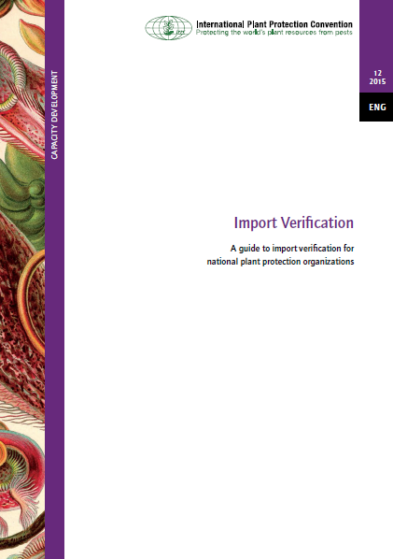
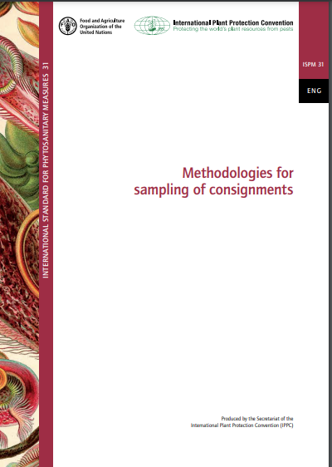
Further guidance:
- ISPM 23 Guidelines for inspection
IPPC Definitions, Standards and Resources
Useful information in IPPC Guideline:
- A guide to import verification for NPPOs

Slide 10
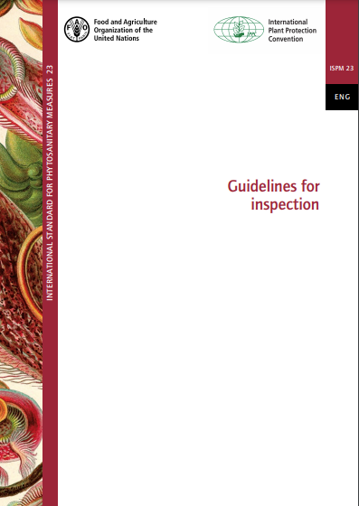
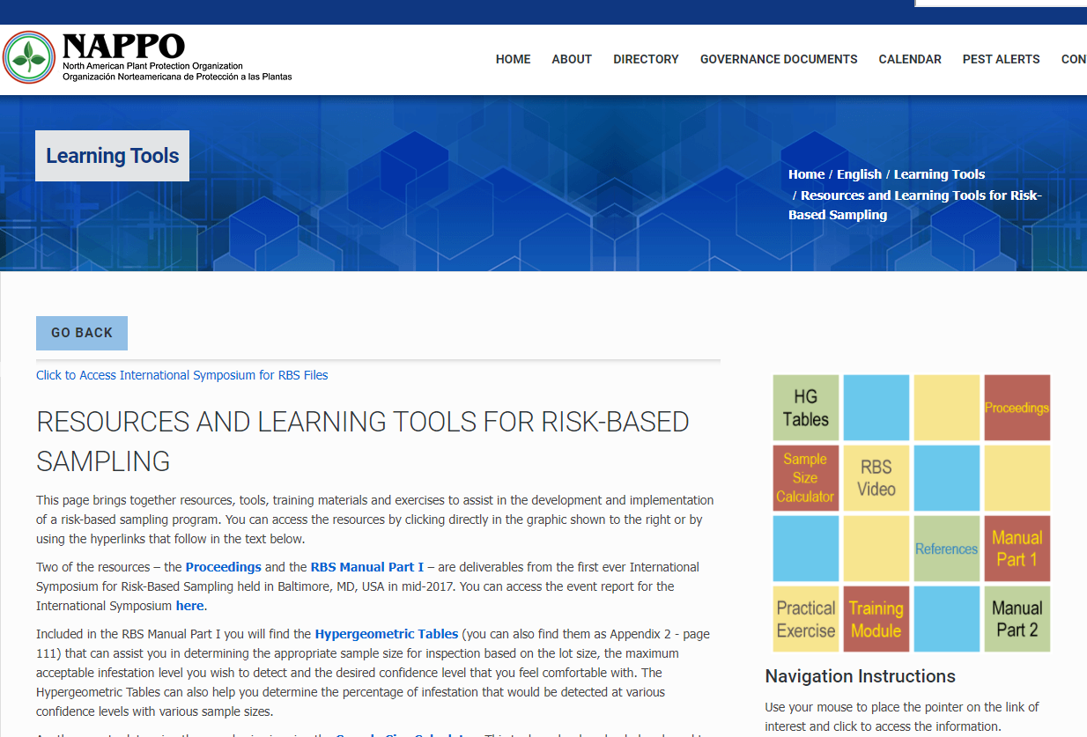
FAW Inspections Recommendations
Sample size
The sample size should be determined taking into account the statistical background provided in ISPM 31 Methodologies for sampling consignments
North American Plant Protection Organization (NAPPO)
Resources and learning tools for risk-based sampling
https://nappo.org/english/learning-tools/Resources-and-Learning-Tools-for-Risk-Based-Sampling

Slide 11
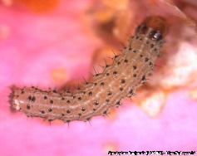



FAW Identification and Diagnostics
If the inspector suspects the presence of exotic Spodoptera species the lot or consignment should be detained under official control.
Specimens should be sent to the designated laboratory to confirm the species identity
Before being sent to the laboratory:
Larvae should be boiled and then placed in 70 percent ethanol for a morphological diagnostic or should be placed in 95–100 percent ethanol for molecular diagnostic,
Adults wrapped in paper inside hermetic containers (taking care to preserve the wings) or in ethanol (wing patterns and colours will not be preserved in ethanol).

Slide 12
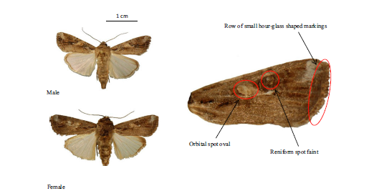
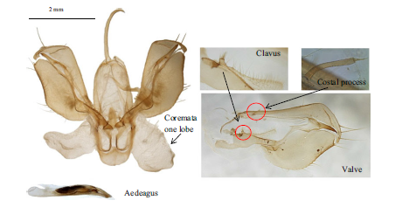
FAW Identification and Diagnostics
Morphological keys and identification guides allow adult moths to be identified with a high degree of confidence
Species-level morphological identification is possible for larvae but more difficult and usually requires consideration of contextual information (type and extent of damage, hosts, origin…)
Experts with experience on this genus can make an identification based on the morphology of immature stages (in particular late instar larvae), with due consideration of the context.

Slide 13
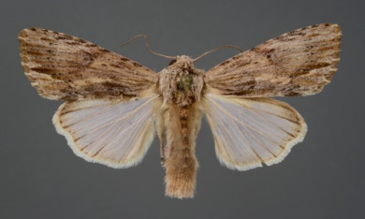
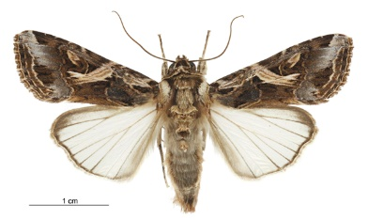
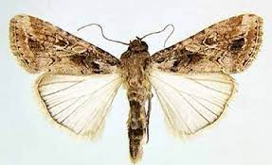
FAW Identification and Diagnostics
Established identification keys to be used
At least three other Spodoptera species – S. eridania, S. littoralis, S. litura must be discounted to confirm identification of FAW.
Larvae of Poaceae-feeding species, like S. cilium, S. exempta, S. mauritia, S. exigua, S. ornithogalli, are easily confused with FAW.
Larvae of several other noctuid genera, Agrotis, similar to S.frugiperda.
Early larval stages of most other noctuid species are difficult to distinguish morphologically from FAW.
The morphological identification of eggs is not possible.
Spodoptera eridania
Spodoptera frugiperda
Spodoptera litura
Spodoptera exempta
Caterpillars of FAW related pests © CABI

Slide 14
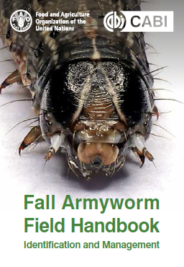
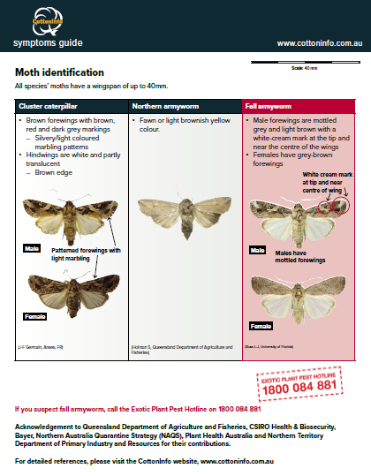
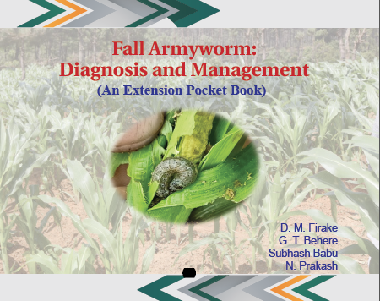
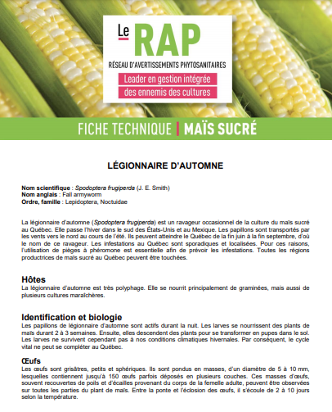
FAW Identification
Identification leaflets on FAW are available and should be made available to field staff, for example:
FAO & CABI (2019),
Australian Grains Research & Development Corporation (GRDC, 2020),
CottonInfo (2020),
Indian Institute for Maize Research (Firake et al., 2019),
Quebec Ministry of Agriculture, Fisheries and Food (RAP–MAPAQ, 2018).

Slide 15
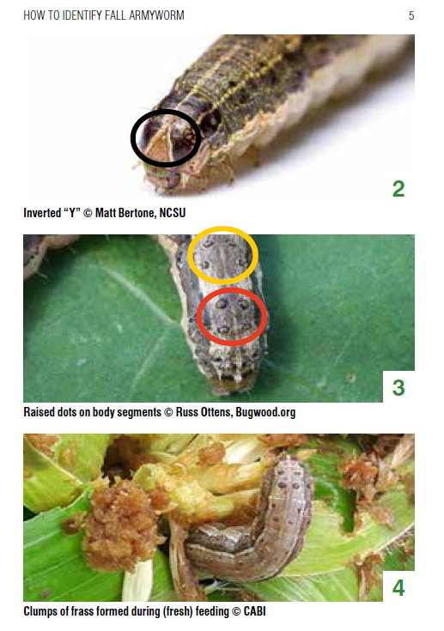
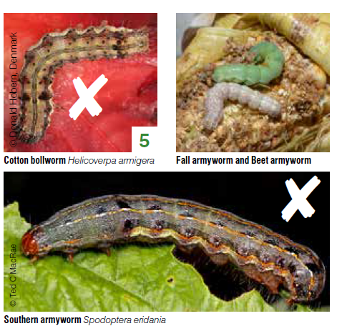
FAW Identification
FAO & CABI. 2019b. Fall armyworm field handbook: Identification and management

Slide 16
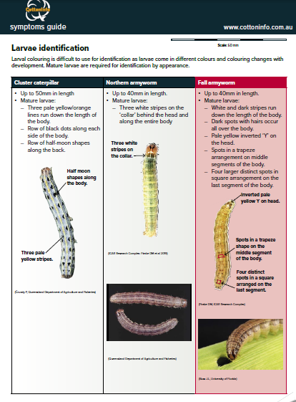
FAW Identification
CottonInfo. 2020. From endemics to exotics: Identifying cluster caterpillar, northern armyworm and fall armyworm Australia, https://www.cottoninfo.com.au/sites/default/files/documents/ID_guide_sc2.pdf

Slide 17
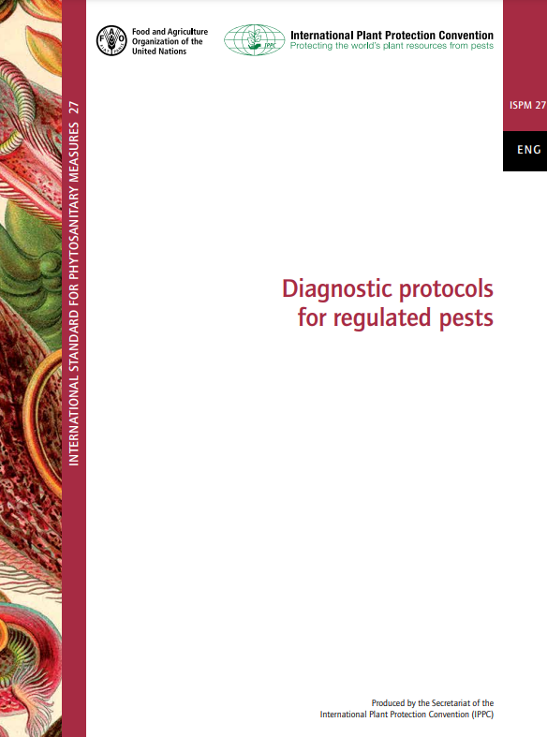

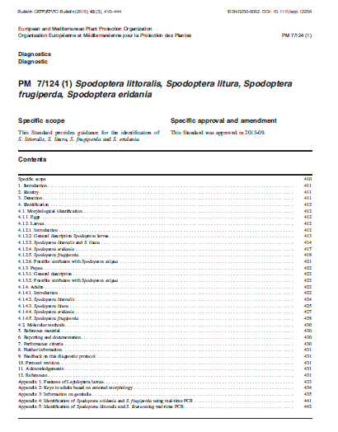
FAW Diagnostics
EPPO Standard PM 7/124 (1) Spodoptera littoralis, Spodoptera litura, Spodoptera frugiperda, Spodoptera eridania
ISPM 27 Diagnostic protocols for regulated pests
(no specific Annex for FAW – in IPPC work programme)
IPPC Guide to delivering phytosanitary diagnostic services

Slide 18
FAW Diagnostics – Molecular identification
Molecular identification can be relatively time-consuming, especially if a DNA-sequencing facility and service providers are not readily accessible.
Well established molecular tests are available:
Four simplex real-time PCR test that can be combined into a single method based on TaqMan chemistry (Van De Vossenberg and Van Der Straten, 2014);
Partial mitochondrial DNA cytochrome c oxidase subunit I (mtCOI) gene (allowing the differentiation of “rice” and “corn” host preference);
LAMP tests have been developed in South Korea (Kim et al., 2020) and Australia (Australian Government, 2020).

Slide 19
Thank you
Valerio Lucchesi
Scientific Officer / Adjoint Scientifique
European and Mediterranean Plant Protection Organization (EPPO/OEPP)
21 boulevard Richard Lenoir 75011 PARIS FRANCE
Tel: + 33 (0) 1 45 20 77 94 / + 33 (0) 1 84 79 07 53 (direct)
Email lucchesi@eppo.int – Web www.eppo.int – Twitter @EPPOnews

