Slide 1
Update on the IPPC ePhyto Solution
Agenda item 7.2

Slide 2
OUTLINE
An overview of the IPPC ePhyto Solution
1.1 Overview
1.2 A brief history
1.2 Why ePhyto?
IPPC ePhyto Solution updates
2.1 ePhyto Hub
2.2 ePhyto Generic System (GeNS)
2.3 Channel delegation and forwarding
2.4 eSignatures
Collaboration
Future plans

Slide 3
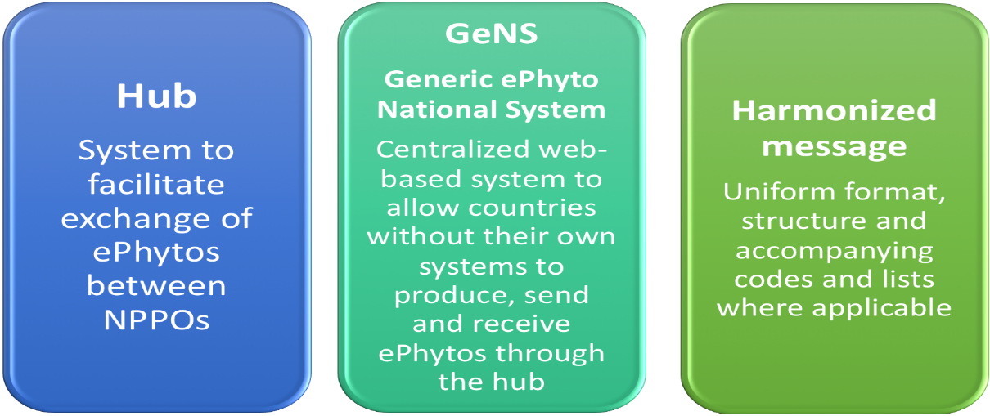
1. OVERVIEW OF THE IPPC EPHYTO SOLUTION
“ePhyto” is short for electronic phytosanitary certificate. In simple terms, it is the data contained in a phytosanitary certificate in digital form.
The IPPC ePhyto Solution consists of:
The IPPC ePhyto Solution meets the requirements of International Standard for Phytosanitary Measures (ISPM) 12 Appendix 1 and
Helps countries comply with Articles 7.9 (release of perishable goods) and 10.1 (simplifying formalities and documentation requirements for cross-border trade) of the Trade Facilitation Agreement of the World Trade Organization.

Slide 4
1.2 A brief history of the IPPC ePhyto Solution
1. OVERVIEW OF THE IPPC EPHYTO SOLUTION
2006
2009
2010
2013
2014
2016
2018
2019
2022
The first IPPC meeting on the development of electronic phytosanitary certification was held in The Netherlands
NAPPO hosted an IPPC workshop on electronic certification in Canada
IPPC Secretariat established an Open-ended EWG on E-certification
CPM-8 established an ePhyto Steering Group (ESG)
ESG developed a Hub Feasibility Study and CPM-9 adopted Appendix 1 to ISPM 12
The project funded by the STDF began and the UNICC were selected as the lead technical unit to build and host the IPPC ePhyto Solution Hub and GeNS
The pilot of the ePhyto Hub was successfully completed with 10 NPPOs
The pilot phase of the project closed and the IPPC ePhyto Solution goes live
The award winning solution has more that 100 countries registered

Slide 5
1.3 Why ePhyto?
1. OVERVIEW OF THE IPPC EPHYTO SOLUTION
The ePhyto Solution allows countries to electronically exchange ePhytos with any other country in the system each other through a central hub - quickly and accurately without sacrificing plant health.
There is no need for bilateral IT agreements and no charge for a country to join the system once they meet the necessary requirements.
The system was initially set up to exchange electronic phytosanitary certificates, but any certificate (animal health, food safety, etc.), once coded in XML, can be exchanged.
NPPOs, agricultural and forestry industries, as well as freight forwarders and others are already benefitting from transaction cost reductions, improved trade security, risk management and increased trade flows.

Slide 6
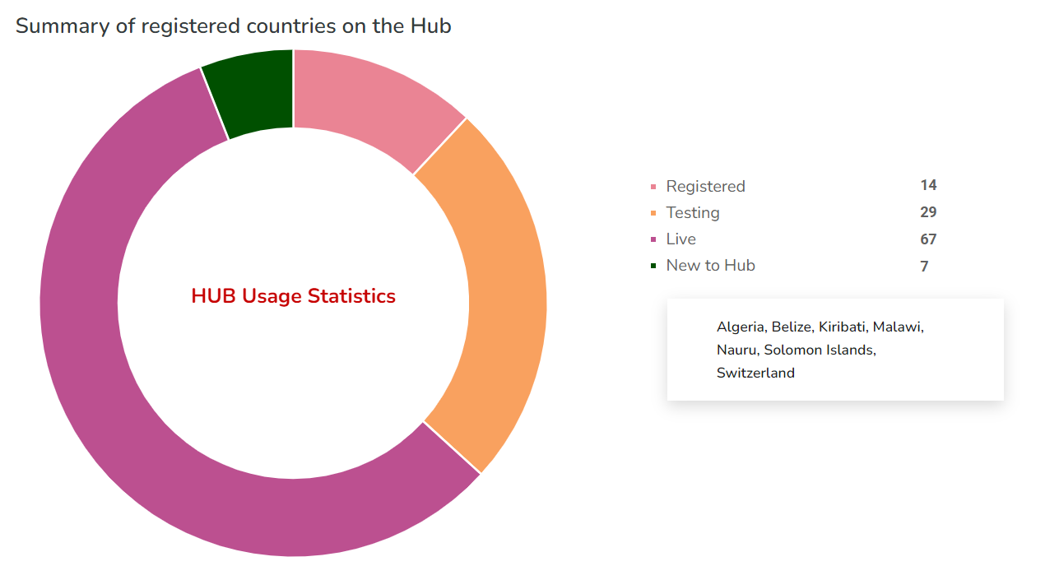
2. THE IPPC EPHYTO SOLUTION UPDATES
2.1 The ePhyto Hub
*Data from www.ephytoexchange.org as per May 2022

Slide 7
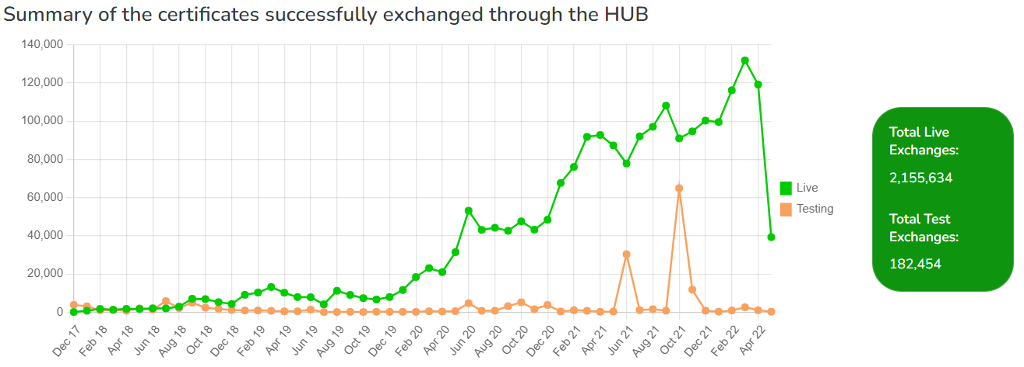
2. THE IPPC EPHYTO SOLUTION UPDATES
2.1 The ePhyto Hub
The system is increasingly handling over 100,000 certificates per month, with the capacity to handle (in the current configuration) up to 100,000 certificates per day.
*Data from www.ephytoexchange.org as per May 2022

Slide 8
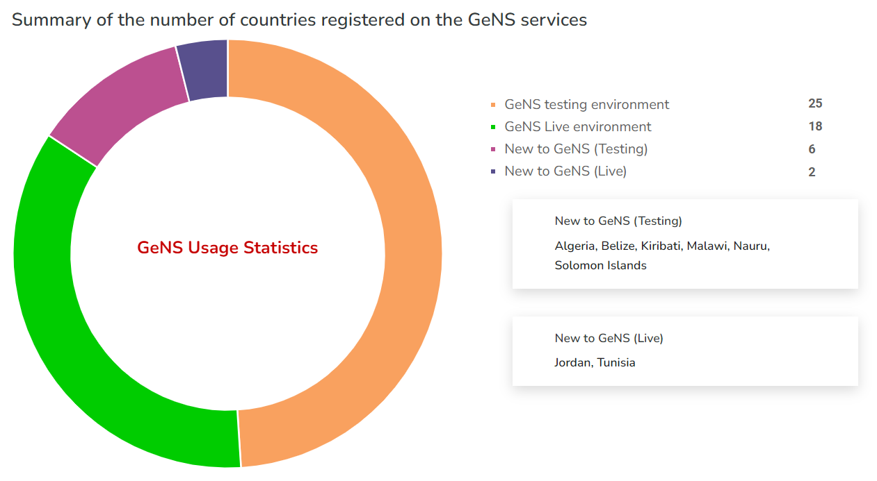
2. THE IPPC EPHYTO SOLUTION UPDATES
2.2 ePhyto Generic System (GeNS)
Remember: The GeNS is a web-based Generic ePhyto National System for countries without their own infrastructure to connect to the Hub
*Data from www.ephytoexchange.org as per May 2022

Slide 9
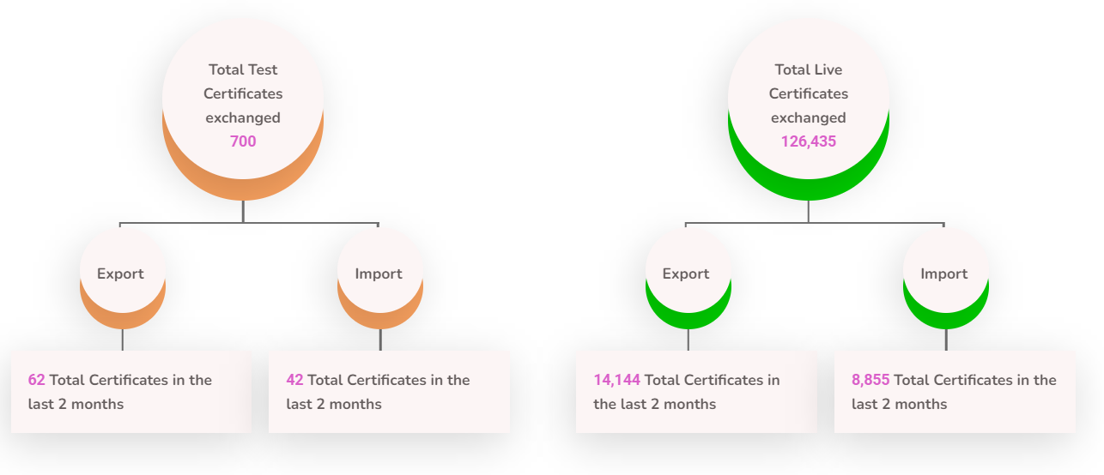
2. THE IPPC EPHYTO SOLUTION UPDATES
2.2 ePhyto Generic System (GeNS)
*Data from www.ephytoexchange.org as per May 2022

Slide 10
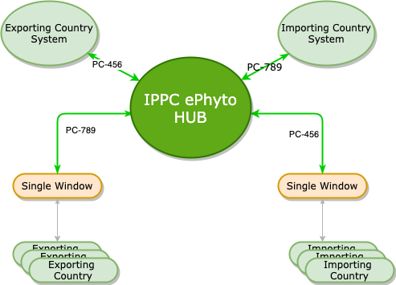
2. THE IPPC EPHYTO SOLUTION UPDATES
2.3 Channel Delegation
Single Window systems can now connect to the HUB to send/receive ePhytos on behalf of countries they manage.
The delegation rule can be adjusted on the following criteria:
Incoming/Outgoing messages
Document Type (Regular and Re-export)
Document Status (Issued, Withdraw)
The EU Traces system is using this feature.
Countries can send ePhytos to any EU member (or any country on the ePhyto Solution ) through the HUB, and the message will be pulled by the Traces system and delivered to the intended country.

Slide 11
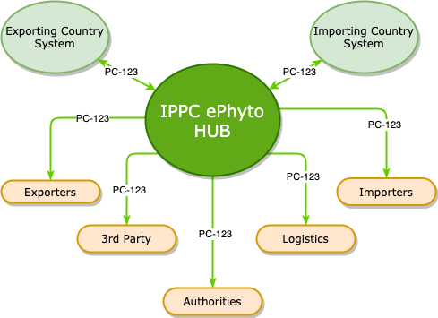
2. THE IPPC EPHYTO SOLUTION UPDATES
2.3 Channel Forwarding
A country will be able to specify multiple recipients on the ePhyto envelope while sending it to the destination country.
The sender will add the forwarding channel codes on the envelope header of the ePhyto.
Currently piloting.

Slide 12
2. THE IPPC EPHYTO SOLUTION UPDATES
2.4 eSignatures
What is an electronic signature?
An electronic signature (e-signature) refers to data in electronic form attached to or logically associated with other data in electronic form and which is used by the signatory to sign.
Due to EU regulation, any country wishing to trade with EU Member States using the ePhyto Solution needs to have the ePhytos signed digitally.
This feature has been implemented in the GeNS for a number of countries – NPPOs need to work with the certification provider and UNICC

Slide 13
3. COLLABORATION
The IPPC Secretariat is working with a number of international organizations and groups to make the ePhyto Solution a trade facilitation tool for any country (or organization) wishing to use it. These include:
The Global Alliance for Trade Facilitation of the World Economic Forum
The ePhyto Industry Advisory Group
The Standards and Trade Development Facility
The World Bank and International Finance Corporation
The World Customs Organization

Slide 14
3. FUTURE PLANS
CPM Focus Group on Sustainable Funding for ePhyto
Aim to present short, medium and long term solutions to CPM-17 (2023)
Translation into other languages (GeNS)
French version piloted and live with Madagascar
Work with the Global Alliance to develop the GeNs in Arabic
Routine maintenance and enhancements
Channel enhancements
ePayments
Continued collaboration with non-phytosanitary agencies/organizations (OIE/Codex/Others)
NPPO workshops with the ePhyto Industry Advisory Group (IAG)
Ongoing projects with the Global Alliance for Trade Facilitation
Linkage to other government systems (Single Windows, Customs, ASYCUDA, Industry etc.)

Slide 15
Thank you
IPPC Secretariat Food and Agriculture Organization of the United Nations (FAO) ippc@fao.org | www.ippc.int

