Slide 1
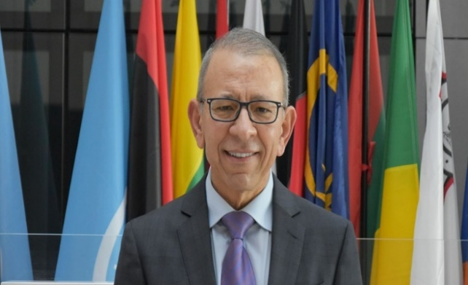
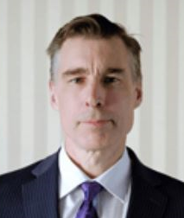
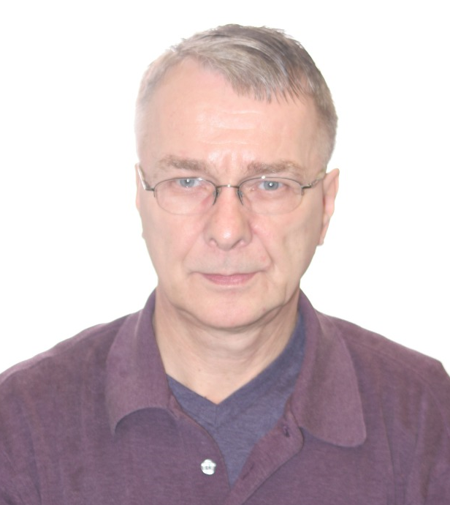
Session 1
Moderator: Osama El-Lissy
Speakers:
Greg Wolff Lars Kjaer

