Slide 1
Sea Containers Task Force (SCTF)
Background to its establishment and its work

Slide 2

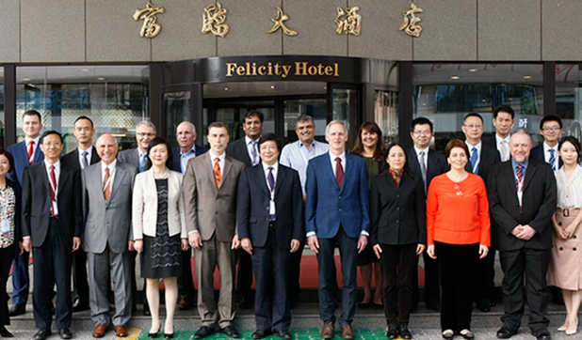
Background to inception of SCTF
2008 –topic for International Standard for Phytosanitary Measures (ISPM) on managing risks of sea containers proposed
2009 – specification for ISPM finalized by Standards Committee
2010 – specification for ISPM adopted by Commission on Phytosanitary Measures (CPM-5)
2012 – draft ISPM prepared; audit-based approach to verify cleanliness
2013 – special session at CPM-8; complexity noted
2014 – consultations on draft ISPM; concerns and lack of support noted
2015 – IPPC Recommendation on sea containers adopted at CPM-10
2016 – ISPM put on hold; special sea containers session at CPM-11
2017 – Complementary Action Plan for Assessing and Managing the Pest Threats Associated with Sea Containers adopted and Sea Containers Task Force established
2021 – Final key objectives for SCTF agreed to by CPM

Slide 3
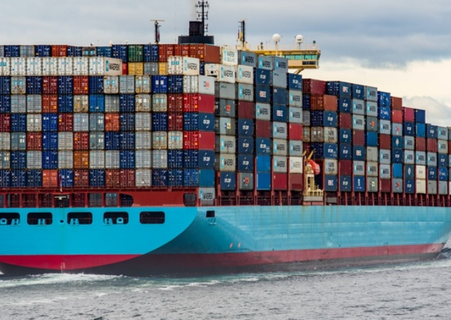
SCTF tasks and expectations
Complementary Action Plan did not in fact request clear actions for providing guidance on risk management
It did intend that information on risks would be generated and reviewed
  Measuring impact of the CTU shipping code
  Increasing awareness of pest risks of sea containers
  SCTF was also asked to:
    Provide information on pest risks and their management
    Coordinate among and between IPPC community, industry and international organizations
    Establish a mechanism for governments to report to CPM on progress
    Provide advice on how the CTU Code or any other instrument could be updated
CPM-15 updated the SCTF’s objectives in 2021 to seek guidance on what the SCTF had learned and to include more scope for making recommendations on managing risks:
  Provide information on core strategic questions
  Consider value of potential workshop (this workshop)
  Suggestion to update IPPC Recommendation No. 6
  Outline for a dedicated Sea Containers Focus Group to drive towards conclusive outcomes

Slide 4
SCTF outcomes in later agenad item
G. Wolff
Former Chair of Sea Containers Task Force

