Slide 1
Final report of Sea Containers Task Force
Findings, outcomes and next steps

Slide 2
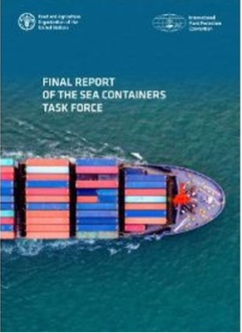
Complementary Action Plan objectives
Measuring impact of the Code of Practice for Packing of Cargo Transport Units (STU Code)
Questionnaire; limited responses
National Plant Protection Organization surveys; limited resources
Unable to measure impact meaningfully due to insufficient information
Increasing awareness of pest risks related to container pathway
IPPC guidelines on minimizing pest contamination developed
IPPC information leaflet and fact sheet developed
Guide to the CTU Code and Container Packing List
Other communications materials
Review of use of Authorized Economic Operators:

Slide 3
Additional objectives from CPM-15 in 2021
Provide information on core strategic questions
Accomplishments/what has been learned:
Raising awareness
Identifying key challenges and needs (effective communications being critical)
Role of cargo elucidated
Equally, empty containers must also be included in any approaches
Presence of risk obvious, magnitude/level of risk still unclear
Immense economic damage could be caused by poorly designed/implemented measures
CTU Code:
Low awareness among contracting parties
Potential value perceived and promotion suggested
Roles of different industry members:
Individual responsibility cannot be borne solely by one sector (e.g., packers, carriers, consignors); a combined approach that reduces risk overall is needed
Empty containers have much reduced oversight
Communications and (voluntary guidance) recommended, e.g., apps
Incentives vs regulatory approach:
More analysis needed
Without stakeholder support, success may be unachievable

Slide 4
Important deliberations, findings and conclusions
Increasing consolidation of information, focused identification of key issues and challenges, and exploration of prospective measures
The role of the cargo itself in the risks of contamination
Sensitivity and inherent complexity of the logistics systems and operations relating to container transport
The importance of efficient container logistics to global supply chains and national economies was a constant consideration
The impacts of supply chain impediments were exemplified during the later stages of the covid pandemic
SCTF comments on improvement to CTU Code (via Secretariat)
Contribution to IMO Inspection Guidelines

Slide 5
SCTF viewpoints and recommendations
Contracting parties and national plant protection organizations are encouraged to continue raising awareness, collecting and sharing information, collaborating with relevant organizations and one another
Consider requiring contamination inspection as part of safety inspection
Voluntary measures implemented by industry may be an important component of a broad systems approach, combined with other measures
Revision to existing IPPC recommendation
May be a vehicle to encourage ideas and voluntary measures
What is the current level of risk in order that the effects of potential measures may be evaluated in relation to this?
Potential for development of ISPM (IPPC standard)
No clarity on what meaningful, effective and practicable content could be
Container redesign
Composite containers (integral steel floors) may make cleaning easier
If introduced through the normal replacement cycle, would be low impact, low cost(?) and need no other coordination

Slide 6
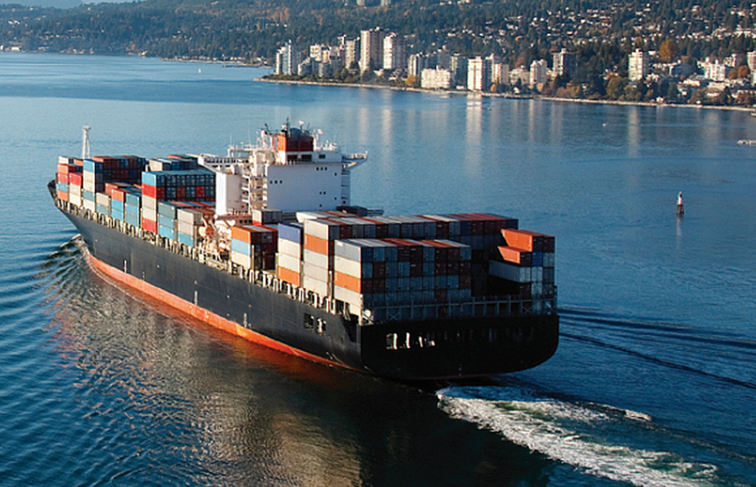
Considerations for workshop
There is no obvious or easy single solution
A combination of voluntary measures, communications, encouragement, guidance, low impact measures may result in risk reduction
What voluntary measures can be pursued
What mandatory measures would be low impact
Whatever guidance the IPPC may prepare, any negative impacts on container logistics must be minimal or non-existent
Stakeholder support will be important for approaches to be successful
Approaches must include scope for packed and empty containers
Complete risk elimination is impossible
What is the current level of risk?
How can we evaluate effects of potential measures in relation to this?
Treatment of containers (chemical/heat) is not feasible
What future options might emerging technology allow for?
Optical sensor aspects to accompany automate inspection at certain touch points? Costs?
Information to accompany digital manifests?
Real time sharing of “hot spots” for contamination? Origin- and commodity-based?
If harmonised IPPC guidance cannot be developed, individual countries will be forced to adopt independent measures
How can these
be coordinated?

Slide 7
Thank you
G. Wolff Former Chair of SCTF

