Slide 1
Coordinating Climate Change and Phytosanitary Issues at a Global Level
CPM Focus Group on Climate Change and Phytosanitary Issues

Slide 2
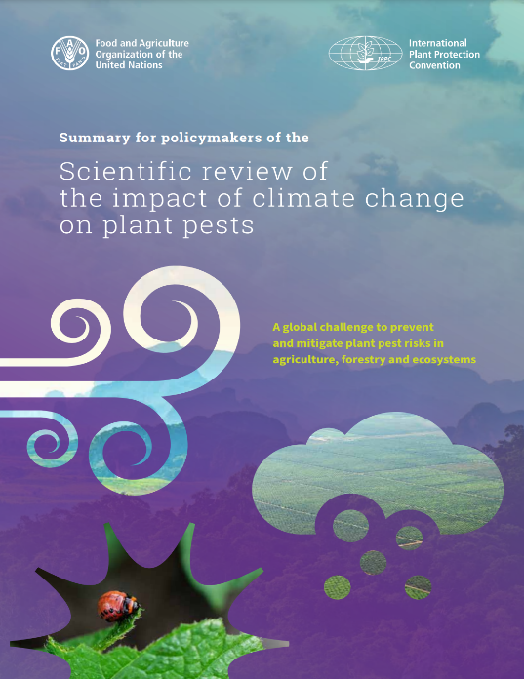
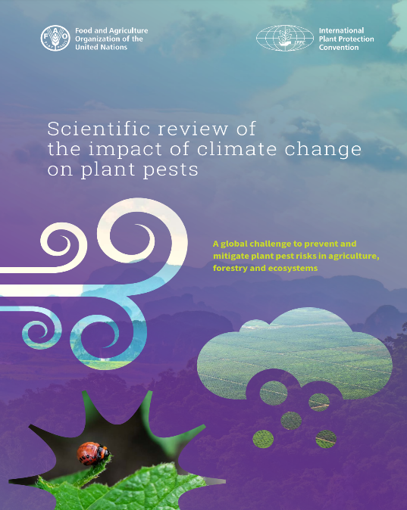
Climate Change Impacts on Plant Health
‘A Global Issue’
Available science suggests that climate change has a significant impact on plant health, through the actual and potential expansion of pest distribution and intensity, and changes in pest epidemiology and life cycle.
Mitigation of these impacts will present a major challenge to the national, regional and international plant protection organizations.

Slide 3
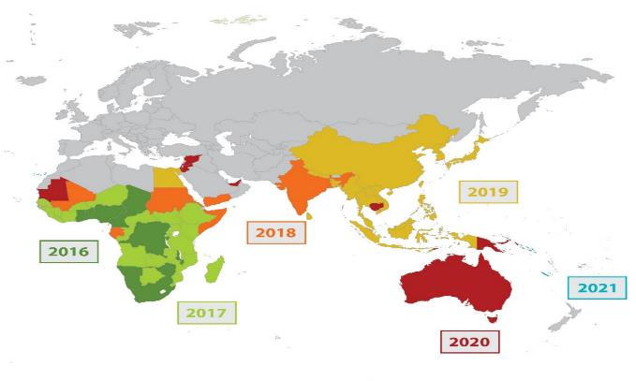
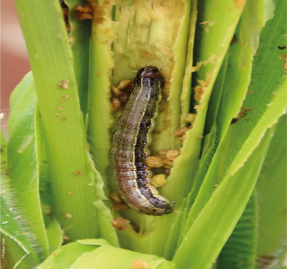
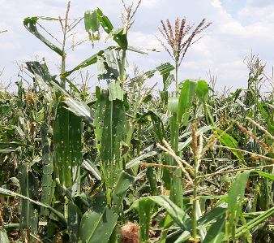
Climate Change and Phytosanitary Issues
‘A Global Opportunity’
The International Plant Protection Convention (IPPC) Strategic Framework 2020-2030 includes the “Assessment and management of climate change impacts on plant health” as one the eight development agenda items to be addressed by the global plant health community over the current decade.
Strategic Framework for the International Plant Protection Convention (IPPC) 2020–2030: https://www.fao.org/3/cb3995en/cb3995en.pdf

Slide 4
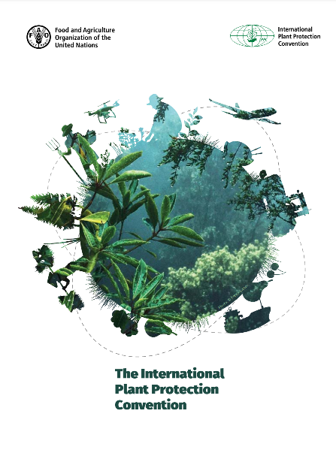
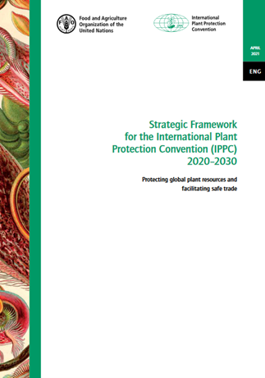
IPPC Development Agenda Item
Strategic Framework 2020-2023
Assessment and management of climate change impacts on plant health
GOAL
By 2030, the impacts of climate change on plant health and the safe trade of plants and plant products are evaluated, especially in relation to pest risk assessment and pest risk management issues, and phytosanitary issues are represented and highlighted within the international climate change debate.

Slide 5
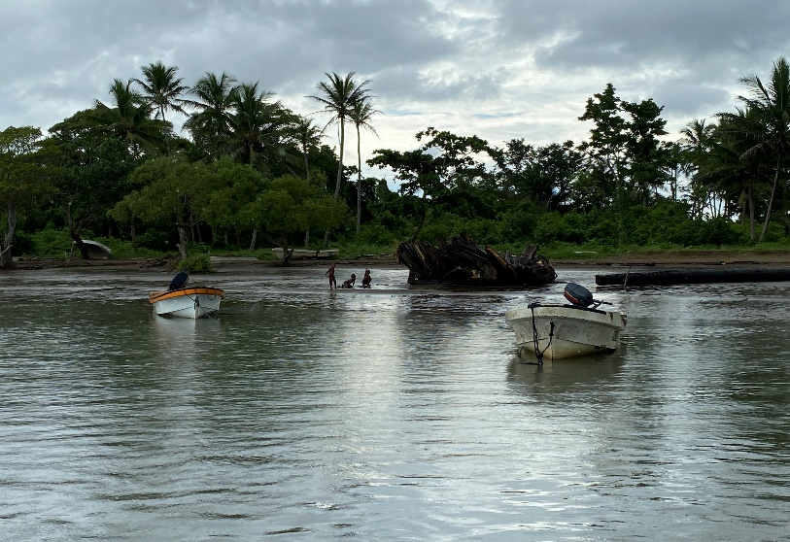
CPM Focus Group on Climate Change and Phytosanitary Issues (FG-CCPI)
The Commission on Phytosanitary Measures (CPM) Focus Group on Climate Change and Phytosanitary Issues (FG-CCPI) was formally endorsed by the CPM Bureau in July 2021 and became active in September 2021.
The primary role of the FG-CCPI will be to support the implementation and delivery of the IPPC’s ‘Action Plan on Climate Change Impacts on Plant Health’ over the 2022-2025 period.

Slide 6
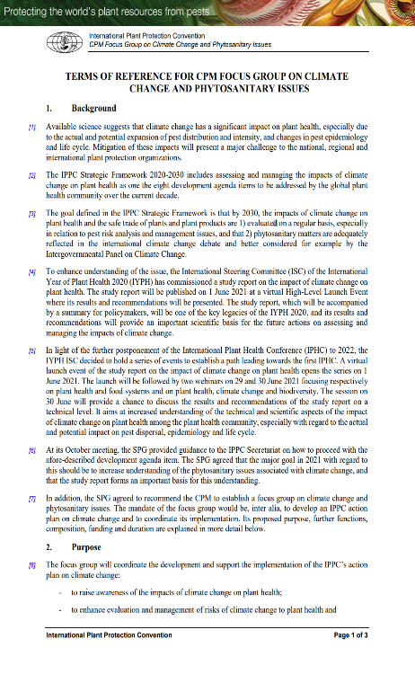
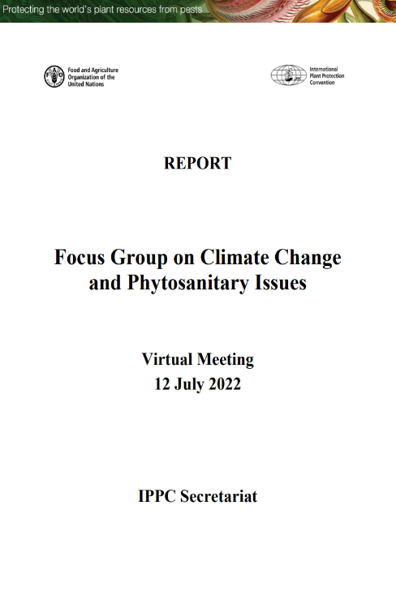
CPM Focus Group on Climate Change and Phytosanitary Issues (FG-CCPI)
The Focus Group is composed of ten members with regional representation and specialized skills and experience in climate change and phytosanitary issues, and knowledge of the IPPC and its activities.
The Focus group meets on a monthly basis to coordinate the delivery of the FG-CCPI Action Plan and develop key materials and resources to support the Action Plan.
The Focus Group will remain effective until CPM-19 (2025), and the composition of the focus group is presented in: https://www.ippc.int/en/publications/90486/.

Slide 7
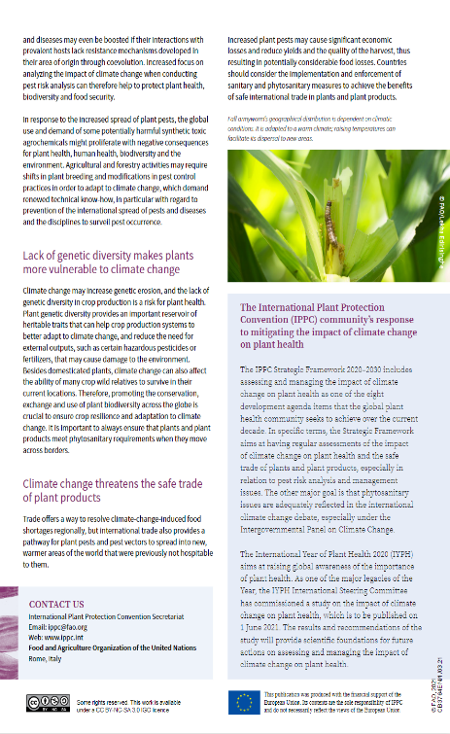
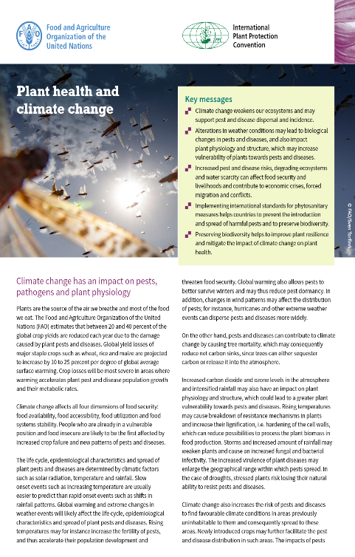
FG-CCPI Key Outcomes and Core Action Areas
Outcome 1:
Raising awareness of the impacts of climate change on plant health
Core action areas:
Convene and participate in meetings and side events related to the impacts of climate change on plant health.
Facilitate discussions within IPPC subsidiary bodies, regional workshops as well as other IPPC technical groups.
Assist Contracting Parties (CPs) to meet their National Reporting Obligations (NRO)established by IPPC.

Slide 8
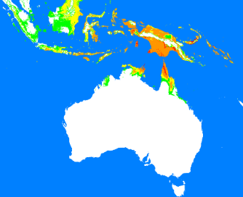
FG-CCPI Key Outcomes and Core Action Areas
Outcome 2:
Enhancing the evaluation and management of risks of climate change to plant health
Core action areas:
Support countries to collect, analyse and use climate change impacts-related information in decision-making
Support countries in building capacity to help mitigate the impacts of climate change on plant health

Slide 9
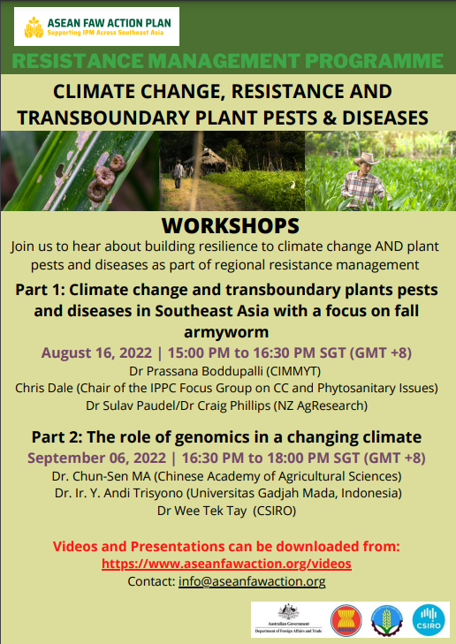
FG-CCPI Key Outcomes and Core Action Areas
Outcome 3:
Enhancing the recognition of phytosanitary matters in the international climate change debate
Core action areas:
Strengthen collaboration with relevant international, regional and national organizations
Facilitate, promote and support phytosanitary issues -related policy dialogue at the global level

Slide 10
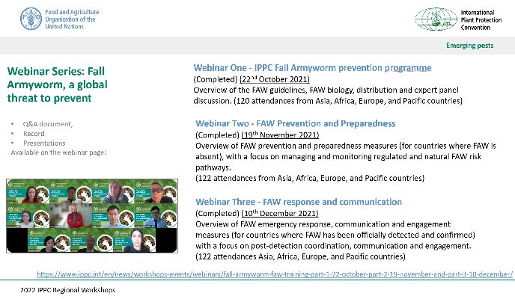
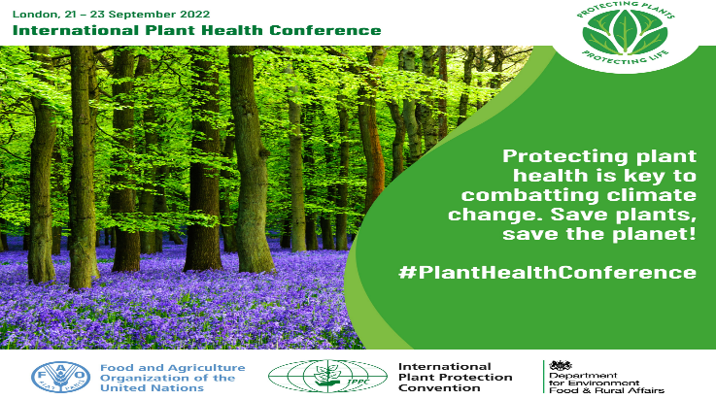
FG-CCPI Action Plan
Priorities 2022-2023
1. Raising awareness of the impacts of climate change on plant health through increasing CPM wide understanding of how climate change may increase of the potential movement and spread of pests through webinars and special sessions involving CPM, RPPOs and NPPOs.

Slide 11
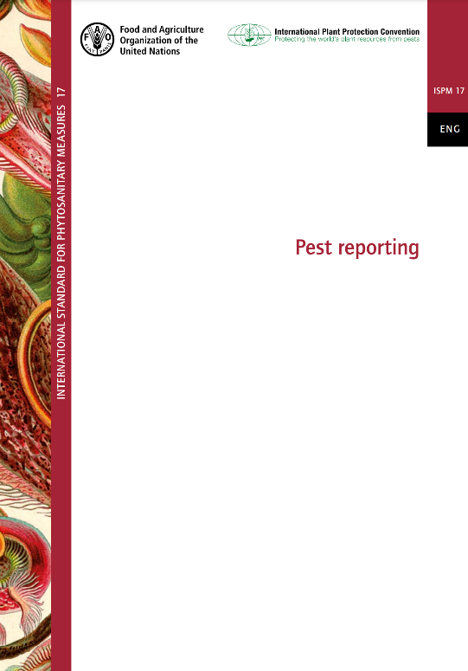
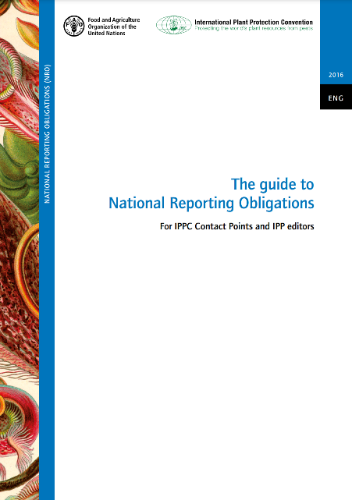
FG-CCPI Action Plan
Priorities 2022-2023
2. Exploring opportunities to enhance IPPC National and Regional reporting systems to identify and share climate change information relating to changes in pest distributions, host range, and adaptability of pests and host plants.

Slide 12
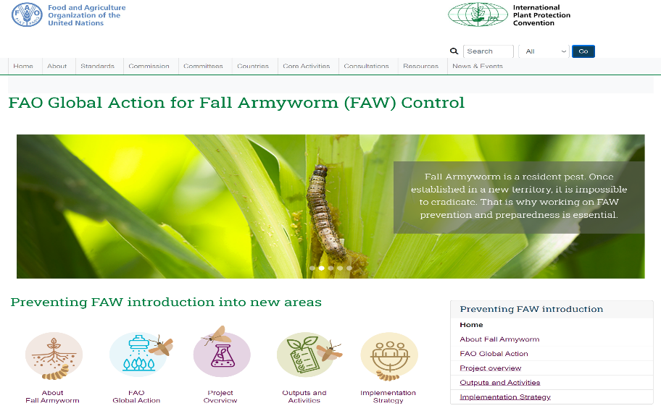
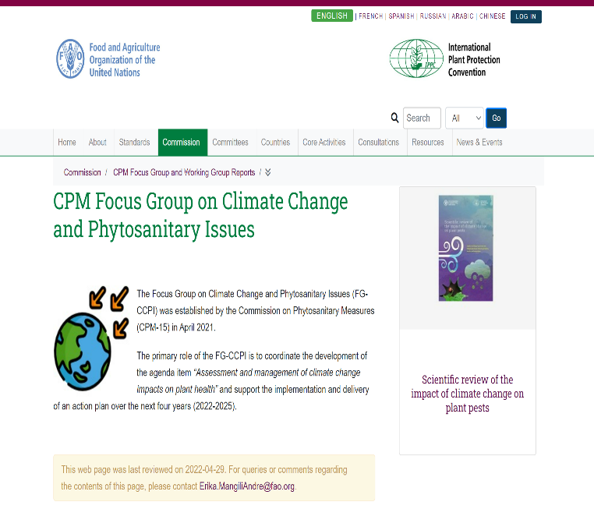
FG-CCPI Action Plan
Priorities 2022-2023
3. Developing a ‘Climate Change Impacts on Plant Health’ webpage on the IPP as a repository of all FG-CCPI related materials and resources.

Slide 13
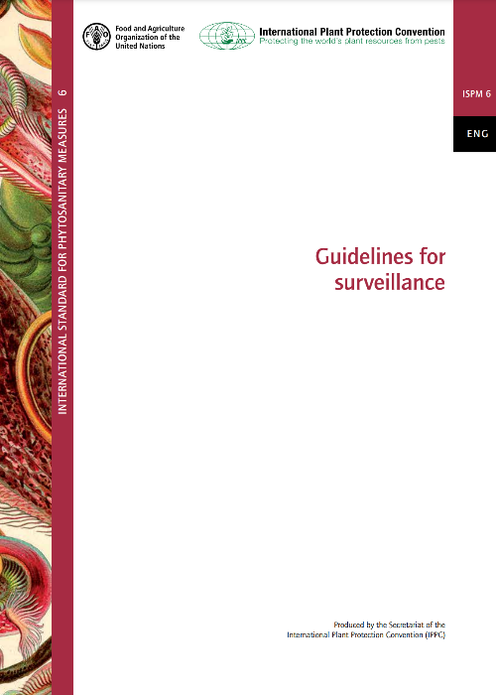
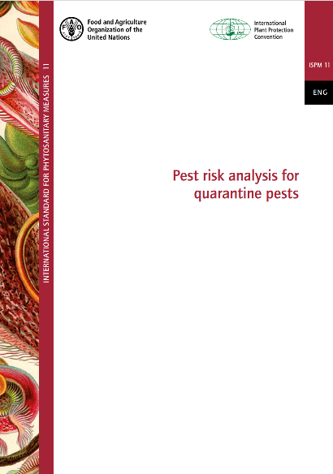

FG-CCPI Action Plan
Priorities 2022-2023
4. Enhancing the evaluation and management of risks of climate change to plant health to incorporate climate change factors into the traditional Pest Risk Analysis (PRA) processes and investigating opportunities to incorporate climate change considerations in existing pest surveillance systems and practices.

Slide 14
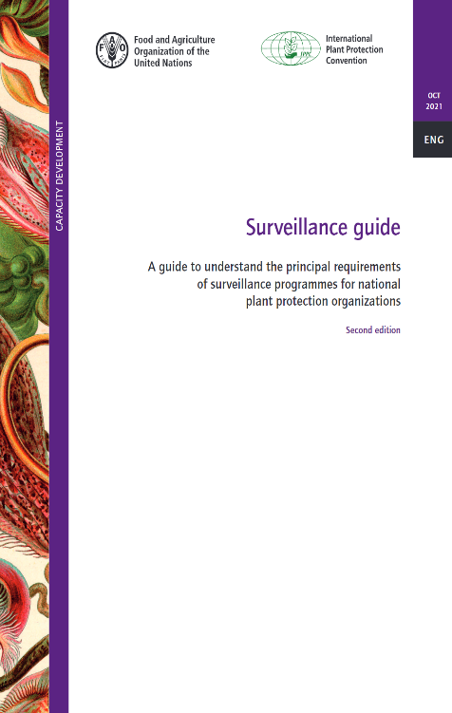
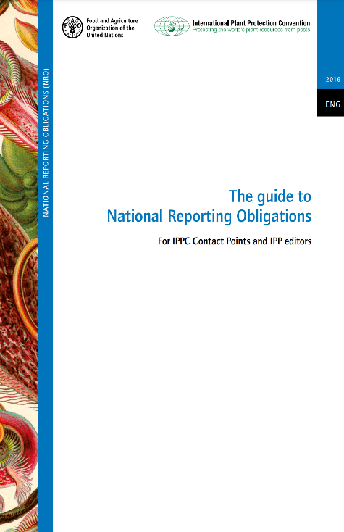
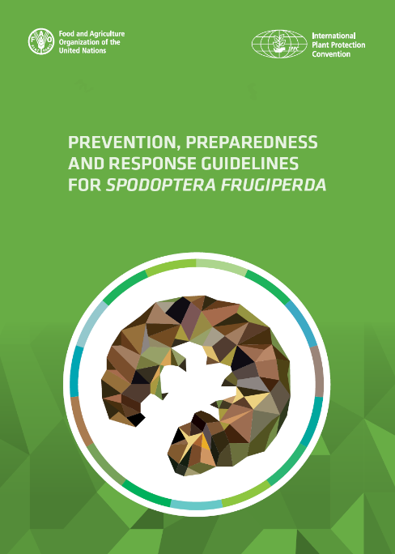
FG-CCPI Action Plan
Priorities 2022-2023
5. Developing an IPPC Guide to assist NPPOs in identifying, assessing, mitigating and managing climate change impacts on plant health.

Slide 15
Thank You
Chris Dale
Biosecurity Specialist, Australian Department of Foreign Affairs and Trade (DFAT)
Chair, CPM Focus Group on Climate Change and Phytosanitary Issues

