Slide 1
34th Technical Consultation among Regional Plant Protection Organizations
19 September 2022
Mekki Chouibani
www.neppo.org

Slide 2
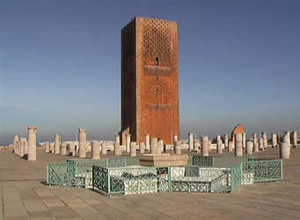
1. Specificities
Agreement
  signed in February 18, 1993
  entered into force on January 8, 2009
  Recognized officially in March 2012, by 7th CPM:
Heaquarter: Rabat
  Members: Algeria, Egypt, Jordan, Iraq, Libya, Morocco, Pakistan, Oman, Sudan, Syria and Tunisia
  Signed but not ratified: Iran, Mauritania*, Yémen, (Mauritania submitted its instrument of adhesion to FAO-DG)
  Executive Committee: Algeria, Jordan, Libya, Pakistan, Syria, Tunisia
Staff: Executive Director, Assistant director

Slide 3



NEPPO aims to….
Promote regional cooperation and capabilities of its members through :
  Preventing the spread and introduction of pests
  Controlling pests in an appropriate manner
Facilitate safe regional and international trade
By:
promoting information exchange (Pest status, pest report, regulations, phytosanitary measures, ..);
harmonizing phytosanitary regulations and measures
developing regional strategy to face spread and introduction of pests
enhancing capacity building of NPPO

Slide 4
2. Technical and capacity development achievements-1
Organization of virtual workshops
  Opuntia cochineal, September 16, 2021
  Citrus Black spot, September 16, 2021
  Green scale of date palm, October 07, 2022
Participation in the webinars on prevention, preparedness and response guidelines for fall army worm, October 2021
Organization of high-level virtual meeting on Xylella fastidiosa, January 26, 2022, Cairo declaration
Organization of a training course on the active and better participation at IPPC meetings, February 28, 2022
Organization of Pre-CPM meeting, March 1-3, 2022
Organization of training on biological control of locusts, Agadir, May 16-20, 2022 (Participation of 11 countries for CLCPRO and CRC) with EMPRES (FAO), CLCPRO and CRO,
Participation in the regional meeting on FAW (Monthly meetings)

Slide 5
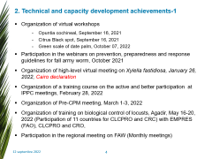
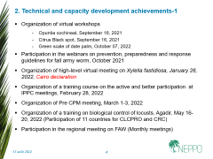
2. Technical and capacity development achievements-2
Participation in the regional meeting on Red Palm Weevil (Monthly meetings),
Preparation of
  a guideline for phytosanitary measures at borders and on the territory against Red Palm Weevil and
  a pest-free area protocol for Red Palm Weevil
Gather and dissemination of information in real-time and as much as possible
Participation and contribution to the IC strategic team for PCE
Representing RPPO in the IPPC Focus Group on Communication
Participation at CPM 16, April 5,7, and 21, 2022
Participation at the 60th meeting of the Working Party on Phytosanitary Regulations. Paris, 2022-06-21/24

Slide 6
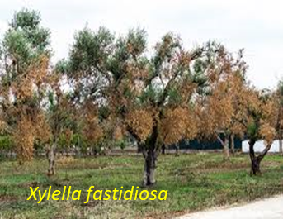
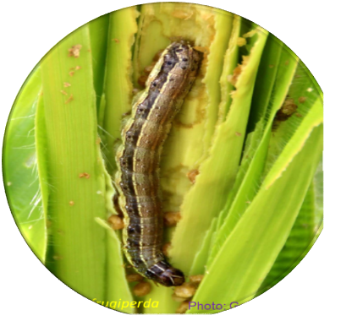
3.1. Xylella fastidiosa
Serious threat to regional agriculture, food security, and biodiversity
Continental Jump
500 host plants (Olive: 9999200 ha (ADAO), small stakeholders about 90%
Severe damage
Spread in Europe
3.2. Fall Armyworm
Continental jump: America, Africa, Asia
Host plant 80 mainly maize, Rice
Importance of the host plants crops for food and feed supply and area cultivated in all the region.
Severe damage and high potential of spread
Newly detected in Saudi Arabia
3. Emergent pests

Slide 7
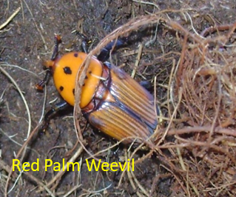
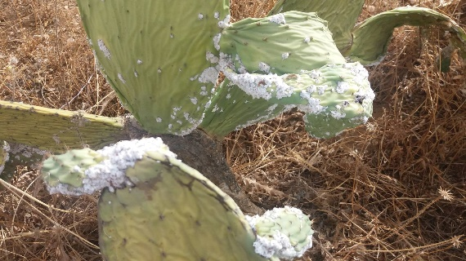
3.3. Red Palm Weevil
Continental jump: Asia, Africa, Europe
Importance of Date palm: 1039750 ha and the presence of Ornamental palm
Severe damage: 2009: 1,74-8,69 Mi USD Gulf region (Removal), Murcia 7 Mi Euros
Spread in the South of Europe,
Contained in Morocco and Tunisia
Development of guidelines for phytosanitary measures at borders and on the territory against red palm weevil
Development of a pest-free area protocol for red palm Weevil
3.4. Opuntia cochineal
Very severe damage: on prickly pear cactus Opuntia ficus-indica
Spread in North Africa, Jordan, Lebanon, Israel, Palestine,
New outbreak in Yemen
N. Nasr

Slide 8
Thank you, Gracias, Merci

