Slide 1
The Sea Container Hygiene System
Rama Karri, Australian Department of Agriculture, Fisheries and Forestry
&
Sina Waghorn, New Zealand Ministry for Primary Industry

Slide 2
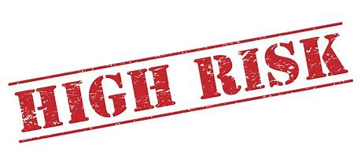
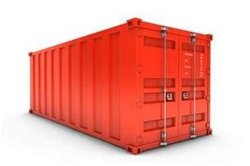
High-risk containers
All containers arriving from high-risk countries are subject to mandatory inspection on arrival in Australia and New Zealand, unless they are processed through offshore quality systems.

Slide 3

History
Prior to SCHS:
Approximately 40-50% of sea containers from the Pacific were found to be contaminated;
100% of sea containers from specific pacific ports arrived in New Zealand and Australia were inspected on arrival.
All contaminated sea containers were sent for cleaning or treatment

Slide 4
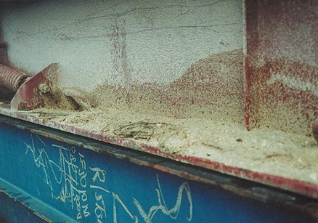
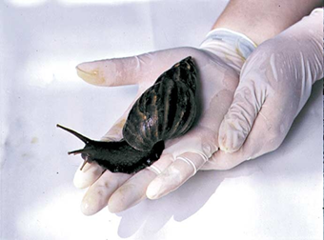
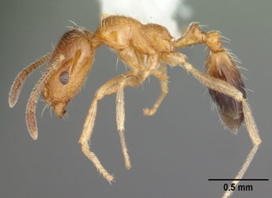
Contamination
40 to 50% – soil, grains, plant material;
17% of sea containers arriving in NZ from Pacific contained invasive ants species;
A significant number of snail detections

Slide 5
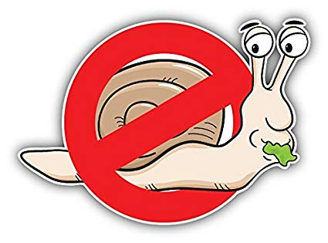
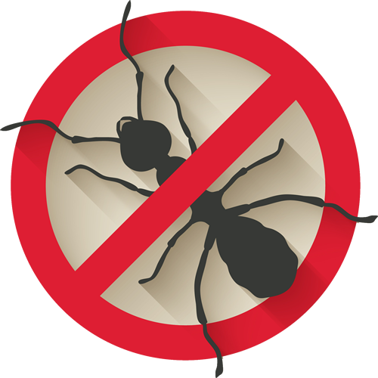
The benefits to NPPOs
Risks are managed offshore;
For example, within one year of implementing the systems contamination rates of system sea containers was reduced:
Ants: from 17% to 0.47%
General contamination: from 50% to 4.75%
Resources can be diverted to other higher-risk activities;
95% reduction of inspections of system sea containers with good compliance history;
Strong working relationship with Pacific nations.

Slide 6
Benefits to industry
Initial set up costs offset by:
Less congestion;
Reduced demurrage costs;
Reduced on-arrival inspections (from 100% to 5%
with ongoing compliance);
Reduced on-arrival treatment or cleaning costs;
Reduced delay in discharge and clearance.

Slide 7
The system’s success
Since its establishment, a total of 12 Systems
have been approved across 6 Pacific Countries
Reduce contamination rates by 99.5%
Reduced time and costs
Stimulation of local employment and awareness of biosecurity
Contributing to the global movement of clean sea containers from those ports or shipping lines

Slide 8
Industry-led offshore activities
Site preparation: pest control and habitat reduction
Before
After

Slide 9
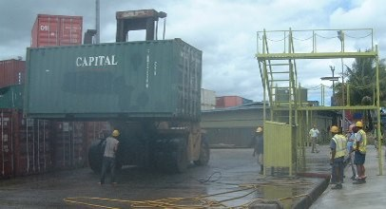
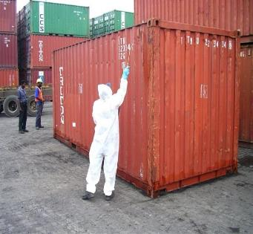
Industry-led offshore activities
2) Cleaning the sea container (inside and out)
3) Spraying the sea container with residual pesticides

Slide 10
Industry-led offshore activities
4) Labelling the cleaned and treated sea
containers
5) Storing cleaned and treated containers
in dedicated storage areas
(prior to shipping)

Slide 11
Government-led onshore activities
Monitoring cleanliness through on-arrival inspections;
Providing feedback to industry;
Determine intervention rate based on compliance (100% >50% >20% >5% inspection rates every 3 months);
Conducting offshore audits.

Slide 12
Rama Karri, Australian Department of Agriculture, Fisheries and Forestry
&
Sina Waghorn, New Zealand Ministry for Primary Industry

