Slide 1
INTERNATIONAL WORKSHOP ON REDUCING THE INTRODUCTION OF PESTS THROUGH THE SEA CONTAINER PATHWAY The International Plant Protection Convention: An Overview 20 September 2022
Konan L. Kouamé
Senior Inspector, Ministry of Agriculture – Cote D.Ivoire
CPM Chairperson

Slide 2
Outline
The global situation on plant pests
History of the International Plant Protection Convention (IPPC)
IPPC Strategic Framework 2020-2030
IPPC Core Activities
Standard setting
Implementation and capacity development
Communications and partnership
Governance
Conclusions

Slide 3
THE GLOBAL SITUATION ON PLANT PESTS
The impact of plant pests
10-16%
40%
USD 220 billion
(per year)
Loss in global harvests
Loss in global food supply
Cost
More plant pests are appearing in areas
where they had never been before.
Notes:
Source?? From IST

Slide 4
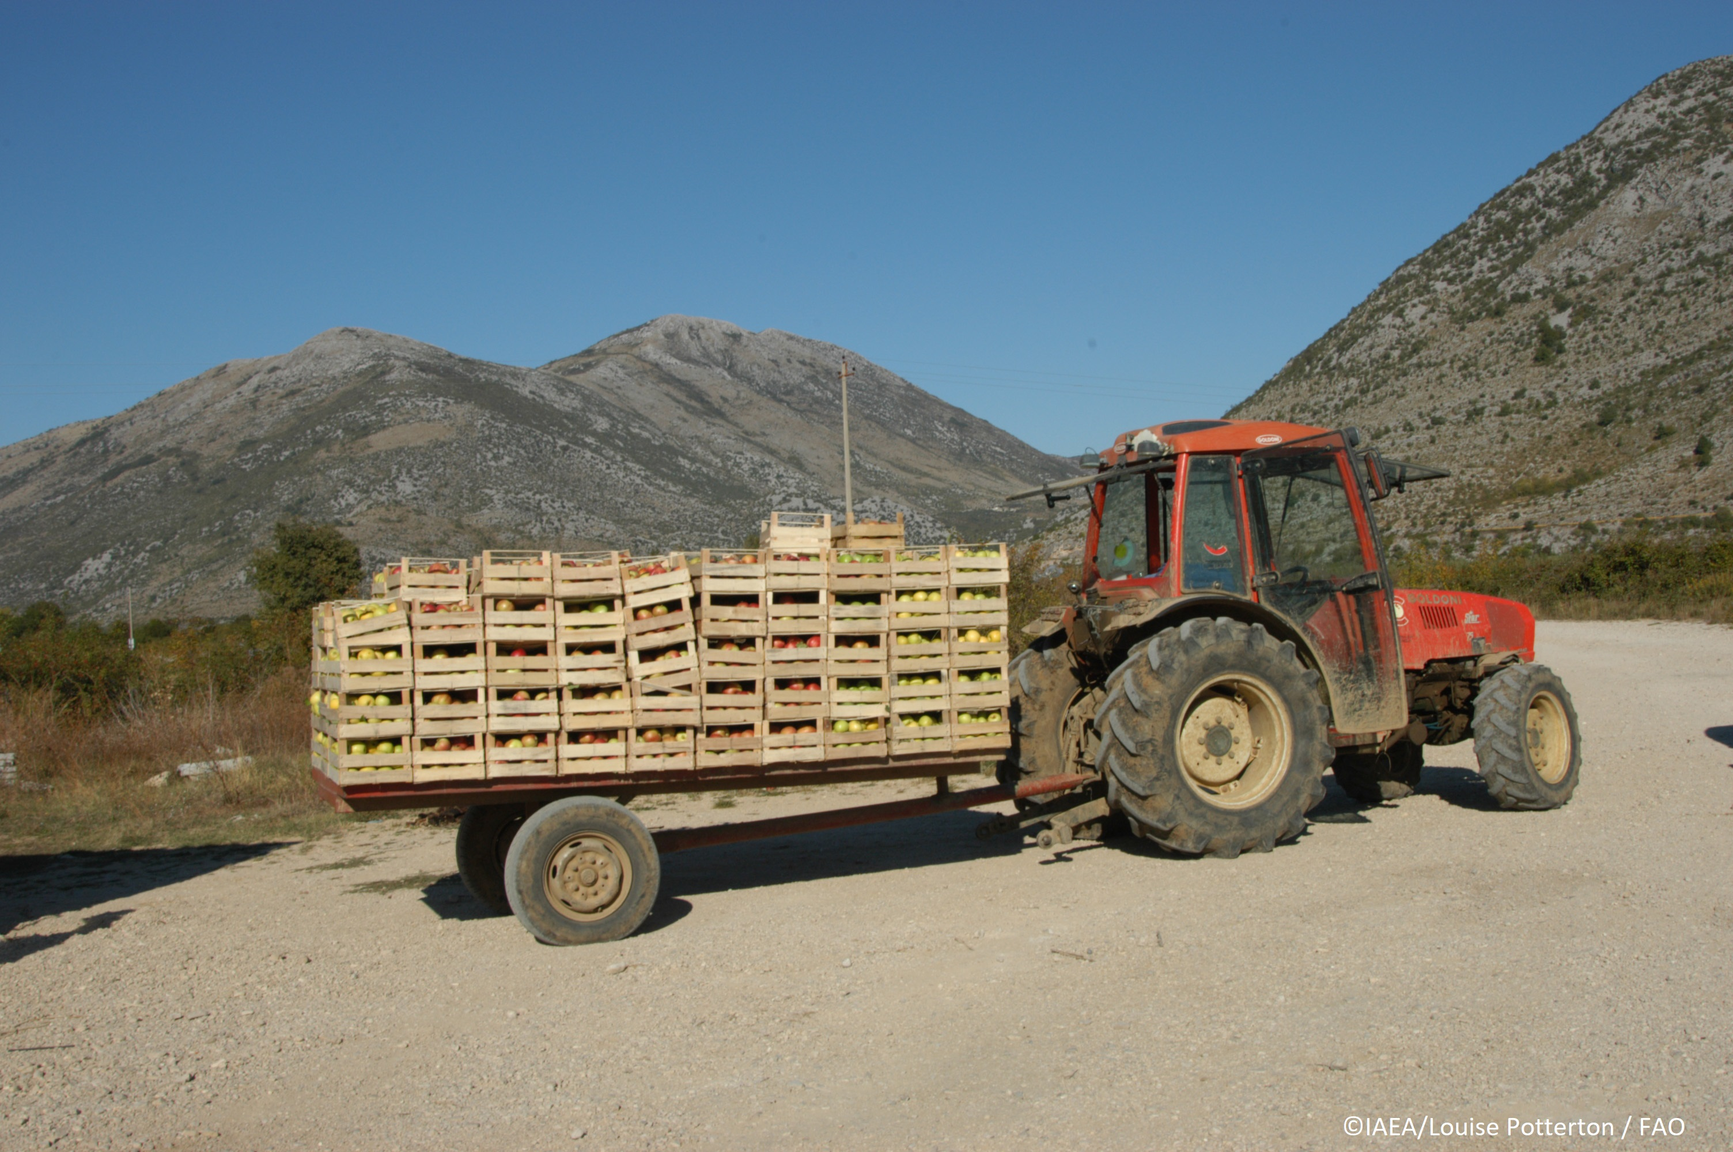
Movement of People and Goods
The increase of pests and other invasive species that are harmful to plants is caused by an increase in the movement of plants and plant products, commodities and people
Climate change and its effect on the environment provide new habitats for alien species
However, regulation of the movement of plants and plant products can help to reduce these risks.

Slide 5
INTERNATIONAL PLANT PROTECTION CONVENTION : IPPC​
International treaty to secure cooperation among nations in protecting global plant resources from the spread and introduction of pests of plants, in order to preserve food security, biodiversity and to facilitate safe trade
The standard setting organization for plant health recognized by WTO (in SPS Agreement)
These standards are global instruments for the harmonization of national phytosanitary measures for trade that protect plants and their environment
Recognized as a biodiversity-related convention, along with the Convention of Biological Diversity
Currently 184 countries are Contracting Parties to the IPPC
IPPC Secretariat is housed by FAO.
Notes:
<Additional explanation about content of the IPPC (if needed)>
The purpose of the International Plant Protection Convention (IPPC) is to prevent the spread and introduction of pests of plants and plant products and to promote appropriate measures for their control.
With IPPC recognized by WTO-SPS agreement, one of the main changes that occurred is the requirement that the decision to import plants, plant products and other regulated articles should have a scientific basis.
All decisions on imports that are not based on international standards must be based on pest risk analysis.

Slide 6
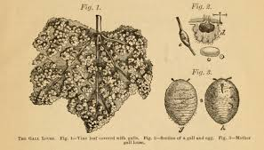
History of the International Plant Protection Convention
1881
1929
1951
1979
1997
2005
1st Plant Health Convention between European countries against Phylloxera vastatrix
Adoption of the 1st International Convention for the Protection of Plants with a global approach
Adoption of the Convention and deposition before the Director General of the Food and Agriculture Organization (FAO) of the UN
Minor revision of the Convention towards a more global harmonization
Revision of the Convention to align with the WTO's SPS Agreement
The new revised text of the IPPC came into force, 30 days after 2/3 of CPs accepted the revised text
Notes:
Precoursor to the IPPC, 1929 International Convention for the Protection of plants
https://iea.uoregon.edu/treaty-text/2605. Around 24 countries joined this treaty.

Slide 7
History of IPPC : Rational for Amendment
In 1986, the landscape began to change significantly as the General Agreement on Tariffs and Trade (GATT) entered into an eighth round of multilateral trade negotiations known as the Uruguay Round. Prior to the conclusion of these negotiations in 1993, it was clear to IPPC Members and FAO that the IPPC would have a prominent position in the Agreement on the Application of Sanitary and Phytosanitary Measures (the SPS Agreement)
In response, FAO established a Secretariat for the IPPC in 1992, followed by the formation of the Committee of Experts on Phytosanitary Measures (CEPM) in 1993 (precursor to the Standards Committee)
Contracting parties decided to amend the Convention to more accurately reflect the contemporary role of the Convention, particularly with respect to the relationship of the Convention to the SPS Agreement and the revised text was adopted by FAO in 1997.

Slide 8
What are the IPPC objectives?
Enhance global food security and increase sustainable agricultural productivity
Protect the environment from the impacts of plant pests
Facilitate safe trade, development and economic growth

Slide 9
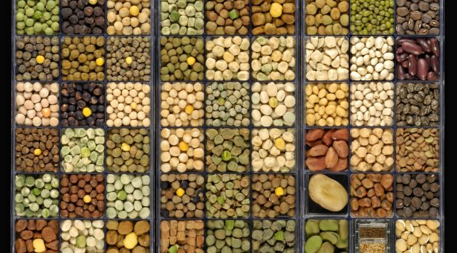
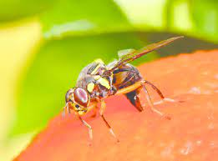
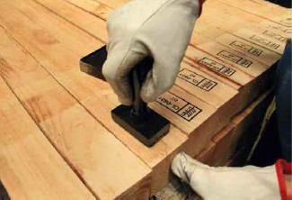
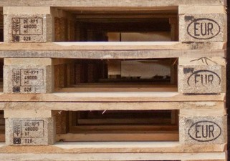
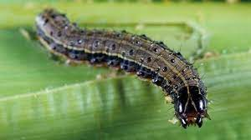
In practice, what does the IPPC do?
The IPPC develops International Standards on Phytosanitary Measures (ISPMs) and facilitates their implementation to ensure food security and reduce the risks to agriculture and biodiversity.

Slide 10
IPPC Strategic Framework 2020-2030
The latest version of the IPPC Strategic framework 2020-2030 is available in the 6 FAO languages at: https://www.fao.org/documents/card/en/c/cb3995en

Slide 11
IPPC CORE ACTIVITIES
IPPC
Secretariat
Standard setting
Implementation and capacity development
Communications and partnerships
Governance
Facilitates the development as well as the implementation of ISPMs
Helps ensure food security and
Helps reduce risks to agriculture and biodiversity

Slide 12
Development and adoption of Standards, CPM Recommendations, Diagnostic Protocols and Phytosanitary Treatments Standard setting work of the IPPC is led by the Standards Committee (SC) SC is supported by various technical panels, expert working groups, and the IPPC Secretariat The Standard Setting Unit facilitateS the development of international standards through a transparent and inclusive process meeting the needs of contracting parties.
IPPC CORE ACTIVITIES
1. Standard setting

Slide 13
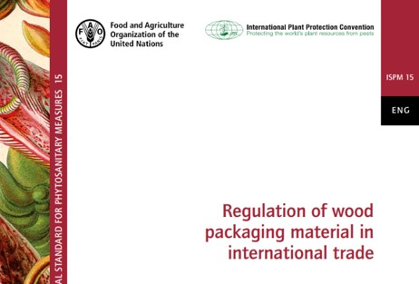
Numbers of ISPMs, DP, PT and CPM Recommendations
IPPC CORE ACTIVITIES
1. Standard setting
46 ISPMs
31 diagnostic
protocols
44 phytosanitary
treatments
10 CPM
Recommendations

Slide 14
2. Implementation and Capacity Development
IPPC CORE ACTIVITIES
Implementation and capacity development activities include:
Facilitating the development of IPPC Guides and training materials
Conducting Phytosanitary Capacity Evaluations (PCE)
Managing Phytosanitary Capacity Development Projects
Collaborating with educational institutions, RPPOs and other international organizations
The Implementation and Capacity Development Committee (IC) provides oversight of relevant activities

Slide 15
Exemples 1. Guides and training materials
Guides (examples):
Market Access
Import Verification
Export Certification
Establishing a NPPO
Surveillance
Pest Status
National Reporting Obligations
Pest Risk Communication
Pest Free Areas
21 Guides
5 Training materials
Training materials (examples):
e-learning course “Introduction to the International Plant Protection Convention”
e-learning course “Pest Risk Analysis”
e-learning course “National Reporting Obligations”
Training kit: Pest Risk Analysis
19 Phytosanitary
System

Slide 16
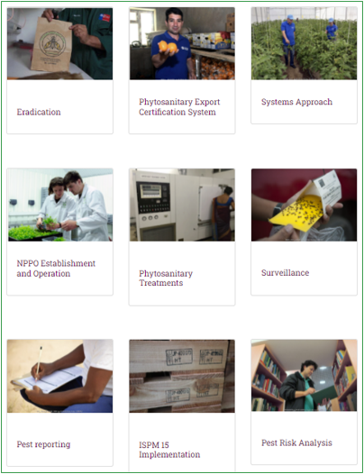
Exemples 2. Phytosanitary System
A web page presenting the different components of a national Phytosanitary System webpage has been set up. It provides a one-stop service to support NPPOs and brings together relevant ISPMs, CPM recommendations, Guides and training materials and contributed resources
Eradication | Phytosanitary Export Certification System | Systems Approach | NPPO Establishment and Operation
Phytosanitary Treatments | Surveillance | Pest reporting | ISPM 15 Implementation
Pest Risk Analysis | Inspection | Diagnostics | Contingency plans
Pest free areas & Areas of low pest prevalence | E-Commerce | Phytosanitary Import Regulatory System | Phytosanitary Legislation
Sea containers | FAQs | How to share your phytosanitary technical resources
Phytosanitary System: https://www.ippc.int/en/core-activities/capacity-development/phytosanitary-system/

Slide 17
Exemples 3. Phytosanitary Capacity Evaluations (PCE)
A PCE:
Helps countries evaluate and identify their phytosanitary strengths and weaknesses in order to develop a strategic plan that helps build a better national phytosanitary system. This includes improving their legislative, technical and administrative measures which all help them meet their IPPC obligations;
Uses a questionnaire style approach consisting of 13 modules. Results are recorded in a modular online software system that helps to document the evaluation process; and
Is a consensus-driven and confidential process involving all concerned stakeholders, both public and private.
Results in a National Phytosanitary Capacity Development Strategy
Additional information available at:
https://www.ippc.int/en/core-activities/capacity-development/phytosanitary-capacity-evaluation/

Slide 18
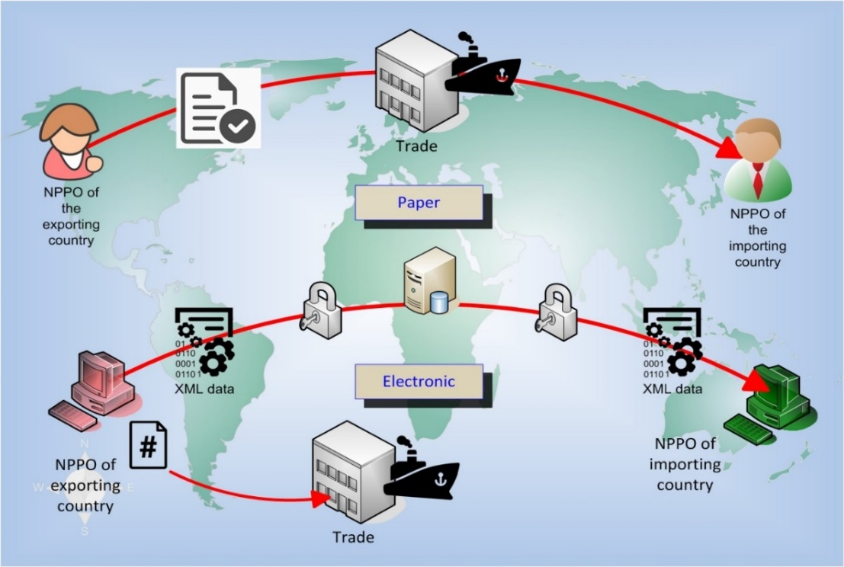
Exemples 4. The IPPC ePhyto Solution
ePhyto is the abbreviation for “electronic phytosanitary certificate”.
ePhyto is the electronic equivalent of the phytosanitary certificate on paper (ISPM 12)
ePhyto video: https://www.youtube.com/watch?v=gjDz7aOv-Ys

Slide 19
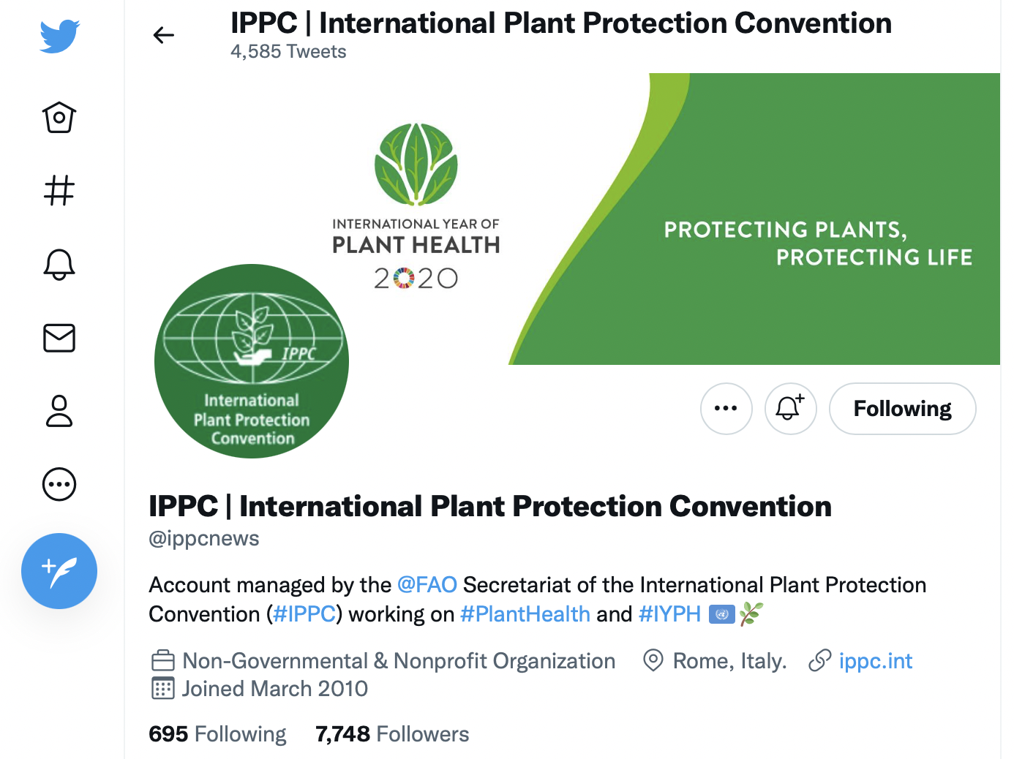
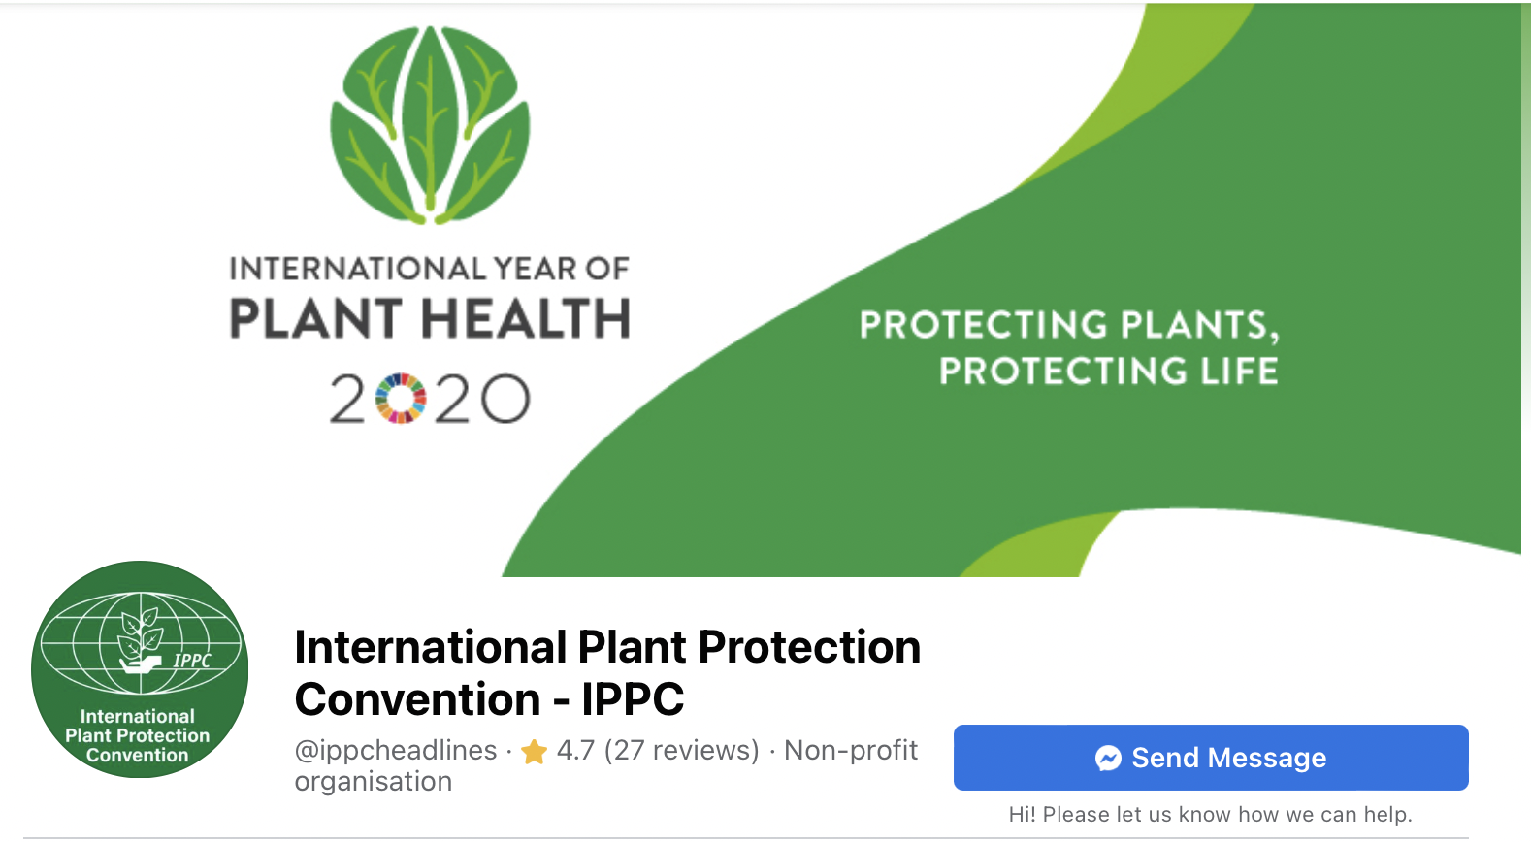
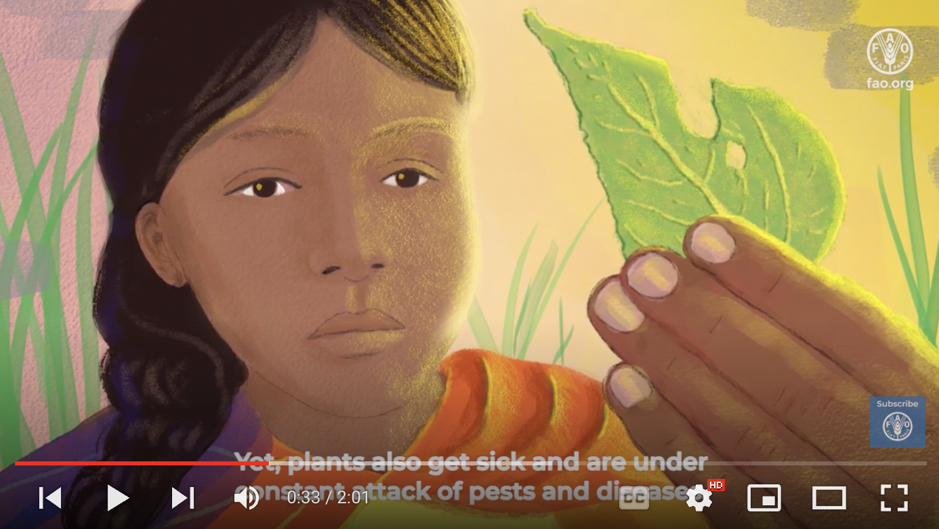
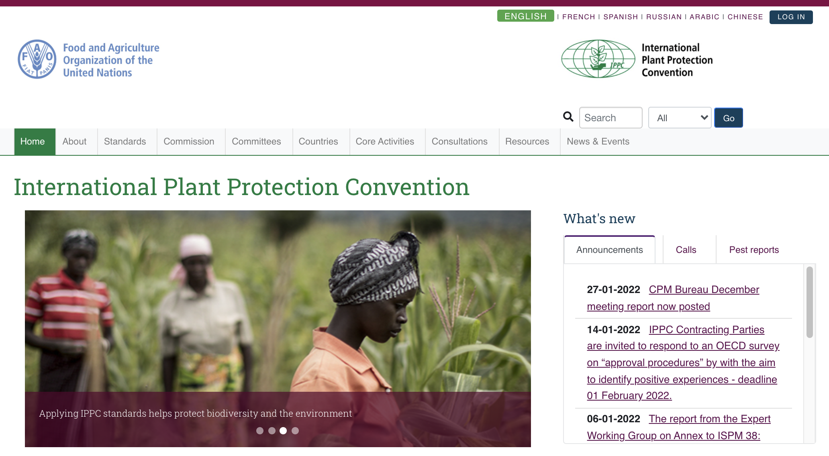
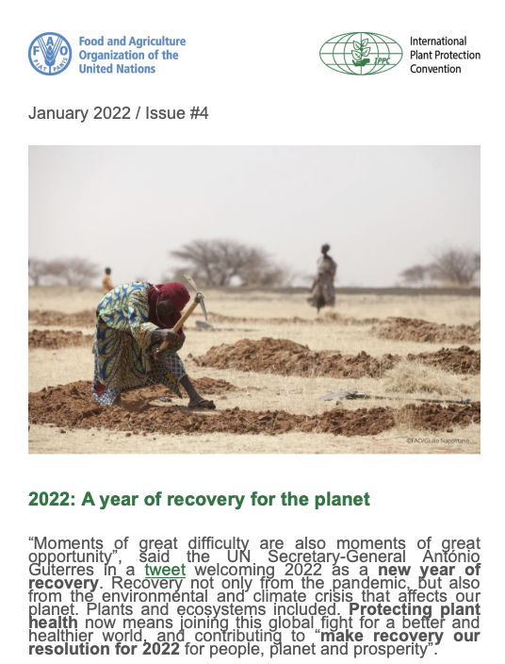
3. Communications and partnerships
IPPC SECRETARIAT CORE ACTIVITIES
Social media
Create awareness on what the IPPC Community and partners are doing to protect plants from pests
External cooperation with relevant organizations
Partnerships with Regional Plant Protection Organizations (RPPOs)
International Year of Plant Health (IYPH) 2020 global campaign, 12 May is being proposed as an International Day for Plant Health
International Phytosanitary Portal
IPPC Newsletter

Slide 20
4. Governance
IPPC SECRETARIAT CORE ACTIVITIES
Commission on Phytosanitary Measures (CPM)
Strategic Planning Group (SPG)
184 Contracting Parties
10 Regional Plant Protection Organizations
40+ Partner organizations
IPPC Secretariat
Coordinates IPPC Secretariat work programme, guided by the IPPC Strategic Framework 2020-2030
Hosted by FAO
CPM Bureau
Standards Committee
(SC)
Implementation and Capacity Development Committee (IC)
Towards achieving FAO Strategic Objectives and relevant SDGs
Notes:
CMP : 184 PC. Bureau : Organe exécutif de la CMP; fournit directives au Secrétariat de la CIPV et à la CMP sur : Orientations stratégiques, coopération, gestion financière et opérationnelle.
CN : surveillance processus établissemement des normes; IC : surveillance programme renfo capacités
1. No pauverty; 2 Zero hunger; 8, Decent work and economic growth; 12. Responsable consumption and production; 13. Climat action. Life on land; 17, Partnerships for the Goals

Slide 21
The Commission on Phytosanitary Measures (CPM)
Article XI of the IPPC provides for the establishment of a Commission on Phytosanitary Measures (CPM) to serve as the Governing body.
After the 1997 revised convention text was adopted by FAO, the first meeting of the Interim CPM (ICPM) was held in 1998 and once these revisions were ratified by Contracting Parties the first meeting of the CPM was held in 2006.
In 2023 the seventeenth session of the CPM will be held in Rome.

Slide 22
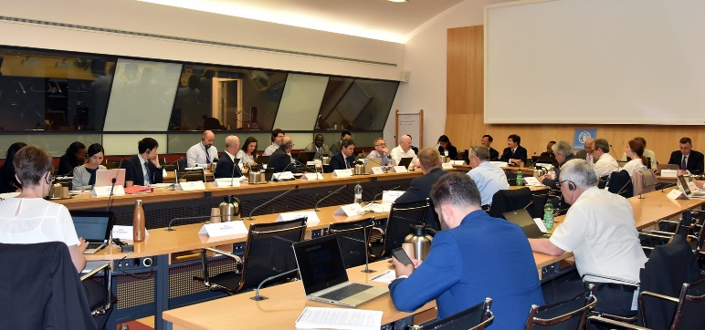
Strategic Planning Group (SPG)
Provide strategic perspective to the work of the IPPC and to support improvement through the provision of recommendations
Advice the CPM on any issues which have been referred and other issues related to the functions of the SPG
Is composed of: the CPM Bureau, the Chairpersons of the IC and SC, representatives of RPPOs, other interested persons representing Contracting Parties

Slide 23
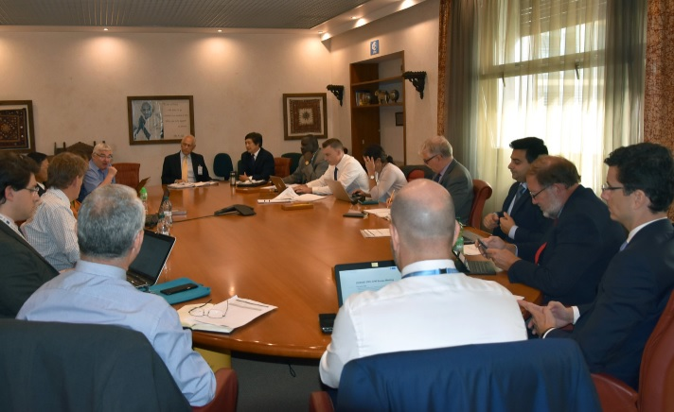
CPM Bureau
The CPM Bureau is the executive body of the Commission that provides guidance to the IPPC Secretariat and CPM on strategic direction, cooperation, financial and operational management between sessions of the CPM.
One Bureau member is selected by each FAO region and confirmed by the CPM. The CPM also elects a CPM Chairperson and two Vice-chairpersons.

Slide 24
Standards Committee (SC)
Subsidiary Body of the CPM
25 members from each of the seven FAO regions
The SC is responsible for:
overseeing the IPPC Standard Setting Process
managing the development of International Standards for Phytosanitary Measures (ISPMs)
providing guidance and oversight to the work of Technical Panels (TPs) and Expert Working Groups (EWGs)

Slide 25
SC Working Groups
The SC has a number of Working Groups
SC-7 : Seven SC members. They support the work of the SC in the detailed consideration of draft ISPMs and specifications
Technical panels (TPs) : established for specific phytosanitary technical areas, develop ISPMs and provide guidance to the SC regarding specific phytosanitary issues. 4 TPs currently: TPDP, TPG, TPPT, TPCS
Expert Working Groups (EWG) : draft or revises draft ISPMs in accordance with the relevant specification
EWG meetings in 2021 and 2022 : use of specific import authorizations (February 2021), Annex to ISPM 38: International movement of seeds (October 2021, Annex to ISPM 37: Determination of host status of fruit to fruit flies (Tephritidae) (January 2022).

Slide 26
Implementation and Capacity Development Committee (IC)
Subsidiary Body of the CPM
12 members (7 regional representatives and 5 experts)
2 Representatives (one each from the SC and the RPPOs)
Develops, monitors and oversees a work plan to:
strengthen the phytosanitary capacity of contracting parties (CPs)
support the implementation of the IPPC, ISPMs and CPM Recommendations
By :
Identifying the baseline capacity of contracting parties
Analyzing issues and providing solutions
Supporting CPs to meet their Convention obligations and to implement ISPMs and CPM Rec.
Monitoring the efficacy of Implementation and Capacity Development activities

Slide 27
IC Sub-groups and IC Teams The IC establishes Sub-groups and Teams to address specific implementation and capacity development issues
IC Sub-Groups | IC Teams
Dispute Avoidance and Settlement (DAS) | Phytosanitary Capacity Evaluation (PCE) | Projects
IPPC Observatory | Guides and Training Materials | e-Commerce
Sea Container Task Force (SCTF) | Web resources | Fusarium oxysporum f. sp. cubense Tropical Race 4 (TR4)
National Reporting Obligations (NRO) | Contributed Resources

Slide 28
Development of Guides and Training Materials by Working Groups
Working Groups are currenting working on the following Guides and Training Materials:
Guides:
e-Commerce Guide for plants, plant products and other regulated articles (2017-039)
Guide to support implementation of ISPM 15 (2017-043)
Contingency planning, Guide (2019-012)
E-learning materials:
Pest Risk Analysis, e-Learning course (2020-002)
Phytosanitary export certification system, e-Learning course (2020-003)
Surveillance and reporting obligations, e-Learning course (2020-012)
Inspection, e-Learning course (2020-011)
Development of Guides and Training materials page on the IPP:
https://www.ippc.int/en/core-activities/capacity-development/guides-and-training-materials/development-guides-and-training-materials/

Slide 29
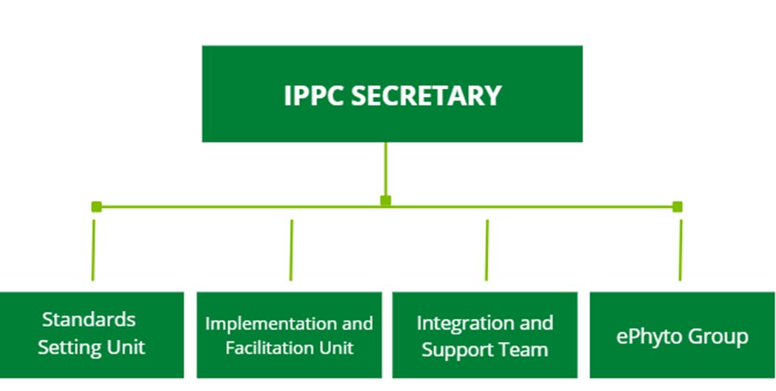
Coordinates the core activities of, and provides operational support to, the IPPC work programme
IPPC Secretariat Structure
Coordinates the processes for setting standards
Supports the SC, technical panels and expert working groups in the development of standards
Coordinates the process for implementation and capacity development
Supports the IC, Sub-groups, teams as well as working groups in the development of guides and training materials
Supports the governance, partnership, and communication
Organizes the CPM, CPM Bureau, and SPG meetings
Supports the global implementation of the IPPC ePhyto Solution

Slide 30
Closing reminder
All IPPC Community materials can be found at https://www.ippc.int/en/ and on our social media channels
Sign up to receive news-items to stay up-to-date with the latest information
All guides and training materials are saved in one place https://www.ippc.int/en/core-activities/capacity-development/guides-and-training-materials/
Remember to share NPPO-specific examples for the "Call on Implementation and Capacity Development projects (2022)" (deadline 25th March 2022)

Slide 31
Thank you
IPPC Secretariat Food and Agriculture Organization of the United Nations (FAO) ippc@fao.org | www.ippc.int

