Slide 1
Development perspectives: challenges and implementation strategies
International Workshop on Reducing the Introduction of Pests Through the Sea Container Pathway
19-20 September 2022
London, United Kingdom
Shane Sela
World Bank
Washington, DC

Slide 2
World Bank Support
Financing
Finance government programs and projects
Support policy and institutional reforms and capacity development
Advice and analytics
Research and analysis
Support to policy design
Institutional strengthening
Capacity building
Strategic strengthening

Slide 3
Trade and regional integration
Trade brings significant development benefits
Jobs
Economic growth
Increasing reliance on GVCs
Global support
Trade policy
Implementation of the WTO Trade Facilitation Agreement
Trade connectivity and logistics

Slide 4
THE WTO TFA
Bureaucratic border procedures are a burden on trade
WTO TFA
  Reduce procedural difficulties
  Increase efficiency
  Increase government effectiveness
Aligned with SPS Agreement
Increasing efficiency of procedures
  Automation/digitization
  Simplification of documentary procedures
  Targeting rather than routine/repetitive operations
  Increased coordination between agencies/sharing of information
Increased transparency/predictability of procedures
Source: WTO

Slide 5

Why is trade facilitation important?
ECA county average import time
8
5 days
3
DAYS
4 days
Since 1995 SOS measures have increased more than 5-fold
In themselves NTMs/SPS measures are not necessarily barriers to trade. Procedural application causes the barriers
In many countries, the high costs of goods are driven by documentary and clearance processes
Technical regulatory requirements can be difficult for the private sector to meet
3
14 days
12
DOCUMENTS ASSEMBLY AND PROCEDURES
CUSTOMS AND TECHNICAL CONTROL
TERMINAL AND PORT HANDLING
INLAND TRANSPORT
Software issues
Hardware and software issues
These categories account for more than 50 – 60% of the total time to export and import in many countries around the world.
These categories account for 40% or less of the total time to export and import around the world.
Source: DB 2014

Slide 6
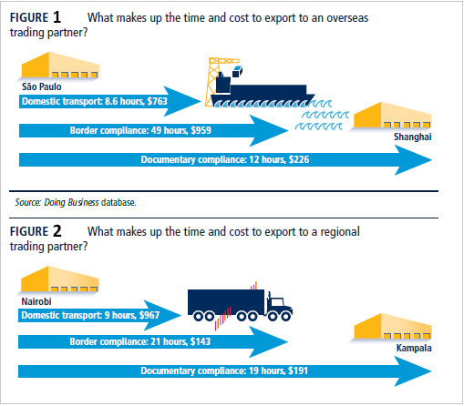
For example…

Slide 7
Objectives & Benefits of TF
Transparency & Fairness
Modernized Border Procedures and Controls
Better Governance
Benefits for government
Better compliance
Benefits for traders
Predictability
More informed decisions
More effective legislation, regulations, systems and procedures
More efficient government agencies
Align with modern business practices
Reduced clearance time/costs
Reduced complexity
Better accountability

Slide 8
Trade Facilitation Agreement
Transparency
Articles
Fees, Charges and Formalities
Articles
Institutional Arrangement
Article
Article 23
Institutional
arrangements

Slide 9
Not a just a Customs agreement
Transparency
Articles
Fees, Charges and Formalities
Articles
Institutional Arrangement
Article
Article 23
Institutional
arrangements
Notes:
Some of the articles, although specific to Customs can be adopted by other border agencies to expedite trade (e.g. establishing risk-based inspection measures; pre-arrival processing (particularly with electronic documents, SPS agencies can use electronic documents to more effectively assess commodities in advance)

Slide 10
Challenges to the management of containers in trade
Containers are an element in all goods trade – regulatory options could have significant economic repercussions
Not all containers present risks – targeting improvements are critical to any strategy
Complexities in container logistics
Regional vs. international trade
Regulators lack legislative authorities

Slide 11
Challenges to the management of containers in trade
Lack of coordination between private and public sector agencies involved in port clearances
Lack of automation
Lack of border coordination
Regulators lack of infrastructure, staff to monitor

Slide 12
Addressing the risks
Positive outcomes in trade facilitation relies on government-private sector cooperation
A single prescriptive approach is unlikely to be easily achieved
A targeted layering of approaches/strategies are more likely to yield improvements over broad-brush measures
  Outreach
  Targeted controls
  Private-public partnerships
  etc.

Slide 13
Addressing the risks
Developing countries will require support in improvements to capacities and infrastructure to implement any management strategy
  The challenge in sufficiency staff will remain
Automation would facilitate compliance communication – need to consider how this would integrate with other cross-border documentary clearance procedures
Any strategy is likely to include some level of misalignment arising from country capacities
  This could have significant implications for market access and could stimulate use as an NTB (particularly given scope)

Slide 14
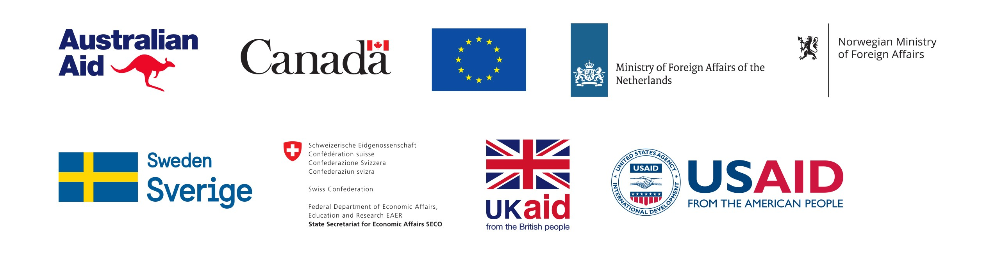
Thank you
For more information:
www.worldbank.org/tradefacilitation
ssela@worldbank.org

