Slide 1
Promoting and strengthening cargo packing standards in global supply chains
Guidance produced by the Cargo Integrity Group, including The Quick Guide to the CTU Code and the Container Packing Checklist
Stephane Graber, Director General, FIATA
PROPER PACKING OF CTUs: KEY TO SAFE SHIPPING
INTRODUCING CARGO INTEGRITY GROUP & ITS ASPIRATIONS
Peregrine Storrs-Fox, Risk Management Director,
Webinar | 20 Apr 2021

Slide 2
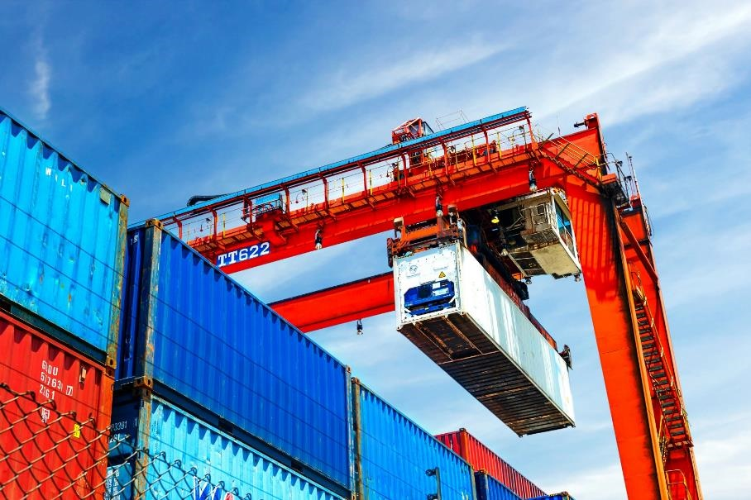
HISTORY OF CARGO INTEGRITY INITIATIVE
Cross-industry collaboration success aimed at improving the packing of goods in cargo transport units and multi-modal containers
Started in the context of:
VGM (amendment to SOLAS Chapter VI, Part A, Regulation 2)
Recognition that gross mass, while important, is but one part of the broader cargo transport unit (CTU) packing process
Growing governmental concern over transfer of invasive plant and animal species in intermodal supply chain

Slide 3
RATIONALE FOR CARGO INTEGRITY INITIATIVE
66%
TT Club analyses show that 66% of incidents related to cargo damage are caused or exacerbated by poor packing practices
This includes such things as:
load distribution
cargo securing
classification
documentation
declaration
ineffective data transfer
$6bn
Cost to the transport and logistics industry estimated in excess of USD6 billion annually

Slide 4
CARGO INTEGRITY GROUP TODAY
Mission: Collaborating to improve standards for the safe and secure packing of cargoes in cargo transport units and the avoidance of contamination by invasive pests.
Comprised of industry representatives across the supply chain:
Bureau International des Containers (BIC)
Container Owners Association (COA)
Global Shippers Forum (GSF)
International Cargo Handling Co-ordination Association (ICHCA International)
World Shipping Council (WSC)
International Federation of Freight Forwarders Associations (FIATA)
TT Club
World Shipping Council (WSC)

Slide 5
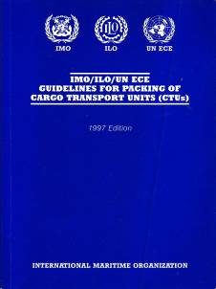
SOURCES OF KNOWLEDGE ABOUT PACKING
Historic development of guidance
Cargo superintendents
Mariners & shipping lines
Insurance companies
Intergovernmental initiatives
Challenges
Body of expertise
Accessibility of guidance
Trade developments

Slide 6
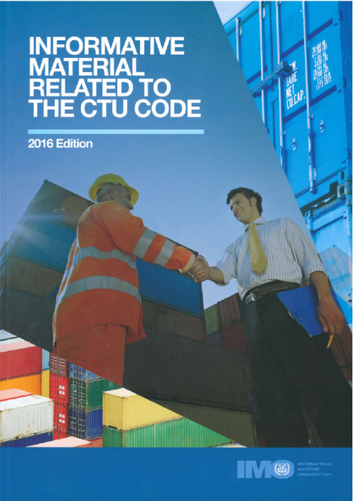
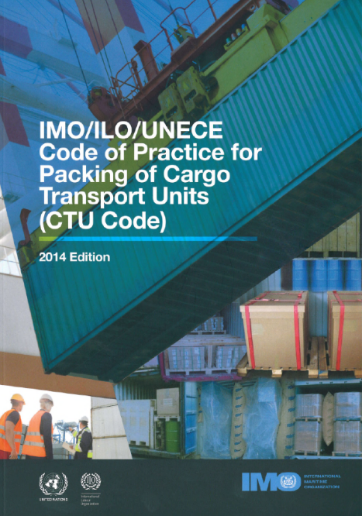
WHAT IS THE CTU CODE?
Status & awareness
Approved by IMO/ILO/UNECE (MSC.1/Circ.1497 & MSC.1/Circ.1498)
Code 45pp; Annexes 100pp; Informative Material 175 pp
Due diligence (MSC.1/Circ.1531)
Cracking the Code
Key requirements (Do’s & Don’ts) [3]
Chains of responsibility [4]
Packing & Securing [9 / A7 / IM5&6]
https://www2.unece.org/wiki/display/TransportSustainableCTUCode/CTU+Code
established expertise
6

Slide 7
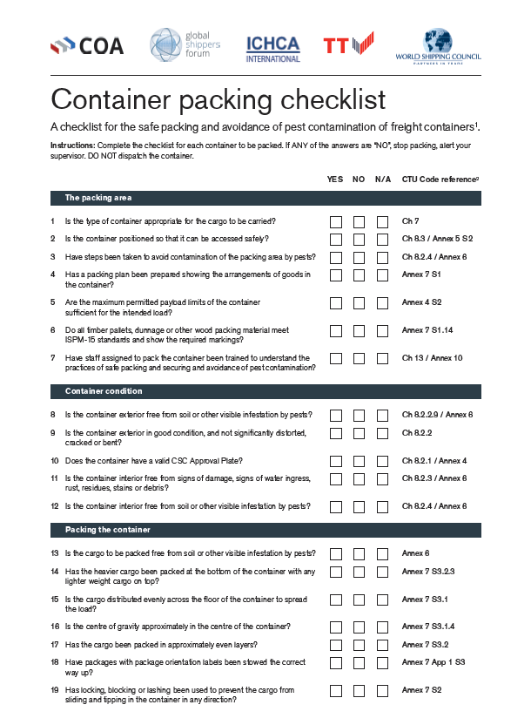
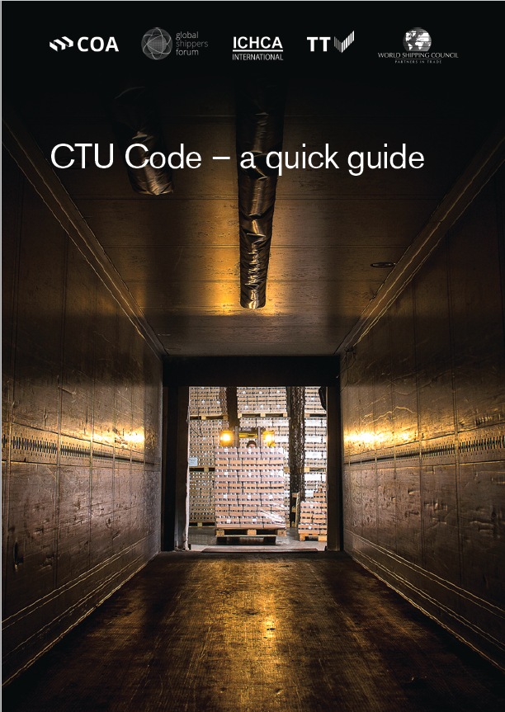
UNDERSTANDING THE CTU CODE
To help all stakeholders better understand the CTU Guide, the Cargo Integrity Group compiled the following:
CTU Quick Guide
Container packing checklist
These resources are aimed at developing understanding for actors across the industry, and to support sound-decision making
Work currently underway on a possible CTU Code mobile app to facilitate access to the CTU Code contents on a day-to-day basis
established expertise
7

Slide 8
INTRODUCING ‘CTU CODE – A QUICK GUIDE’
Creating a ‘route map’ to aid understanding & implementation
Depicting complex relationships typical to global CTU supply chain
Simplified process guidance, including:
Planning and preparation
General safety (e.g. enclosed space entry)
Checking the CTU
Dealing with Dangerous Goods
Effective packaging
Principles & practice of packing
Securing
Completion checks
Receipt & unpacking

Slide 9
CONTAINER PACKING CHECKLIST
Specific for intermodal freight containers
Clear process checklist for safe packing & avoidance of pest contamination based on CTU Code
Sequences main check-points from container packer’s perspective
‘Yes/No’ answer format. Successful completion allows dispatch of container.
References to relevant CTU Code source material for supervisors to consider
Copyrighted material but free to use in unmodified form.

Slide 10
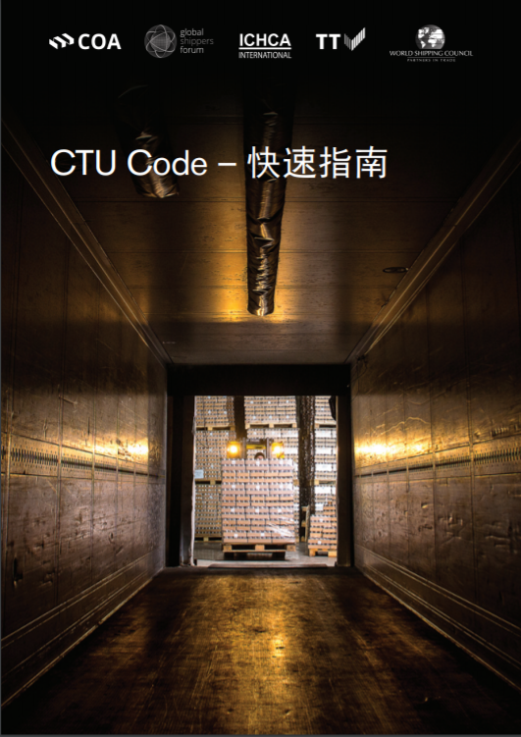
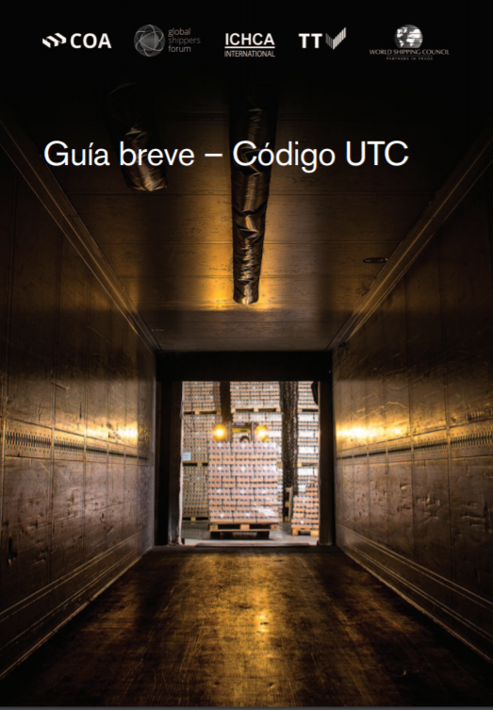
ACCESSIBILITY TO QUICK GUIDE & CHECKLIST
Freely available on partner websites, such as https://www.ttclub.com/loss-prevention/cargo-integrity/
Aspiration to translate to all ‘official’ UN languages
Chinese (Nov 2020)
Spanish (Mar 2021)
Arabic (May 2021)
Russian (Jun 2021)
French (TBA)
Please disseminate widely!

Slide 11
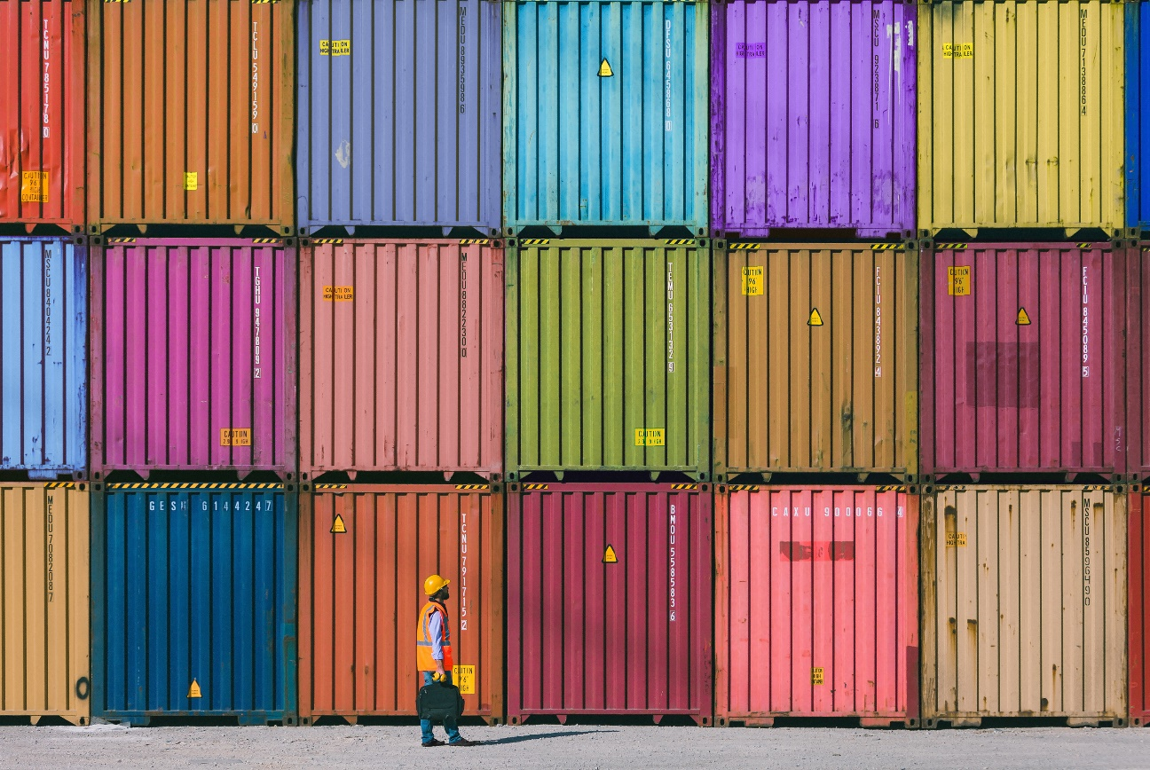
THE CTU CODE: CRUCIAL FOR MITIGATING VISIBLE PEST CONTAMINATION
High volume of international traded goods moving around the world brings with it associated risk of plant health, agriculture and biodiversity
Contamination is often difficult to detect and goes unnoticed
Correct storage, handling and packing of containers is crucial to preventing the spread of pests and ensuring safe transport. This includes:
Checking the container is free of signs of infestation, damage or contamination – at origin and destination
Ensuring a safe working environment
Properly securing and positioning the container
Handling the container with care throughout the transport chain
Correct reporting on the condition of the container and proper cleaning after unpacking

Slide 12
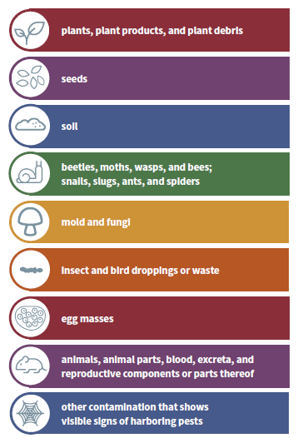
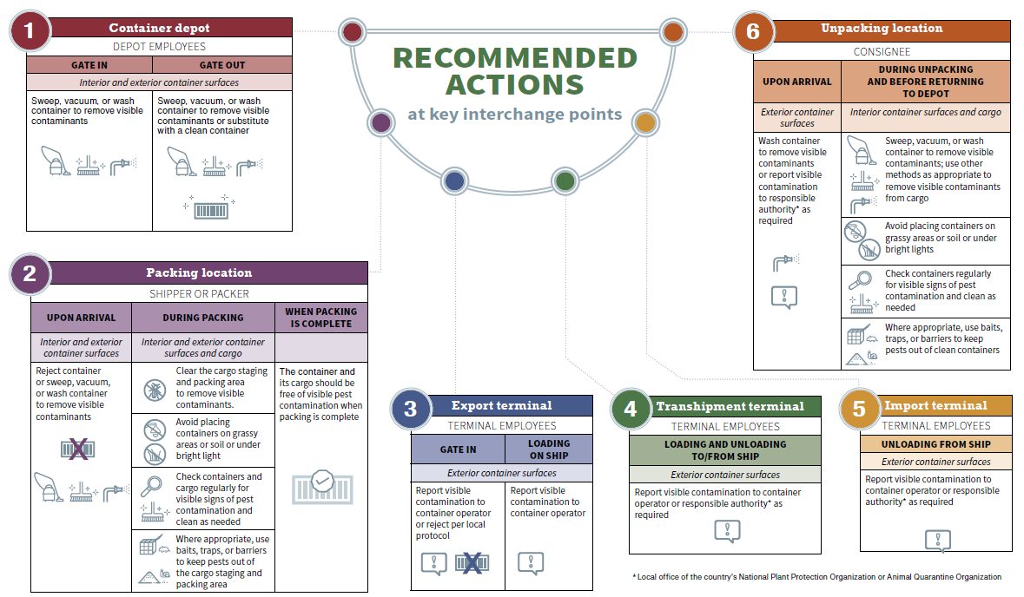
INVASIVE PESTS: MITIGATION = A MULTI-STAKEHOLDER EFFORT
http://www.fao.org/documents/card/en/c/ca7963en/

Slide 13
WHAT MORE NEEDS TO BE DONE?
Developing and facilitating understanding and training on the CTU Code and related resources are crucial
This ensures that all actors in the supply chain, including small and medium-sized enterprises, can better understand their roles and responsibilities
The multi-lingual publication of the CTU Code provides an opportunity for greater dissemination across the world regions
The Cargo Integrity Group, through its diverse membership, is working to ensure that the information can be brought far across the supply chain

Slide 14
COLLABORATING FOR CULTURAL “STEP-CHANGE”
Working towards industry wide change
Call to action
Recognition of the scale of the challenge
Galvanising “fragmented” stakeholders
Reconciling diverse interests
Legal & operational innovation
Cargo Integrity [#Fit4Freight] initiative
Promoting awareness & adoption of the CTU Code
Seeking changes in regulatory requirements
Monitoring of CTU packing performance
Working with other industry & governmental stakeholders

Slide 15
Thank you
Any questions?

