Slide 1
34th Technical Consultations on Regional Plant Protection Organizations
21, 22 September 2022

Slide 2
Overview
Specificity
Technical and Capacity Building Achievements
Regional priority pest list
Regional training and workshops
Plant pest diagnostics
Surveillance programmes and other activities
Others
Challenges
Proposal for further collaboration

Slide 3
1. SPECIFICITIES
1967- CPPC established in by FAO Council
2014 -CPPC Abolished
2010- Original agreement establishing CAHFSA
2011- Revised Agreement - February 25
2014 – CAHFSA Operational
2015 – CAHFSA Fully operational
2018 - Recognition as RPPO conferred

Slide 4
Members
MEMBER STATES: Antigua and Barbuda. Bahamas. Barbados. Belize. Dominica. Grenada. Guyana. Haiti. Jamaica. Montserrat. Saint Lucia. St Vincent and the Grenadines. Suriname. Trinidad and Tobago.
ASSOCIATE MS: Anguilla, Bermuda, British Virgin Islands, Cayman Islands, Turks and Caicos Islands

Slide 5
Organizational Chart
COTED
BOARD OF DIRECTORS
RPPO
OFFICE OF THE CEO
AHFSS THEMATIC WORKING GROUP
TECHNICAL COMMITTEE
CPHD
PLANT HEALTH DIVISION
FOOD SAFETY DIVISION
ANIMAL HEALTH DIVISION
FINANCE AND ADMINISTRATION DIVISION
RPPO Secretariat
CFSC Secretariat
Secretarial Service
TWG
TWG
CGPC Secretariat
Cleaning Service
Transportation

Slide 6
2. Technical and Capacity Building Achievements

Slide 7
2.1 Regional Priority Pest List-2022
Ranking | Plant Pests
1 | Red ring nematode
2 | Fusarium oxysporum fsp cubens TR4
3 | Ceratitis capitata- Medfly
4 | Rice panicle mite
5 | Helicoverpa armigera- Old World Bollworm
6 | Ralstonia solanacearum Race 3 Biovar 2 - Brown rot of potato
7 | Banana bunchy top virus
8 | Maize lethal necrosis disease
9 | Rhynchophorus ferrugineus- Red Palm Weevil
10 | Peronosclerospora philippinensis (Downy Mildew)
Notes:
New list of priority pests- complete it in August 2022.
Objective Prioritization of Exotic Pests (OPEP):
AHS

Slide 8
2.2 Regional Trainings and workshops
Distance training on PRA (30 May-29 June 2022)
Organization of Official Control for NPPO Managers (26 April-22 May 2022)
E-meetings/Webinars
Pre-CPM
Establishment and update of a regulated pest list
Use of IPPC Ephyto Hub
Amendments to EU plant health rules
Implication for plant health of the Russian-Ukraine wars
Training workshops on pest identification

Slide 9
2.3 Surveillance Projects and Activities
Citrus canker
Citrus Leprosis virus
Potato brown rot disease
Tuta absoluta
TR4
Tephritid fruit flies
Regional surveillance activities
Diagnostic training
Emergency response plan
Regional simulation exercises
National simulation exercises
Notes:
We have on going surveillance activities for, citrus canker, Citrus Leprosis virus, Tuta absoluta
TR4 and Tephritid fruitflies

Slide 10
2.3.1 Strengthening National Surveillance Programmes
Provision of Materials and Supplies
Citrus Canker
Fruit fly
Tomato Leafminer
Red Palm Weevil

Slide 11
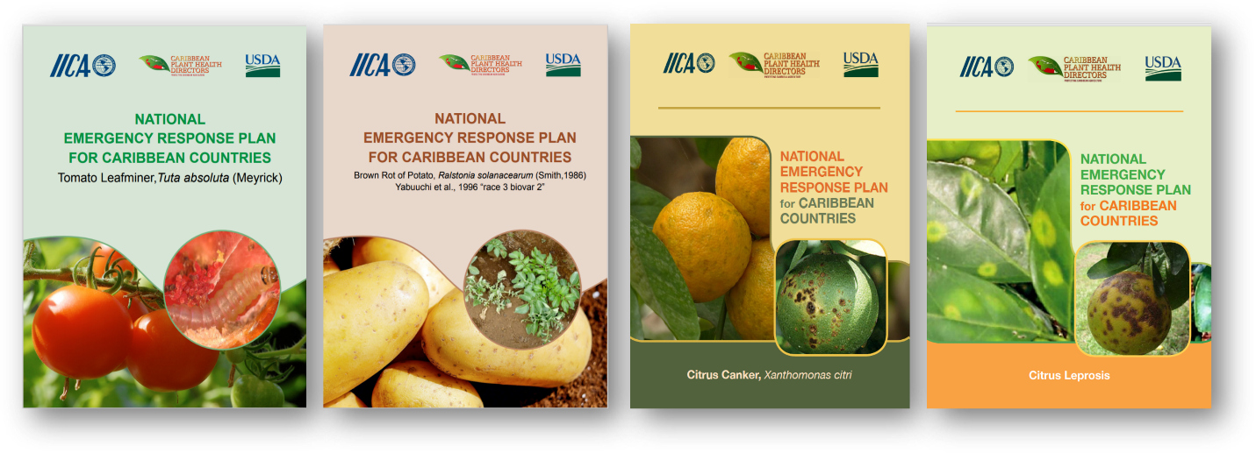
2.3.2 Emergency Response Plans (ERP) and Guidelines for conducting Tabletop Simulations

Slide 12
2.3.3 Other Projects/Activities
PCE in the Bahamas
Adoption of 14 commodity-specific guidelines.
5-Year strategic plan

Slide 13
3. Challenges
Climate change
Insufficient human capital at CAHFSA
Competing priorities
Limited technical capacity in the NPPOs
Diagnostics
PRA
Surveillance
Notes:
Under staffing, high turn over rate

Slide 14
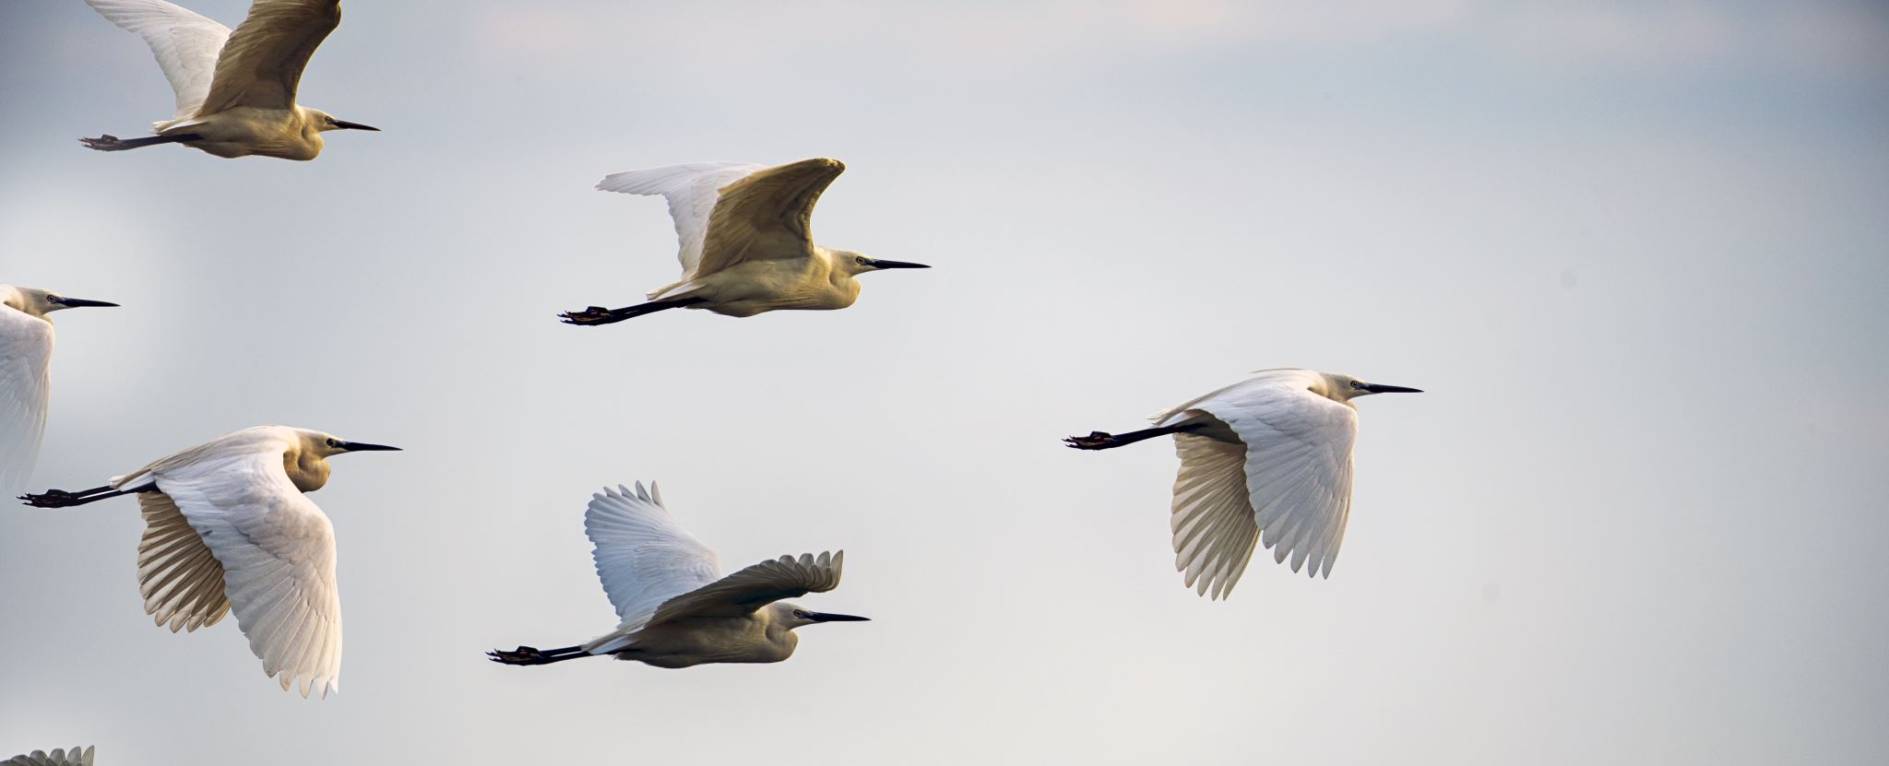
Pest diagnostic services
Development of training programmes and advocacy material
Working groups/advisory bodies
Pest risk analysis
mentoring
Sharing of PRA
RPPO twinning
4. Proposal for future collaboration

Slide 15
Thank You
Juliet Goldsmith
Caribbean Agricultural and Food Safety Agency
juliet.goldsmith@cahfsa.org
rppo.secretariat@cahfsa.org

